Slide 1
predictors of verbal aggression towards infants
Sarvenaz Oloomi (Perinatal Anxiety Research Lab)
*Disclaimer: Sensitive Topics
Notes:
Disclaimer first about sensitive topic and end with resources
To get into this topic, I want you first to think about what you would consider verbal aggression towards a young child or an infant? YOUR CHILDHOOD Wait 3 seconds. It is probably difficult to think of how you can express verbally aggressive behaviour towards precious young infants? Different cultural ideas of aggression or abuse
We want to contextualize the importance of verbal aggression and search for possible predictors with this work

Slide 2
Parental VERBAL AGGRESSION
Maltreatment: harm or risk of harm to a dependent minor
Verbal Aggression: yelling and emotional manipulation/humiliation
  Type of child maltreatment
  Falls under emotional abuse
  High prevalence behaviour among parents
Notes:
Child maltreatment defined by government of Canada is the harm, or risk of harm, that a child or youth may experience while in the care of a person they trust or depend on
Types of child maltreatment include physical abuse, sexual abuse, neglect, exposure to family violence and emotional abuse which includes verbal aggression
Verbal abuse includes direct acts of emotional maltreatment, such as deliberate and cruel acts of criticizing, humiliating, or terrorizing
Why is all of this important? How often does this even happen?
In 2013, in Canada, over 43,000 confirmed cases of child maltreatment were reported, more than 59% of which were multiple incidences (Fallon et al., 2015). Data from the United States in 2006 suggests that the highest risk of child maltreatment is in infants younger than 12 months of age (24.4 per thousand children)
Very little research on individual prevalence but about 90% of parents with children younger than 2 engage in at least one form of emotionally and psychologically aggressive behaviour (e.g. name calling, using curse words, shouting, and threatening; recorded in 2003 in the US; Uslu et al., 2010)
Make the charts the same format and color code them similarly

Slide 3
Background
Theories of Verbal Aggression
Impact of Abuse
Risk Factors for Verbal aggression
Mental health issues
Emotional dysfunction
Internalizing and externalizing disorders
Limited re verbal aggression
Built on theories of physical aggression
Limited re verbal aggression
Child and parental factors
Environmental factors
Notes:
Why is this stats important?
Child maltreatment has significant risks and consequences, including detrimental neurocognitive impacts for development, as well as a plethora of other psychological and developmental effects throughout childhood and adolescence. Limited research on verbal abuse suggests it can lead to problems in proper psychological and emotional functioning in a developing child and can be a predictor of a variety of social and emotional problems in the future
Since research is limited, etiological models are often based on other types of research especially physical abuse as they have been correlated in the literature. That is, it has been shown that parents who yell more and show more verbal aggression towards their kids are also more likely to be physically abusive. Also it seems engaging in physically abusive behaviours almost always includes verbally aggressive behaviours while the inverse is not necessarily found.
There has been extensive research on potential risk factors in other types of abuse in children like sexual and physcial but due to the less obvious nature of verbal aggression (cultural differences and no clear signs to others) it has been underreported and underexamined. Some risk factors suggested include low SES, lack of social support, parental emotional disturbance, depression, aggression, and history of abuse, and child health complications

Slide 4
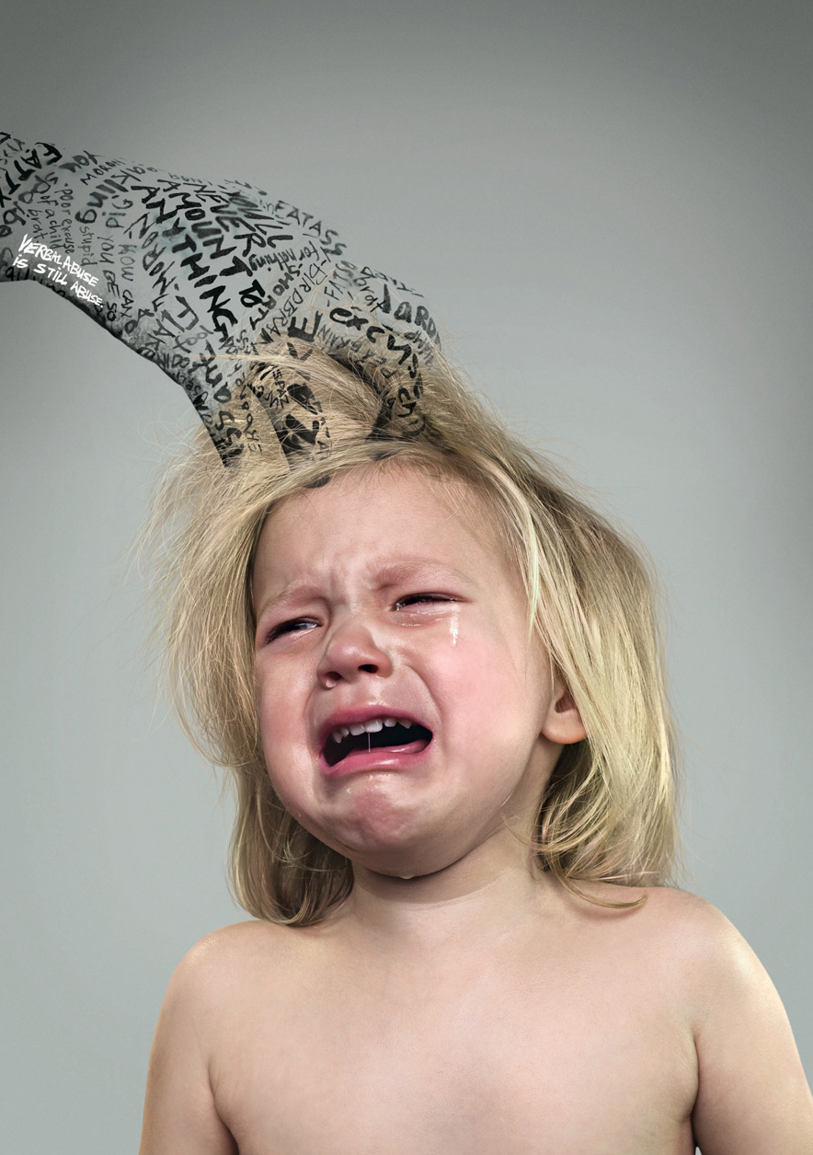
Minimal Research on…
Verbal aggression overall
Predictors for verbal aggression
Infant population
Total population (i.e. limited to at-risk populations)
Notes:
What do we know and predictors and gap
Get more into why we don’t study babies (harder to recruit, our assumption)

Slide 5
Current Study
Sample: English-speaking postpartum mothers in BC (N = 388)
Methods:
  Questionnaires
  Administered twice post-partum
  Primarily online
  Abuse assessed anonymously
Objective: Assess risk factors for maternal verbal aggression towards infants
Predictors:
  Depression
  Sleep
  Social support
  Parenting beliefs and attitudes (CAPI)
Notes:
Talk about all the gaps (infants and anonymous data)
Predictions for parents with higher potential for engaging in verbally aggressive behaviour
Split the slides more and break down the points more and especially on this one talk more about it (background is too much and background points should be their own slides)

Slide 6




DEPRESSION
Sleep
Predictors
Social support
CAPI
5-7 weeks: r(344) = .203**, p < .001
6-9 months: r(387) = .188**, p < .001
5-7 weeks: r(344) = .093*, p = .084
6-9 months: r(388) = .178**, p < .001
5-7 weeks: r(342) = -.130*, p = .016
6-9 months: r(388) = -.159*, p = .002
Total Abuse Scale (6-9 months): r(235) = .128*, p = .049
Notes:
Conceptually related variables to physical aggression since it is related to verbal aggression
Connection of the CAPI as a measure vs. variable
Standard for abuse risk potential with kids for CAPI but not really used in verbal aggression

Slide 7
Significance and Conclusion
Increase research on verbal abuse and infants
More focus on predictors instead of consequences
Prevention efforts for this sensitive population
Notes:
Preliminary data supports this
Building models of verbal aggression

Slide 8
Further Reading
Resources
Call 9-1-1 if immediate risk to a child is suspected
Call 1-800-668-6868 for the kids help phone line
Call 1-800-663-9122 for the BC Helpline for Children
UBC Campus Lightbox
Black, D. A., Heyman, R. E., & Smith Slep, A. M. (2001). Risk factors for child physical abuse. Aggression and Violent Behavior, 6(2), 121-188. https://doi.org/10.1016/S1359-1789(00)00021-5
Stith, S. M., Liu, T., Davies, L. C., Boykin, E. L., Alder, M. C., Harris, J. M., Som, A., McPherson, M., & Dees, J. E. M. E. G. (2009). Risk factors in child maltreatment: A meta-analytic review of the literature. Aggression and Violent Behavior, 14(1), 13-29. https://doi.org/10.1016/j.avb.2006.03.006
Thank you for listening! This research would not be possible without the PAR Lab and Dr. Nichole Fairbrother.
Notes:
Binary logistic regression models and correlations

