Slide 1


Interacting Online: The positive effects of webcam use during videoconferencing
Jacqueline Nguyen
Social Health Lab
Dr. Frances Chen & Dr. Christine Anderl
Notes:
My project looks into the effects of webcam use during videoconferencing.

Slide 2
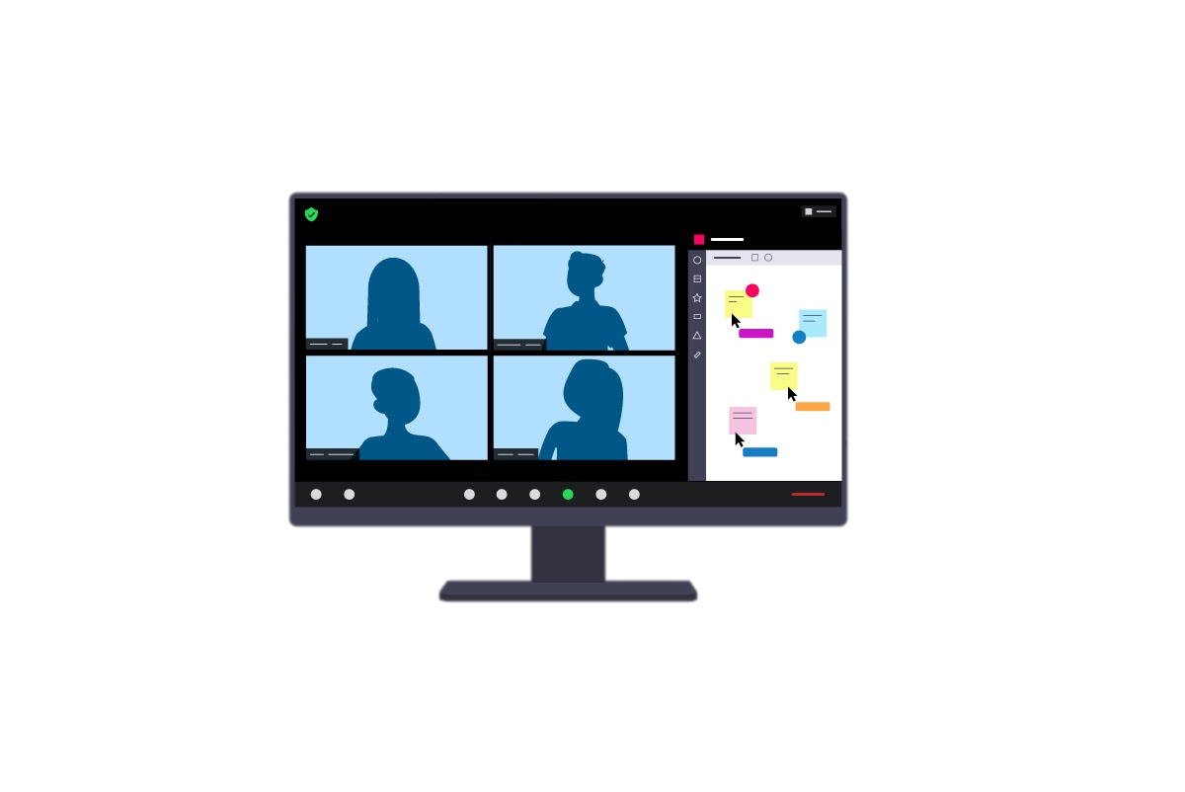
Videoconference Fatigue
The decreased affective well-being in response to the transition from in-person meetings to online videoconference platforms.
i.e., tired, cognitively drained, lack of motivation
(Shockley et al., 2021)
Notes:
Since the beginning of the pandemic, researchers have begun to study videoconference fatigue, (1st point) which is the “decreased ….”. (2nd point) this is basically feeling tired due to frequent videoconferencing.

Slide 3




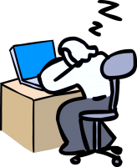
Own Webcam Use & Tense Arousal
Past research has found that turning our webcams on is associated with increased videoconference fatigue.
Self-focused attention → a state of concern towards self-referent information & wanting to be perceived positively by others.
  Associated with higher tense arousal
  Hypothesis 1.1: In virtual meetings, having one’s own webcam turned on more often will be positively correlated with higher scores of tense arousal.
(Shockley et al., 2021; Fenigstein et al., 1975)
Notes:
Research have suggest that having our own webcams turned on is a primary contributor to videoconference fatigue.
(1st point) this can be explained by self focused attention, which is the state of concern towards self-referent info and wanting to be perceived positively by others.
(sub point) This is associated with higher tense arousal.
(2nd point) w/ respect to videoconferencing, you can think of it like having a constant mirror. Turning your webcam on allows you to see yourself, which is salient and and unnatural aspect in everyday conversation, thus heightening self-foucsed attention.
(3rd point) this leads to my first hypothesis that “in virtual meetings …. “.

Slide 4
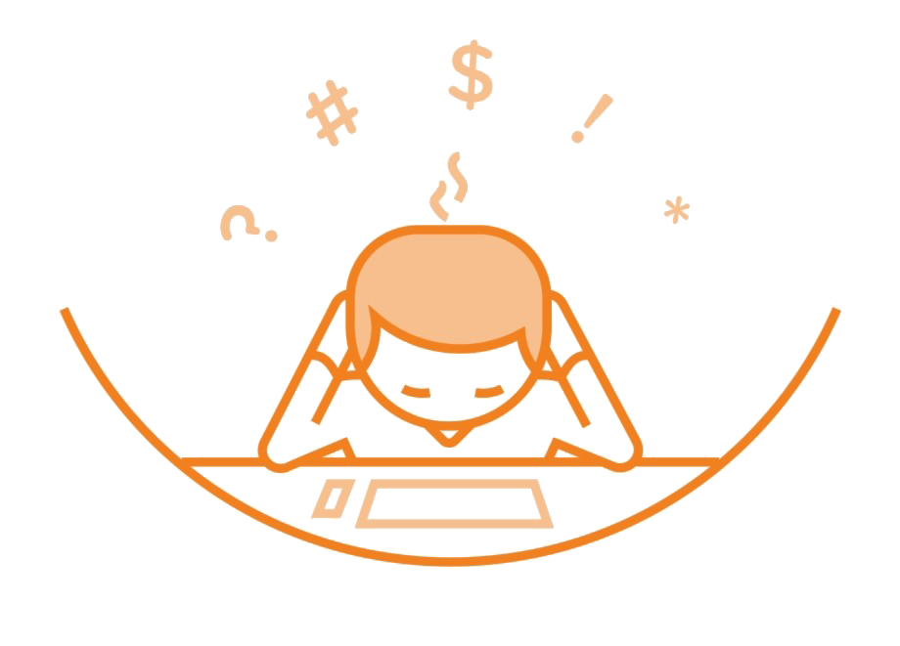
The Influence of Neuroticism
Individuals with higher levels of neuroticism:
are prone to experience greater levels of tense arousal.
tend to engage in more negative self-focused attention due to having a more negative self-concept.
  Hypothesis 1.2: Levels of neuroticism will moderate the relationship between own webcam use and tense arousal.
(Field et al., 2010)
Notes:
To build off on my 1st hypothesis, I will dicusss neuroticism.
“Ps w/ higher levels ….”.
(1st point) “these ps also tend …”
(2nd point) thus my next hypothesis states that “levels of Neuroticism will moderate ….”

Slide 5


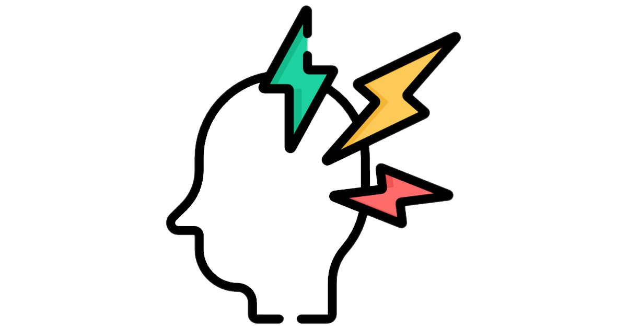

H1 Summary
Neuroticism
Own Webcam Use
Tense Arousal
Notes:
Higher levels of neuroticism should amplify the relationship between …

Slide 6

Others’ Webcam Use & Positive Affect
There has been a lack of research that involves the impact of the attendees’ use of their webcams.
Having more attendees turn their webcams on may enhance the positive effects of virtual meetings.
Conversational Flow → relies on verbal & nonverbal cues to maintain a smooth, effortless conversation.
  Associated with more enjoyment / positive affect
  Hypothesis 2.1: In virtual meetings, the proportion of others who have their webcams turned on will be positively correlated with higher scores of positive affect.
(Truong et al., 2020)
Notes:
Moving on to my next point about others’ webcam use. “There has been a lack….”
(1st point) we believe that if more attendees turn their webcams on, the positive effects of videoconferencing can be enhanced.
(2nd point) this assumption can be explained by conversational flow. CF … .
(subpoint) CF is associated w/ more enjoyment of the conversation and motivates us to continue the conversation further. If everyone turns their webcams off, we are no longer receiving cues nessesary for conversational flow.
(H1.2) Thus we hypothesize that

Slide 7

The Influence of Extraversion
Individuals with higher levels of extraversion:
spent more time video chatting during the pandemic.
are more sensitive to social rewards (i.e., nonverbal cues) which is associated with reports of stronger positive affect.
  Hypothesis 2.2: Levels of extraversion will moderate the relationship between others’ webcam use and positive affect.
(Pfund et al., 2021; Baccolo & Cassia, 2019)
Notes:
“… spent more time VCing with friends/family and for work during the pandemic in comparison to those lower on extraversion.

Slide 8


H2 Summary
Extraversion
Others’ Webcam Use
Positive Affect
Notes:
“… amplify the relationship between…”

Slide 9

The Current Study
Participants: N = 176 , mean age = 42 , residing in the UK , recruited via Prolific.co
Procedure: online questionnaire about their most recent video call
Measures:
  Own webcam use → “Did you have your webcam turned on?”
    0 = never to 4 = yes, the entire time.
  Others’ webcam use (%) → n attendees with webcam on / total N attendees
  Tense arousal & Positive affect → Schimmack and Grob’s affect scale (2000)
    “To what extent did you feel … tense” and “… pleasant.”
    1 = not at all to 7 = very much
  Neuroticism & Extraversion → BFI-10 (Rammstedt & John, 2007)
    “I see myself as someone who… gets nervous easily” and ”… is outgoing and sociable.”
    1 = strongly disagree to 5 = strongly agree.
Analysis: hierarchical linear regressions
Notes:
Procedure: we used an online questionnaire in which ps responded to questions about their most recent video call.
10 item big 5 inventory.
Simple linear regressions for main effects and multiple linear regressions for moderation effects.

Slide 10
H1 Results
Neuroticism
Own Webcam Use
Tense Arousal

Slide 11
H1 Results
Neuroticism
β = -.08, p = .269
Own Webcam Use
Tense Arousal
β = -.21, p = .005

Slide 12
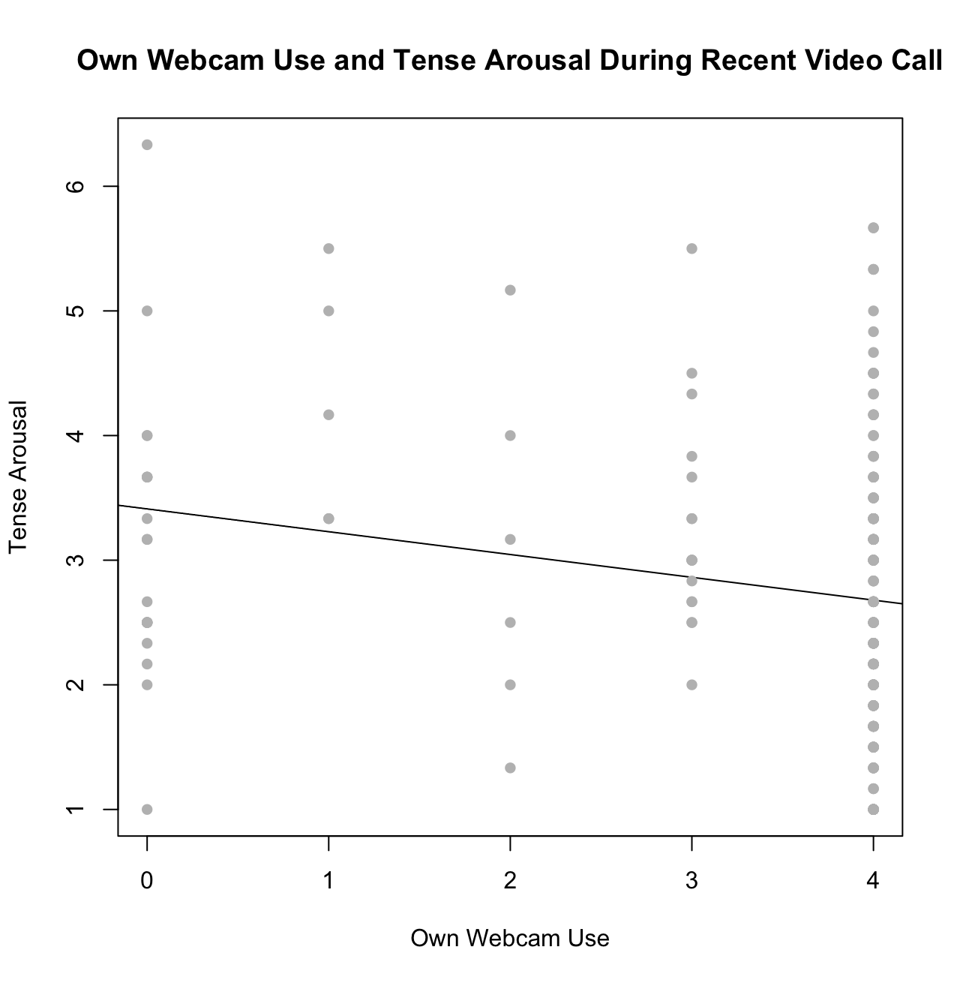
H1.1 was not supported.
Own webcam use was a negative predictor of tense arousal.
Issue of directionality?
H1.2 was also not supported.
Neuroticism was not a significant moderator.
Main effects can be applied to the general population rather than a select group.
Notes:
Surprisingly, own webcam use was a neg predictor of tense arousal (graph).
How can this be explained?
(1st point) there could be a question about the directionality of our result. Perhaps it is not turning our own webcams on that predicts less tense arousal, but instead it could be that participants who felt less tense in the first place, were more comfortable with turning their webcams on.
(2rd point) graph.
(4rth point) this could tell us that the main effects can be applied to the general pop. rather than a select group of ps w/ certain personality traits.

Slide 13

H2 Results
Extraversion
Others’ Webcam Use
Positive Affect

Slide 14
H2 Results
Extraversion
β = .10, p = .160
Others’ Webcam Use
Positive Affect
β = .23, p = .003

Slide 15
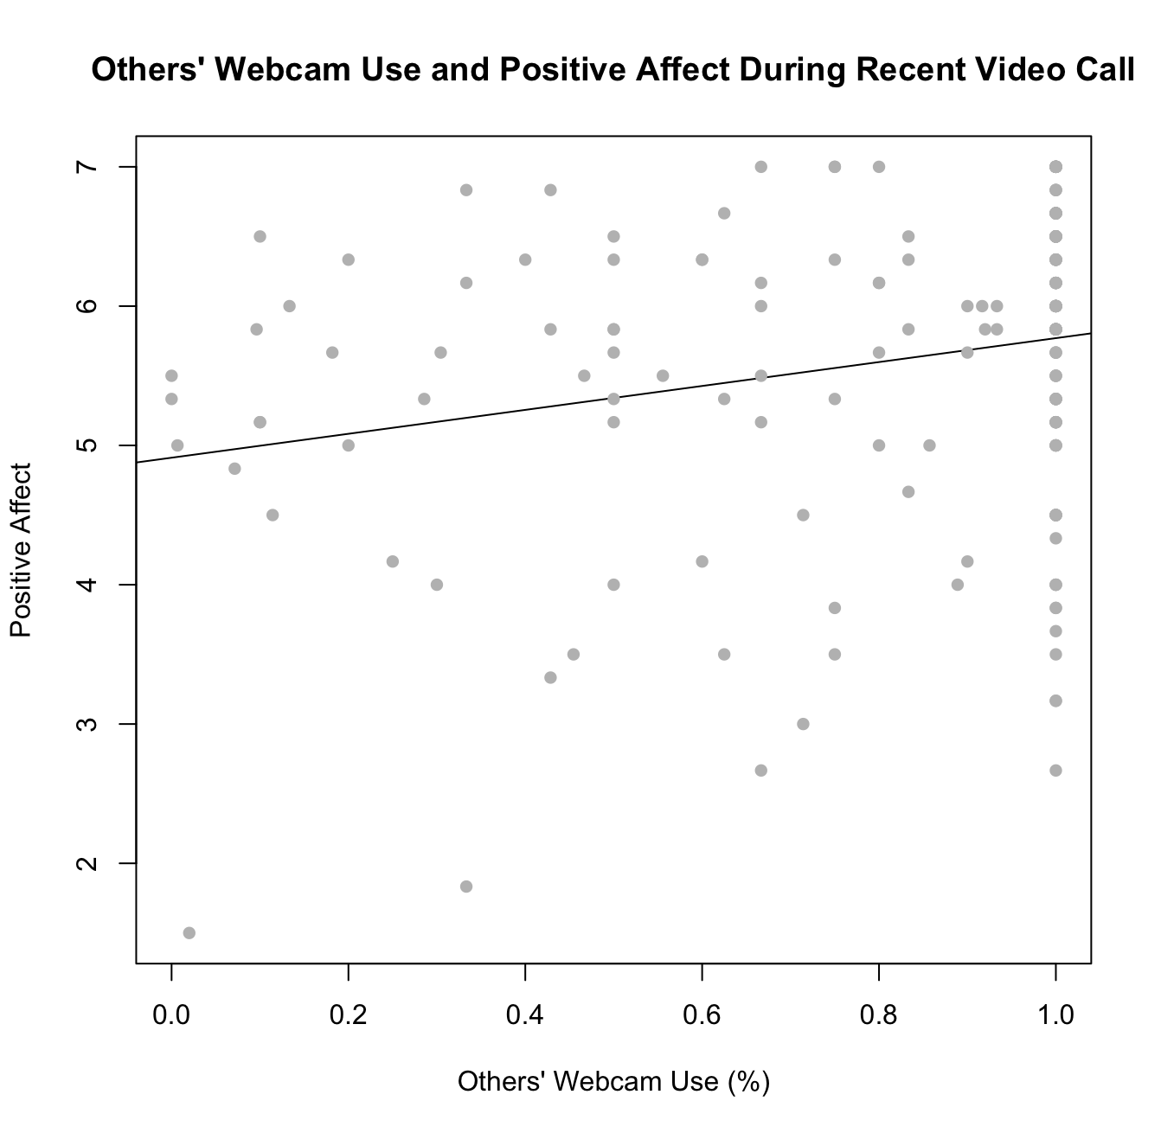
H2.1 was supported.
The proportion of others’ webcam use on the participant was a positive predictor of positive affect.
H2.2 was not supported
Extraversion was not a significant moderator.
Main effects can be applied to the general population rather than a select group.
Notes:
we DID find that the proportion ..... graph. As more others have their webcams on, the more positive affect ps reported.
Extraversion levels had no influence on the relationship between others webcam use and positive affect.

Slide 16
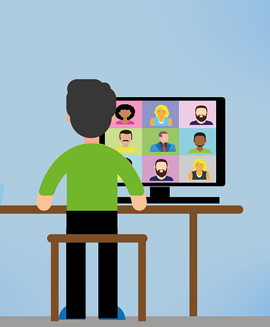
Implications
Videoconference fatigue cannot be oversimplified by having all attendees turn their webcams off as the solution.
It is important to replicate real-life conversations in an online setting to enhance meeting-enjoyment.
Future research: effective strategies to reduce videoconference fatigue while maximizing enjoyment and positive affect.
Notes:
Researchers have commonly recommended to turn our webcams off to avoid videocfonerence fatigue, however, our results suggest that videoconference fatigue should not be oversimplified in this way.
(1st point) since videoconference had become a normal aspect in our daily lives, “it is important …”
(2rd point) for future research, we should aim to find effective strategies in reducing videoconference fatigue while maximizing the positive aspects such as enjoyment and positive affect.

Slide 17

Thank you for listening

Slide 18
References
Baccolo, E., & Macchi Cassia, V. (2019). Individual differences in perceptual sensitivity and representation of facial signals of trustworthiness. Journal of Experimental Psychology. Human Perception and Performance, 45(2), 224-236. https://doi.org/10.1037/xhp0000601
Fenigstein, A., Scheier, M. F., & Buss, A. H. (1975). Public and private self-consciousness: Assessment and theory. Journal of Consulting and Clinical Psychology, 43(4), 522-527. https://doi.org/10.1037/h0076760
Field, N. P., Joudy, R., & Hart, D. (2010). The moderating effect of self-concept valence on the relationship between self-focused attention and mood: An experience sampling study. Journal of Research in Personality, 44(1), 70-77. https://doi.org/10.1016/j.jrp.2009.11.001
Pfund, G. N., Harriger, J., & Hill, P. L. (2021). Video chat usage and the big five in women during the COVID-19 pandemic. Personality and Individual Differences, 171https://doi.org/10.1016/j.paid.2020.110537
Shockley, K. M., Gabriel, A. S., Robertson, D., Rosen, C. C., Chawla, N., Ganster, M. L., & Ezerins, M. E. (2021). The fatiguing effects of camera use in virtual meetings: A within-person field experiment. Journal of Applied Psychology, 106(8), 1137-1155. https://doi.org/10.1037/apl0000948
Truong, M., Fast, N. J., & Kim, J. (2020). It’s not what you say, it’s how you say it: Conversational flow as a predictor of networking success. Organizational Behavior and Human Decision Processes, 158, 1-10. https://doi.org/10.1016/j.obhdp.2020.02.004

