Slide 1


The Influence of AI on Academic Publishing
Presented by: Priya Madina
Vice President, External Affairs and Policy,
Taylor & Francis
© 2024 Taylor & Francis

Slide 2
Agenda
01
Introduction
02
Overview of AI in Academic Publishing
03
Research Integrity Challenges
04
Considerations for Using AI When Publishing
05
Conclusion
© 2024 Taylor & Francis
© 2024 Taylor & Francis

Slide 3
Introduction
© 2024 Taylor & Francis

Slide 4

Introduction
Taylor & Francis (T&F)
Leading global academic publisher
Specialization in HSS
Founded in 1798
Priya Madina
Vice President of External Affairs & Policy
Specialisms: overall strategy and team direction, external affairs & advocacy, open research policy
© 2024 Taylor & Francis

Slide 5
Overview of AI in Academic Publishing
© 2024 Taylor & Francis

Slide 6

Introduction
Generative AI refers to the use of machine learning algorithms and natural language processing techniques to automate and optimize various tasks involved in the publishing process.
Traditional AI: Focuses on analyzing historical data and making future numeric predictions.
Generative AI: Allows computers to produce brand-new outputs that are often indistinguishable from human-generated content.
Note: For the purposes of this discussion, we are referring to generative AI.
© 2024 Taylor & Francis

Slide 7

AI and Academic Publishing Opportunities
Maintaining high quality research for publication
AI can help researchers and publishers to make the most of their time and disseminate their research further by:
Reducing the cost of language improvement
Widening access and accessibility
Making idea generation and idea exploration quicker and more efficient
Helping with literature classification
Assistance with coding
These efficiencies can make research more equitable
and accessible.
© 2024 Taylor & Francis

Slide 8
AI and Academic Publishing Opportunities
Increasing efficiency during the publication process
Automating editorial tasks
Repurposing existing content into new forms
Journal Finder tool
Example:
Taylor & Francis have partnered with DataSeer to monitor author compliance with our data sharing policies and to track the extent to which our authors are employing open research practices. This should:
  Increase data-sharing policy compliance
  Reduce editorial workload
  Provide business intelligence on engagement with open research practices
© 2024 Taylor & Francis

Slide 9

AI and Academic Publishing Opportunities
Publishing AI research to drive progress
We publish over 300 AI-focused journals across various fields like computer science, medicine, and social sciences.
We have launched the world’s first research journal dedicated to Psychology & AI: Journal of Psychology and AI | Taylor & Francis Online (tandfonline.com).
Online, we provide resources like the Artificial Intelligence Hub (routledge.com) and the AI for Everything (routledge.com) series to showcase innovative AI uses in research and teaching.
© 2024 Taylor & Francis

Slide 10
Caveats
It is important to note that many of these use cases of AI in publishing are still in their infancy.
These tools are prone to be inaccurate and make mistakes, for some tasks they are still unreliable.
Most researchers and publishers are now still exploring and experimenting with them.
Any output from these tools needs human oversight, validation, and fine-tuning – even in the future when the AI becomes more accurate and “intelligent”.
© 2024 Taylor & Francis

Slide 11
Research Integrity Challenges
© 2024 Taylor & Francis

Slide 12
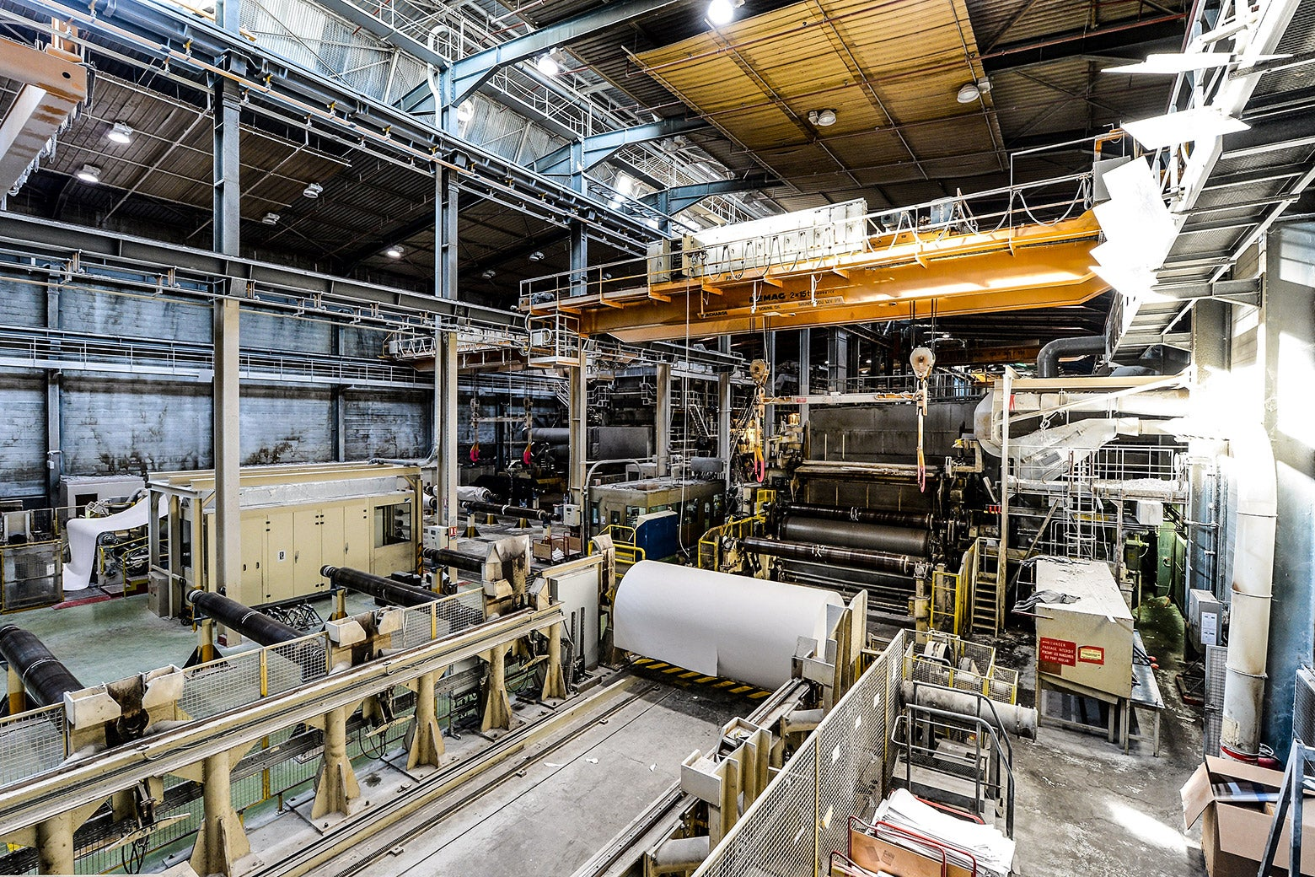
Papermill Expansion and its Ramifications
Fraudulent research, otherwise known as papermills are a huge problem for our whole industry.
This is because AI is causing a greater proliferation in the production of research papers.
John Gapper warned in the Financial Times, “…if an unreliable linguistic mash-up is freely accessible, while original research is costly and laborious, the former will thrive”.
The problem is significant – also because there are different types of papermills, and they are all highly adaptive.
© 2024 Taylor & Francis

Slide 13
AI and Academic Publishing Opportunities
Industry tools to combat fraud
Academic publishers are using specialist AI tools to help combat fraudulent behavior and safeguard the academic record.
Cactus PaperPal
STM’s Paper Mill Detection Tool
© 2024 Taylor & Francis

Slide 14
Misinformation and Disinformation Proliferation
Misinformation is unintentional false or inaccurate information.
Disinformation is deliberately false content, which can be used to spread fear and suspicion.
The World Economic Forum stated that a wave of AI driven misinformation and disinformation that could influence key looming elections poses the biggest short-term threat to the global economy.
© 2024 Taylor & Francis

Slide 15

Concerns Around Using AI Tools
Confidential content being uploaded to generative AI platforms may threaten privacy and copyright.
AI hallucinations can provide misleading or erroneous results. Human oversight remains necessary.
As AI technology evolves, the tools necessary to detect its presence in research will start to become outdated as they strive to keep up.
© 2024 Taylor & Francis

Slide 16

Challenges in Detecting AI Misuse
Reliance on authors' honesty about AI use.
Risks associated with uploading content to platforms like Chat GPT.
Some fraudulent users are using AI to hack into their research papers to increase their citation credits.
© 2024 Taylor & Francis

Slide 17
Considerations for Using AI When Publishing
© 2024 Taylor & Francis

Slide 18

The AI Policy Landscape
Policymakers are working to legislate to keep up with the pace of change.
Governments, funders and institutions are beginning to develop AI policies for responsible usage which may affect applying for funding.
Similarly, publishers like T&F are developing guidelines to help guide authors, editors and peer reviewers on how to use AI in a way that is ethical.
© 2024 Taylor & Francis

Slide 19
AI Awareness for Publishing – Quick Takeaways
Examples from our T&F AI Policy:
Authors are accountable for the originality, validity, and integrity of the content of their submissions.
Authors must clearly acknowledge the use of generative AI tools in their work.
Editors and peer reviewers must not upload files, images or information from unpublished manuscripts into Generative AI tools.
© 2024 Taylor & Francis

Slide 20
Conclusion
© 2024 Taylor & Francis

Slide 21
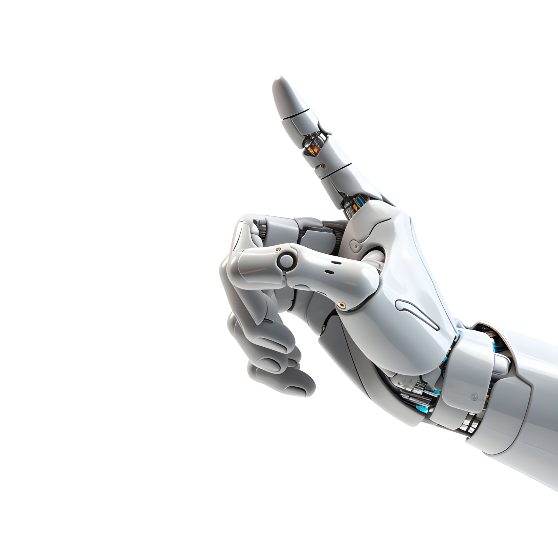
Conclusion
Potential for AI to positively impact academic publishing with the right ethical frameworks in place.
Importance of addressing research integrity issues with responsible AI use.
AI is new and here to stay –
educate yourself, check your internal AI policies and experiment!
© 2024 Taylor & Francis

Slide 22
T&F and AI related Policies
Links below:
T&F AI Policy
T&F Editorial Policies
Authorship and Principles of Publishing Ethics
T&F Journal Editor Code of Conduct
© 2024 Taylor & Francis

