Slide 1
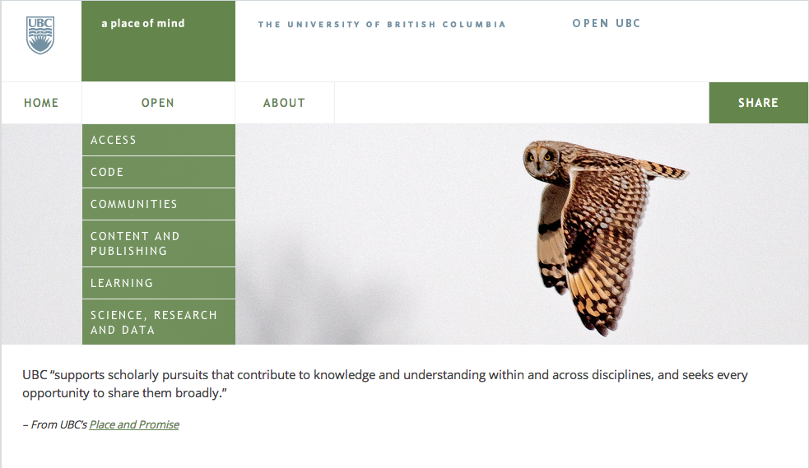

Slide 2
What makes a technology open?
What are the features or qualities of an open technology?

Slide 3
Support Community
Support Collaboration & Active Participation
Support Student Ownership of Content
Support for Open Sharing (Reuse, Revise, Remix, Redistribute)
Flexible and Adaptive

Slide 4
Instructors and learner should be artists....
…not plumbers

Slide 5
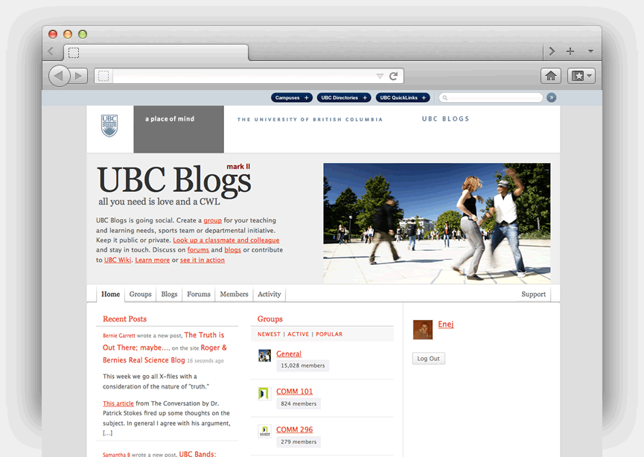
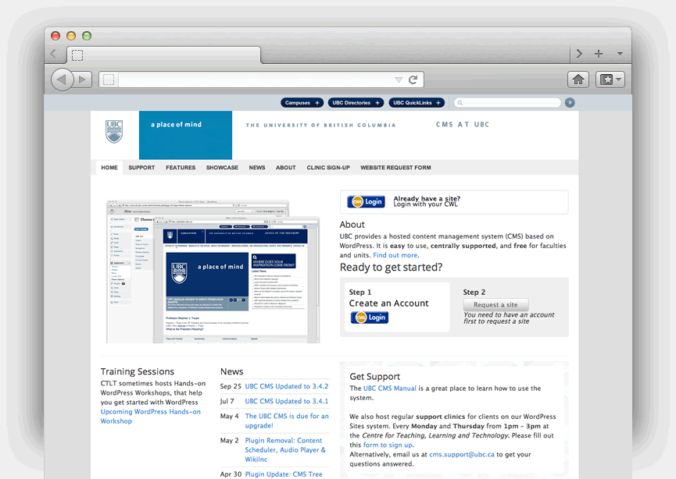

UBC Blogs, UBC CMS and The UBC Wiki

Slide 6
Faculty wants to launch open learning project to engage public

Slide 7
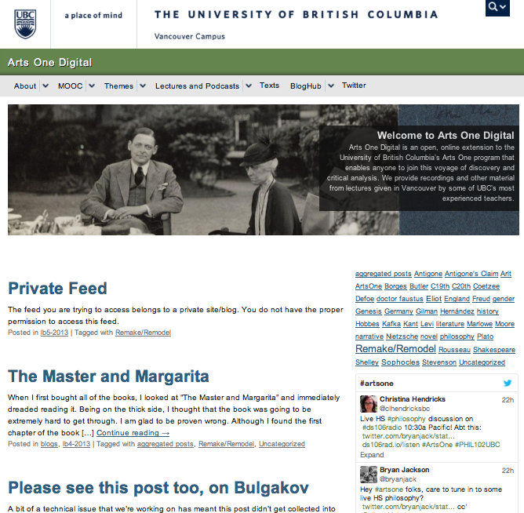

Slide 8
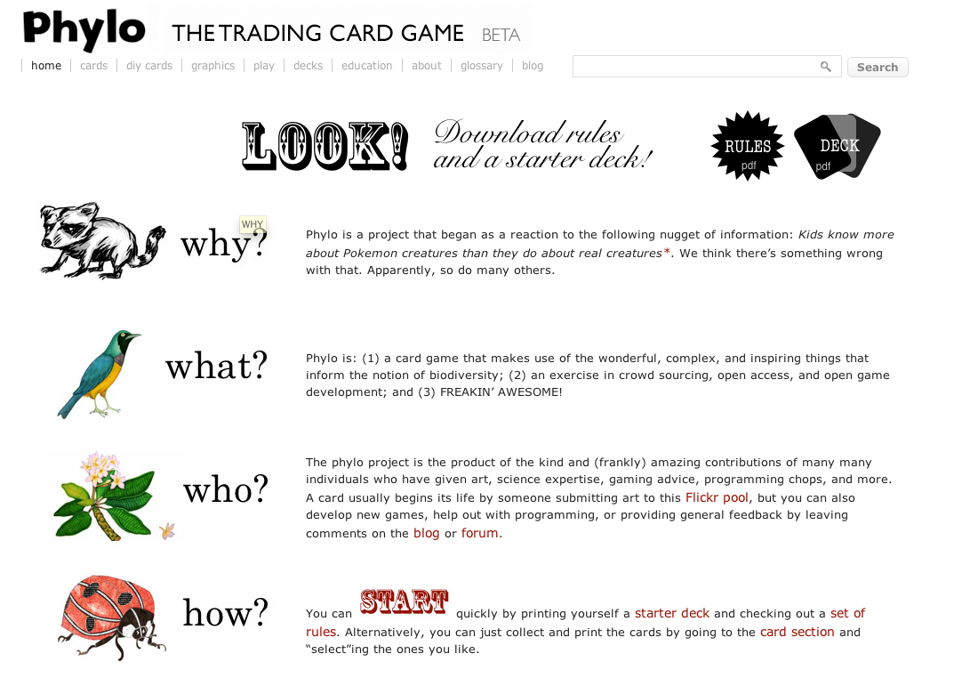

Slide 9
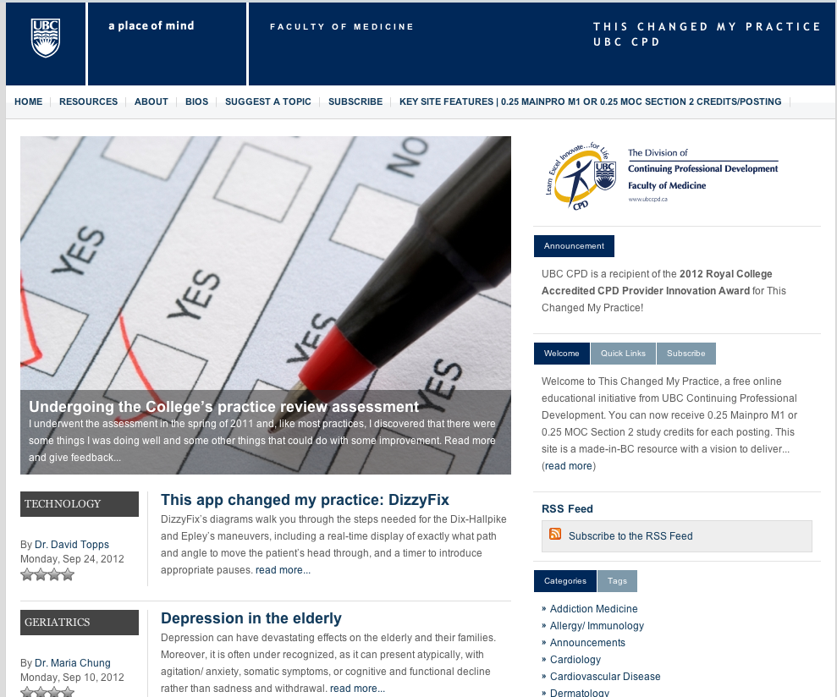

Slide 10
Instructor is designing a course in a “student as producer” model

Slide 11
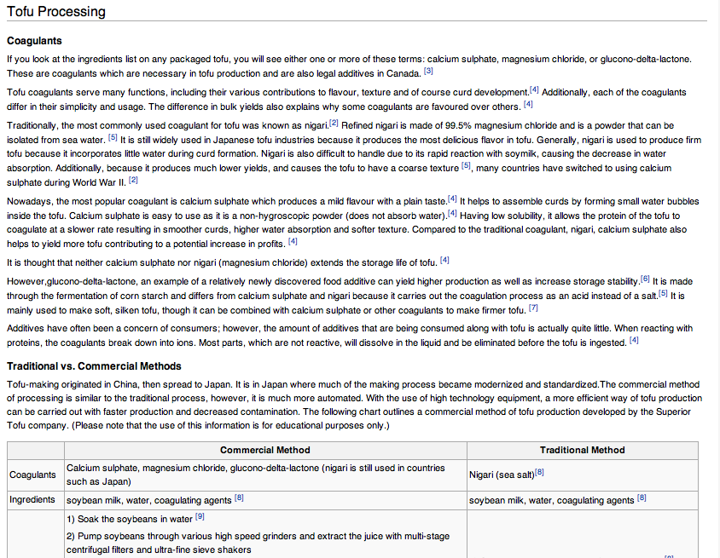

Slide 12
Large course wants a twitter-like back channel to increase in class student engagement

Slide 13
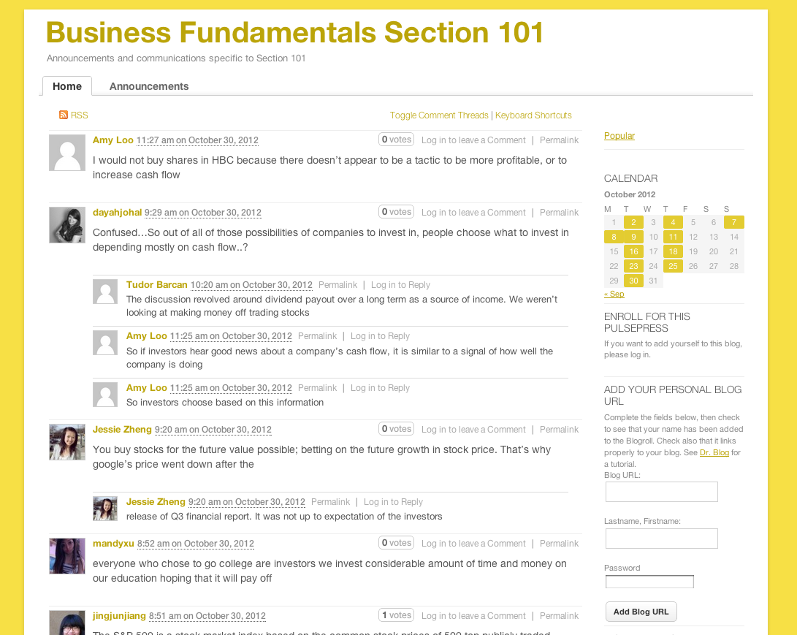

Slide 14
Instructor wants students demonstrate key skills and accomplishments in an ePortfolio

Slide 15
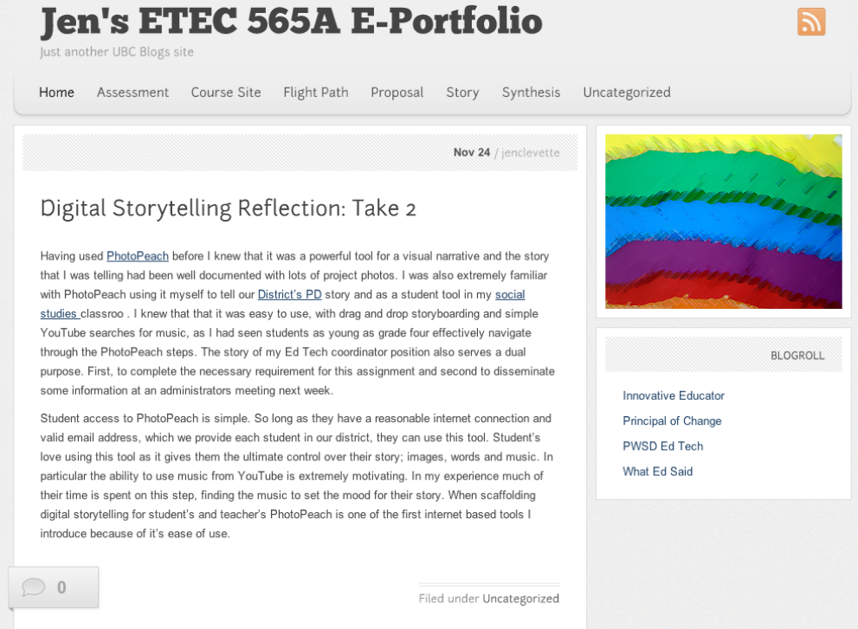

Slide 16
Learning module has content that must constantly updated by different people over different terms

Slide 17


Slide 18
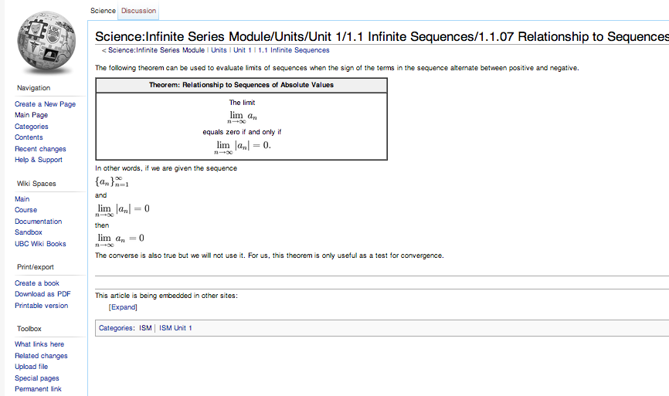

Slide 19
Instructor wants to Aggregate Content from Student Resources

Slide 20
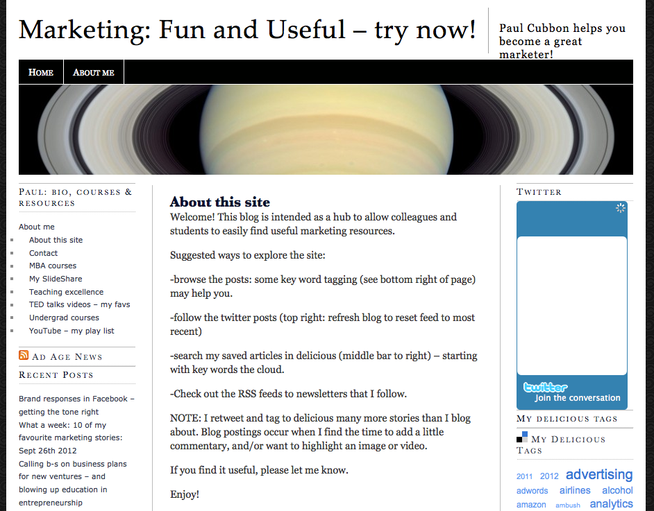

Slide 21
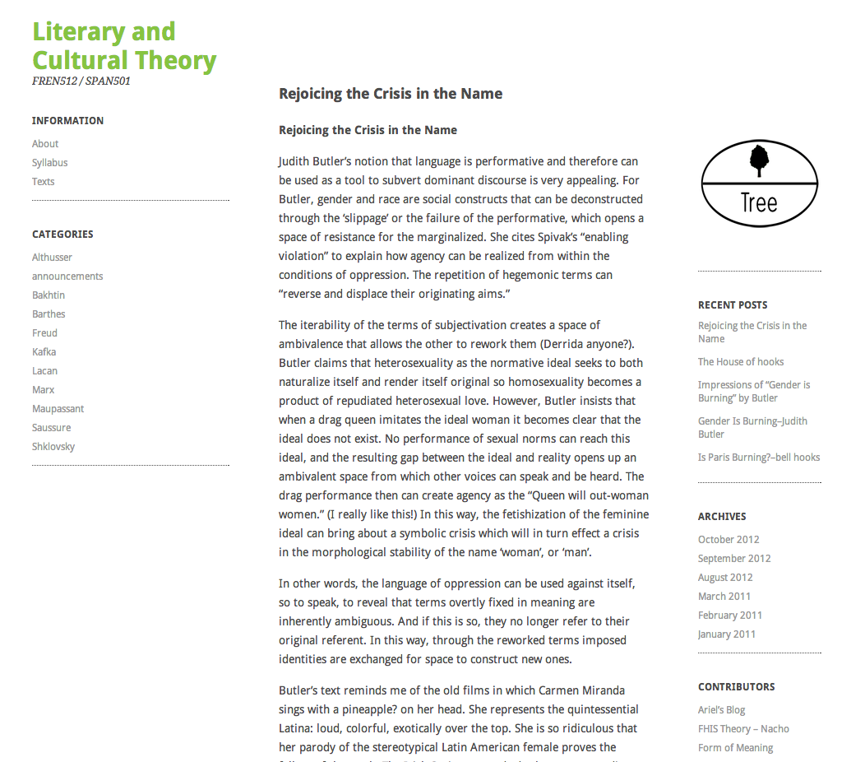

Slide 22
Group Blog /
Communities of Practice

Slide 23
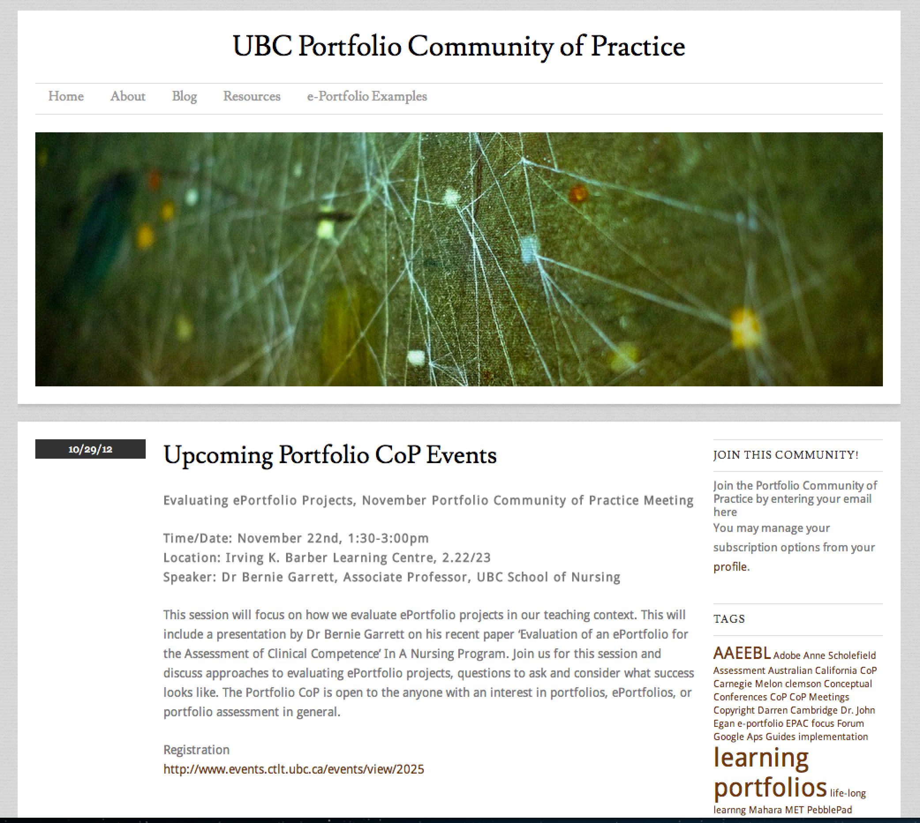

Slide 24
Open technology should be enabling....

