Slide 1
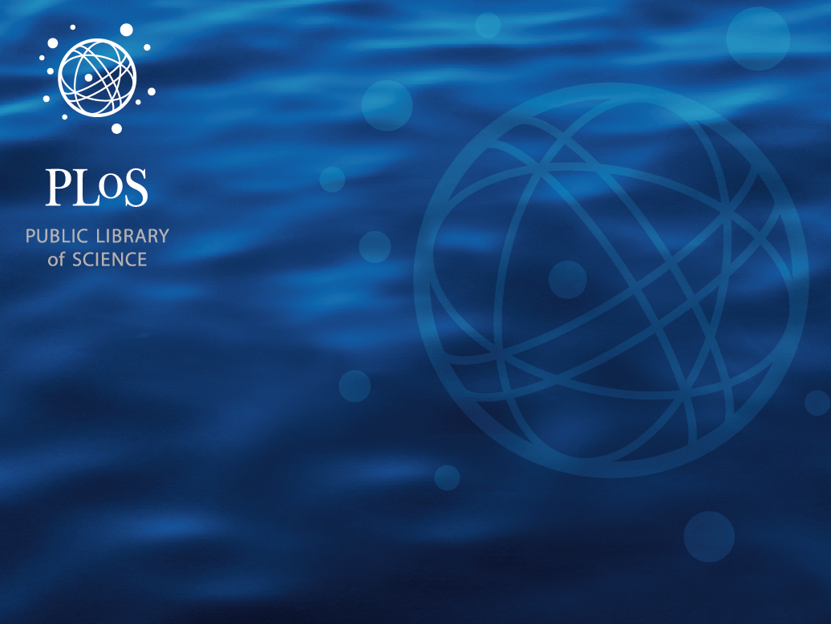
Leading the next frontier of OA: Filtering, Aggregating, and Evaluating Research Content
Session 4
October 25, 2011
Jennifer Lin,
Product Manager, PLoS
Committed to making the world’s scientific and medical literature a public resource

Slide 2
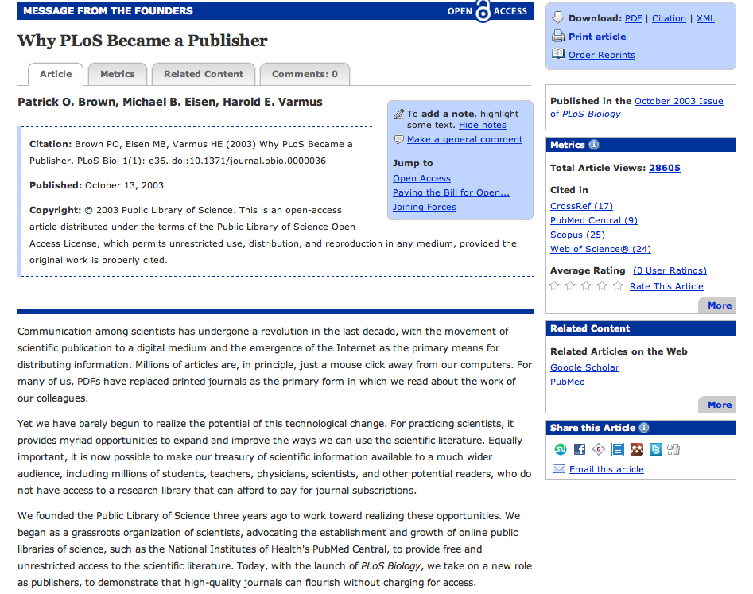
In the beginning of OA…

Slide 3
7,000
OA Journals
Research content is multiplying.
OA content is multiplying at an even faster rate.
PubMed
%PMC
%OA
7% of PubMed is present within the OA subset of PMC

Slide 4
In 2011 alone, PLoS will publish:
15,500
14,000
PLoS Publications
PLoS ONE Papers

Slide 5
Information Overload and Filter Failure
.
Journal IF
More data
Google Scholar
More published research
More distribution channels
How do we manage this deluge of scientific research data and content?

Slide 6
At PLoS, this challenge represents the next frontier for OA.
Researchers need new approaches to the:
structuring
presentation
use
evaluation of research literature.
We need post-publication tools to manage research content.

Slide 7
PLoS is tackling this challenge
Approach:
Build a flexible operational framework with a robust toolset for researchers to experiment and develop customized solutions for their research needs.
Filter
Aggregate
Evaluate
Content

Slide 8
What existing tools support our research discovery process?
Key word search on PubMed, Google Scholar, journal page, etc.
Taxonomic browsing in research area
RSS alerts/emails of newly published articles
… [insert your own] …

Slide 9
How do I find research of relevance to me?
I learn about it through other researchers.
Citations
Conferences
Collaborators
Listserve
Social bookmarks
Twitter
Facebook
Blogs

Slide 10

Research Dissemination IS Research Impact
But how do we measure it?

Slide 11
To be more specific:
The process of research dissemination creates indicators of impact.
Dissemination
Publication
Citations
Web usage
Star Ratings
Social bookmarking
Community rating
Media/blog coverage
Commenting activity
and more…
Current technology makes it possible to measure these communication conduits

Slide 12
The ecosystem of research dissemination channels is broad and diverse
Blog Coverage
Non-Scholarly Citations
Article “usage”
Community Input
News Coverage
Scholarly Citation

Slide 13
We can capture these channels, measure them as indicators of impact, and make them the basis of research assessment.
Dissemination
Publication
ALMs
Citations
Web usage
Star Ratings
Social bookmarking
Community rating
Media/blog coverage
Commenting activity
and more…
Collectively as a suite, Article-Level Metrics measures research impact in a transparent and comprehensive manner.

Slide 14
TOOLS: FILTER, AGGREGATE, EVALUATE
Information
Overload
Blog Coverage
Non-Scholarly Citations
Article “usage”
Community Input
News Coverage
Scholarly Citation
Filter
Failure
ALMS

Slide 15
ALM Data Channels
ALM Category | Data Types and Channels
 | Existing | Planned Additions
Article Usage | HTML page views PDF downloads XML downloads PMC HTML pageviews PMC HTML PDF downloads Trackbacks
Community Input - PLoS site | Reader Comments Reader Notes Ratings
Citations - Scholarly Literature | PubMed Central Scopus CrossRef Web of Science Google Scholar (direct search link) | Microsoft Academic Search
Citations - Non-Scholarly Literature |  | Wikipedia Encyclopedia of Life F1000 Evaluations
Media Coverage |  | News (Google, Yahoo)
Blog Coverage | Nature Blogs (direct search link) Google Blogs (direct search link) | Yahoo Search Reditt
Social/Behavioral Mining | CiteULike | Twitter Facebook Mendeley Reference Manager Bookmarks Social bookmarks (Zotero, Delicious, Digg)

Slide 16
ALMs: Uses
Authors
Measure the impact and reach of their work
Benchmark article performance against others
Researchers
Analyze trends/behaviors across a database of academic literature
Evaluate publication decisions to maximize the impact of their work
Gain insight into article’s impact within context of related research
Communicate impact of research to employers, funders, potential collaborators
Conduct custom searches that account for research impact
Collect relevant articles and organize based upon array of criteria
Gauge value of any article with post-publication peer review
Self-Metrics
Research & Discovery

Slide 17
Article Level Metrics at PLoS Product Demos
On a PLoS Article
    http://www.plosone.org/article/metrics/info%3Adoi%2F10.1371%2Fjournal.pone.0000443
On the Biodiversity Hub
    http://hubs.plos.org/web/biodiversity/article/10.1186/1471-2148-6-65
As part of navigation / search
    http://www.plosone.org/search/simpleSearch.action?startPage=0&volume=&eLocationId=&id=&filterArticleType=&filterKeyword=&filterJournals=PLoSONE&query=cancer&sort=Most+views%2C+all+time&pageSize=10
Marketing / Dev site for the ALM API
    http://article-level-metrics.plos.org/ & http://api.plos.org/

Slide 18
Article Level Metrics (ALM) at PLoS
ALM initiative:
Collect data at the research article level beyond usage and citations, measures which might provide insight into “impact” across the dissemination domains
Present these data on the article & within search
Develop ALM data toolset
Provide an extensible, open platform which allows others to use the same tool, and also allows us to apply the tool to 3rd party content
Reach out to publishers, decision makers, funding bodies, governance organizations to promote adoption of article level metrics

Slide 19
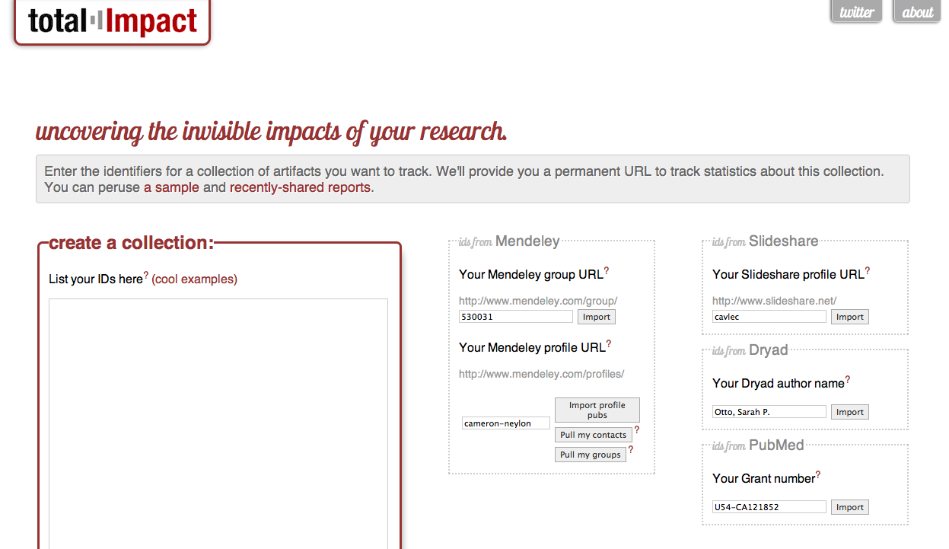
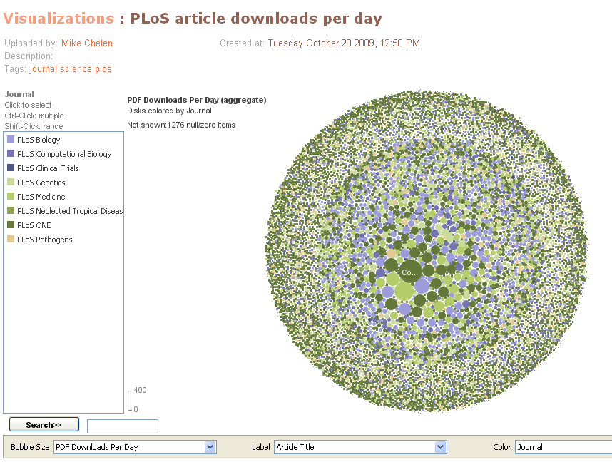
New ALM Uses from the Community
With PLoS’s open API, the uses of ALM data are unlimited.
Third party re-use of the PLoS API
    Total Impact (http://total-impact.org/sandbox/)
    Science Card (http://sciencecard.org/)
    Altmetric (http://www.altmetric.com/)
Heather Piwowar, Jason Priem
Mike Chelen

Slide 20
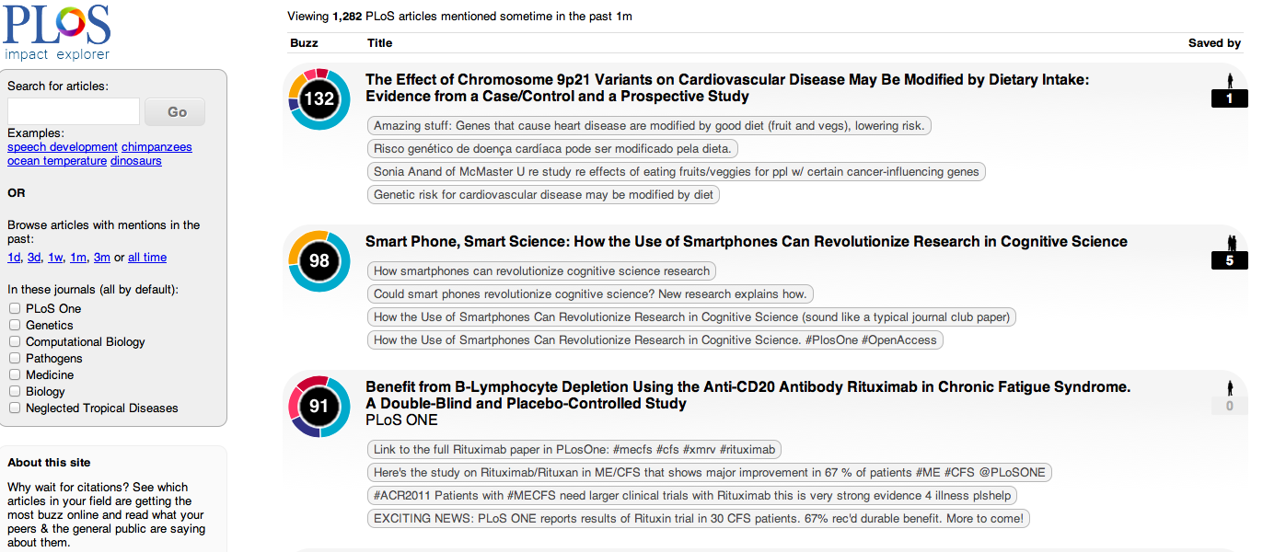
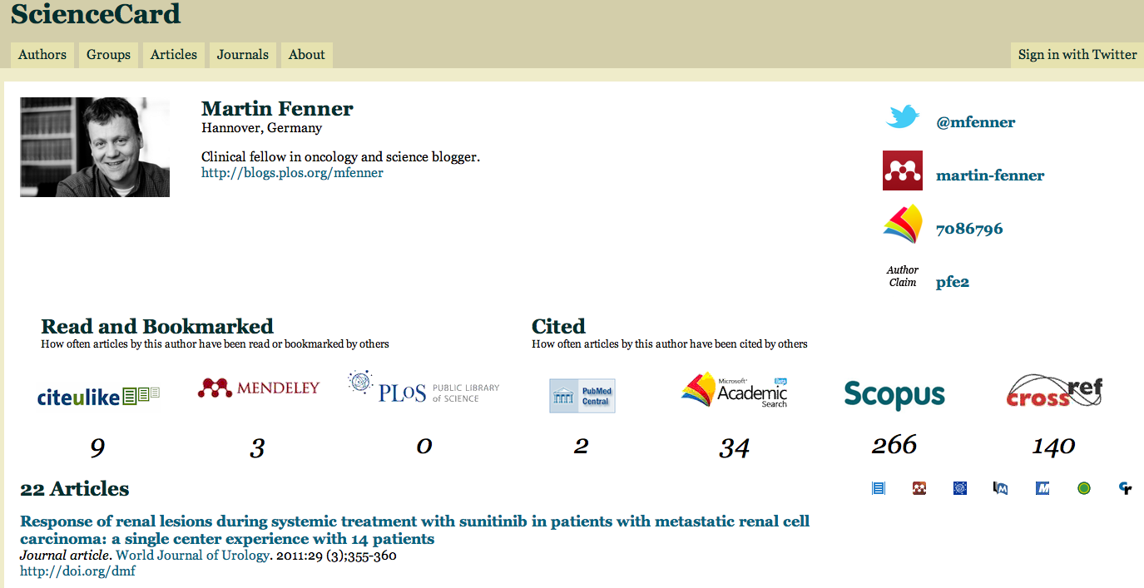
Euan Addie
Martin Fenner

Slide 21
Thank you for your time and interest in ALMs.
Questions or Comments? jlin@plos.org

