Slide 1
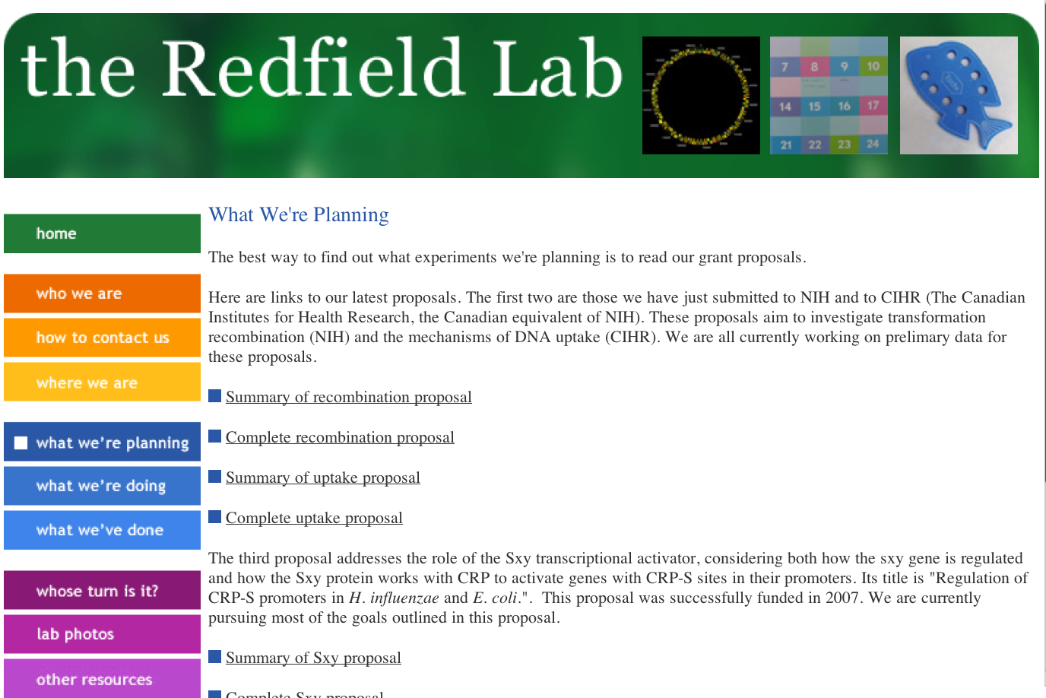
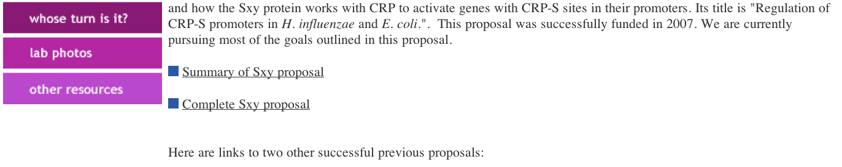

Slide 2
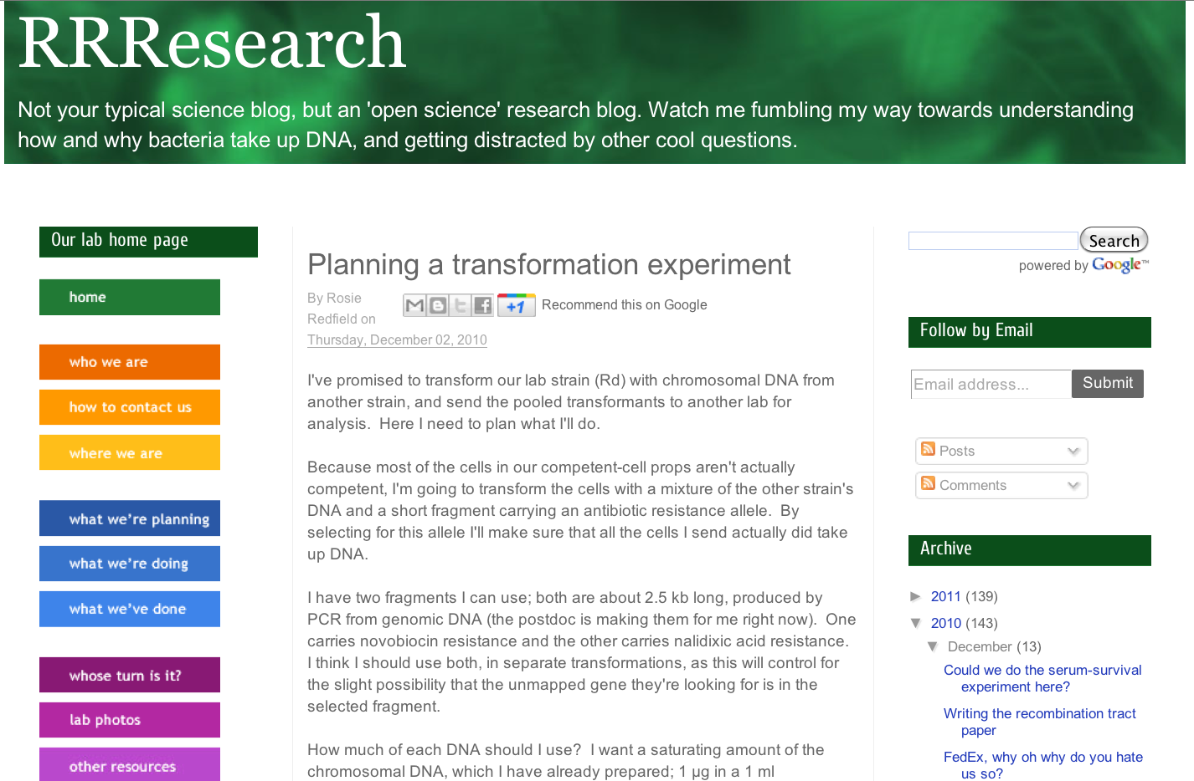
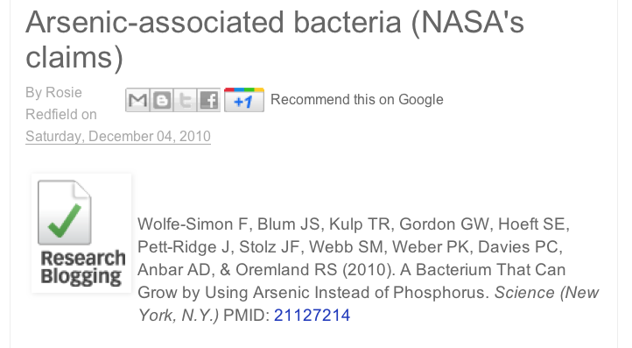
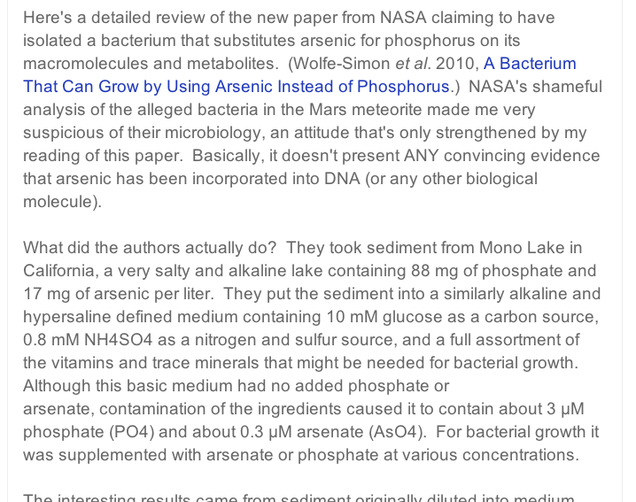

Slide 3
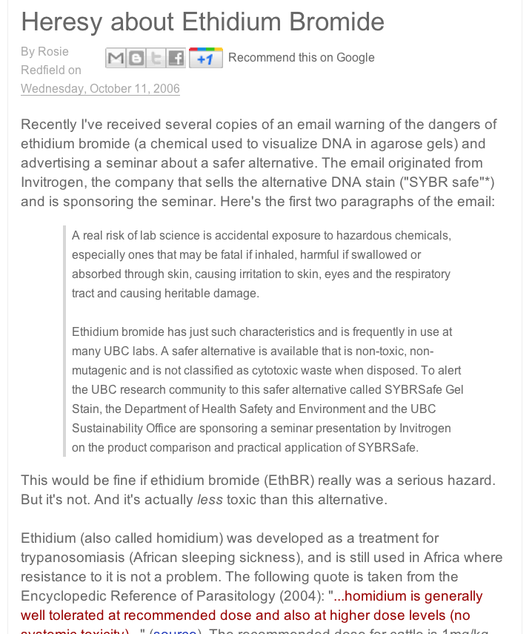

Slide 4
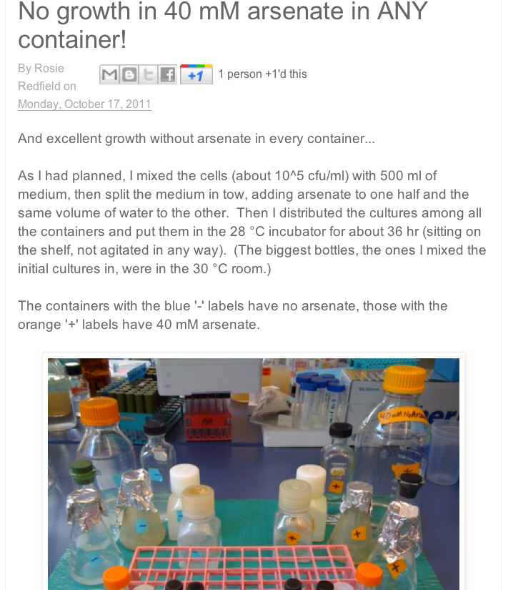

Slide 5
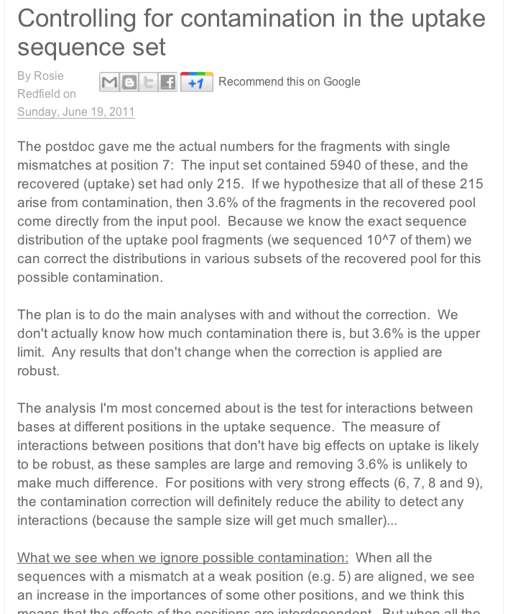

Slide 6
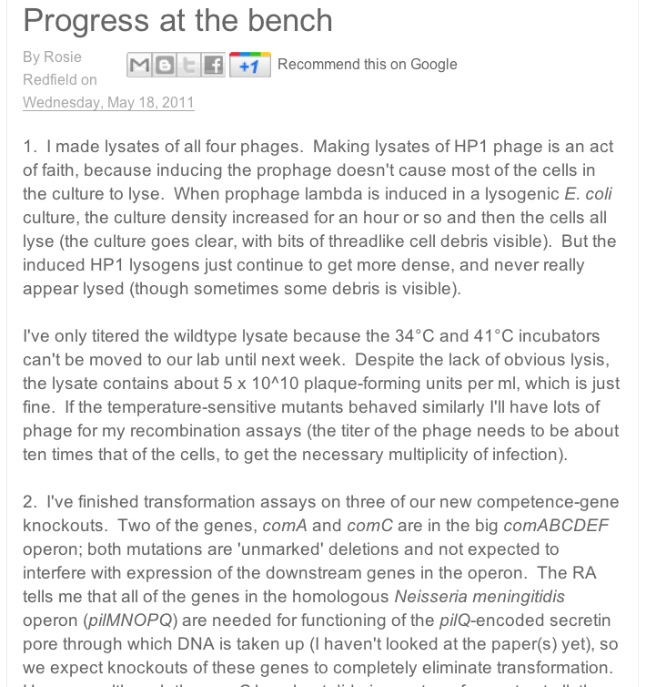

Slide 7
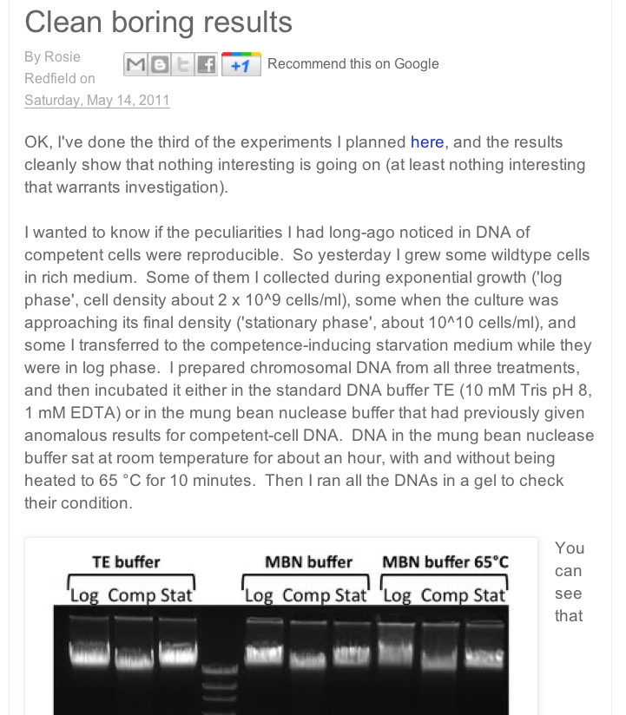

Slide 8
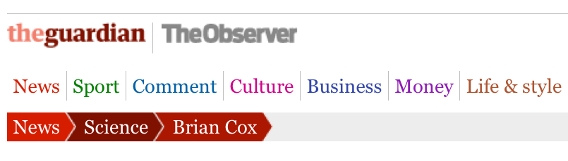
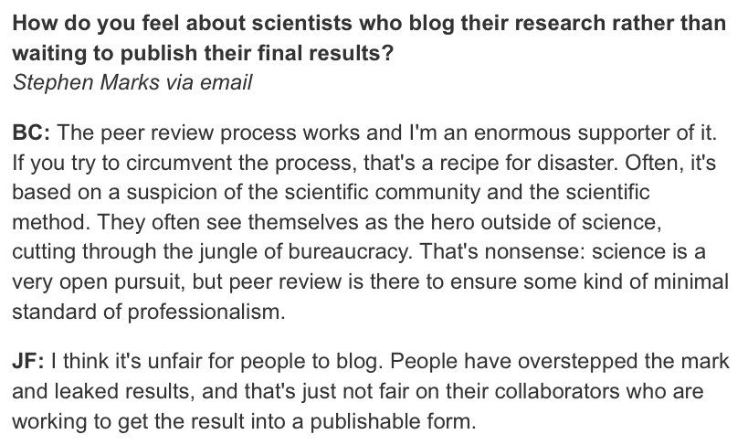
Brian Cox and Jeff Forshaw explain the big bang
What is infinity? Is the Milky Way omlette-shaped? Readers ask particle physicists to unscramble some of the universe’s mysteries

Slide 9
Brian Cox and Jeff Forshaw explain the big bang
What is infinity? Is the Milky Way omlette-shaped? Readers ask particle physicists to unscramble some of the universe’s mysteries
RRResearch is not an attempt to circumvent peer review.
Collaborators always know in advance about the openness of my research.
The research benefits of open communication usually outweigh the risk of being scooped.
The public should be able to see how research is really done.

