Slide 1
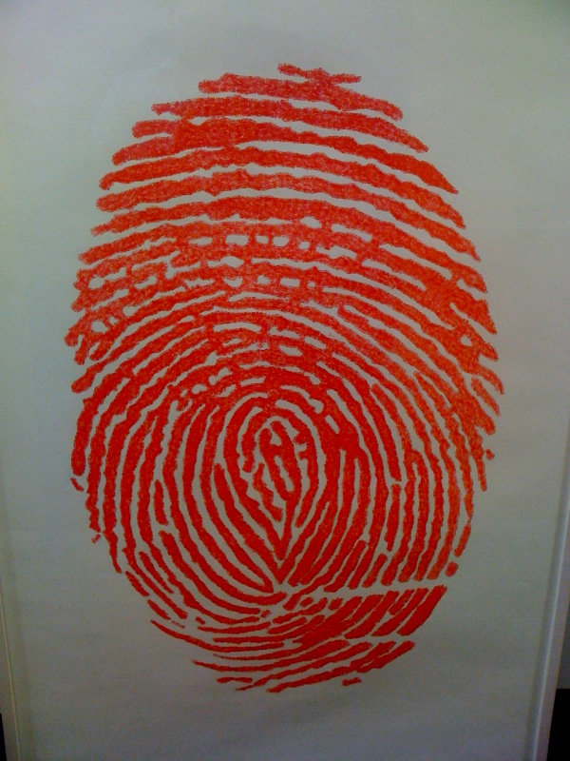
Evidence based library and information practice
Denise Koufogiannakis
University of Alberta
British Columbia Research Libraries Group Lecture Series
February 7, 2014 | Vancouver, BC
Notes:
Image: Cc Eik Perfectance http://farm3.staticflickr.com/2752/4502945167_6a05cf650b_o.jpg

Slide 2
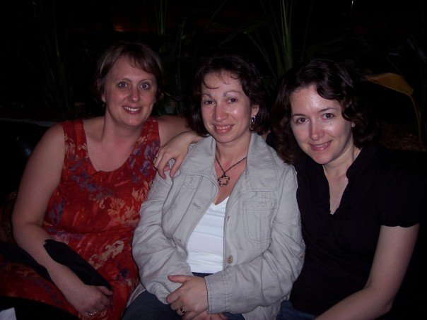
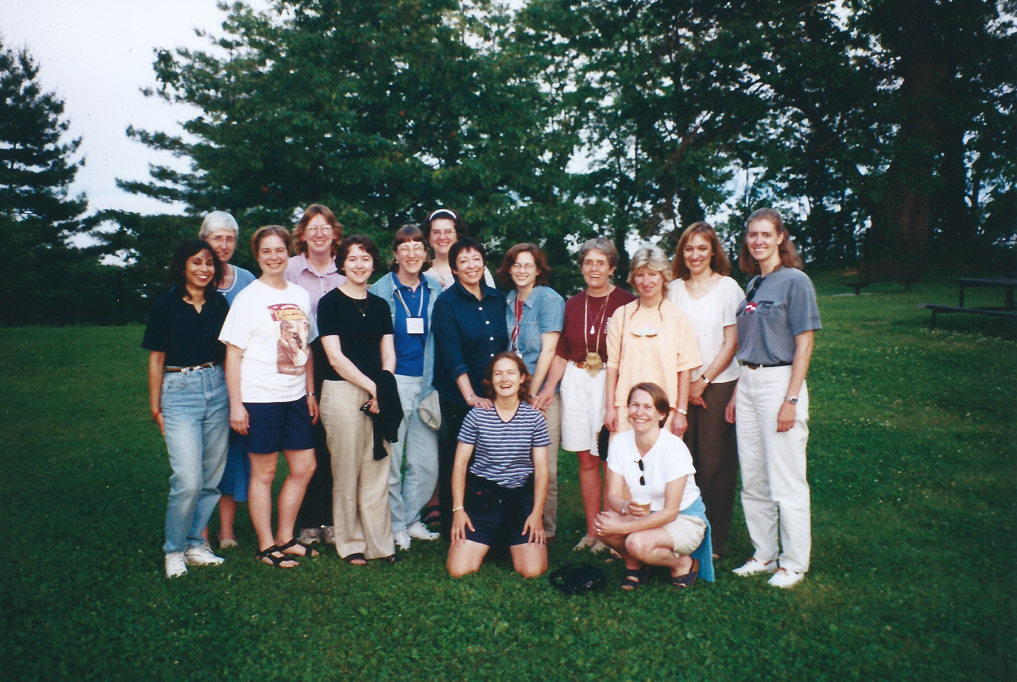
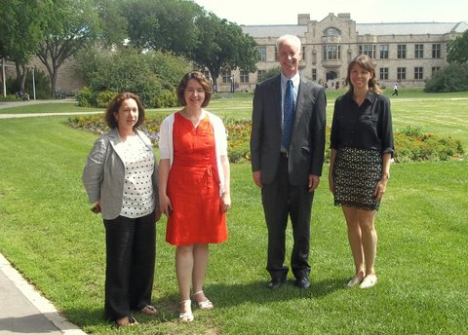
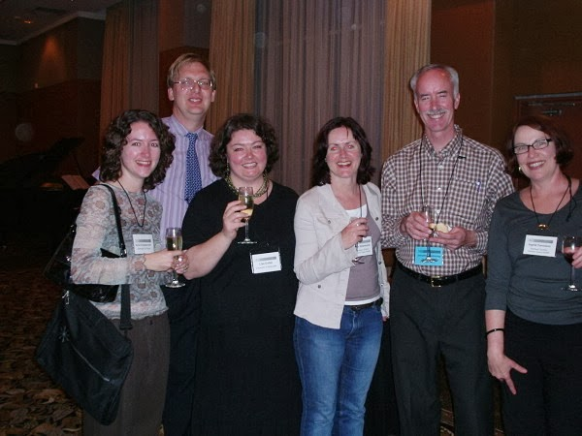

Slide 3

What is evidence based library and information practice?

Slide 4
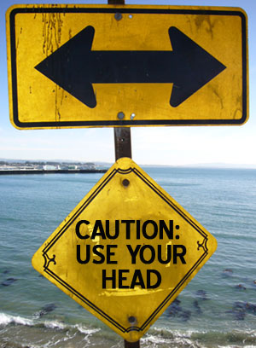
“an approach to information science that promotes the collection, interpretation and integration of valid, important and applicable user-reported, librarian observed, and research-derived evidence. The best available evidence, moderated by user needs and preferences, is applied to improve the quality of professional judgements”
(Booth, 2000)
Notes:
Image: CC Some rights reserved by SusieFoodie

Slide 5
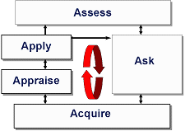
5A’s of evidence based practice
(Hayward, 2007, http://www.cche.net/info.asp)
Notes:
Copyright, R. Hayward, 2007.

Slide 6
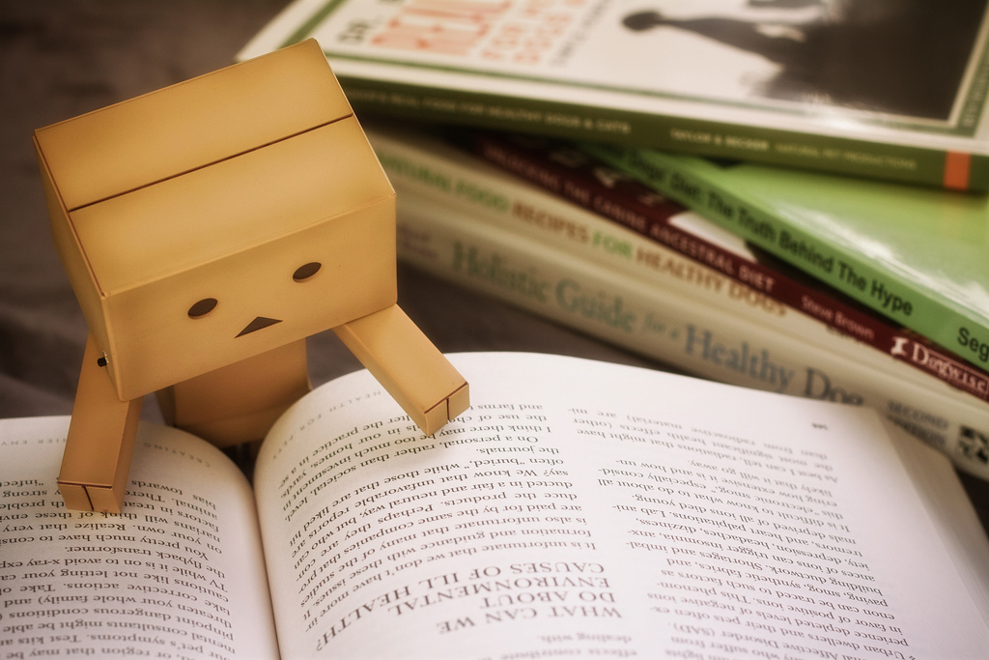
A focus on published research
Notes:
Cc Nomadic Lass via Flickr

Slide 7
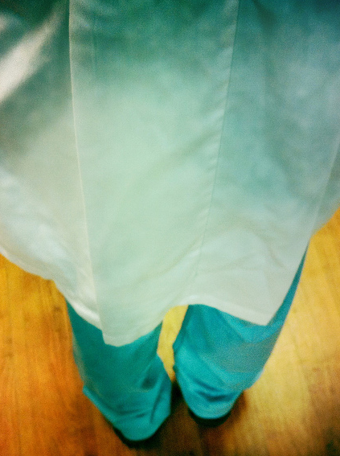
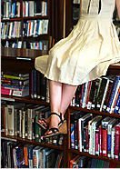
Notes:
Image 1: License Some rights reserved by johnwilliamsphd
Image 2: License Some rights reserved by Super Furry Librarian

Slide 8
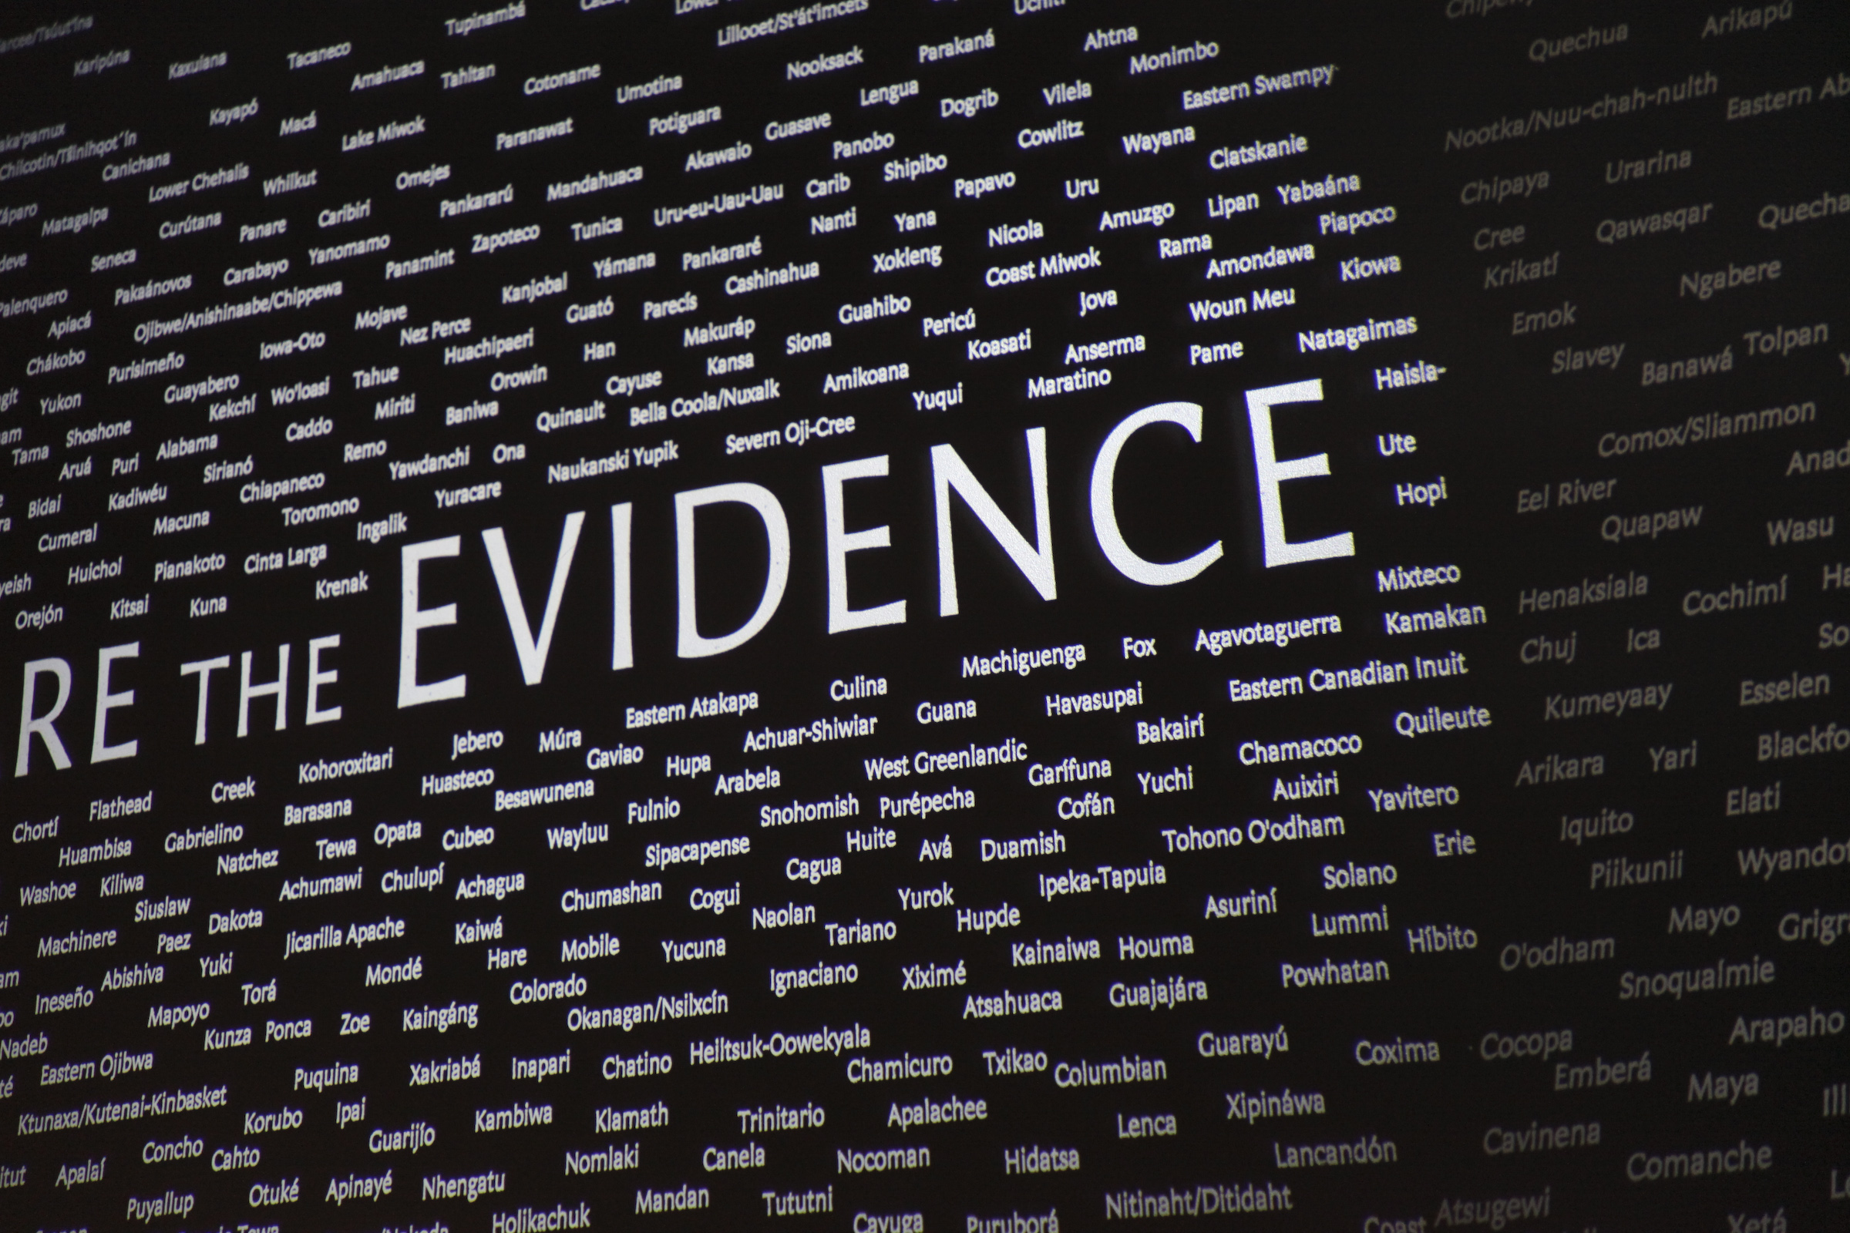
Notes:
What is evidence in Librarianship?
Cc Jared Tarbell 2009 (via Flickr)

Slide 9

“the available body of facts or information indicating whether a belief or proposition is true or valid”
(Oxford Dictionary, 2011)
Notes:
CC Some rights reserved by TexasT's

Slide 10
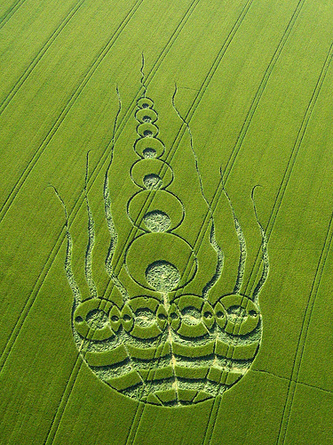
Properties of evidence
Relevance
Credibility
Weight
      (Schrum, 2011)
Notes:
Image cc License Some rights reserved by superdove

Slide 11
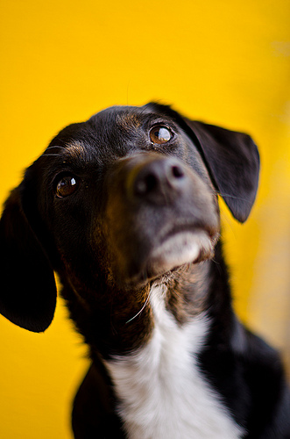
“I’m clueless how to speak evidence”
(Librarian 13)
Notes:
Image: CC Some rights reserved by lovlibovli

Slide 12
Evidence Sources
Hard evidence | Soft evidence
Published literature | Input from colleagues
Statistics | Tacit knowledge
Local research and evaluation | Feedback from users
Other documents | Anecdotal evidence
Facts

Slide 13
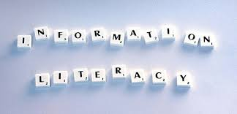

Slide 14
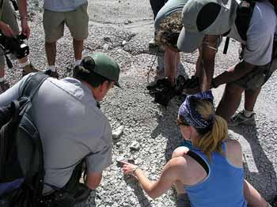
how do librarians use evidence?
Notes:
Image: cc License Some rights reserved by pennstatenews

Slide 15
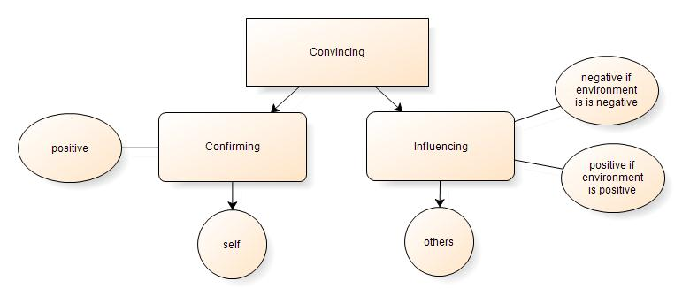
The concept of convincing
Koufogiannakis, 2013

Slide 16
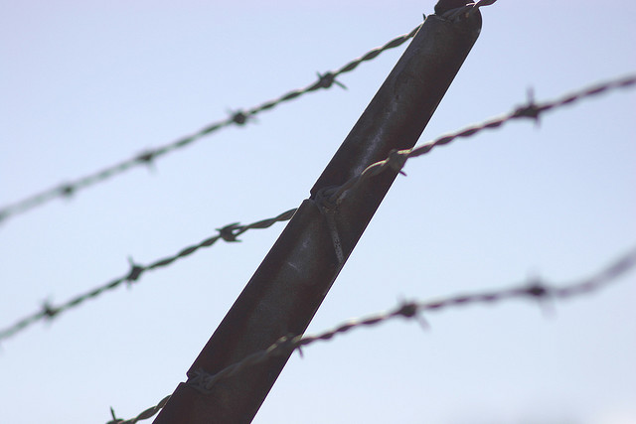
"evidence is used as a weapon"
Partridge, Edwards, & Thorpe (2008 & 2010)
Notes:
Image: cc License Some rights reserved by grendelkhan

Slide 17
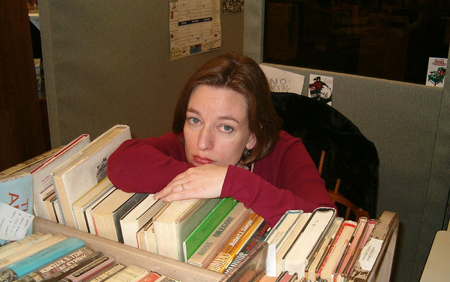
Importance of the work environment
Notes:
Image cc License Some rights reserved by Grace Fell

Slide 18
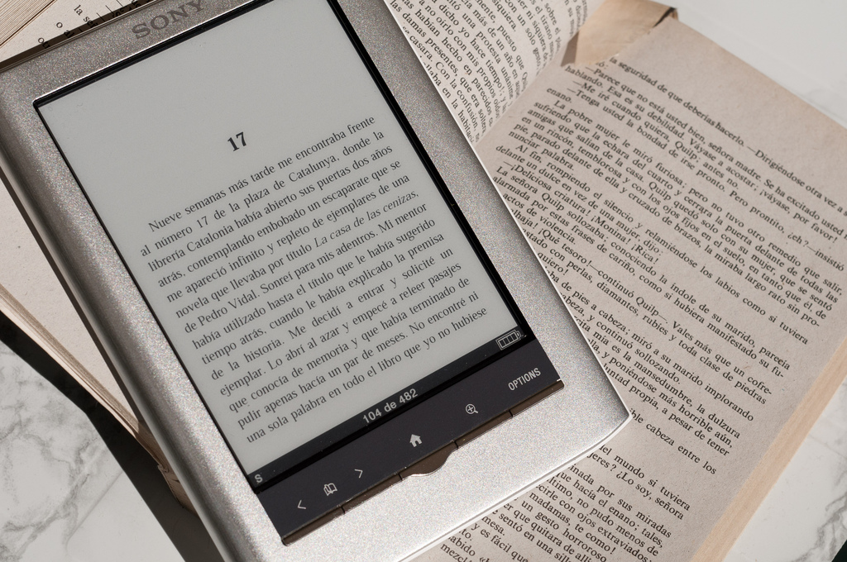
Bias
Notes:
Flickr image cc luipermom

Slide 19
An amended model (based on Booth, 2009)
Articulate
Assemble
Assess
Agree
Adapt
Notes:
1. Articulate – come to an understanding of the problem and articulate it.
2. Assemble – assemble evidence from multiple sources that are most appropriate to the problem at hand.
3. Assess – place the evidence against all components of the wider overarching problem. Assess the evidence for its quantity and quality.
4. Agree – determine the best way forward and if working with a group, try to achieve consensus based on the evidence and organizational goals.
5. Adapt –revisit goals and needs. Reflect on the success of the implementation

Slide 20
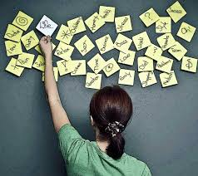
Articulate
Notes:
Asking questions
Getting to the heart of the matter
Understanding what you are trying to do
Coming to a common understanding
Image: CC by Crispin Blackall (Flickr)

Slide 21
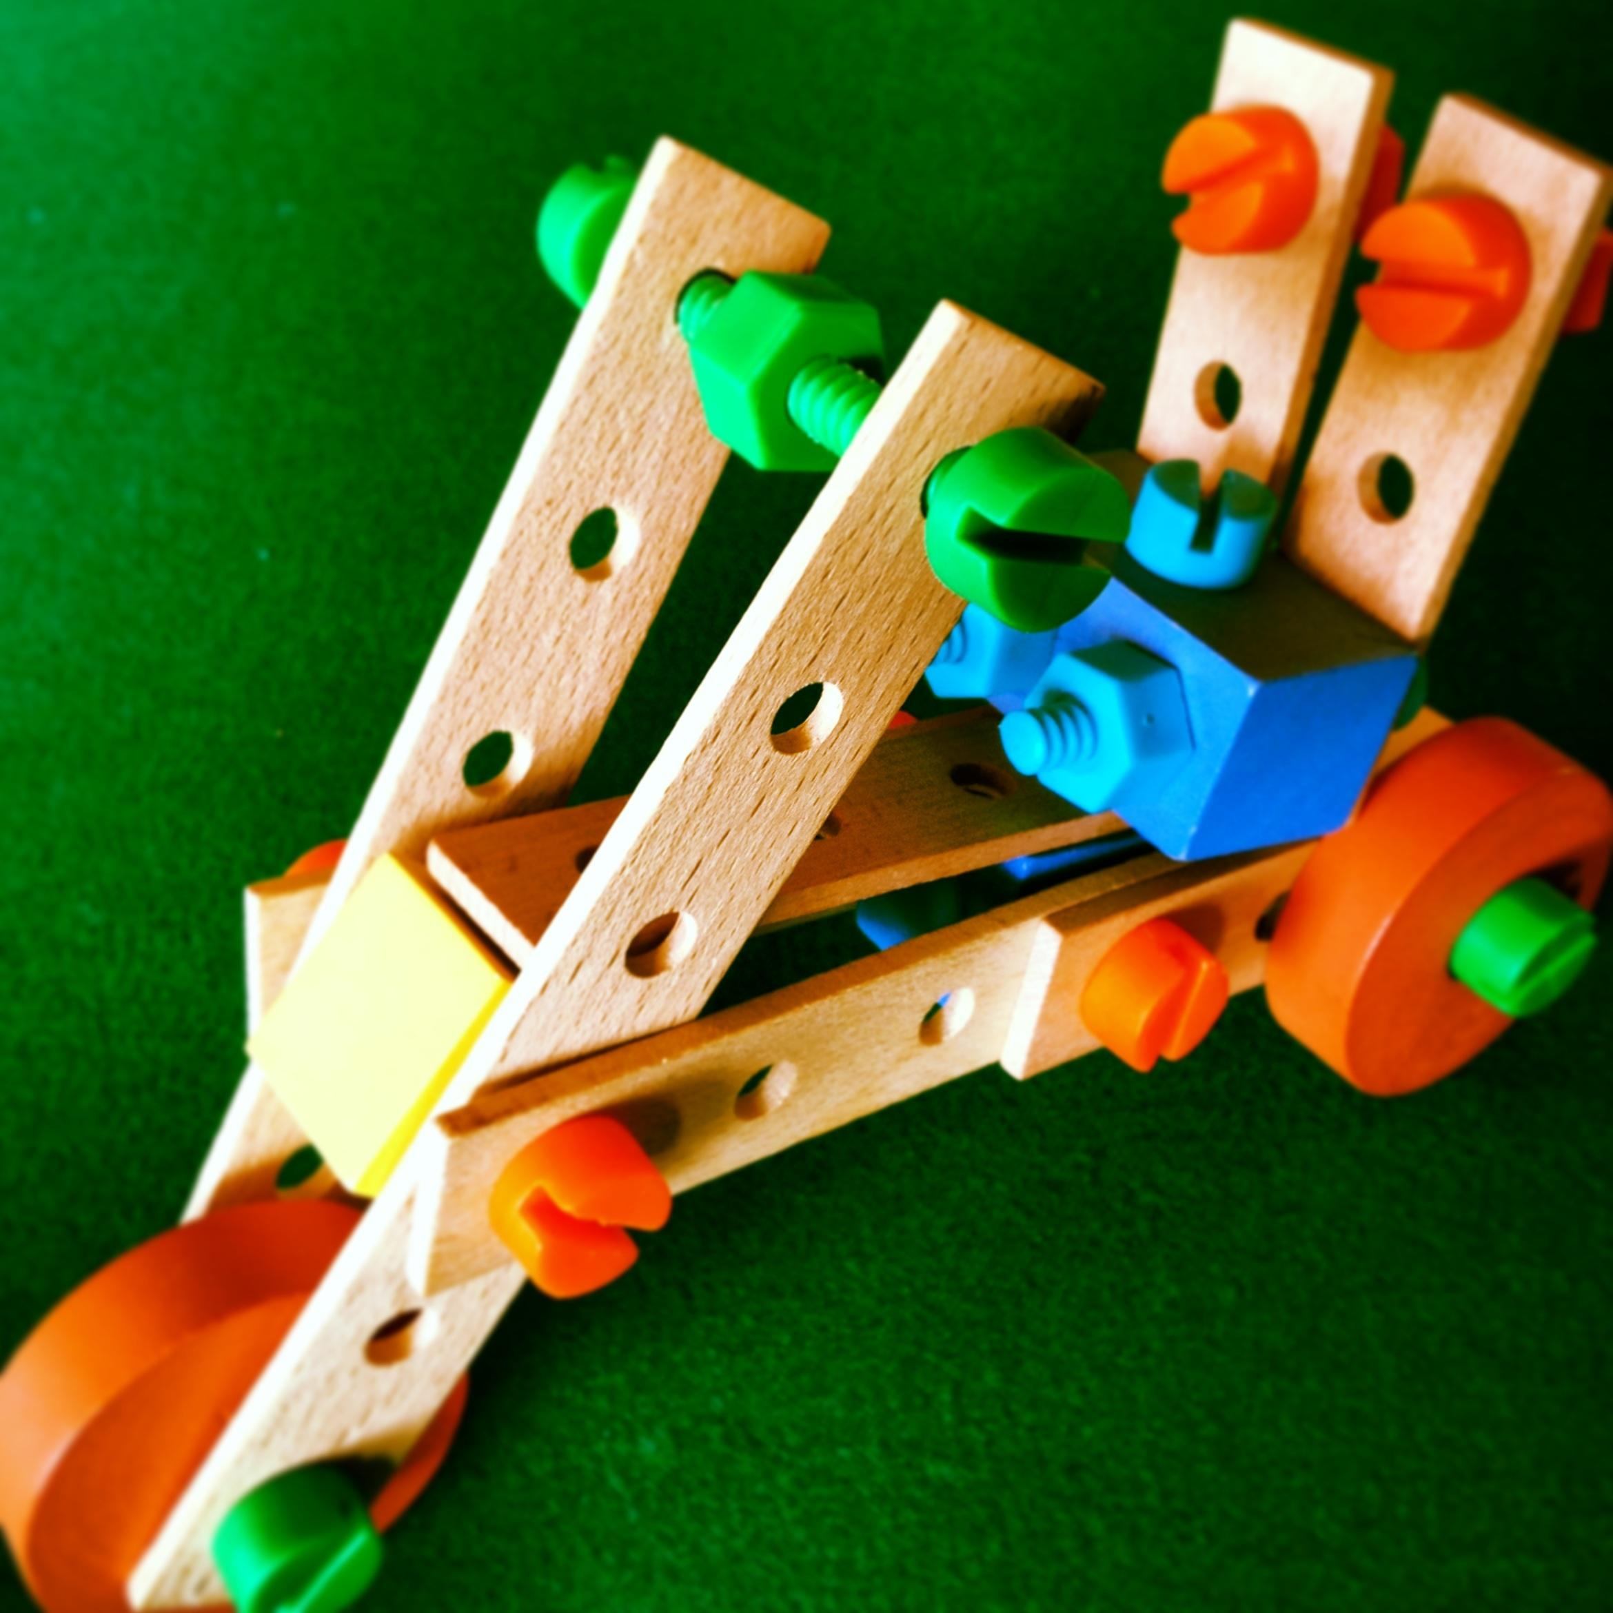
Assemble
Notes:
Gathering evidence
What is most appropriate to help answer the question?

Slide 22


Systematic reviews
http://lis-systematic-reviews.wikispaces.com
Evidence summaries
http://ejournals.library.ualberta.ca/index.php/EBLIP
Notes:
Organized by domain and by author
This site documents all the known systematic reviews in library and information studies (LIS). The purpose of gathering LIS systematic reviews is to provide librarians and other information professionals with a central place to locate this information. Systematic reviews provide practitioners with an assessment of research on a particular topic, up to the point in time when the systematic review was published.
Included LIS systematic reviews meet at least one of the following criteria:
1. Published in a library journal
2. Authored by an LIS lead author
3. Affiliated with a Library or Information Unit or Academic Library or Information Department
4. Include studies conducted in a library setting
5. Include at least 25% of included studies from library journals

Slide 23
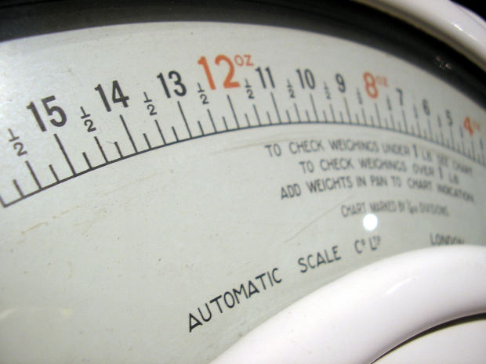
Assess
Notes:
Appraise and weigh the evidence sources you have
What are you missing? What do you still need?
Weigh up the evidence
Reliable
Valid
Applicable
Checklists help with critical appraisal process
Language is different for interpretive (qualitative) research
Reliability is “the likelihood that this study reports something that is reproducible, as opposed to being a “fluke” or chance.”
Validity is “the extent to which the results are likely to be free from bias”.
Applicability, which is: “the extent to which the results are likely to impact on practice”

Slide 24
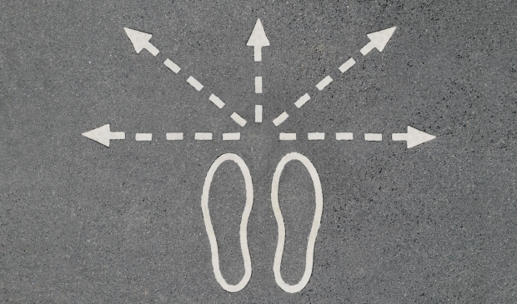
Agree
Notes:
The hard part!
Make a decision/build consensus
Variables that influence this – ideal vs reality
Soft sources often come into play here

Slide 25
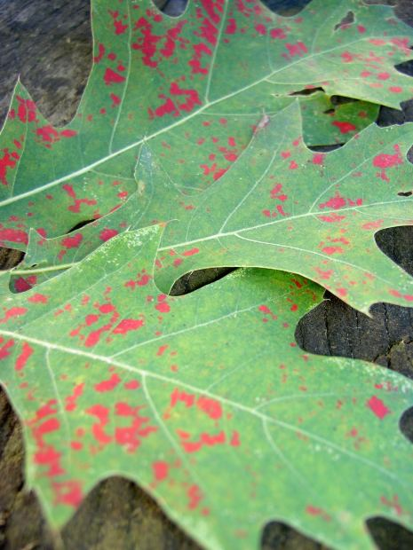
Adapt
Notes:
Implement, monitor, change as required
Start again!

Slide 26

Key questions an EB practitioner should ask themselves
What do I already know?
What local evidence is available?
What does the literature say?
What other information do I need to gather?
How does the information I have apply to my context?
What worked? What didn’t? What did I learn?
Make a decision

Slide 27
Bringing the components together
Research Evidence
Professional knowledge
Local evidence

Slide 28
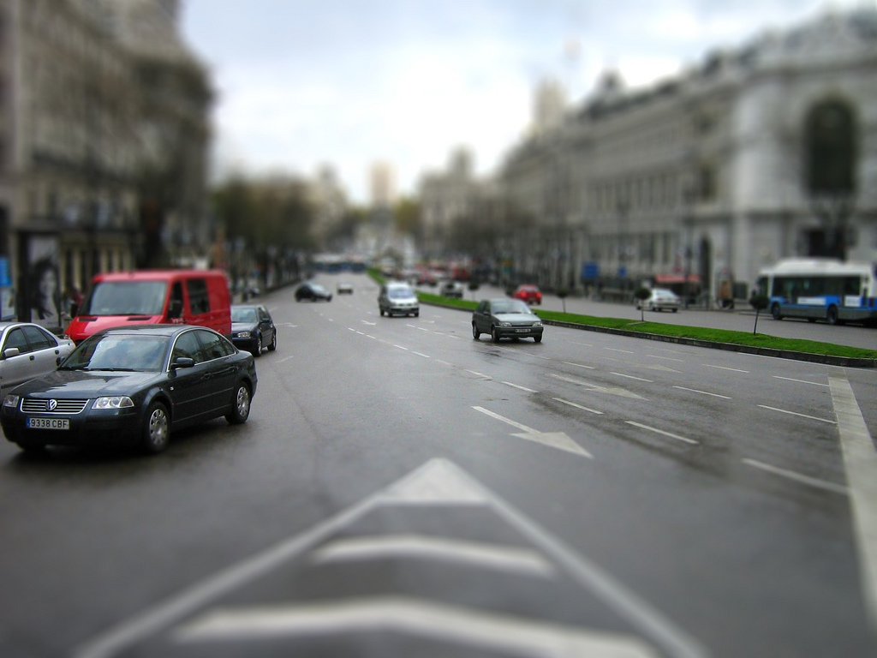
Determinants of evidence use
Organizational dynamics
Time
Personal outlook
Education and training
Information needs
Notes:
Flickr image cc Bjorn Gresenbauer

Slide 29
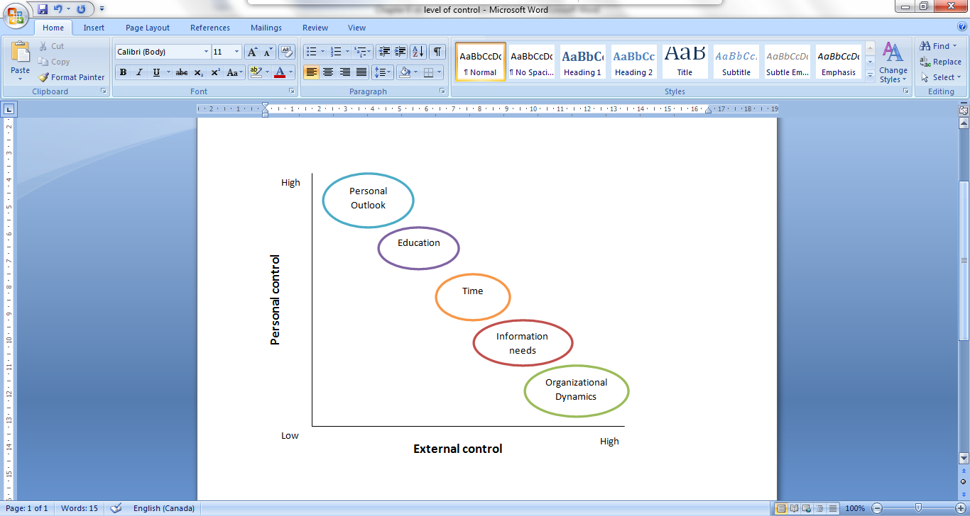
Determinants by level of control
Notes:
From PhD
Tie back to barriers that are personal/organizational from the beginning of the course

Slide 30
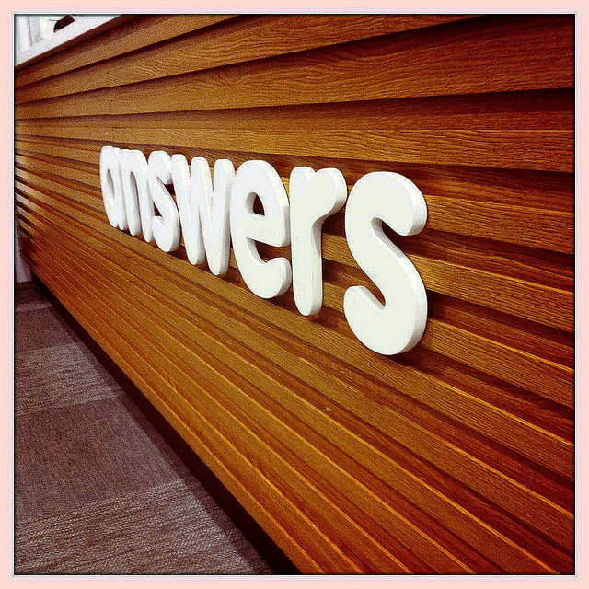
evidence helps us find answers
- we get there by questioning
- we get there by testing
- we get there by making mistakes
Notes:
Image License Some rights reserved by cavale

Slide 31
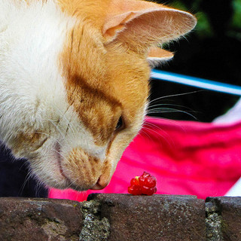
    EBLIP is a mindset
Notes:
Flickr Image cc wHaTEvEr

Slide 32
“Wisdom means acting with knowledge while doubting what you know.”
Jeffrey Pfeffer & Robert I. Sutton

Slide 33
For more detail (articles are open access):
Koufogiannakis, D. (2012). Academic librarians’ conception and use of evidence sources in practice. Evidence Based Library and Information Practice, 7(4), 5-24.
Koufogiannakis, D. (2013). Academic librarians use evidence for convincing: A qualitative study. SAGE Open, 3: 2158244013490708.
Koufogiannakis, D. (in press) Determinants of evidence use in academic librarian decision making. College & Research Libraries. Pre-print: http://crl.acrl.org/content/early/2014/01/17/crl13-570.short?rss=1

Slide 34
References
Booth, A. (2000, July). Librarian heal thyself: Evidence based librarianship, useful, practical, desirable? 8th International Congress on Medical Librarianship, London, UK.
Booth, A. (2009). EBLIP five-point-zero: Towards a collaborative model of evidence-based practice. Health Information and Libraries Journal, 26(4), 341-344.
Hayward, R. S. (2007). Evidence-based information cycle. Centre for Health Evidence. Retrieved 9 Nov. 2011 from http://www.cche.net/info.asp
Partridge, H., Edwards, S., & Thorpe, C. (2010). Evidence-based practice : Information professionals’ experience of information literacy in the workplace. In A. Lloyd, & S. Talja (Eds.). Practising information literacy: Bringing theories of learning, practice and information literacy together. Wagga Wagga, NSW: Charles Sturt University.
Schrum, D. (2011). Classifying forms and combinations of evidence: Necessary in a science of evidence. In P. Dawid, W. Twining, & M. Vasilaki (Eds.). Evidence, inference and enquiry. (pp. 11-36). Oxford: Oxford University Press.
Thorpe, C., Partridge, H., & Edwards, S. L. (2008). Are library and information professionals ready for evidence based practice? Paper presented at the ALIA Biennial Conference: Dreaming08, Alice Springs, Australia. Retrieved 20 Nov 2011 from http://conferences.alia.org.au/alia2008/papers/pdfs/309.pdf

