Slide 1
Chapter 6:
Comparison Methods Part 2

Slide 2
Table of Contents
The Internal Rate of Return (IRR)
  IRR Comparisons for Independent Projects
  Incremental IRR
  IRR Comparisons for Mutually Exclusive Projects
  External Rate of Return Methods
  When to Use the ERR
Rate of Return
  Equivalence of Rate of Return and PW/AW Methods
Levelized Cost
Why Choose One Method Over the Other?

Slide 3
Introduction
Chapter 5 explained how to categorize projects as independent or mutually exclusive and introduced evaluation methods like present worth, annual worth, and payback period.
The chapter now focuses on comparing projects using the internal rate of return (IRR) method, which is commonly used in practice.

Slide 4
The Internal Rate of Return (IRR)
Investments are made with the expectation of earning money in the future.
We measure the return from an investment as a rate, like an interest rate.
The rate of return usually calculated for a project is called the Internal Rate of Return (IRR).
"Internal" means it only considers the cash flows related to the investment, not external factors.

Slide 5
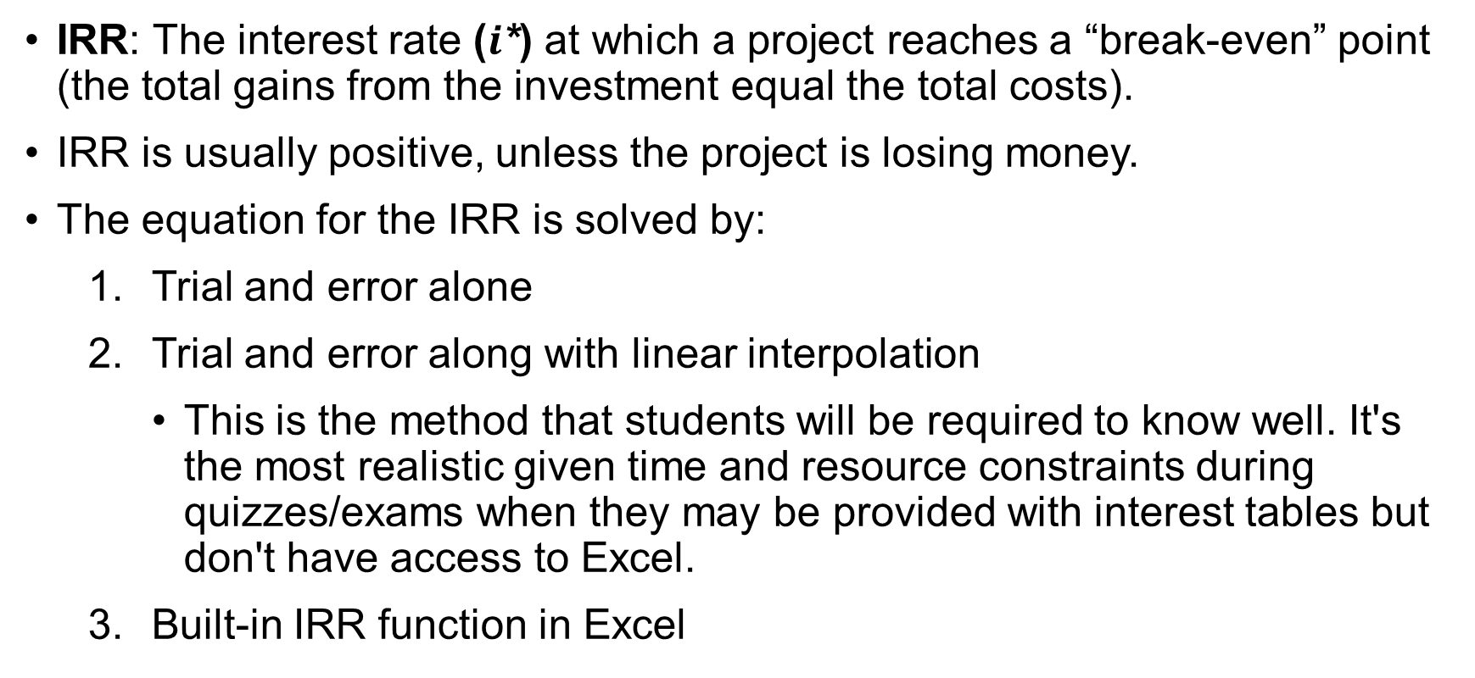
The Internal Rate of Return (IRR)
IRR: The interest rate ($i$*) at which a project reaches a “break-even” point (the total gains from the investment equal the total costs).
IRR is usually positive, unless the project is losing money.
The equation for the IRR is solved by:
  Trial and error alone
  Trial and error along with linear interpolation
    This is the method that students will be required to know well. It's the most realistic given time and resource constraints during quizzes/exams when they may be provided with interest tables but don't have access to Excel.
  Built-in IRR function in Excel

Slide 6

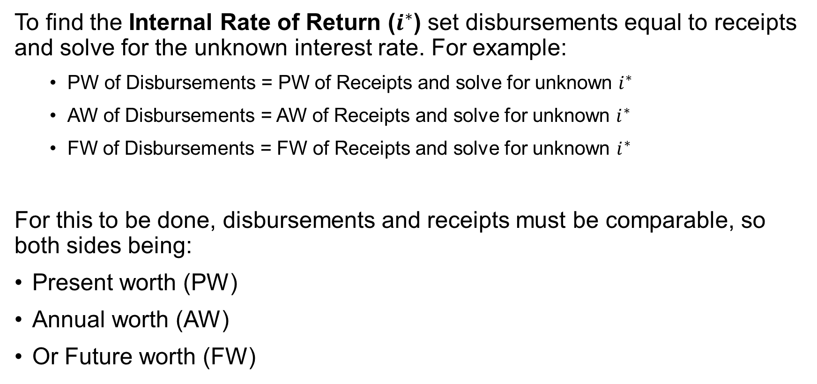
The Internal Rate of Return (IRR)
To find the Internal Rate of Return ($i^{∗}$) set disbursements equal to receipts and solve for the unknown interest rate. For example:
  PW of Disbursements = PW of Receipts and solve for unknown $i^{∗}$
  AW of Disbursements = AW of Receipts and solve for unknown $i^{∗}$
  FW of Disbursements = FW of Receipts and solve for unknown $i^{∗}$
For this to be done, disbursements and receipts must be comparable, so both sides being:
Present worth (PW)
Annual worth (AW)
Or Future worth (FW)

Slide 7
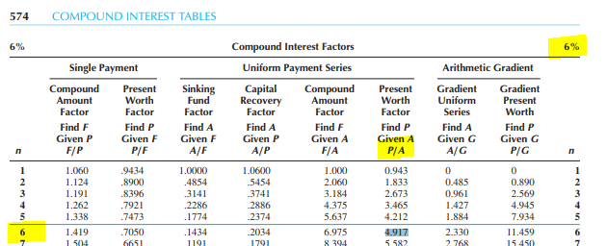
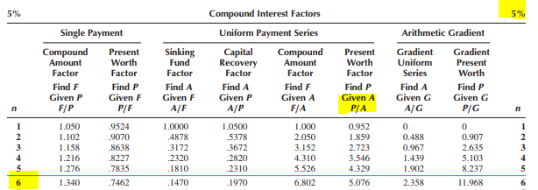
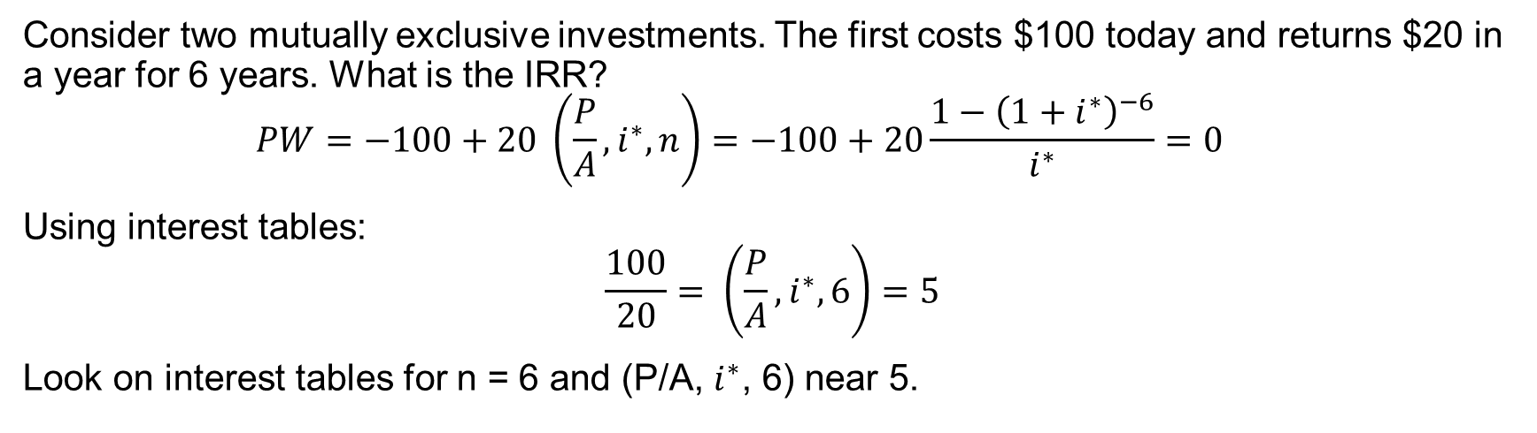
IRR Example
Consider two mutually exclusive investments. The first costs $100 today and returns $20 in a year for 6 years. What is the IRR?
  $$PW=−100+20 \left(\frac{P}{A}, i^{∗}, n\right)=−100+20\frac{1−{\left(1+i^{∗}\right)}^{−6}}{i^{∗}}=0$$
Using interest tables:
$$\frac{100}{20}= \left(\frac{P}{A}, i^{∗}, 6\right)=5$$
Look on interest tables for n = 6 and (P/A, $i^{∗}$, 6) near 5.

Slide 8
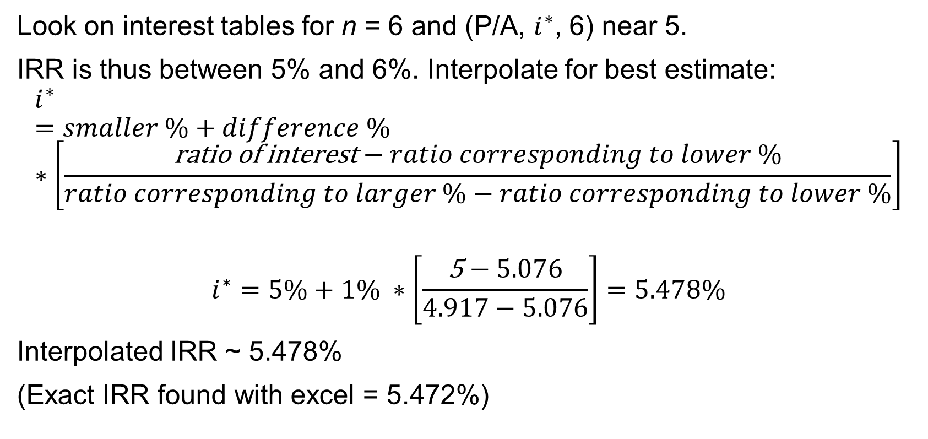
Example (cont’d)
Look on interest tables for n = 6 and (P/A, $i^{∗}$, 6) near 5.
IRR is thus between 5% and 6%. Interpolate for best estimate:
$$i^{∗}=smaller \%+difference \% ∗\left[\frac{\text{ratio} \text{of} \text{interest}−ratio corresponding to lower \%}{ratio corresponding to larger \%−ratio corresponding to lower \%}\right]$$
$$i^{∗}=5\%+1\% ∗\left[\frac{\text{5}−5.076}{4.917−5.076}\right]=5.478\%$$
Interpolated IRR ~ 5.478%
(Exact IRR found with excel = 5.472%)

Slide 9
The IRR Rule for Independent Projects
The internal rate of return rule states that a project or investment should be pursued if its IRR is greater than the minimum required rate of return (MARR). The IRR Rule helps companies decide whether or not to proceed with a project.
A project has: IRR = 2.8% and MARR = 8%
Should the investment be made?
No, because the IRR (2.8%) is lower than the MARR (8%).

Slide 10
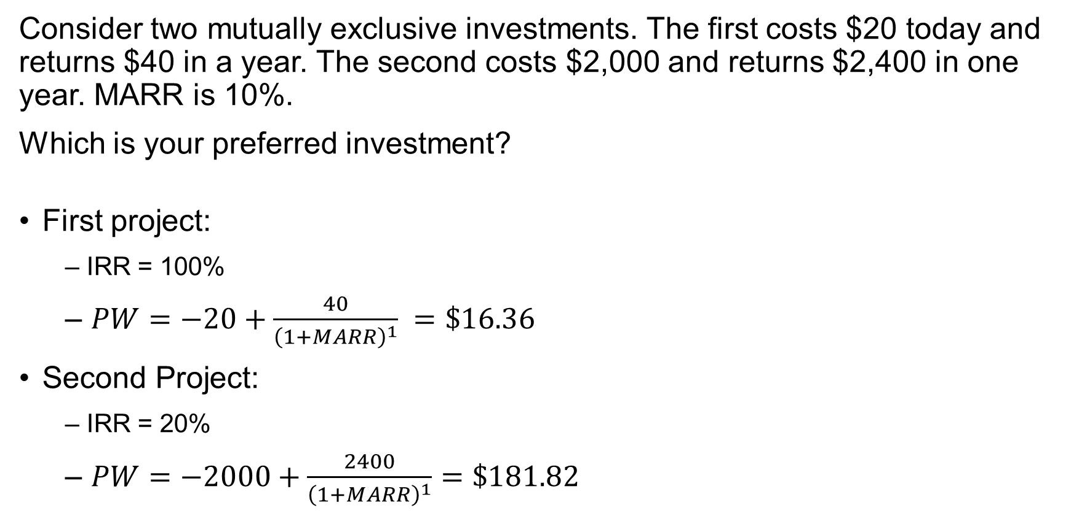
IRR vs PW Choice Example
Consider two mutually exclusive investments. The first costs $20 today and returns $40 in a year. The second costs $2,000 and returns $2,400 in one year. MARR is 10%.
Which is your preferred investment?
First project:
  – IRR = 100%
  – $PW=−20+\frac{40}{{\left(1+MARR\right)}^{1}} =\$16.36$
Second Project:
  – IRR = 20%
  – $PW=−2000+\frac{2400}{{\left(1+MARR\right)}^{1}}=\$181.82$

Slide 11
Explanation of Example
The first project has a higher IRR than the second, but the second has a higher Present Worth (PW).
When projects are mutually exclusive, there is a temptation to pick the one with the higher IRR.
However, solely focusing on IRR is incorrect because it neglects the magnitude of the return. It's essential to consider the magnitude of the return, not just the IRR.
Only considering IRR may lead to overlooking projects where IRR > MARR.
  These projects could then have a higher Present Worth (PW) due to the magnitude of their return.

Slide 12
IRR Comparisons for Mutually Exclusive Projects
For mutually exclusive projects, the analysis gets a bit more complex.
Project Evaluation Process
  Sort projects by first costs (lowest to highest). Call this lowest first cost the current best.
  Calculate IRR for the lowest-cost project. If it is greater than or equal to the MARR, this project remains the "current best candidate."
  Challenge the "current best candidate" by calculating the Incremental IRR between the next ranked project and the current best.
  If the Incremental IRR is greater than or equal to the MARR, replace the "current best candidate" with the challenging project.
    It is only worth spending additional money on a higher cost project if the additional investment has an IRR greater than the MARR.
  Repeat Step 3 and Step 4 for the remaining projects in the ranked list until there are no further challengers, ensuring that the chosen project at each step meets the IRR ≥ MARR condition.

Slide 13
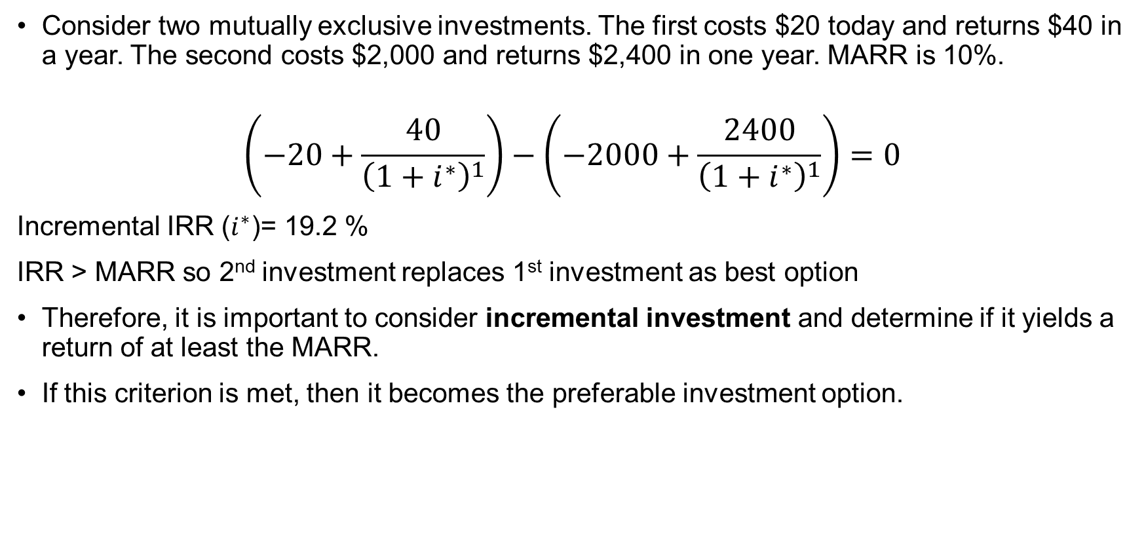
The Incremental IRR…
Consider two mutually exclusive investments. The first costs $20 today and returns $40 in a year. The second costs $2,000 and returns $2,400 in one year. MARR is 10%.
$$\left(−20+\frac{40}{{\left(1+i^{∗}\right)}^{1}}\right)−\left(−2000+\frac{2400}{{\left(1+i^{∗}\right)}^{1}}\right)=0$$
Incremental IRR ($i^{∗}$)= 19.2 %
IRR > MARR so 2nd investment replaces 1st investment as best option
Therefore, it is important to consider incremental investment and determine if it yields a return of at least the MARR.
If this criterion is met, then it becomes the preferable investment option.

Slide 14

Finding Incremental IRR
Rearranging the formula:
The${ i}^{∗ }$for which ${(Initial Cost}_{1}−{Savings}_{1})−({Initial Cost}_{2}−{Savings}_{2})=0$
OR ${(Initial Cost}_{2}−{Initial Cost}_{1})=({Savings}_{2}−{Savings}_{1})$
Notes:
Incremental IRR (Internal Rate of Return) is a financial metric used to evaluate the potential return of a project or investment when compared to an existing project or investment. It measures the additional return that a new project or investment would generate compared to an existing one. The notation for incremental IRR typically involves the use of subscripts or additional variables to distinguish it from the regular IRR.
Here's a common notation for incremental IRR:
IRR_i or IRR_new: This notation represents the incremental IRR for the new project or investment being considered. It is the internal rate of return for the new project or the additional investment.
IRR_base or IRR_existing: This notation represents the IRR of the existing or base project or investment. It is the internal rate of return for the current project or investment that you are comparing the new one to.
To calculate the incremental IRR, you would subtract the IRR_base from the IRR_new:
Incremental IRR = IRR_new - IRR_base
The incremental IRR helps you assess whether the new project or investment is worth pursuing based on the additional return it offers compared to the existing one. If the incremental IRR is greater than a specified hurdle rate or cost of capital, it may be considered a financially attractive opportunity.

Slide 15
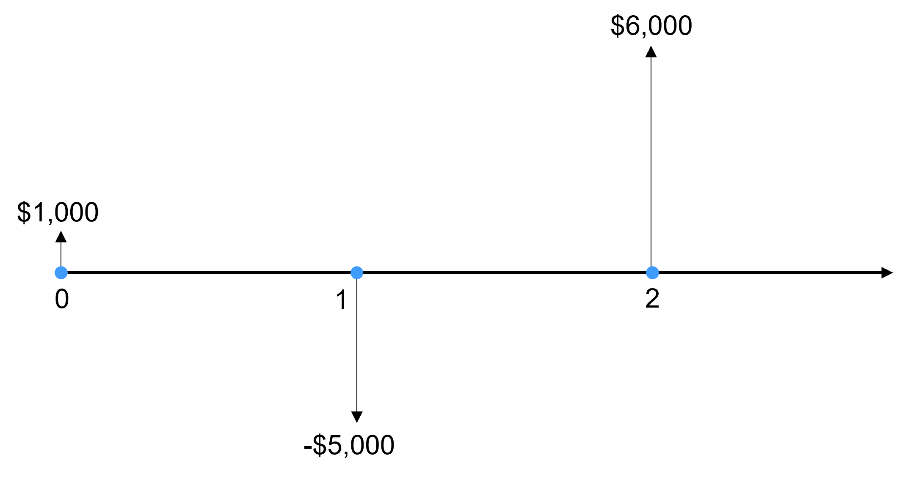

Multiple IRRs Example
A challenge when applying the IRR method is there may be more than one IRR.
Consider a project that pays $2,000 today, incurs a cost of $7,000 one year from now, and pays $6,000 in two years. What is the IRR?
Solve for $i^{∗}$ in:
$$2000−7000+6000=0$$
$2−\frac{7}{1+i^{∗}}+\frac{6}{{\left(1+i^{∗}\right)}^{2}}=0$
${{2i}^{∗}}^{2}−3i^{∗}+1=0$
2$\left(i^{∗}−1\right)\left(i^{∗}−0.5\right)=0$
$6,000
$2,000
-$7,000

Slide 16

Multiple IRRs Example (cont’d)
Illustrated on the graph below, there are two solutions for $i^{∗}$, which are 50% and 100%. This illustrates that an equation can have multiple solutions.

Slide 17
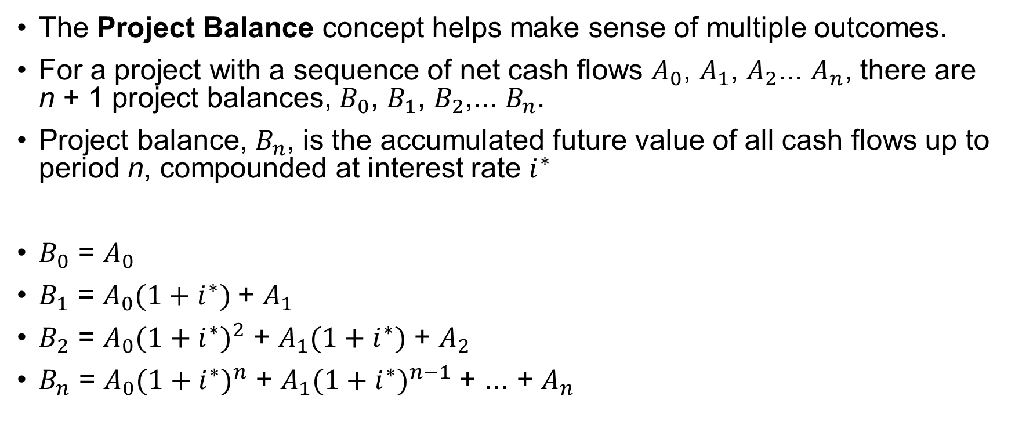
Multiple IRRs Example (cont’d)
The Project Balance concept helps make sense of multiple outcomes.
For a project with a sequence of net cash flows $A_{0}$, $A_{1}$, $A_{2}$... $A_{n}$, there are n + 1 project balances, $B_{0}$, $B_{1}$, $B_{2}$,... $B_{n}$.
Project balance, $B_{n}$, is the accumulated future value of all cash flows up to period n, compounded at interest rate $i^{∗}$
$B_{0}$ = $A_{0}$
$B_{1}$ = $A_{0}(1+i^{∗})$+ $A_{1}$
$B_{2}$ = ${A_{0}(1+i^{∗})}^{2}$ + $A_{1}(1+i^{∗})$ + $A_{2}$
$B_{n}$ = ${A_{0}(1+i^{∗})}^{n}$ + ${A_{1}(1+i^{∗})}^{n−1}$ + ... + $A_{n}$
Notes:
**

Slide 18
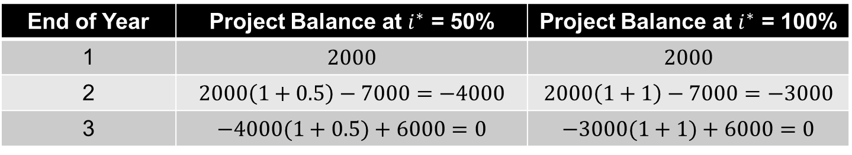
Multiple IRRs Example (cont’d)
Consider the example again but now using Project Balances:
End of Year | Project Balance at $i^{∗}$ = 50% | Project Balance at $i^{∗}$ = 100%
1 | $$2000$$ | $$2000$$
2 | $$2000\left(1+0.5\right)−7000=−4000$$ | $$2000\left(1+1\right)−7000=−3000$$
3 | $$−4000(1+0.5)+6000=0$$ | $$−3000(1+1)+6000=0$$

Slide 19
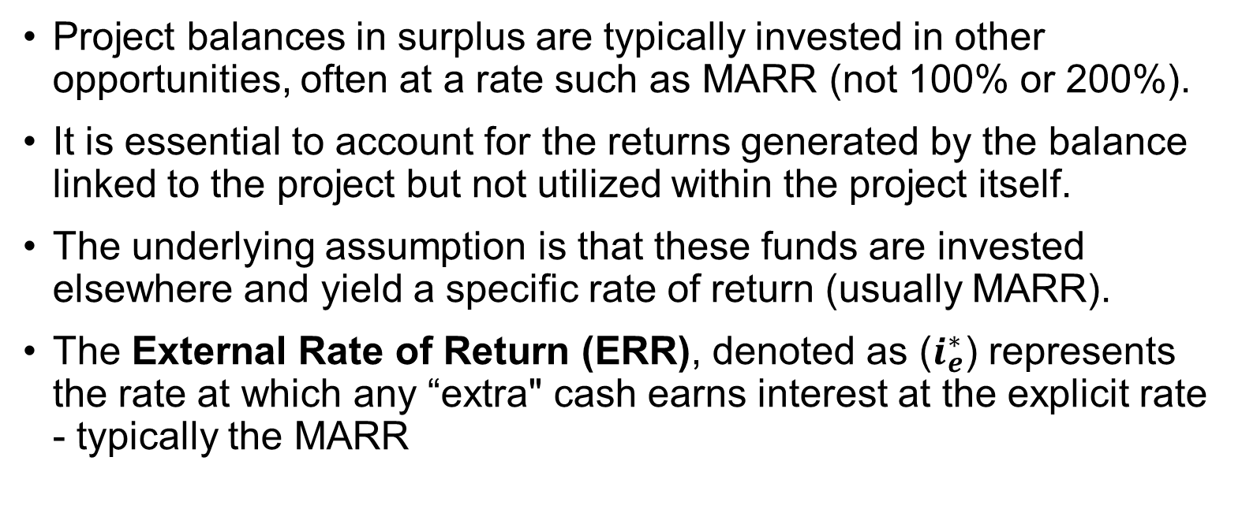
External Rate of Return Method
Project balances in surplus are typically invested in other opportunities, often at a rate such as MARR (not 100% or 200%).
It is essential to account for the returns generated by the balance linked to the project but not utilized within the project itself.
The underlying assumption is that these funds are invested elsewhere and yield a specific rate of return (usually MARR).
The External Rate of Return (ERR), denoted as ($i_{e}^{∗}$) represents the rate at which any “extra" cash earns interest at the explicit rate - typically the MARR

Slide 20
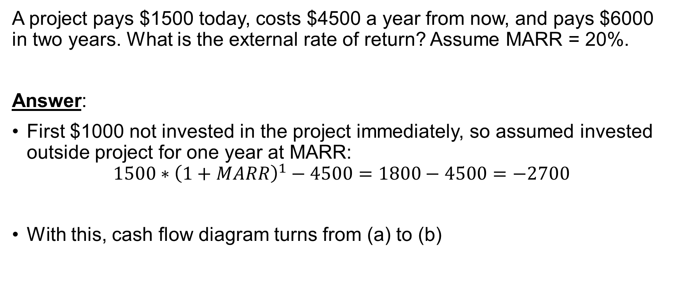
Example
A project pays $1500 today, costs $4500 a year from now, and pays $6000 in two years. What is the external rate of return? Assume MARR = 20%.
Answer:
First $1000 not invested in the project immediately, so assumed invested outside project for one year at MARR:
$$1500∗{\left(1+MARR\right)}^{1}−4500=1800−4500=−2700$$
With this, cash flow diagram turns from (a) to (b)
Notes:
Add Diagram*

Slide 21
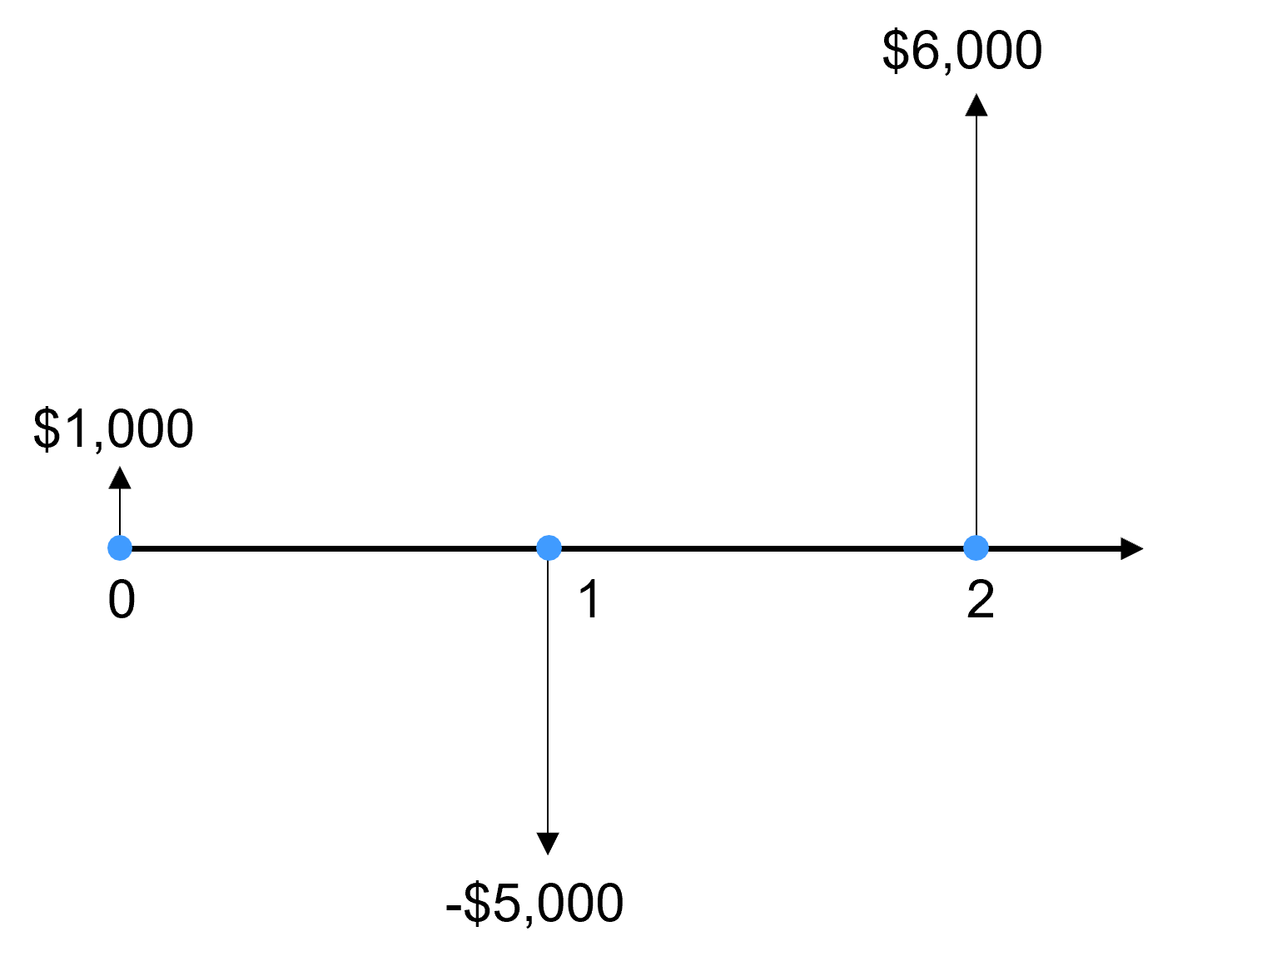
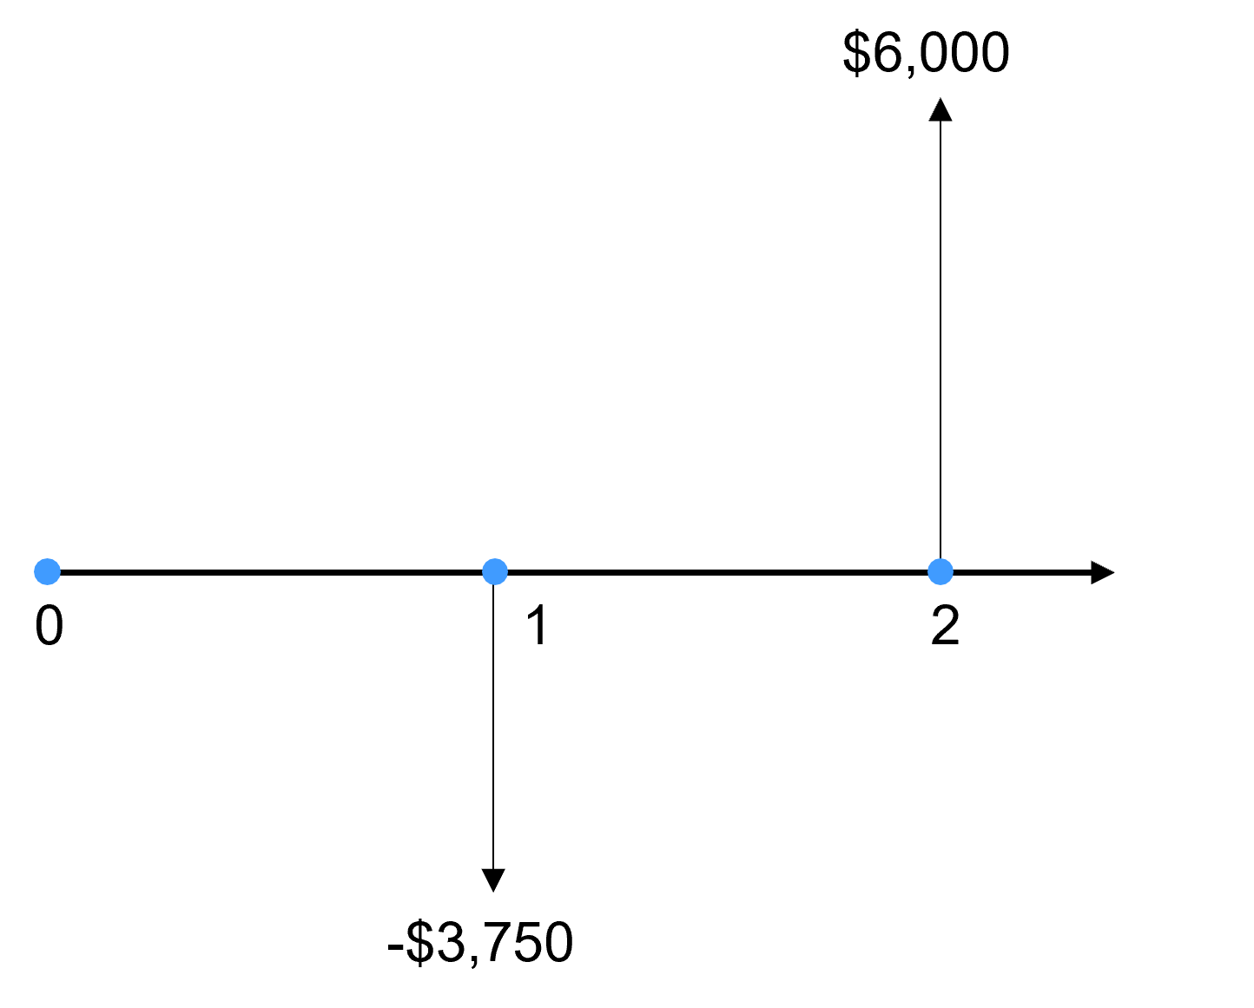
Example (cont’d)
(a)
(b)
$1,500
-$4,500
-$2,700

Slide 22
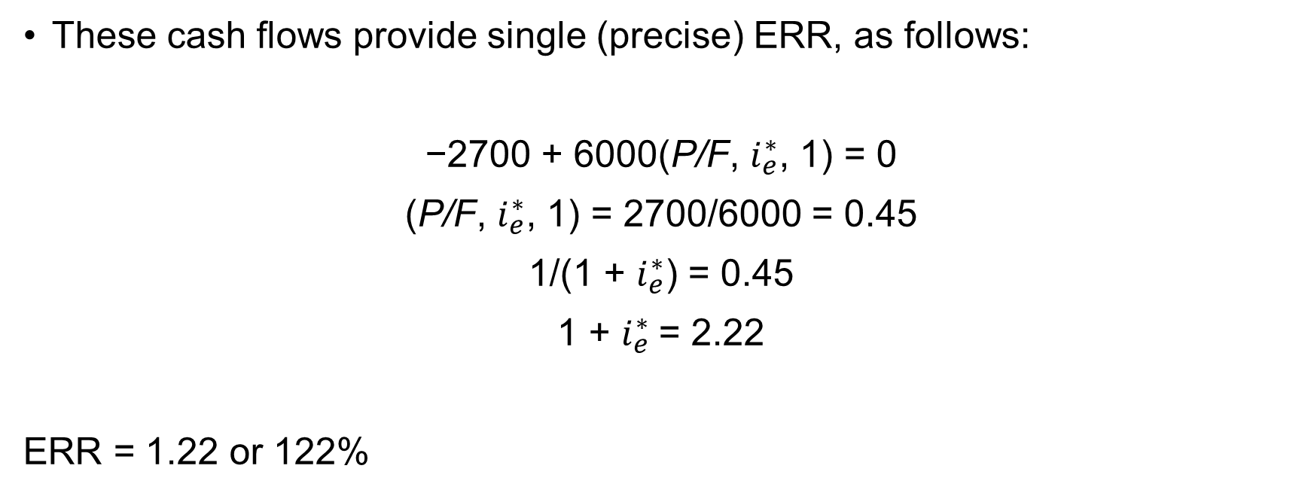
Example (cont’d)
These cash flows provide single (precise) ERR, as follows:
−2700 + 6000(P/F, $i_{e}^{∗}$, 1) = 0
(P/F, $i_{e}^{∗}$, 1) = 2700/6000 = 0.45
1/(1 + $i_{e}^{∗}$) = 0.45
1 + $i_{e}^{∗}$= 2.22
ERR = 1.22 or 122%

Slide 23
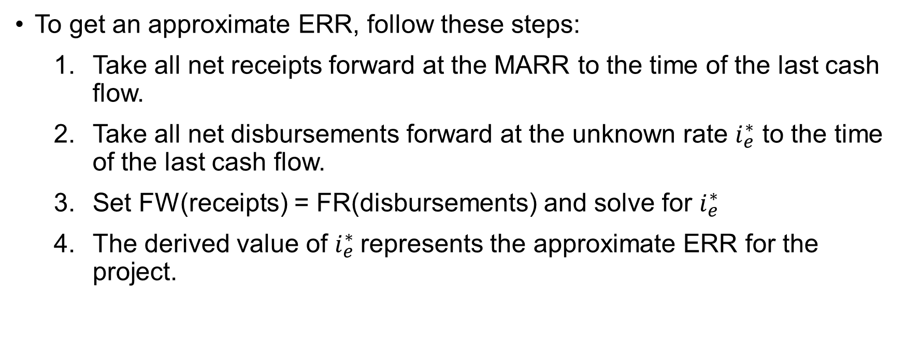
External Rate of Return Methods
To get an approximate ERR, follow these steps:
  Take all net receipts forward at the MARR to the time of the last cash flow.
  Take all net disbursements forward at the unknown rate $i_{e}^{∗}$ to the time of the last cash flow.
  Set FW(receipts) = FR(disbursements) and solve for $i_{e}^{∗}$
  The derived value of $i_{e}^{∗}$represents the approximate ERR for the project.

Slide 24
When to Use the ERR
The ERR method is suitable when dealing with situations involving multiple possible IRRs.
Predicting in advance whether multiple IRRs exist can be challenging.
However, most investments are straightforward, with just one positive IRR.
A simple investment involves periods of cash outflows followed by periods of cash inflows.
If a project does not fit this simple investment pattern, it may have more than one IRR.

Slide 25
When to Use the ERR
The number of times the sign of successive cash flows changes can indicate the presence of X number of IRRs.
Multiple IRRs might be evident when plotting PW (or AW, FW) against interest rates.
If the plot does not reveal the multiple IRRs, a more intricate method becomes necessary.
Employing the approximate ERR for decision-making yields consistent results with exact ERR and PW methods, helping decide whether to invest or not.

Slide 26
Equivalence of Rate of Return and
Present/Annual Worth Methods
When comparing Rate of Return and PW/AW methods, we notice these significant observations:
  When correctly applied, both sets of methods result in the same decision.
  Each set of methods possesses its own merits and drawbacks.
  In the case of an independent project with a distinct IRR, the IRR method and the PW method yield identical decisions.

Slide 27
Levelized Cost
Levelized cost: a method used to determine the minimum selling price of a product that ensures the MARR.
The levelized cost is then compared to the market value of the product.
PW(revenues) - PW(costs) + PW(salvage) = 0

Slide 28
When to Use Which Method?
Method | Advantages | Disadvantages
IRR | Facilitates comparisons among projects of varying sizes Commonly used | Relatively challenging to compute May result in multiple IRRs
Present (or Future) Worth | Provides an explicit measure of profit contribution | Difficult to compare projects of different sizes
Annual Worth | Decision-makers may find annual cash flows familiar, making it easier to understand | Difficult to compare projects of different sizes
Payback Period | Very easy to calculate Commonly used Considers the need to have capital recovered quickly. | Discriminates against long-term projects. Ignores the time value of money and expected service life.
Levelized Cost | Provides the minimum selling price required to justify an investment. | Not suitable for project comparisons

Slide 29
Creative Commons: CC BY-NC-SA 4.0
The contents of these slides are protected by the licence:
Creative Commons Attribution-NonCommercial-ShareAlike 4.0 International
Attribution: Engineering Economics Textbook Replacement Teaching Materials © 2024 by Tamara R. Etmannski is licensed under CC BY-NC-SA 4.0

