Slide 1
Chapter 1
Intro to Engineering Decision Making

Slide 2
Table of Contents
Engineering Decision Making
What is Engineering Economics?
Making Decisions
Approaching Abstractions
How is This Course Organized?

Slide 3
Engineering Decision Making
Identifying the most economically advantageous option: While early engineers focused mainly on technical aspects, modern engineering decision-making incorporates financial, environmental, and political factors.
Economic awareness is crucial for engineers as engineering projects depend on the use of resources like raw materials, money, labor, and time.
Engineers must be able to evaluate various technically viable alternatives.

Slide 4
What is Engineering Economics?
Engineering economics: a scientific discipline that focuses on quantitative analysis techniques used to choose the most favorable option among several technically viable alternatives.
Engineering economics plays a crucial role in evaluating the suitability of a project, estimating its value, and providing engineering justification for its implementation.

Slide 5
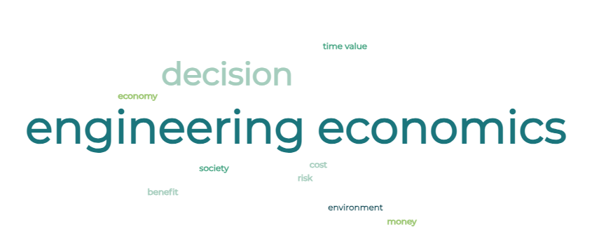
What is Engineering Economics?

Slide 6
Making Decisions
Decisions are based on beliefs, but facts should form the foundation of those beliefs. (Decision Pyramid, Figure 1.1).
Economic analysis examines the facts: the information on the costs and benefits of a project.
Although decisions may be influenced by preferences, politics, and people, economic analysis establishes the factual foundation for decision-making.
Ideally, these facts should have the ability to influence politics, people, and preferences.

Slide 7
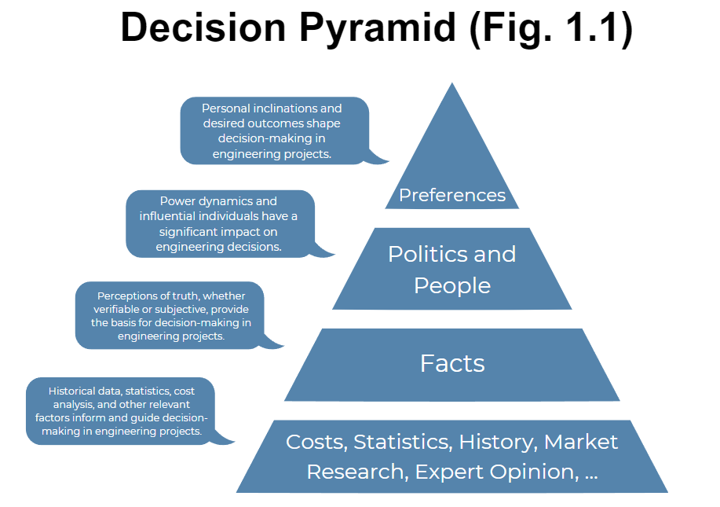
Making Decisions
Decisions are based on beliefs, but facts should form the foundation of those beliefs.

Slide 8
Approaching Abstractions
Model: a simplified representation of reality that shows relevant and useful information for a specific purpose.
Models are used to analyze situations and make predictions about the real world.
Projects are often represented through Engineering Economic Models, which provide estimates of their costs and benefits over time.

Slide 9
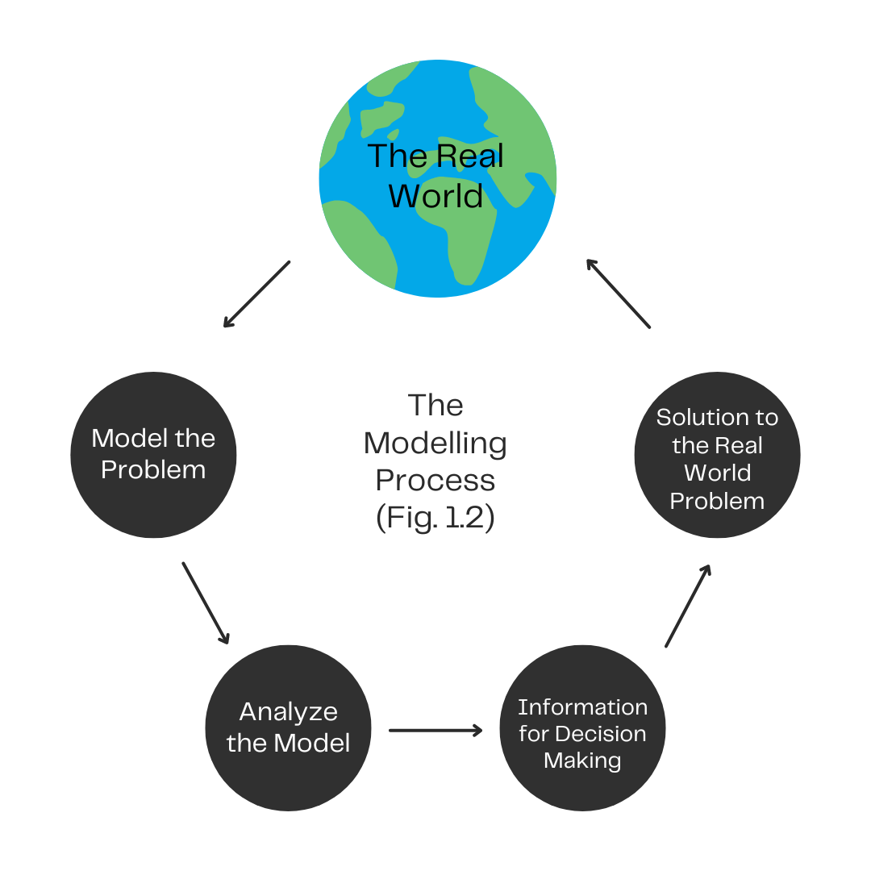
Approaching Abstractions
Figure 1.2 demonstrates the fundamental modeling process that is widely applicable to human activities, particularly in engineering.

Slide 10
Creative Commons: CC BY-NC-SA 4.0
The contents of these slides are protected by the licence:
Creative Commons Attribution-NonCommercial-ShareAlike 4.0 International
Attribution:
Engineering Economics Textbook Replacement Teaching Materials © 2024 by Tamara R. Etmannski is licensed under CC BY-NC-SA 4.0

