Slide 1
Chapter 12
Financial Accounting

Slide 2
Table of Contents
Balance Sheet
Income Statement
Statement of Cash Flows
Financial Ratio Analysis

Slide 3
Why Learn Accounting?
As an engineer, you may have a set of broad managerial responsibilities that require you to understand financial statements in order to make a project decision
Engineers must understand finance and accounting if they want their projects to be funded
  For an engineer to produce results, estimating costs and predicting the savings and return on investment are critical
The role of engineers is to provide optimal solutions. To do this, engineers must be able to provide a combination of the Ideal/Cost effective solutions to an employer.

Slide 4
What is Accounting?
Financial Accounting is a branch of accounting concerned with the summary, analysis and reporting of financial transactions related to a business
  Includes recording important financial numbers over periods such as revenues, expenses, taxes, etc. for key external stakeholders (investors, creditors, government, industry regulators)
Managerial Accounting is a branch of accounting concerned with costs and benefits of activities of an enterprise
  Helps internal executives make decisions about the future direction of the company and analyze key business decisions
  Engineers often play a part in decisions connected to costs/benefits.
Financial accounting is mainly for external stakeholder use while managerial accounting is strictly for internal stakeholders to make business related decisions

Slide 5
Measuring Performance of a Firm
There are 3 key financial statements used to analyze the financial position of a firm:
Balance Sheet: Reports a company’s assets, liabilities, shareholders equity at a specific point in time
Income Statement: Reports the revenues minus expenses over a period of time
Statement of Cash Flows: summarizes the amounts of cash flowing in and flowing out of a company over a period of time

Slide 6
The Balance Sheet
Every balance sheet has three key aspects:
Assets: Anything a company owns that has financial value (Cash, Equipment, Supplies, etc.)
  Current assets: Can be converted into cash within one year
  Fixed or long-term assets: Would take longer than one year to convert into cash
Liabilities: Debts a company owes (usually to suppliers, creditors, banks, etc.)
  Current liabilities: debts that will be paid within one year
  Long-term liabilities: debts that will be paid in a time frame longer than one year
Owners' Equity: A measurement of what a company is worth (assets – liabilities)
  Share Capital: Value of investors shares
  Retained Earnings: Profits of a business that have not been paid out to shareholders

Slide 7
The Balance Sheet - examples
Current assets
  Cash, accounts receivable, inventory, prepaid insurance…
Fixed or long-term assets
  Plant, property, equipment (PP&E), Accumulated depreciation…
Current liabilities
  Accounts payable, interest payable, unearned revenue…
Long-term liabilities
  Long term debt, mortgages…
Share Capital
  Common Stocks, preferred stocks
Retained Earnings

Slide 8
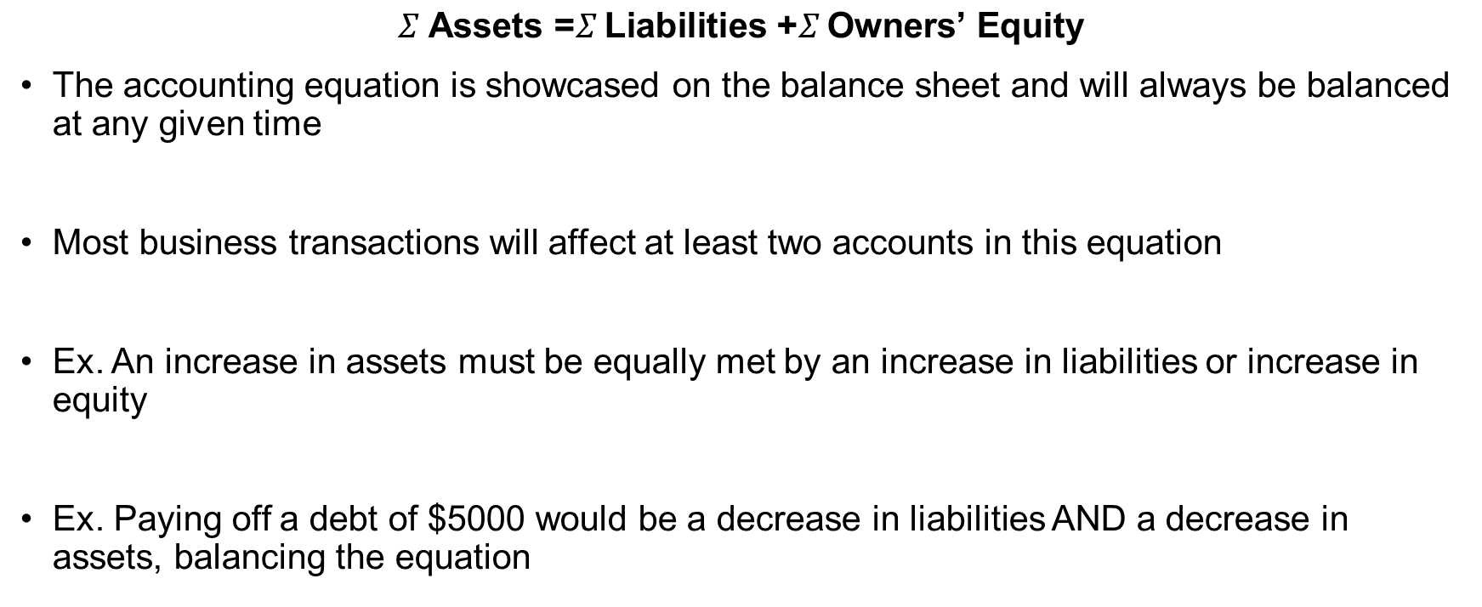
The Accounting Equation
$$Σ \text{Assets}\text{ =}Σ \text{Liabilities}\text{ +}Σ \text{Owners}\text{’ }\text{Equity}$$
The accounting equation is showcased on the balance sheet and will always be balanced at any given time
Most business transactions will affect at least two accounts in this equation
Ex. An increase in assets must be equally met by an increase in liabilities or increase in equity
Ex. Paying off a debt of $5000 would be a decrease in liabilities AND a decrease in assets, balancing the equation

Slide 9
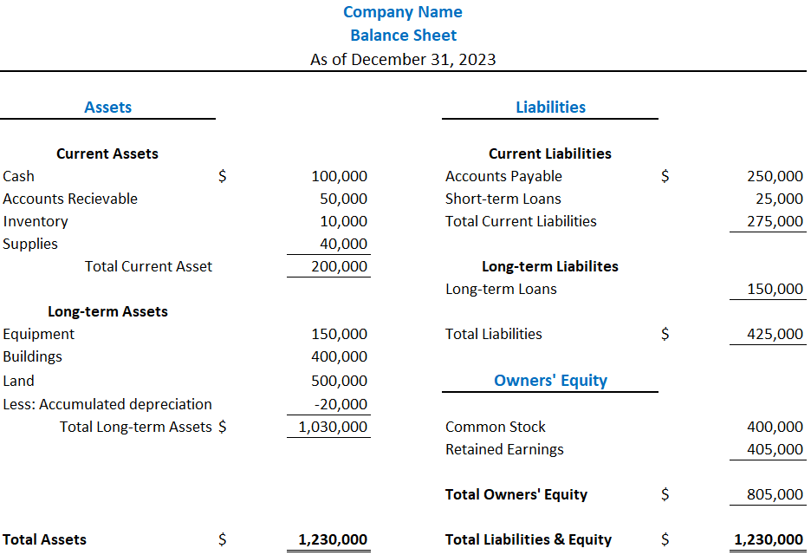
The Balance Sheet Example

Slide 10
The Balance Sheet Example
Balance Sheet will have the name of company and date of the snapshot at the top of the document
Assets will be on the lefthand side: split between current and long-term assets
Liabilities will be on the righthand side: split between current & long-term liabilities
Owners’ Equity will be on the righthand side under liabilities
Total Assets will always equal Total Liabilities + Equity

Slide 11
The Income Statement
The Income Statement: Summarizes revenues and expenses over a specific period of time
Showcases 3 key financial components:
Revenues: Money generated from sales of regular business operations
  An increase in revenue is an increase in owners’ equity & in assets
Expenses: Costs required for regular business operations
  Can include cost of goods sold, rent, insurance, wages, depreciation
  Decreases owners’ equity
Profits: Income before taxes = Total Revenues – Total Expenses
  Income statements will show profits before income before taxes along with Net Income

Slide 12
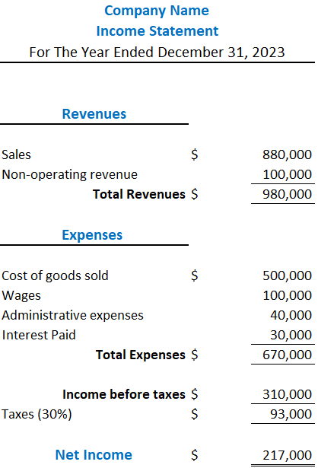
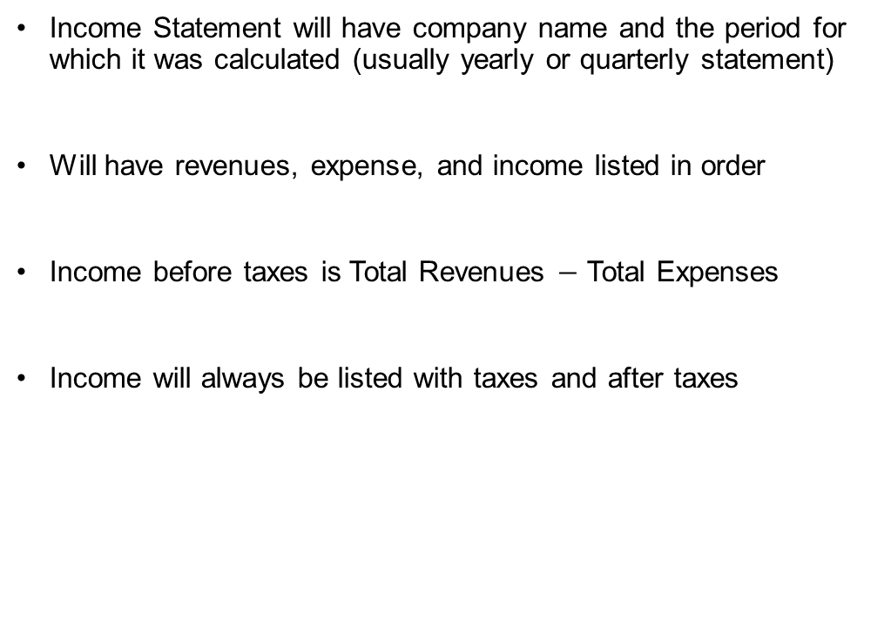
The Income Statement Example
Income Statement will have company name and the period for which it was calculated (usually yearly or quarterly statement)
Will have revenues, expense, and income listed in order
Income before taxes is Total Revenues $−$ Total Expenses
Income will always be listed with taxes and after taxes

Slide 13
Need For Statement of Cash Flows
The statement of cash flows is used to determine whether a company is generating cash
Cash is needed to:
  Pay dividends to shareholders
  Invest in company assets
  Pay employees
  Take advantage of market opportunities
If a company has a positive net income, it does not always imply it has positive cash flows
  Delta Airlines filed for bankruptcy early 2000’s despite being profitable for years preceding bankruptcy
    They were unable to generate enough cash to cover operating costs and interest payments

Slide 14
The Statement of Cash Flows
Statement of Cash Flows: summarizes the amounts of cash flowing in and flowing out of a company
To see changes, cash flow statements classify changes into three main activities:
  Operating
  Investing
  Financing

Slide 15
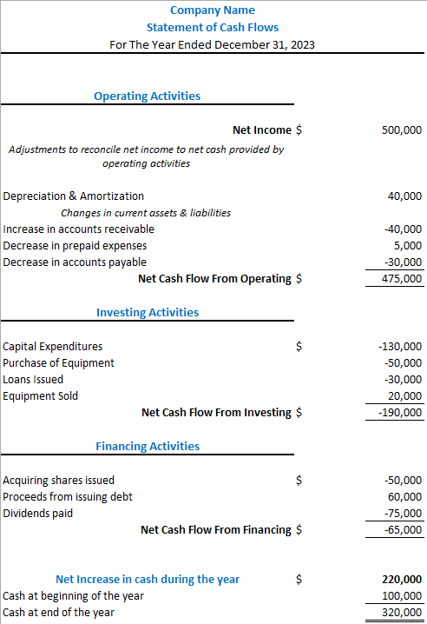
Statement of Cash Flows Example
Statement of Cash Flows will have company name and the period for which it was calculated at the top (usually yearly or quarterly statement)
Three Major Sections: operating activities, investing activities, and financing activities.
Net Cash Flow: Calculation of the net cash flow by summing the cash flows from operating, investing, and financing activities to determine whether the company had a net increase or decrease in cash during the period.

Slide 16
Classification of Cash Flows - Operating
From Operating Activities:
  Shows how much cash is generated by operating activities involved in producing and delivering goods and services
  Starts with net income from the income statement which already includes cash inflows of sales and outflows of cost of goods sold (COGS), wages, taxes, etc.
The main calculation for operating activities is reflecting on transactions that changed balance sheet values but did not change cash
Operating Activities
Net Income |  |  | $ | 500,000
Adjustments to reconcile net income to net cash provided by operating activities
Depreciation & Amortization |  |  |  | 40,000
Changes in current assets & liabilities
Increase in accounts receivable |  |  |  | -40,000
Decrease in prepaid expenses |  |  |  | 5,000
Decrease in accounts payable |  |  |  | -30,000
Net Cash Flow From Operating |  |  | $ | 475,000
Ex. Deprecation affected net income, but did not actually reduce cash, hence why it has a positive cash flow
Ex. An increase in accounts receivable changed net income, but resulted in no increase in cash, hence the reason it has a negative cash flow on this statement

Slide 17
Classification of Cash Flows - Operating
From Operating Activities:
  Net income from Income Statement
  + depreciation expenses
  - Gains, + losses
  - Decrease in liabilities
  + Increase in liabilities
  - Increase in assets
  + Decrease in assets
  ______________________________
  = Cash Flow from Operations

Slide 18
Classification of Cash Flows - Investing
From Investing Activities:
  Represent the cash inflows and outflows related to the acquisition and disposal of long-term assets and investments.
  Cash inflows can include:
    Sale or Disposal of plant assets
    Sale or maturity of investments in debt and equity
    Collection of principal on loans to other entities
  Cash outflows can include:
    Purchase of plant assets
    Purchases of investment in debt or equity
    Offering loans to other entities
Investing Activities
Capital Expenditures | $ | -130,000
Purchase of Equipment |  | -50,000
Loans Issued |  | -30,000
Equipment Sold |  | 20,000
Net Cash Flow From Investing | $ | -190,000

Slide 19
Classification of Cash Flows - Financing
From Financing Activities:
  Related to external sources of financing for the company
  Cash inflows can include:
    Borrowings on notes, bonds, etc. from creditors (debt)
    Issuing shares to shareholders (equity)
  Cash outflows can include:
    Dividend payment to shareholders
    Repayment of principal investment to creditors
    Reacquiring shares and redeeming long-term debt
Financing Activities
Acquiring shares issued | $ | -50,000
Proceeds from issuing debt |  | 60,000
Dividends paid |  | -75,000
Net Cash Flow From Financing | $ | -65,000

Slide 20
Estimations in Financial Statements
Financial statement values are sometimes estimates and may not reflect accurate market values
Assets value can vary:
  Land is listed at the price paid, not market value, meaning it could be worth more or less in the future
  Depreciation on equipment can vary depending on what depreciation model is used
Stock prices are listed at the issued price, meaning they could be worth more or less in the future

Slide 21
Financial Ratios
Key stakeholders need to know how well a company is performing to industry standards in order to make a sound decision
We can use items from all three financial statements to assess the “health” of a company
Financial Ratios are performance indicators that measure how well a company is operating
Note it is not necessary to know all ratios. Many are used for similar reasons and as engineers you may only be required to know certain ratios for specific scenarios

Slide 22
Financial Ratios
Ratio | Description | Equation | Good Indicator
Liquidity Ratios | Measure a company's ability to meet short-term obligations
Current Ratio | Your business's ability to meet its short-term liabilities when they come due | Current Assets / Current Liabilities | Above 1.5
Quick Ratio | Measure of immediate liquidity excluding inventory | (Current Assets – Inventory - Prepaid) / Current Liabilities | Above 1
Solvency Ratios | Evaluate a company's long-term solvency
Debt-to-Equity Ratio | Assesses the relative proportion of debt and equity financing in a company's capital structure | Total Debt / Total Equity | Below 1
Debt Ratio | indicates the extent to which a company's assets are financed by debt | Total Debt / Total Assets | Below 0.5
Interest Coverage Ratio | Measure of a company's ability to cover interest expenses | Operating Income / Interest Expense | Above 3
Profitability Ratios | Measure a company's profitability and returns
Gross Profit Margin | Shows how much profit a company makes from its revenue after accounting for the cost of producing goods or services. | (Revenue - Cost of Goods Sold) / Revenue | Above 30%
Net Profit Margin | indicates the percentage of revenue that remains as profit after deducting all expenses. | Net Income / Revenue | Above 10%
Return on Assets (ROA) | measures the profitability of a company's assets and how effectively they generate income. | Net Income / Average Total Assets | Above 5%
Return on Equity (ROE) | shows the return generated on the investment made by the company's owners or shareholders | Net Income / Average Total Equity | Above 15%
Notes:
1. Liquidity Ratios
Liquidity ratios measure a company's ability to pay off its short-term debts as they become due, using the company's current or quick assets. Liquidity ratios include the current ratio, quick ratio, and working capital ratio.
Working Capital Ratio
Assessing the health of a company in which you want to invest involves measuring its liquidity. The term liquidity refers to how easily a company can turn assets into cash to pay short-term obligations. The working capital ratio can be useful in helping you measure liquidity. It represents a company's ability to pay its current liabilities with its current assets.
Working capital is the difference between a firm’s current assets and current liabilities: current assets - current liabilities = working capital.
The working capital ratio, like working capital, compares current assets to current liabilities and is a metric used to measure liquidity. The working capital ratio is calculated by dividing current assets by current liabilities: current assets / current liabilities = working capital ratio.
Let's say that XYZ company has current assets of $8 million and current liabilities of $4 million. The working capital ratio is 2 ($8 million / $4 million). That's an indication of healthy short-term liquidity. But what if two similar companies each had ratios of 2? The firm with more cash among its current assets would be able to pay off its debts more quickly than the other.
A working capital ratio of 1 can imply that a company may have liquidity troubles and not be able to pay its short-term liabilities. But the trouble could be temporary and later improve.
A working capital ratio of 2 or higher can indicate healthy liquidity and the ability to pay short-term liabilities, but it could also point to a company that has too much in short-term assets such as cash. Some of these assets might be better used to invest in the company or to pay shareholder dividends.1American Express. "Working Capital Formula & Ratio: How to Calculate Working Capital."
Quick Ratio
The quick ratio is also called the acid test. It's another measure of liquidity. It represents a company's ability to pay current liabilities with assets that can be converted to cash quickly.
The calculation for the quick ratio is current assets - inventory prepaid expenses / current liabilities (current assets minus inventory minus prepaid expenses divided by current liabilities). The formula removes inventory because it can take time to sell and convert inventory into liquid assets.2
XYZ company has $8 million in current assets, $2 million in inventory and prepaid expenses, and $4 million in current liabilities. That means the quick ratio is 1.5 ($8 million - $2 million / $4 million). It indicates that the company has enough to money to pay its bills and continue operating.
A quick ratio of less than 1 can indicate that there aren't enough liquid assets to pay short-term liabilities. The company may have to raise capital or take other actions. On the other hand, it may be a temporary situation.
2. Solvency Ratios
Also called financial leverage ratios, solvency ratios compare a company's debt levels with its assets, equity, and earnings, to evaluate the likelihood of a company staying afloat over the long haul, by paying off its long-term debt as well as the interest on its debt. Examples of solvency ratios include: debt-equity ratios, debt-assets ratios, and interest coverage ratios.
Debt-to-Equity Ratio
What if your prospective investment target is borrowing too much? This can increase fixed charges, reduce earnings available for dividends, and pose a risk to shareholders.
The debt-to-equity (D/E) ratio measures how much a company is funding its operations using borrowed money. It can indicate whether shareholder equity can cover all debts, if necessary. Investors often use it to compare the leverage used by different companies in the same industry. This can help them to determine which might be a lower-risk investment.
Divide total liabilities by total shareholders' equity to calculate the debt-to-equity ratio: total liabilities / total shareholders' equity = debt-to-equity ratio. Let's say that company XYZ has $3.1 million worth of loans and shareholders' equity of $13.3 million. That works out to a modest ratio of 0.23, which is acceptable under most circumstances. But like all other ratios, the metric must be analyzed in terms of industry norms and company-specific requirements.5Robinhood. "What Is the Debt to Equity Ratio?"
3. Profitability Ratios
These ratios convey how well a company can generate profits from its operations. Profit margin, return on assets, return on equity, return on capital employed, and gross margin ratios are all examples of profitability ratios.
Return on Equity (ROE)
Return on equity (ROE) measures profitability and how effectively a company uses shareholder money to make a profit. ROE is expressed as a percentage of common stock shareholders.
It's calculated by taking net income (income less expenses and taxes) figured before paying common share dividends and after paying preferred share dividends. Divide the result by total shareholders' equity: net income (expenses and taxes before paying common share dividends and after paying preferred share dividends) / total shareholders' equity = return on equity.6
Let's say XYZ company's net income is $1.3 million. Its shareholder equity is $8 million. ROE is therefore 16.25%. The higher the ROE, the better the company is at generating profits using shareholder equity.
What's a Good ROE?
Return-on-equity or ROE is a metric used to analyze investment returns. It's a measure of how effectively a company uses shareholder equity to generate income. You might consider a good ROE to be one that increases steadily over time. This could indicate that a company does a good job using shareholder funds to increase profits. That can in turn increase shareholder value.

Slide 23
Financial Ratios
Ratio | Description | Equation | Good Indicator
Efficiency Ratios | Assess a company's operational efficiency
Inventory Turnover Ratio | shows how quickly a company sells its inventory, indicating the efficiency of inventory management | Cost of Goods Sold / Average Inventory | Industry-dependent
Asset Turnover Ratio | measures how effectively a company uses its assets to generate sales | Revenue / Average Total Assets | Industry-dependent
Market Ratios | Reflect market valuation and investor perception
Price-to-Earnings Ratio | Compares a company's stock price to its earnings per share (EPS), giving an idea of how investors value the company's profitability | Market Price per Share / Earnings per Share (EPS) | Industry-dependent
Dividend Yield | Calculates the percentage return on investment from dividends, indicating the income generated from owning a stock | Dividends per Share / Market Price per Share | Depends on investor preference and market
Earnings per Share (EPS) | Represents the profit allocated to each outstanding share of common stock, providing insight into the company's profitability on a per-share basis | Net Income / Weighted Average Number of Shares | Industry-dependent
Growth Ratios | Measure growth rates of sales
Sales Growth Rate | Percentage increase in sales from previous year | (Current Year Sales - Previous Year Sales) / Previous Year Sales | Positive growth
Earnings Growth Rate | Calculates the percentage increase in a company's earnings from one period to another, indicating the growth rate of its profitability | (Current Year Earnings - Previous Year Earnings) / Previous Year Earnings | Industry-dependent
Notes:
4. Efficiency Ratios
Also called activity ratios, efficiency ratios evaluate how efficiently a company uses its assets and liabilities to generate sales and maximize profits. Key efficiency ratios include: turnover ratio, inventory turnover, and days' sales in inventory.
When buying a stock, you participate in the future earnings or the risk of loss of the company. Earnings per share (EPS) is a measure of the profitability of a company. Investors use it to gain an understanding of company value.
The company's analysts calculate EPS by dividing net income by the weighted average number of common shares outstanding during the year: net income / weighted average = earnings per share. Earnings per share will also be zero or negative if a company has zero earnings or negative earnings representing a loss. A higher EPS indicates greater value.3Carbon Collective. "Earnings Per Share."
Price-Earnings Ratio (P/E)
Called P/E for short, this ratio is used by investors to determine a stock's potential for growth. It reflects how much they would pay to receive $1 of earnings. It's often used to compare the potential value of a selection of stocks.
To calculate the P/E ratio, divide a company's current stock price by its earnings-per-share to calculate the P/E ratio: current stock price / earning- per-share = price-earnings rato
A company's P/E ratio would be 9.49 ($46.51 / $4.90) if it closed trading at $46.51 a share and the EPS for the past 12 months averaged $4.90. Investors would spend $9.49 for every generated dollar of annual earnings. Investors have been willing to pay more than 20 times the EPS for certain stocks when they've felt that a future growth in earnings would give them adequate returns on their investments.
The P/E ratio will no longer make sense if a company has zero or negative earnings. It will appear as N/A for "not applicable."
5. Coverage Ratios
Coverage ratios measure a company's ability to make the interest payments and other obligations associated with its debts. Examples include the times interest earned ratio and the debt-service coverage ratio.
6. Market Prospect Ratios
These are the most commonly used ratios in fundamental analysis. They include dividend yield, P/E ratio, earnings per share (EPS), and dividend payout ratio. Investors use these metrics to predict earnings and future performance.

Slide 24
Using Financial Accounting as an Engineer
Why did we learn financial accounting?
  Project Viability Assessment: helps engineers evaluate the economic feasibility of projects, assess potential returns, and make informed recommendations based on financial analysis
  Budgeting and Cost Control: Accurately estimate project costs, create budgets, and control expenses for efficient resource allocation
  Project Management: Effectively manage project finances, track costs, evaluate financial impacts, monitor cash flows, and ensure compliance

Slide 25
Using Financial Accounting as an Engineer
Financial accounting skills empower engineers to make informed decisions, contribute to organizational success, and leverage their technical expertise in a business context
Having a strong understanding of the 3 key financial statements and financial ratios will allow you to make business decisions for the future growth of a company.

Slide 26
Creative Commons: CC BY-NC-SA 4.0
The contents of these slides are protected by the licence:
Creative Commons Attribution-NonCommercial-ShareAlike 4.0 International
Attribution: Engineering Economics Textbook Replacement Teaching Materials © 2024 by Tamara R. Etmannski is licensed under CC BY-NC-SA 4.0

