Slide 1
Chapter 11
Corporate Taxes

Slide 2
Table of Contents
Personal Income Taxes
Corporate Income Taxes
Before and After-Tax MARR and IRR
Undepreciated Capital Cost Allowance
Effect of Taxation on Cash Flows
  Effect on First Cost
  Effect on Savings
  Effect on Salvage or Scrap Value
Approximate and Exact IRR

Slide 3
Introduction
The only certain things in life are death and taxes… unless you live in the Bahamas where there is no personal income tax
  Since you likely don’t, it is essential to learn about corporate and personal taxes
Whenever you make profits whether it be through a personal income or a business, you will have to pay taxes!
Taxes can have a significant impact on the economic viability of a project.
  Imagine starting a project and never accounting for taxes when budgeting and you find out you're obligated to pay 25% of profits in taxes… sometimes even more!
  Learning about taxes will help engineers and businesses anticipate tax obligations, budget effectively, and plan for tax payments

Slide 4
Taxes
Taxes are mandatory payments collected by the government from individuals and businesses to cover the costs of general government services, goods, and activities.
Personal Income taxes:
  Tax based on an individual’s salary minus any tax credits or deductions.
  Progressive Tax Rate (i.e., the rate increases as total income level increases)
  rates can vary between 25% and 50%)
Corporate Income taxes:
  Tax based on a company’s net income
  Flat Tax Rate and depends on the size of firm: (35% – 60%)
  Allowance for specific deductions such as business expenses, depreciation, R&D
  Capital Expenditures (purchases of assets will affect tax calculations)

Slide 5
Federal Income Taxes
2023 Federal Income Tax Brackets | 2023 Federal Income Tax Rate
$53,359 or less | 15%
$53,359 to $106,717 | 20.5%
$106,717 to $165,430 | 26%
$165,430 to $235,675 | 29%
More than $235,675 | 33%
Q: If I make $150,000 per year, how much income tax would I pay?
Remember personal taxes are a progressive rate!

Slide 6
Federal Income Taxes
2023 Federal Income Tax Brackets | 2023 Federal Income Tax Rate
$53,359 or less | 15%
$53,359 to $106,717 | 20.5%
$106,717 to $165,430 | 26%
$165,430 to $235,675 | 29%
More than $235,675 | 33%
Q: If I make $150,000 per year, how much income tax would I pay?
A: $(\$53,359∗0.15)+((\$106,717 − \$53,359)∗0.205)+((\$150,000 −\$106,717)∗0.26)= \$30,195.82$
Remember personal taxes are a progressive rate!

Slide 7
Provincial Income Taxes
2023 Provincial Income Tax Bracket for BC | 2023 BC Income Tax Rate
$45,654 or less | 5.06%
$45,654 to $91,310 | 7.7%
$91,310 to $104,835 | 10.5%
$104,835 to $127,299 | 12.3%
$127,299 to $172,602 | 14.7%
$172,602 to $240,716 | 16.8%
More than $240,716 | 20.5%
Q: If I make $150,000 per year, how much income tax would I pay?

Slide 8
Provincial Income Taxes
2023 Provincial Income Tax Bracket for BC | 2023 BC Income Tax Rate
$45,654 or less | 5.06%
$45,654 to $91,310 | 7.7%
$91,310 to $104,835 | 10.5%
$104,835 to $127,299 | 12.3%
$127,299 to $172,602 | 14.7%
$172,602 to $240,716 | 16.8%
More than $240,716 | 20.5%
Q: If I make $150,000 per year, how much income tax would I pay?
A: $\left(\$45,654∗0.0506\right)+\left(\left(\$91,310 −\$45,654\right)∗0.077\right)+\left(\left(\$104,835 −\$91,310\right)∗0.105\right)+\left(\left(\$127,299−\$104,835\right)∗0.123\right)+(\left(\$150,000−\$127,299\right)∗0.147)= \$13,345.85$

Slide 9
How much tax does one pay?
Paid $30,195.82 in federal income tax
Paid $13,345.85 in provincial income tax (BC)
Total paid: $43,541.67 = 29.03% of $150,000 of annual income
Leading to an income of $106,458.33 after taxes…But there's still more deductions!
  Deductions for Canadian Pension Plan, Employment Insurance, Health Benefits, Pension Plan, and Union Dues

Slide 10

Net Income?
$150,000.00 is gross income
-$30,195.82 in federal income tax
-$13,345.85 in provincial income tax (BC)
-$3,499.80 for Canadian Pension Plan
-$952.74 for Employment Insurance
-$4,797.24 ($399.77/mnth) in Health Benefits, Pension Plan and Union Dues
=$97,208.55 ($8,100/month) is the net income after all taxes and deductions…

Slide 11
Corporate Taxes
Corporate income tax rates can vary from company to company depending on the size of the firm, what country the firm is in, and if there are any tax incentives for certain business operations
  Incentives can include projects taken in specific geographic areas, employing minorities, or pollution remediation procedures
Corporate Tax Rates Around The World in 2022
Country | Corporate Tax Rate | Country | Corporate Tax Rate
Afghanistan | 20% | Japan | 30%
Australia | 30% | Philippines | 25%
Bahamas | 0% | Spain | 25%
Canada | 26% | Sweden | 21%
China | 25% | Switzerland | 20%
France | 26% | United Kingdom | 19%
Germany | 30% | United States | 26%
India | 30% | Venezuela | 34%

Slide 12
Corporate Taxes
Income taxes can have significant effect on engineering economic decisions.
Firstly, cost of an asset is reduced because it generates a series of expense claims against taxes in future years.
Any beneficial savings brought about by investments are also taxed, and consequently the benefit is reduced.
Generally, the effect of taxes is to alter the cash flows of a project in predictable ways, and the principles of Present Value, Future Value, and IRR analysis are simply applied to the modified cash flows.

Slide 13
Incorporating Taxes into MARR
Up until now, taxes have been implicitly incorporated into MARR calculations in the terms of a before-tax MARR
Since taxes have the effect of reducing profits associated with a project, we need to make sure that we set an appropriate MARR for project acceptability.
If impact of taxes is explicitly accounted for, then MARR used for project will be lower and will be called the after-tax MARR.

Slide 14
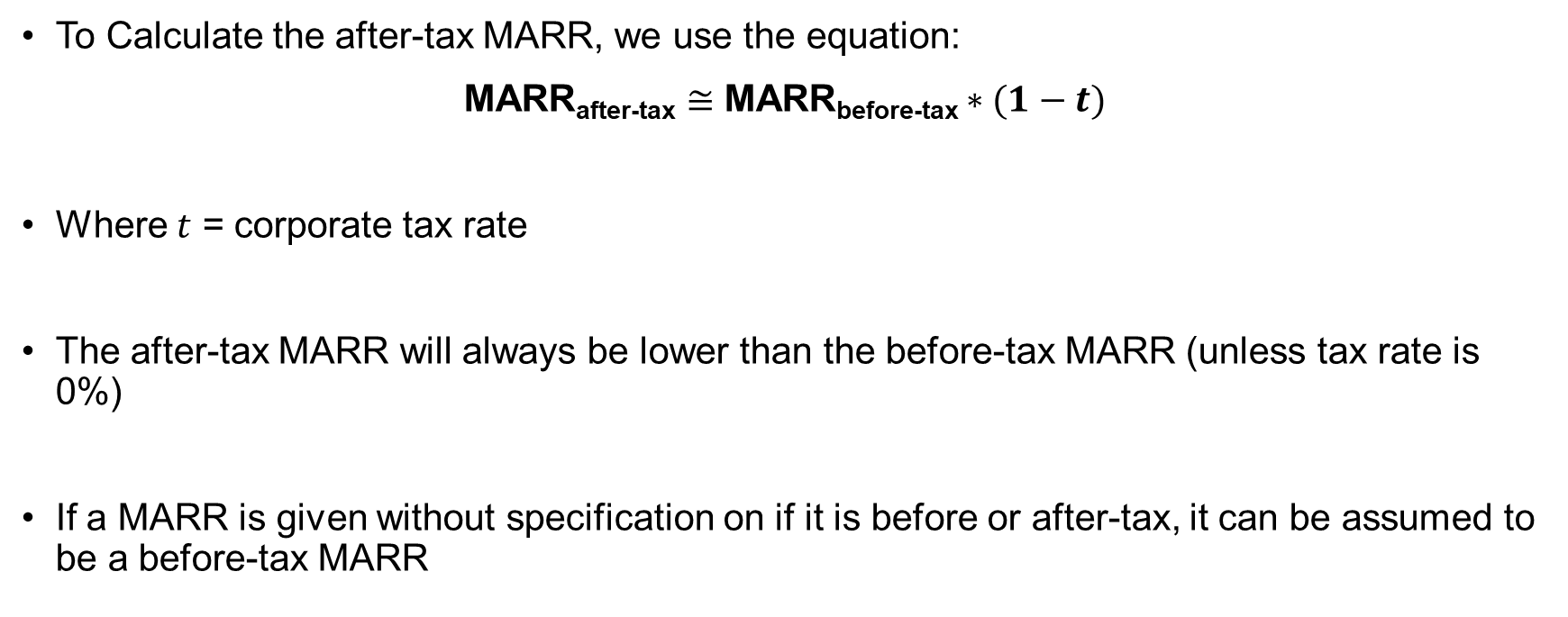
Incorporating Taxes into MARR
To Calculate the after-tax MARR, we use the equation:
MARR_{after-tax} $≅$ MARR_{before-tax} $∗(1−t)$
Where $t$ = corporate tax rate
The after-tax MARR will always be lower than the before-tax MARR (unless tax rate is 0%)
If a MARR is given without specification on if it is before or after-tax, it can be assumed to be a before-tax MARR

Slide 15
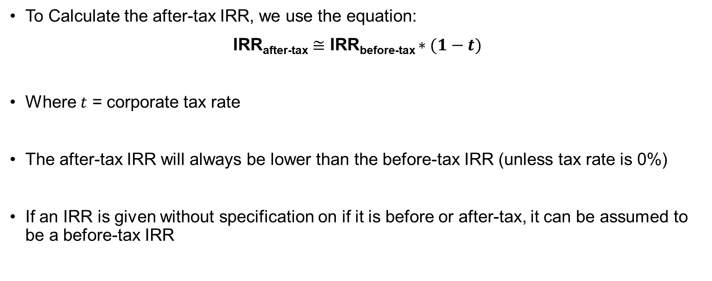
Incorporating Taxes into IRR
To Calculate the after-tax IRR, we use the equation:
IRR_{after-tax} $≅$ IRR_{before-tax} $∗(1−t)$
Where $t$ = corporate tax rate
The after-tax IRR will always be lower than the before-tax IRR (unless tax rate is 0%)
If an IRR is given without specification on if it is before or after-tax, it can be assumed to be a before-tax IRR

Slide 16
MARR Practice Problem
A mining company is selecting projects to take on as investments based on a before-tax MARR of 12%. The project lead feels some investments have been missed because the effects of taxation have not been examined well enough. If you were to review the projects on an after-tax basis, what would be a good choice for MARR if corporate tax rate was 30%?

Slide 17
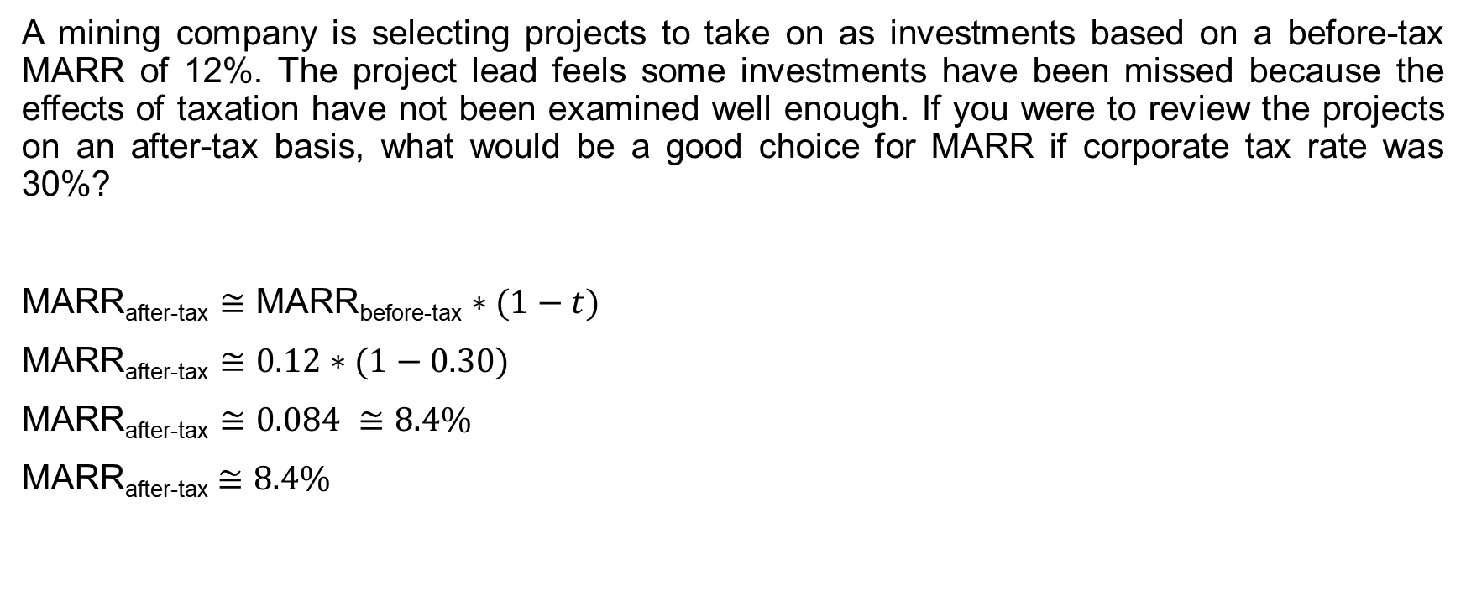
MARR Practice Problem
A mining company is selecting projects to take on as investments based on a before-tax MARR of 12%. The project lead feels some investments have been missed because the effects of taxation have not been examined well enough. If you were to review the projects on an after-tax basis, what would be a good choice for MARR if corporate tax rate was 30%?
MARR_{after-tax} $≅$ MARR_{before-tax} $∗(1−t)$
MARR_{after-tax} $≅0.12∗(1−0.30)$
MARR_{after-tax} $≅0.084 ≅8.4\%$
MARR_{after-tax} $≅8.4\%$

Slide 18
IRR Practice Problem
A company is considering various investment projects, and they have been using a before-tax MARR of 15% as a criterion for selection. If you were to evaluate these projects on an after-tax basis, what would be an appropriate minimum after-tax IRR to use as a criterion for project selection if the corporate tax rate is 25%?

Slide 19
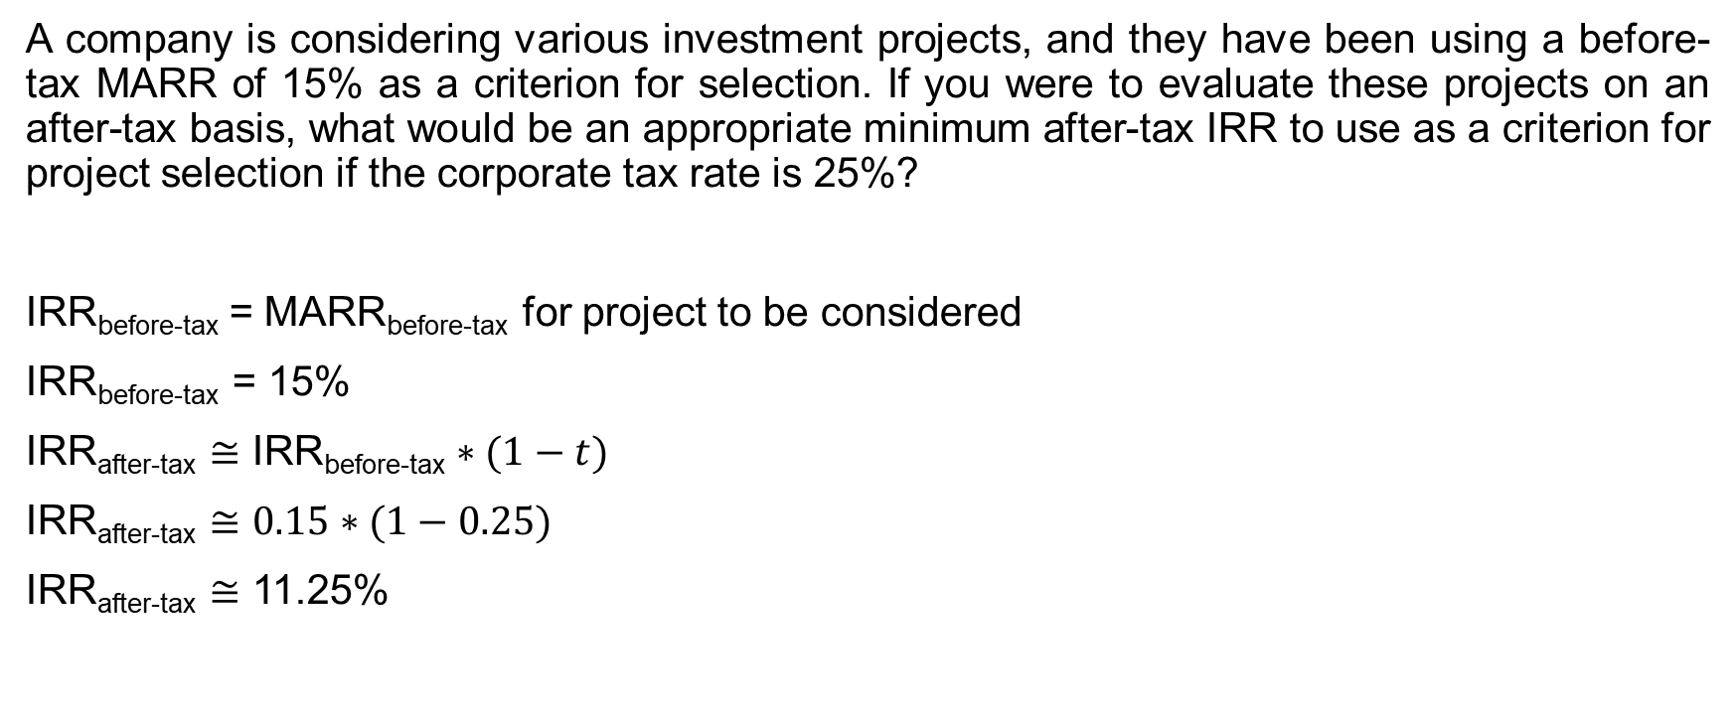
IRR Practice Problem
A company is considering various investment projects, and they have been using a before-tax MARR of 15% as a criterion for selection. If you were to evaluate these projects on an after-tax basis, what would be an appropriate minimum after-tax IRR to use as a criterion for project selection if the corporate tax rate is 25%?
IRR_{before-tax} = MARR_{before-tax} for project to be considered
IRR_{before-tax} = 15%
IRR_{after-tax} $≅$ IRR_{before-tax} $∗(1−t)$
IRR_{after-tax} $≅$ $0.15∗(1−0.25)$
IRR_{after-tax} $≅$ 11.25%

Slide 20
Depreciation & Taxes
Review:
Two Depreciation Methods:
  Straight-line, and declining-balance
  Each method requires estimates of an asset’s useful life and salvage value
Depreciation is a non-cash cost (no actual exchange of dollars but still affects net income and assets on the balance sheet and income statement)
As depreciation is considered an expense that offsets revenue, it is best to “write off” ASAP.
  Is $1000 more valuable a year from now or today? The chapter on Time Value of Money taught us how inflation and investments make money lose value over time
  Therefore, if it is possible to get money back from tax write offs through depreciation expenses, you will want to collect it now rather than later

Slide 21
The Capital Cost Allowance System
Tax write offs will deduct capital expense over period of years by claiming depreciation expense each year of useful life.
The depreciation is recorded in two ways:
  In balance sheet as a reduction in the book value.
  As a depreciation expense on the income statement thereby reducing the before-tax income.
However, Canadian tax system defines a specific amount of depreciation called the Capital Cost Allowance (CCA) System.
  The CCA system prevents capital purchases to be fully claimed as an expense in the year in which they are purchased.
  The CCA system uses the declining-balance depreciation method as learned in chapter 2
There are “classes” that dictate CCA rates and they depends on the type of asset.

Slide 22
The Capital Cost Allowance System
CCA Rates and Classes
CCA Rate (%) | Class | Description
4 to 10 | 1, 3, 6 | Buildings and additions
20 | 8 | Machinery, office furniture, and equipment
25 | 9 | Aircraft, aircraft furniture, and equipment
30 | 10 | Passenger vehicles, vans, trucks, computers, and systems software
40 | 16 | Taxis, rental cars, and freight trucks; coin-operated video games
100 | 12 | Tools, and instruments that cost less than $500; computer software other than systems software
Class of asset dictates the actual CCA rate.
Engineering projects often are class 8 → 20% Rate
The remaining value in each pooled account is called the Undepreciated Capital Cost (UCC).

Slide 23
Undepreciated Capital Cost Allowance
The Canadian tax system uses a half-year rule. This means in the year of purchasing an asset, only half the usual depreciation is applied.
  When the asset is depreciated, companies keep track of the undepreciated capital cost (UCC) which would be the book value of the asset
  Ex. If an asset is bought for $100,000 in the beginning of a year, only $50,000 of the cost is considered in the CCA for that year, while the other $50,000 will be tracked as UCC and will be considered in the following year for CCA benefits
In the following slides, the practice problem will show how to keep track of UCC, CCA, and the tax savings from the CCA

Slide 24
Undepreciated Capital Cost Allowance
Year | Adjustments to UCC From Purchases & Dispositions | Base UCC Amount For Capital Cost Allowance | Capital Cost Allowance | Remaining UCC | Tax Savings from CCA
1 | a | a/2 | a/2 * CCA rate | a – (a/2 * CCA rate) | (a/2 * CCA rate) * Tax rate
2 |  | Let b = a – (a/2 * CCA rate) | b * CCA rate | b – (b * CCA rate) | (b * CCA rate) * Tax rate
3 | … | … | … | … | …
4

Slide 25
UCC Practice Problem
Consider a company that has just purchased a $1,000,000 piece of equipment. For simplicity, we will assume that this equipment is the only equipment in its class. The CCA rate for the equipment is 20 percent and the corporate tax rate is 50 percent. Create a table showing the company's UCC amounts for the first four years of the asset’s life.
Year | Adjustments to UCC From Purchases & Dispositions | Base UCC Amount For Capital Cost Allowance | Capital Cost Allowance | Remaining UCC | Tax Savings from CCA
1
2
3
4

Slide 26
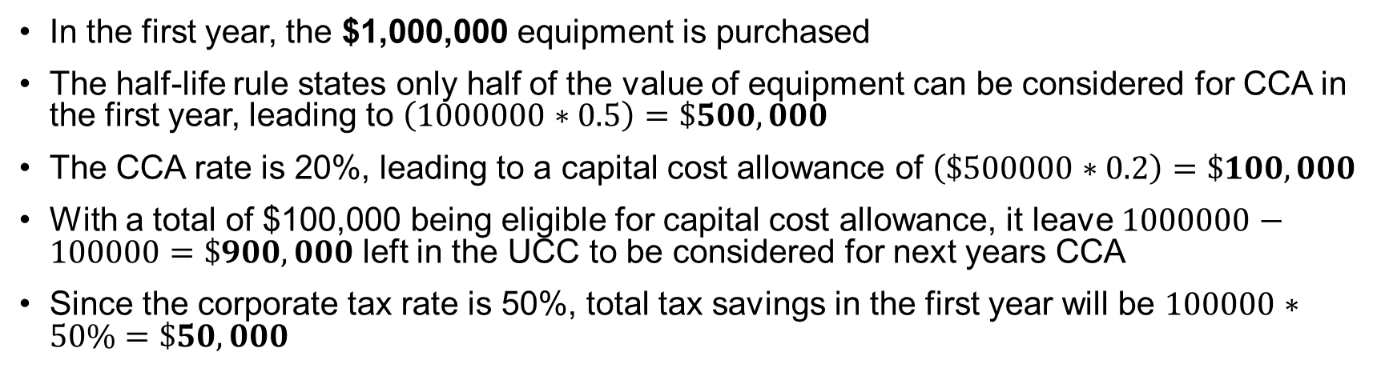
UCC Practice Problem
Year | Adjustments to UCC From Purchases & Dispositions | Base UCC Amount For Capital Cost Allowance | Capital Cost Allowance | Remaining UCC | Tax Savings from CCA
1 | $1,000,000 | $500,000 | $100,000 | $900,000 | $50,000
2
3
4
In the first year, the $1,000,000 equipment is purchased
The half-life rule states only half of the value of equipment can be considered for CCA in the first year, leading to $\left(1000000∗0.5\right)=\$500,000$
The CCA rate is 20%, leading to a capital cost allowance of $\left(\$500000∗0.2\right)=\$100,000$
With a total of $100,000 being eligible for capital cost allowance, it leave $1000000−100000=\$900,000$ left in the UCC to be considered for next years CCA
Since the corporate tax rate is 50%, total tax savings in the first year will be $100000∗50\%=\$50,000$

Slide 27
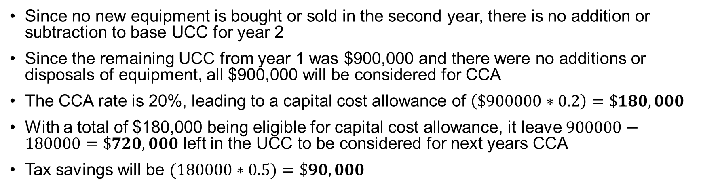
UCC Practice Problem
Year | Adjustments to UCC From Purchases & Dispositions | Base UCC Amount For Capital Cost Allowance | Capital Cost Allowance | Remaining UCC | Tax Savings from CCA
1 | $1,000,000 | $500,000 | $100,000 | $900,000 | $50,000
2 | $0 | $900,000 | $180,000 | $720,000 | $90,000
3
4
Since no new equipment is bought or sold in the second year, there is no addition or subtraction to base UCC for year 2
Since the remaining UCC from year 1 was $900,000 and there were no additions or disposals of equipment, all $900,000 will be considered for CCA
The CCA rate is 20%, leading to a capital cost allowance of $\left(\$900000∗0.2\right)=\$180,000$
With a total of $180,000 being eligible for capital cost allowance, it leave $900000−180000=\$720,000$ left in the UCC to be considered for next years CCA
Tax savings will be $(180000∗0.5)=\$90,000$

Slide 28
UCC Practice Problem
Year | Adjustments to UCC From Purchases & Dispositions | Base UCC Amount For Capital Cost Allowance | Capital Cost Allowance | Remaining UCC | Tax Savings from CCA
1 | $1,000,000 | $500,000 | $100,000 | $900,000 | $50,000
2 | $0 | $900,000 | $180,000 | $720,000 | $90,000
3 | $0 | $720,000 | $144,000 | $576,000 | $72,000
4 | $0 | $576,000 | $115,200 | $460,800 | $57,600
The same steps used for step 2 can be used to fill in the numbers for years 3 & 4
This problem showed how to bookkeep tax savings for one purchase of equipment. What if there was another purchase within the 4 years?
Let's say there was another purchase of an equipment for $500,000 in year two. How would that impact the chart and total tax savings?

Slide 29
UCC Practice Problem
Year | Adjustments to UCC From Purchases & Dispositions | Base UCC Amount For Capital Cost Allowance | Capital Cost Allowance | Remaining UCC | Tax Savings from CCA
1 | $1,000,000 | $500,000 | $100,000 | $900,000 | $50,000
2 | $500,000 | $900,000 + $250,000 | $180,000 + $50,000 | $720,000 + $450,000 | $90,000 +$25,000
3 | $0 | $1,170,000 | $234,000 | $936,000 | $117,000
4 | $0 | $936,000 | $187,200 | $748,800 | $93,600
You would follow the same steps as used in the previous problem, accounting for the half-year rule in year 2, as it is the year in which the new equipment is purchased.
From there, the same rules follow for calculating the tax savings in years 3 & 4.
Now what if the first equipment was sold and disposed of in year 4 for $100,000? How would that change tax savings in the fourth year?

Slide 30
UCC Practice Problem
Year | Adjustments to UCC From Purchases & Dispositions | Base UCC Amount For Capital Cost Allowance | Capital Cost Allowance | Remaining UCC | Tax Savings from CCA
1 | $1,000,000 | $500,000 | $100,000 | $900,000 | $50,000
2 | $500,000 | $1,150,000 | $230,000 | $1,170,000 | $115,000
3 | $0 | $1,170,000 | $234,000 | $936,000 | $117,000
4 | ($100,000) | $836,000 | $167,200 | $668,800 | $83,600
Now what if the first equipment was sold and disposed of in year 4 for $100,000? How would that change tax savings in the fourth year?
A disposition of an asset lowers the base UCC amount for capital cost allowance
In this example, base UCC was lowered by $100,000, resulting in a lower capital cost allowance, lower UCC, and lower tax savings from CCA

Slide 31
The Effect of Taxes on Cash Flows
There are three cash flow elements in purchasing equipment:
First Cost: The initial payment for an equipment that happens at present time
Net Annual Savings: Savings in operating costs that occur over the lifetime of the equipment
Salvage Value: The residual value salvaged at the end of the lifetime of the equipment
Each off these cash flow elements is affected by taxes in different ways and will affect the present worth of the purchase

Slide 32
Practice example:
The Effect of Taxes on Cash Flows
A company is considering purchasing a small device used to test printed circuit boards that has a first cost of $45,000. The tester is expected to reduce labour costs and improve the defect detection rate to bring about a saving of $20,000 per year. The salvage value of the tester will be $5,000 in five years. Corporate tax rate is 42%, CCA rate is 30%, and after-tax MARR is 12%.
What is the effect of Taxes on these cash flows?

Slide 33
The Effect of Taxes on Cash Flows
First Cost:
Net Annual Savings:
Salvage Value:

Slide 34
The Effect of Taxes on Cash Flows
First Cost: the $45,000 investment. This is negative cash flow at present time.
Net Annual Savings: $20,000 savings in operating costs for net positive cash flow at end of each of years from 1–5.
Salvage Value: the $5,000 residual value of the tester at end of 5 years.
Now we must make sure all three elements account for tax savings and are adjusted for present values. Since all the cash flows are not happening in the year of the purchase, we will have to discount them to adjust for present worth.

Slide 35
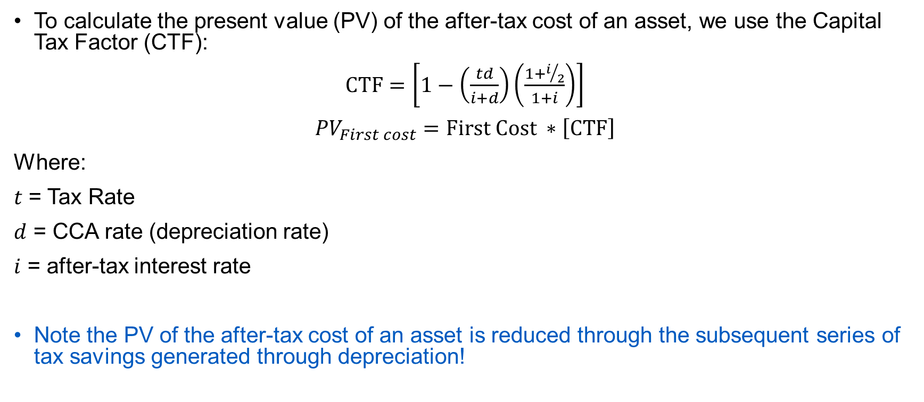
The Effect of Taxes on First Cost
To calculate the present value (PV) of the after-tax cost of an asset, we use the Capital Tax Factor (CTF):
$\text{CTF}=\left[1−\left(\frac{td}{i+d}\right)\left(\frac{1+i/2}{1+i}\right)\right]$
${PV}_{First cost}=\text{First} \text{Cost} ∗\left[\text{CTF}\right]$
Where:
$t$ = Tax Rate
$d$ = CCA rate (depreciation rate)
$i$ = after-tax interest rate
Note the PV of the after-tax cost of an asset is reduced through the subsequent series of tax savings generated through depreciation!

Slide 36

The Effect of Taxes on First Cost
First cost = $45,000,
$t = 42\%$
$d = 30\%$
$i = 12\%$
${PV}_{first cost}=\text{First} \text{Cost} ∗\left[1−\left(\frac{td}{i+d}\right)\left(\frac{1+i/2}{1+i}\right)\right]$

Slide 37
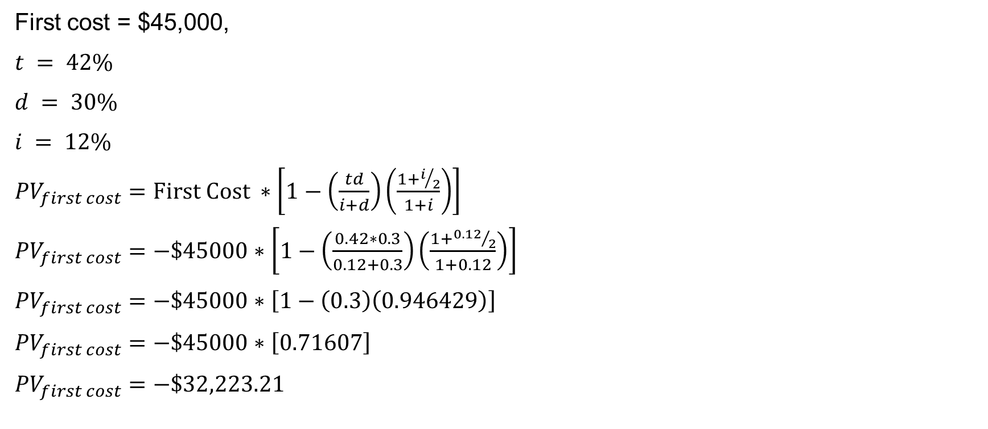
The Effect of Taxes on First Cost
First cost = $45,000,
$t = 42\%$
$d = 30\%$
$i = 12\%$
${PV}_{first cost}=\text{First} \text{Cost} ∗\left[1−\left(\frac{td}{i+d}\right)\left(\frac{1+i/2}{1+i}\right)\right]$
${PV}_{first cost}=−\$45000∗\left[1−\left(\frac{0.42∗0.3}{0.12+0.3}\right)\left(\frac{1+{0.12}/2}{1+0.12}\right)\right]$
${PV}_{first cost}=−\$45000∗\left[1−\left(0.3\right)\left(0.946429\right)\right]$
${PV}_{first cost}=−\$45000∗\left[0.71607\right]$
${PV}_{first cost}=−\$32,223.21$
From CCA tax benefits, $12,776.79 was saved and reduced from the first cost due to future depreciation savings

Slide 38
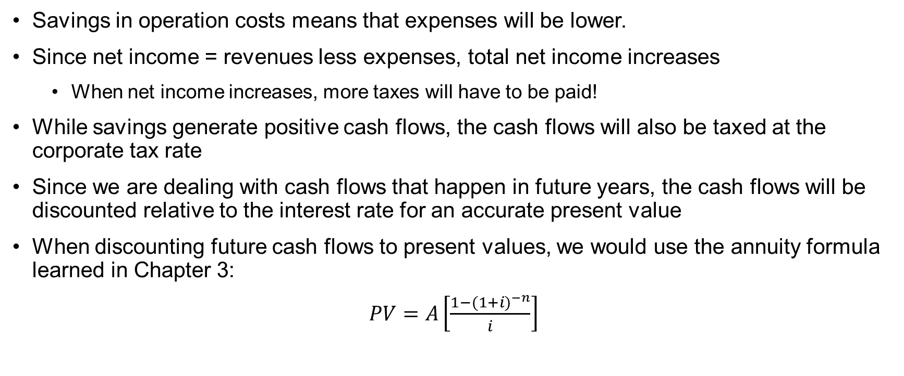
The Effect of Taxes on Savings
Savings in operation costs means that expenses will be lower.
Since net income = revenues less expenses, total net income increases
  When net income increases, more taxes will have to be paid!
While savings generate positive cash flows, the cash flows will also be taxed at the corporate tax rate
Since we are dealing with cash flows that happen in future years, the cash flows will be discounted relative to the interest rate for an accurate present value
When discounting future cash flows to present values, we would use the annuity formula learned in Chapter 3:
$PV=A\left[\frac{1−({1+i)}^{−n}}{i}\right]$

Slide 39
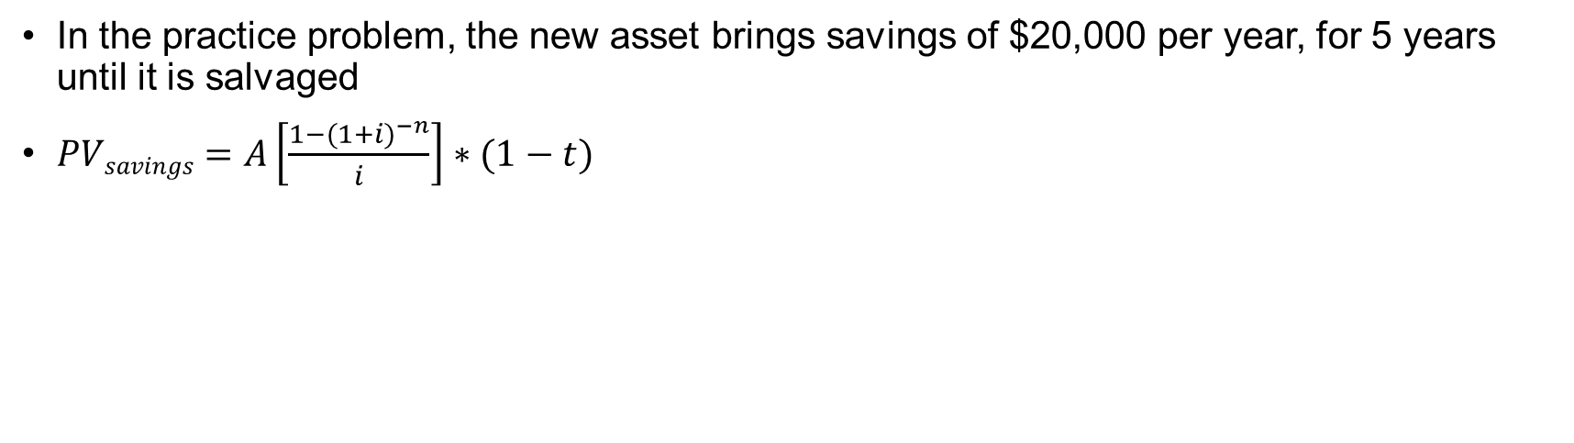
The Effect of Taxes on Savings
In the practice problem, the new asset brings savings of $20,000 per year, for 5 years until it is salvaged
$PVsavings=A\left[\frac{1−({1+i)}^{−n}}{i}\right]∗(1−t)$

Slide 40
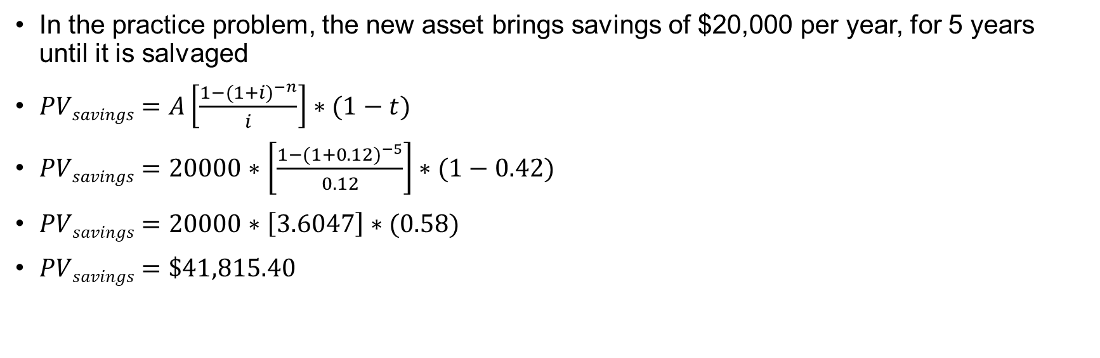
The Effect of Taxes on Savings
In the practice problem, the new asset brings savings of $20,000 per year, for 5 years until it is salvaged
$PVsavings=A\left[\frac{1−({1+i)}^{−n}}{i}\right]∗(1−t)$
$PVsavings=20000∗\left[\frac{1−({1+0.12)}^{−5}}{0.12}\right]∗(1−0.42)$
$PVsavings=20000∗\left[3.6047\right]∗(0.58)$
$PVsavings=\$41,815.40$
After accounting for taxes and discounting cash flows for the after-tax MARR, we have a net savings of $41,815.40 from the 5-year period

Slide 41
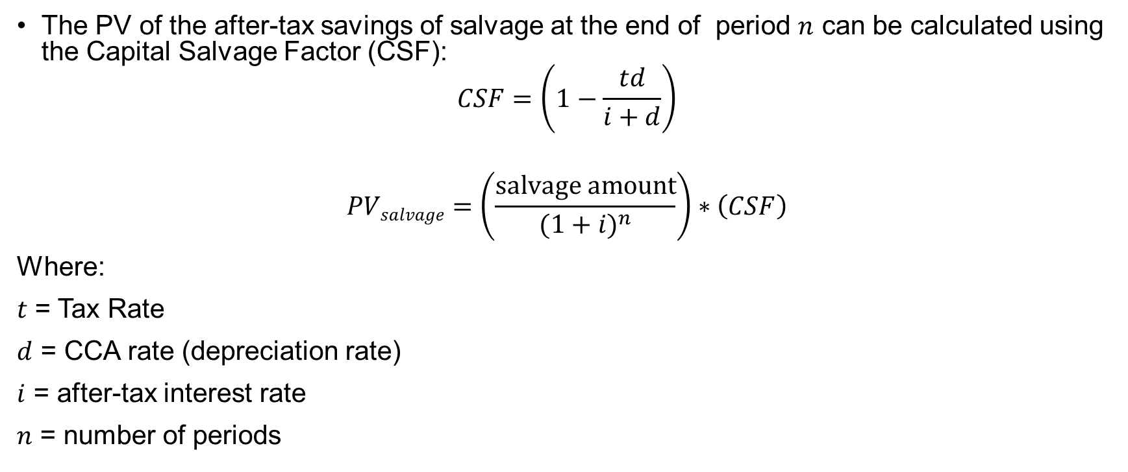
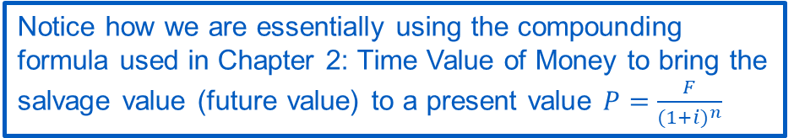
The Effect of Taxes on Salvage Value
The PV of the after-tax savings of salvage at the end of period $n$ can be calculated using the Capital Salvage Factor (CSF):
$$CSF=\left(1−\frac{td}{i+d}\right)$$
$$PVsalvage=\left(\frac{\text{salvage} \text{amount}}{{(1+i)}^{n}}\right)∗\left(CSF\right)$$
Where:
$t$ = Tax Rate
$d$ = CCA rate (depreciation rate)
$i$ = after-tax interest rate
$n$ = number of periods
Note the PV of the after-tax salvage is reduced because it terminated the series of tax savings generated through depreciation
Notice how we are essentially using the compounding formula used in Chapter 2: Time Value of Money to bring the salvage value (future value) to a present value $P=\frac{F}{{(1+i)}^{n}}$

Slide 42

The Effect of Taxes on Salvage Value
In the practice example, the asset is being sold for $5,000 after 5 years
$PVsalvage=\left(\frac{\text{salvage} \text{amount}}{{(1+i)}^{n}}\right)∗\left(1−\frac{td}{i+d}\right)$

Slide 43
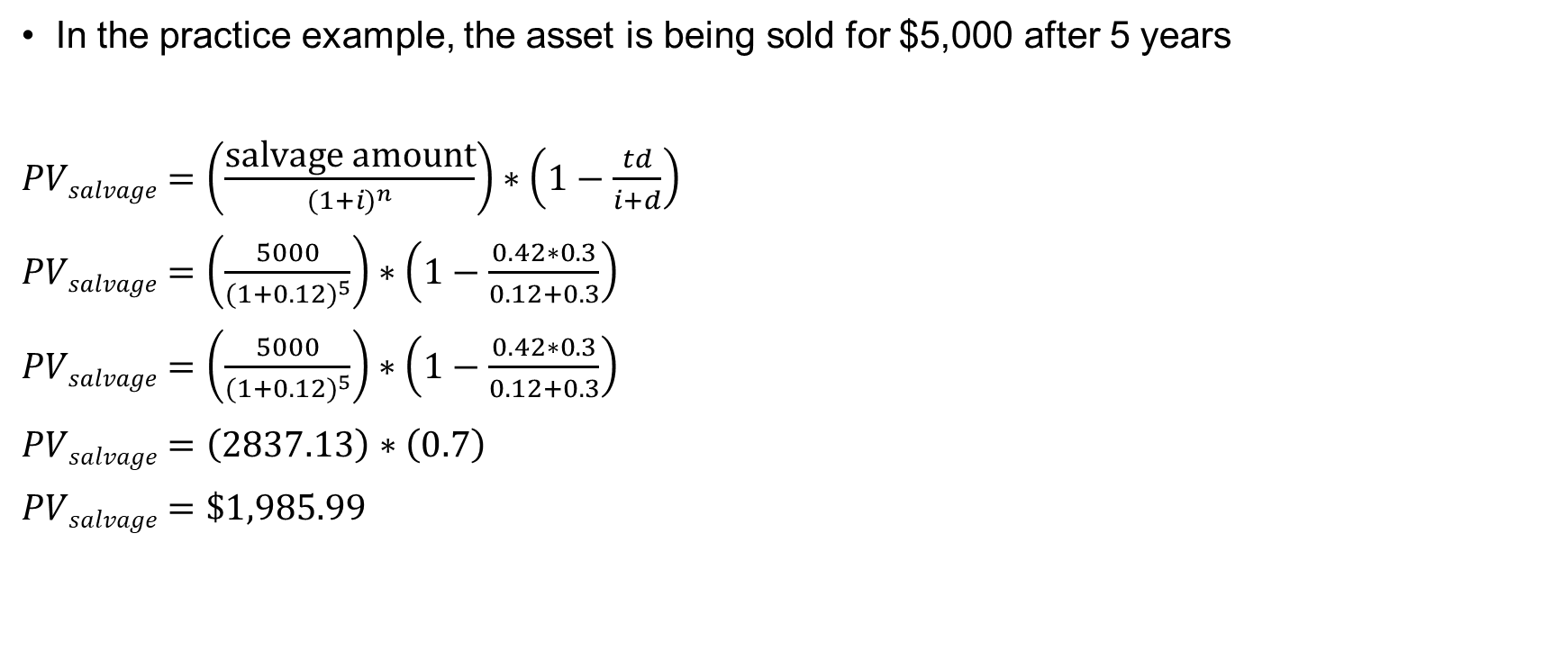
The Effect of Taxes on Salvage Value
In the practice example, the asset is being sold for $5,000 after 5 years
$PVsalvage=\left(\frac{\text{salvage} \text{amount}}{{(1+i)}^{n}}\right)∗\left(1−\frac{td}{i+d}\right)$
$PVsalvage=\left(\frac{5000}{{(1+0.12)}^{5}}\right)∗\left(1−\frac{0.42∗0.3}{0.12+0.3}\right)$
$PVsalvage=\left(\frac{5000}{{(1+0.12)}^{5}}\right)∗\left(1−\frac{0.42∗0.3}{0.12+0.3}\right)$
$PVsalvage=\left(2837.13\right)∗\left(0.7\right)$
$PVsalvage=\$1,985.99$

Slide 44
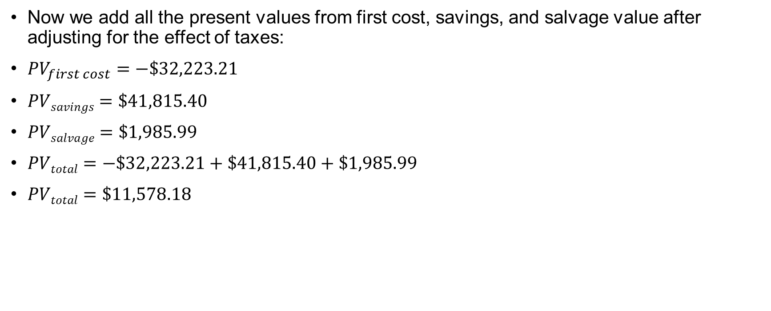
The Effect of Taxes on Cash Flows
Now we add all the present values from first cost, savings, and salvage value after adjusting for the effect of taxes:
${PV}_{first cost}=−\$32,223.21$
$PVsavings=\$41,815.40$
$PVsalvage=\$1,985.99$
$PVtotal=−\$32,223.21+\$41,815.40+\$1,985.99$
$PVtotal=\$11,578.18$
Despite the asset costing $45,000, through the benefits of the capital cost allowance, savings in operating costs and salvage value, the after-tax net value that the asset brings in is $11,578.18

Slide 45
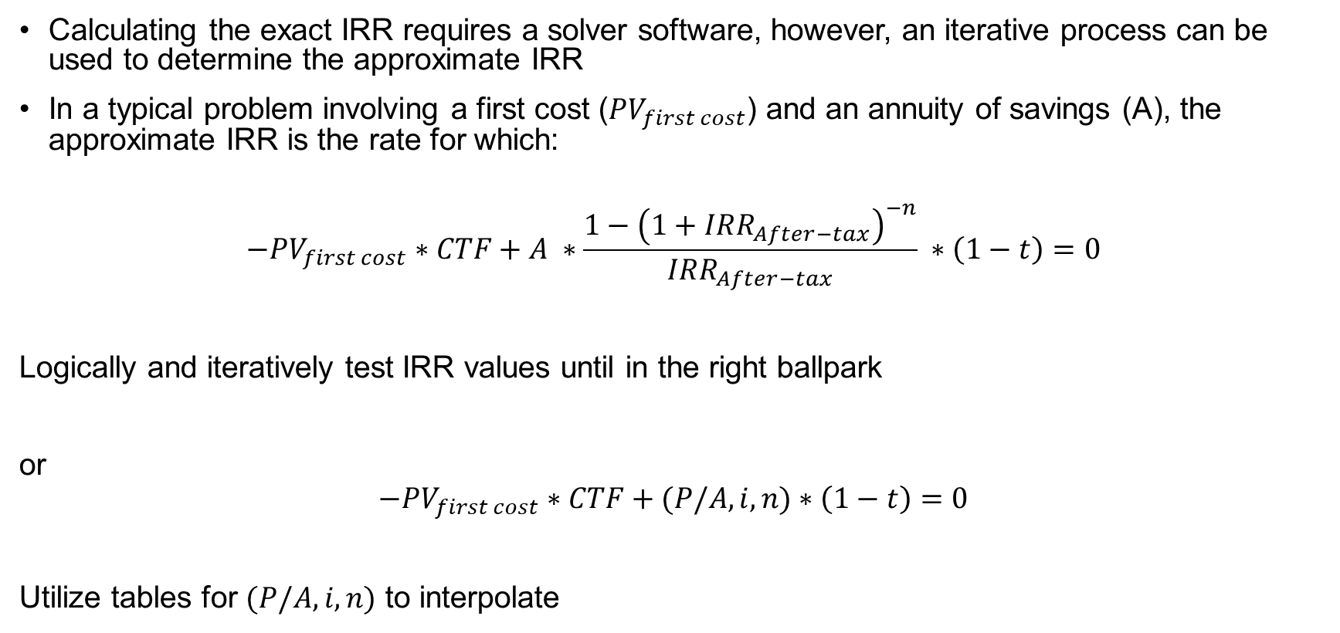
Approximate and Exact IRR
Calculating the exact IRR requires a solver software, however, an iterative process can be used to determine the approximate IRR
In a typical problem involving a first cost (${PV}_{first cost}$) and an annuity of savings (A), the approximate IRR is the rate for which:
$$−{PV}_{first cost}∗CTF+A ∗\frac{1−{\left(1+IRR_{After−tax}\right)}^{−n}}{IRR_{After−tax}} ∗\left(1−t\right)=0$$
Logically and iteratively test IRR values until in the right ballpark
or
$$−{PV}_{first cost}∗CTF+(P/A, i, n)∗\left(1−t\right)=0$$
Utilize tables for $(P/A, i, n)$ to interpolate

Slide 46
Summary
Income taxes can have significant effect on engineering economic decisions.
In this chapter, we provided a basic introduction to the Canadian capital cost allowance system, how it is used to calculate taxes, and the use of undepreciated capital cost accounts.
The CCA rate is a declining-balance rate that is mandated for use in calculating the depreciation expenses for capital assets
Components of a Complete Present Value Tax Calculation
Component |  | Calculation
First Cost |  | Multiply by the CTF
Savings or expenses |  | Multiply by the tax rate & convert to PV
Salvage Value |  | Multiply by the CSF & convert to PV

Slide 47
Creative Commons: CC BY-NC-SA 4.0
The contents of these slides are protected by the licence:
Creative Commons Attribution-NonCommercial-ShareAlike 4.0 International
Attribution: Engineering Economics Textbook Replacement Teaching Materials © 2024 by Tamara R. Etmannski is licensed under CC BY-NC-SA 4.0

