Slide 1
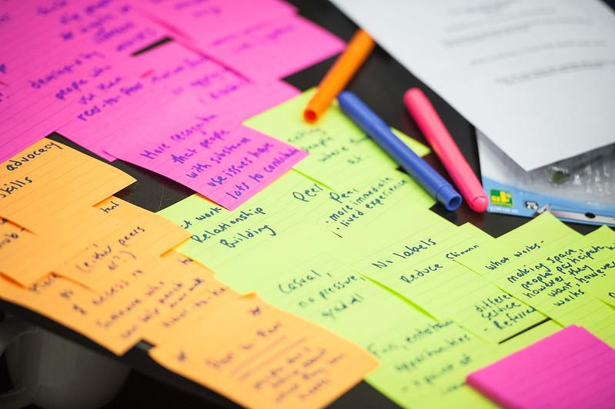
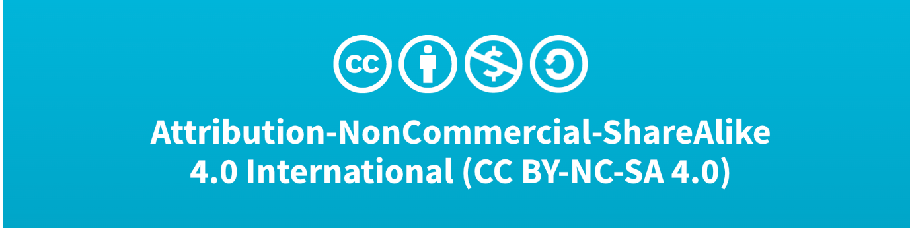
Community-based knowledge exchange and mitigating information privilege
Core
Image by Martin Dee / UBC Brand & Marketing
Notes:
Speaker notes: For today’s class, we will explore community-based knowledge exchange and mitigating information privilege.

Slide 2
Land acknowledgement
Core
Notes:
We encourage you to begin your class with a land acknowledgement. For more information on what a land acknowledgement is and how to create one, we recommend reading UBC’s Doing Land Acknowledgements (https://guides.library.ubc.ca/c.php?g=715538&p=5109932) guide.
To learn about the territories you live and/or work on, check out native-land.ca.

Slide 3
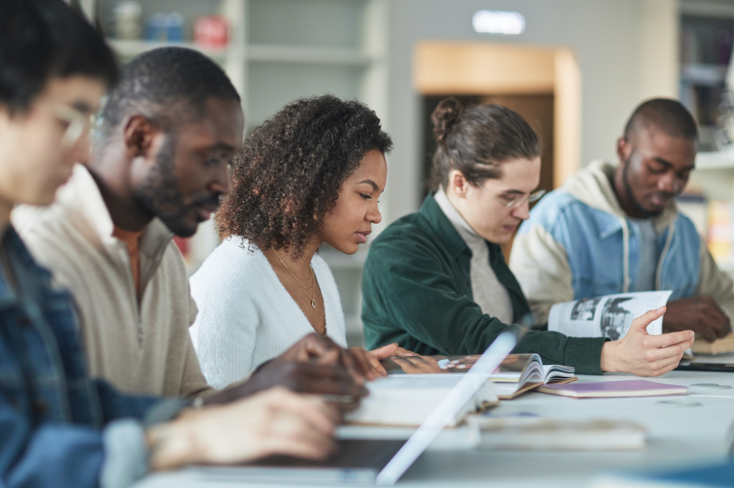
Guiding question
Core
How can we – as librarians and information professionals – practice and promote more equitable knowledge exchange between researchers and community members?
Image by Andy Barbour / Pexels
Notes:
Speaker notes: Our main objective for today is to consider how we, as librarians and information professionals, can practice and promote more equitable knowledge exchange between researchers and community members.

Slide 4
Learning objectives
Core
Define knowledge exchange, information privilege, asset- and deficit-based approaches, and positionality in the context of community-based research
Explain how a reciprocal and relational approach to knowledge exchange can help mitigate information privilege and build trust with community members historically excluded from scholarly publishing
Critically reflect on our own practices as information professionals
Notes:
Speaker notes: By the end of the lecture, you will be able to define knowledge exchange, information privilege, asset- and deficit-based approaches, and positionality in the context of community-based research; explain how a reciprocal and relational approach to knowledge exchange can help mitigate information privilege and build trust with community members historically excluded from scholarly publishing; and critically reflect on our own practices as information professionals.

Slide 5
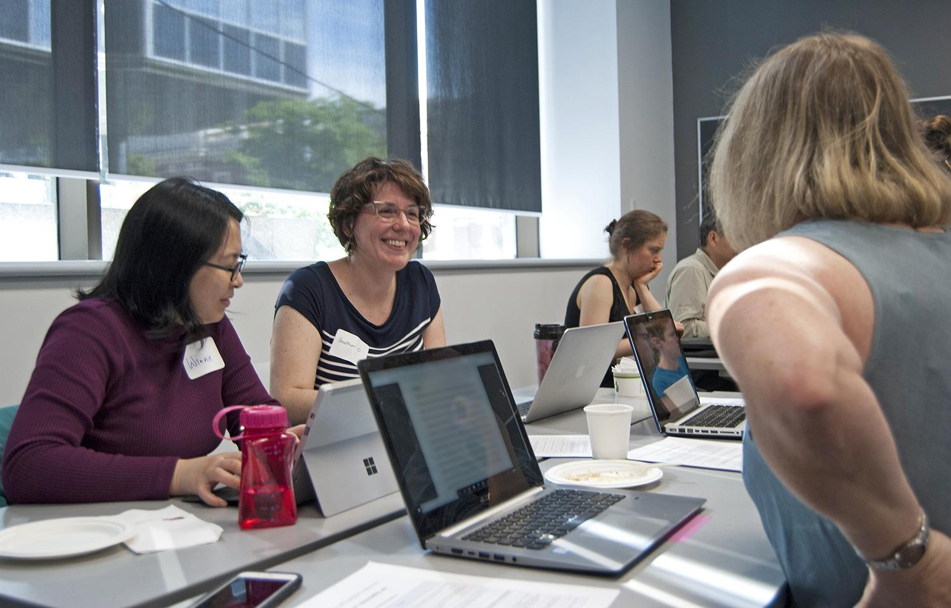
Case study: Downtown Eastside (DTES) and the DTES Research Access Portal (RAP)
Core
Image by Zachary Foote / UBC Library
Notes:
Speaker notes: Throughout today’s class, we will be focusing on the Downtown Eastside, a community located in the city of Vancouver, Canada, and the Downtown Eastside Research Access Portal, or RAP (“rap”), as a case study for how academic-community partnerships can help mitigate information privilege and create more equitable knowledge exchange.
By understanding the Downtown Eastside and the RAP in relation to information privilege and a reciprocal approach to knowledge exchange, we hope that you will be better equipped to reflect on your own practice as an information professional. We also hope that you will incorporate this knowledge and awareness to build more equitable, trusting relationships with the communities that you may one day serve.

Slide 6
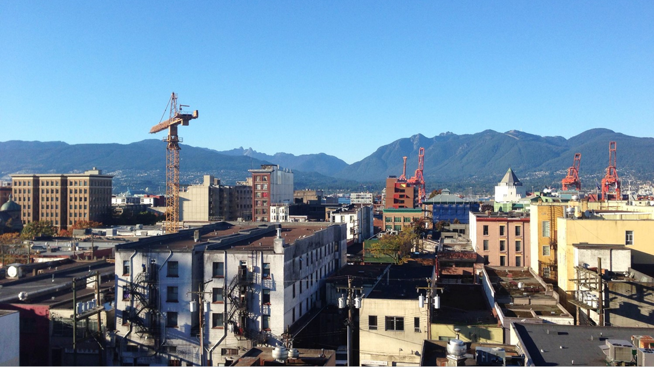
Downtown Eastside (DTES)
Core
One of Vancouver’s oldest and most diverse neighbourhoods
Site of social challenges, political activism, health innovations, and cultural contributions
Magnet for researchers from research institutions like the University of British Columbia (UBC)
Image by Katie Forman / UBC Learning Exchange
Notes:
Speaker notes: To give a bit of background, the Downtown Eastside is one of Vancouver’s oldest and most diverse neighbourhoods and a dynamic site of political, social, public health, and cultural activities.
The area attracts many researchers, particularly those from the University of British Columbia – one of Canada’s top public research institutions – which is based nearby, less than 13 kilometers/8 miles from the Downtown Eastside.

Slide 7
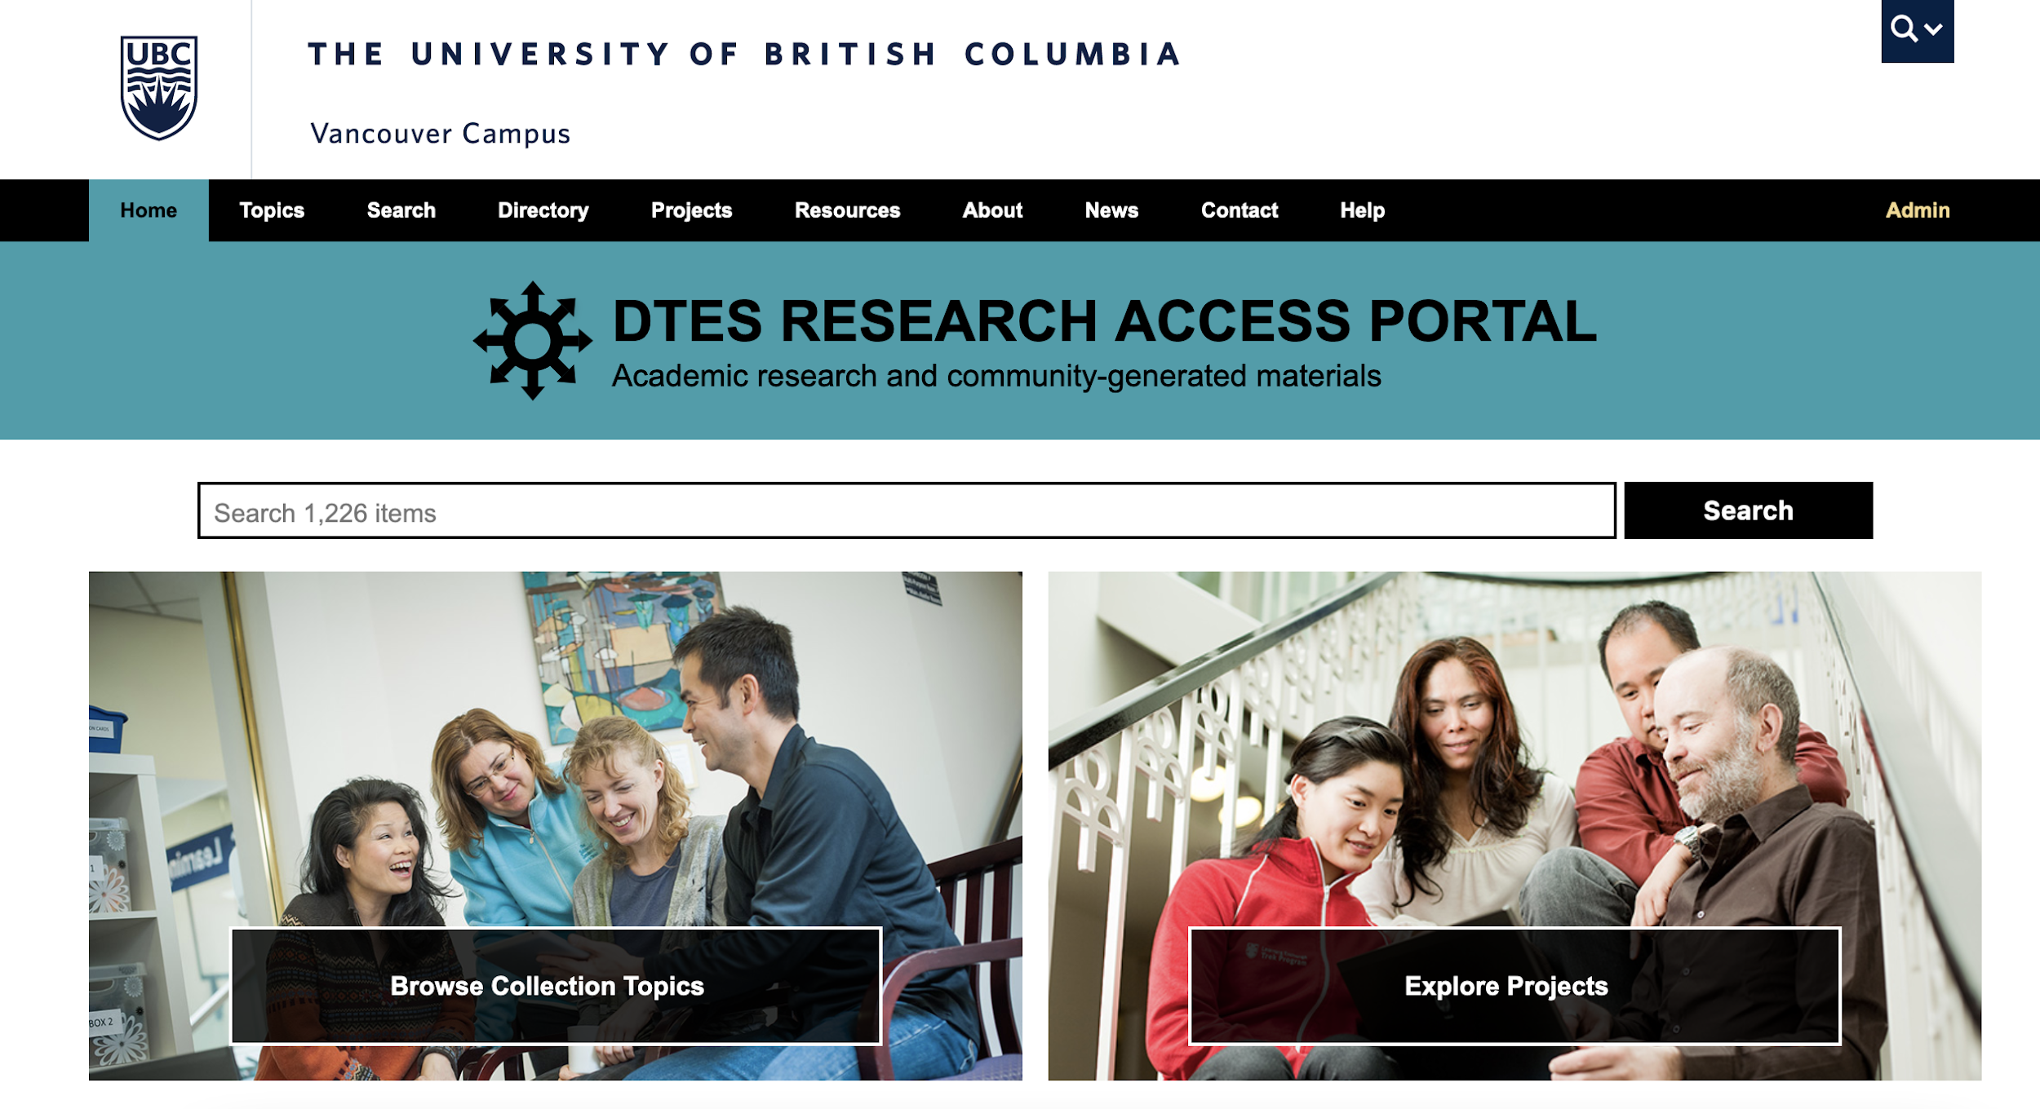
The Downtown Eastside (DTES) Research Access Portal (RAP)
Core
Provides access to research and research-related materials relevant to the DTES
Developed by the Making Research Accessible initiative (MRAi)
Community-driven response to make research more accessible, ethical, and available
dtesresearchaccess.ubc.ca
Notes:
Speaker notes: The RAP is an online portal that provides access to research and research-related materials relevant to the Downtown Eastside. It was developed by the Making Research Accessible initiative, or MRAi (“M-R-A-I”), a UBC-led collaboration with local information institutions and community members. The MRAi launched the RAP in 2020 as part of a community-driven response to make research more accessible for DTES community members, establish more ethical research practices in the Downtown Eastside and other historically marginalized communities, and mitigate information privilege.
We will talk more about the Downtown Eastside and the RAP in a few moments, but first we will need to discuss a few key concepts.

Slide 8

Part 1: Principles and practices of community engagement for knowledge exchange
Core
Image by Kampus Production / Pexels
Notes:
Speaker notes: We’ll start with the principles and practices of community engagement for knowledge exchange.

Slide 9






What is knowledge exchange?
Core
academic
partners
expertise, ideas, experiences, skills
non-academic partners
Reference: https://dtesresearchaccess.ubc.ca/help
Notes:
(The information on this slide is specific to the RAP/UBC’s definition of knowledge exchange. We encourage you include your institution’s definition of knowledge exchange and any relevant resources, if applicable.)
Speaker notes: What is knowledge exchange? The RAP describes knowledge exchange as “… a two-way learning process in which academic and non-academic partners share their expertise and capacities to drive effective research impact… Academic knowledge alone is often not sufficient to create positive change in society. Non-academic partners’ knowledge, skills and experience are also needed for evidence to be contextualized and used.”
You may have heard the terms “knowledge translation” and “knowledge mobilization”, both of which are very similar to knowledge exchange. For this lesson, we will use the term “knowledge exchange” because, as the RAP states, it “intentionally… highlight[s] the interactive, iterative and multidirectional character of the process.”
Throughout today’s class, we will explore how incorporating community-centred, ethical methods for sharing and enabling access to information can more effectively promote knowledge exchange. This kind of community-centred approach can also mitigate information privilege (a concept that we will discuss in a few moments) and build trust with the communities information professionals are trying to serve.
Reference:
DTES Research Access Portal. Help. https://dtesresearchaccess.ubc.ca/help

Slide 10



Asset-based Community Development (ABCD) model
Core
Highlights strengths, knowledge, activism, and positive qualities of the community
Seeks to empower residents – not downplay the real, systemic challenges they face
Notes:
Speaker notes: Having a community-centered approach is the core aspect of the Asset-Based Community Development (ABCD) model, a model that many community-based organizations – including the MRAi – champion.
The ABCD model was created by John P. Kretzmann and John L. McKnight (1993). It highlights the strengths, knowledge, activism, and positive qualities of the community rather than focusing on what the community lacks, or a deficit-based approach. It asserts the valuable knowledge that community members have as experts of their own lives and social circles.
The ABCD model does not intend to downplay the real, systemic challenges experienced by the community; in the Downtown Eastside, residents face the ongoing, devastating impacts of the opioid poisoning crisis, colonial violence, and intergenerational trauma. Instead, the ABCD model seeks to empower the tight-knit core of this community by disrupting the narrative of stigmatization that is frequently associated with the Downtown Eastside.
Reference:
Kretzmann, J.P. & McKnight, J.L. (1993). Introduction. Building Communities from the Inside Out: A Path Toward Finding and Mobilizing a Community's Assets. Evanston, IL: Institute for Policy Research. https://resources.depaul.edu/abcd-institute/publications/Documents/GreenBookIntro%202018.pdf

Slide 11

Extractive research
Core
According to Gaudry (2011):
Researchers often enter a marginalized community and extract valuable information for their own benefit
Research participants rarely experience the benefits of studies that are built on their experiences, knowledge, and participation
Image by Mikhail Nilov / Pexels
Notes:
(This section is specific to a Canadian context; you may want to swap resources or adjust the content to better fit your educational setting and cultural context.)
Speaker notes: Adam Gaudry, a Métis scholar from Canada, argues that contemporary research often follows a familiar methodology: researchers enter a marginalized community and extract valuable information for an academic audience to their own benefit, and research subjects rarely experience the benefits of studies that are built on their experiences, knowledge, and participation (2011). This method mirrors other kinds of resource extraction that take place on Indigenous territories (Gaudry, 2011). Ultimately, the researcher’s main responsibility lies with the institution, rather than the community (Gaudry, 2011).
As Gaudry writes in his essay “Insurgent Research”, “Lost in this extractive process are the context, values, and on-the-ground struggles of the people and communities that provide information and insight to the researcher,” (2011, p. 113).
Many traditional research models use a deficit-based approach that focuses on what an individual or community lacks, which disempowers individual voices and disregards community knowledge.
References
Gaudry, A. J. P. (2011). Insurgent research. Wicazo Sa Review, 26(1), 113-136. https://doi.org/10.1353/wic.2011.0006
For more information on Métis history and identity, please read Gaudry’s article Métis (https://www.thecanadianencyclopedia.ca/en/article/metis) in The Canadian Encyclopedia.

Slide 12

Community-driven, asset-based research
Core
Focuses on building more equitable and participatory learner-based relationships to better respond to community-identified needs
Embodies two-way knowledge exchange
Image by mentatdgt / Pexels
Notes:
Speaker notes: The opposite approach, as we have previously discussed, is an asset-based model that focuses on building more equitable and participatory learner-based relationships to better respond to community-identified needs. This model embodies the two-way spirit of knowledge exchange.

Slide 13

Challenges to asset-based research
Core
Universities:
Tend to view community-engaged scholarship as academic service (not research)
Privilege publication quantity and speed
De-incentivize public scholarship and non-traditional modes of dissemination (Harley et al., 2010)
Image by Emily / Pexels
Notes:
Speaker notes: However, implementing an asset-based model of research can be challenging for numerous reasons. Scholarly practices are often entrenched in antiquated systems of promotion and tenure. Universities tend to view community-engaged scholarship as part of academic service (rather than research), privilege publication quantity and speed, and de-incentivize public scholarship and non-traditional modes of dissemination (Harley et al., 2010).
Reference:
Harley, D., Acord, S. K., Earl-Novell, S., Lawrence, S., & King, C. J. (2010). Assessing the future landscape of scholarly communication: An exploration of faculty values and needs in seven disciplines. Final report. Center for Studies in Higher Education. University of California, Berkeley, Berkeley, CA. Retrieved from https://cloudfront.escholarship.org/dist/prd/content/qt15x7385g/qt15x7385g.pdf

Slide 14

Challenges to asset-based research
Core
Scholars may…
Have limited time
Have limited knowledge about open access publishing (Morrison, 2013)
May lack the access or unawareness of tools to experiment with new genres of scholarly output (Harley et al. 2010)
Are often not practicing integrated knowledge mobilization (Nathan et al., 2017)
Image by Andrea Piacquadio / Pexels
Notes:
Speaker notes: In addition to institutional barriers, scholars have limited time, limited knowledge about open access publishing (Morrison, 2013), and may lack the access or awareness of the tools needed to experiment with new genres of scholarly output that may be better suited to community audiences (Harley et al. 2010).
While many researchers are trained in end-of-project research dissemination (Harley et al., 2010), fewer are practicing integrated knowledge mobilization, which involves collaboration and exchange with knowledge users throughout the research process to adapt to shifts in community consent and priorities over time (Nathan et al., 2017).
This may not be applicable outside of a Canadian context:
In Canada, there is a growing expectation (and mandate) that university research be accountable to and directly benefit Canadians. Community engagement, knowledge mobilization and open access publishing feature heavily in university strategic plans and funding agency policies, but there is still much work to be done.
References:
Harley, D., Acord, S. K., Earl-Novell, S., Lawrence, S., & King, C. J. (2010). Assessing the future landscape of scholarly communication: An exploration of faculty values and needs in seven disciplines. Final report. Center for Studies in Higher Education. University of California, Berkeley, Berkeley, CA. Retrieved from https://cloudfront.escholarship.org/dist/prd/content/qt15x7385g/qt15x7385g.pdf
Morrison, H. (2013). Economics of scholarly communication in transition. First Monday, 18(6). Retrieved from http://firstmonday.org/ojs/index.php/fm/article/view/4370/3685
Nathan, L.P., Kaczmarek, M., Cheng, S., Mann, R. et al. (2017). Good for whom? Unsettling research practice. In Proceedings of the 8th International Conference on Communities and Technologies (pp. 200-297). ACM, https://doi.org/10.1145/3083671.3083685

Slide 15



Positionality
Core
“…the power inherent in [people’s] immediate respective social positions”, which “greatly influences the differences in what individuals have access to in society…
…Whether we want it or not, all parts of our identities are shaped by socially constructed positions and memberships to which we belong” (Misawa, 2010)
Notes:
Speaker notes: Especially when conducting any kind of research or community-driven work, it is crucial to consider one’s positionality.
Positionality is “the power inherent in [people’s] immediate respective social positions”, which “greatly influences the differences in what individuals have access to in society...Whether we want it or not, all parts of our identities are shaped by socially constructed positions and memberships to which we belong” (Misawa, 2010).
Reflecting on your positionality can better inform how you understand your experiences and perspectives as well as the experiences and perspectives of others.
Reference:
Misawa, M. (2010). Queer Race Pedagogy for Educators in Higher Education: Dealing with Power Dynamics and Positionality of LGBTQ Students of Color. International Journal of Critical Pedagogy, 3 (1), 26-35. Retrieved from http://libjournal.uncg.edu/ijcp/article/view/68

Slide 16
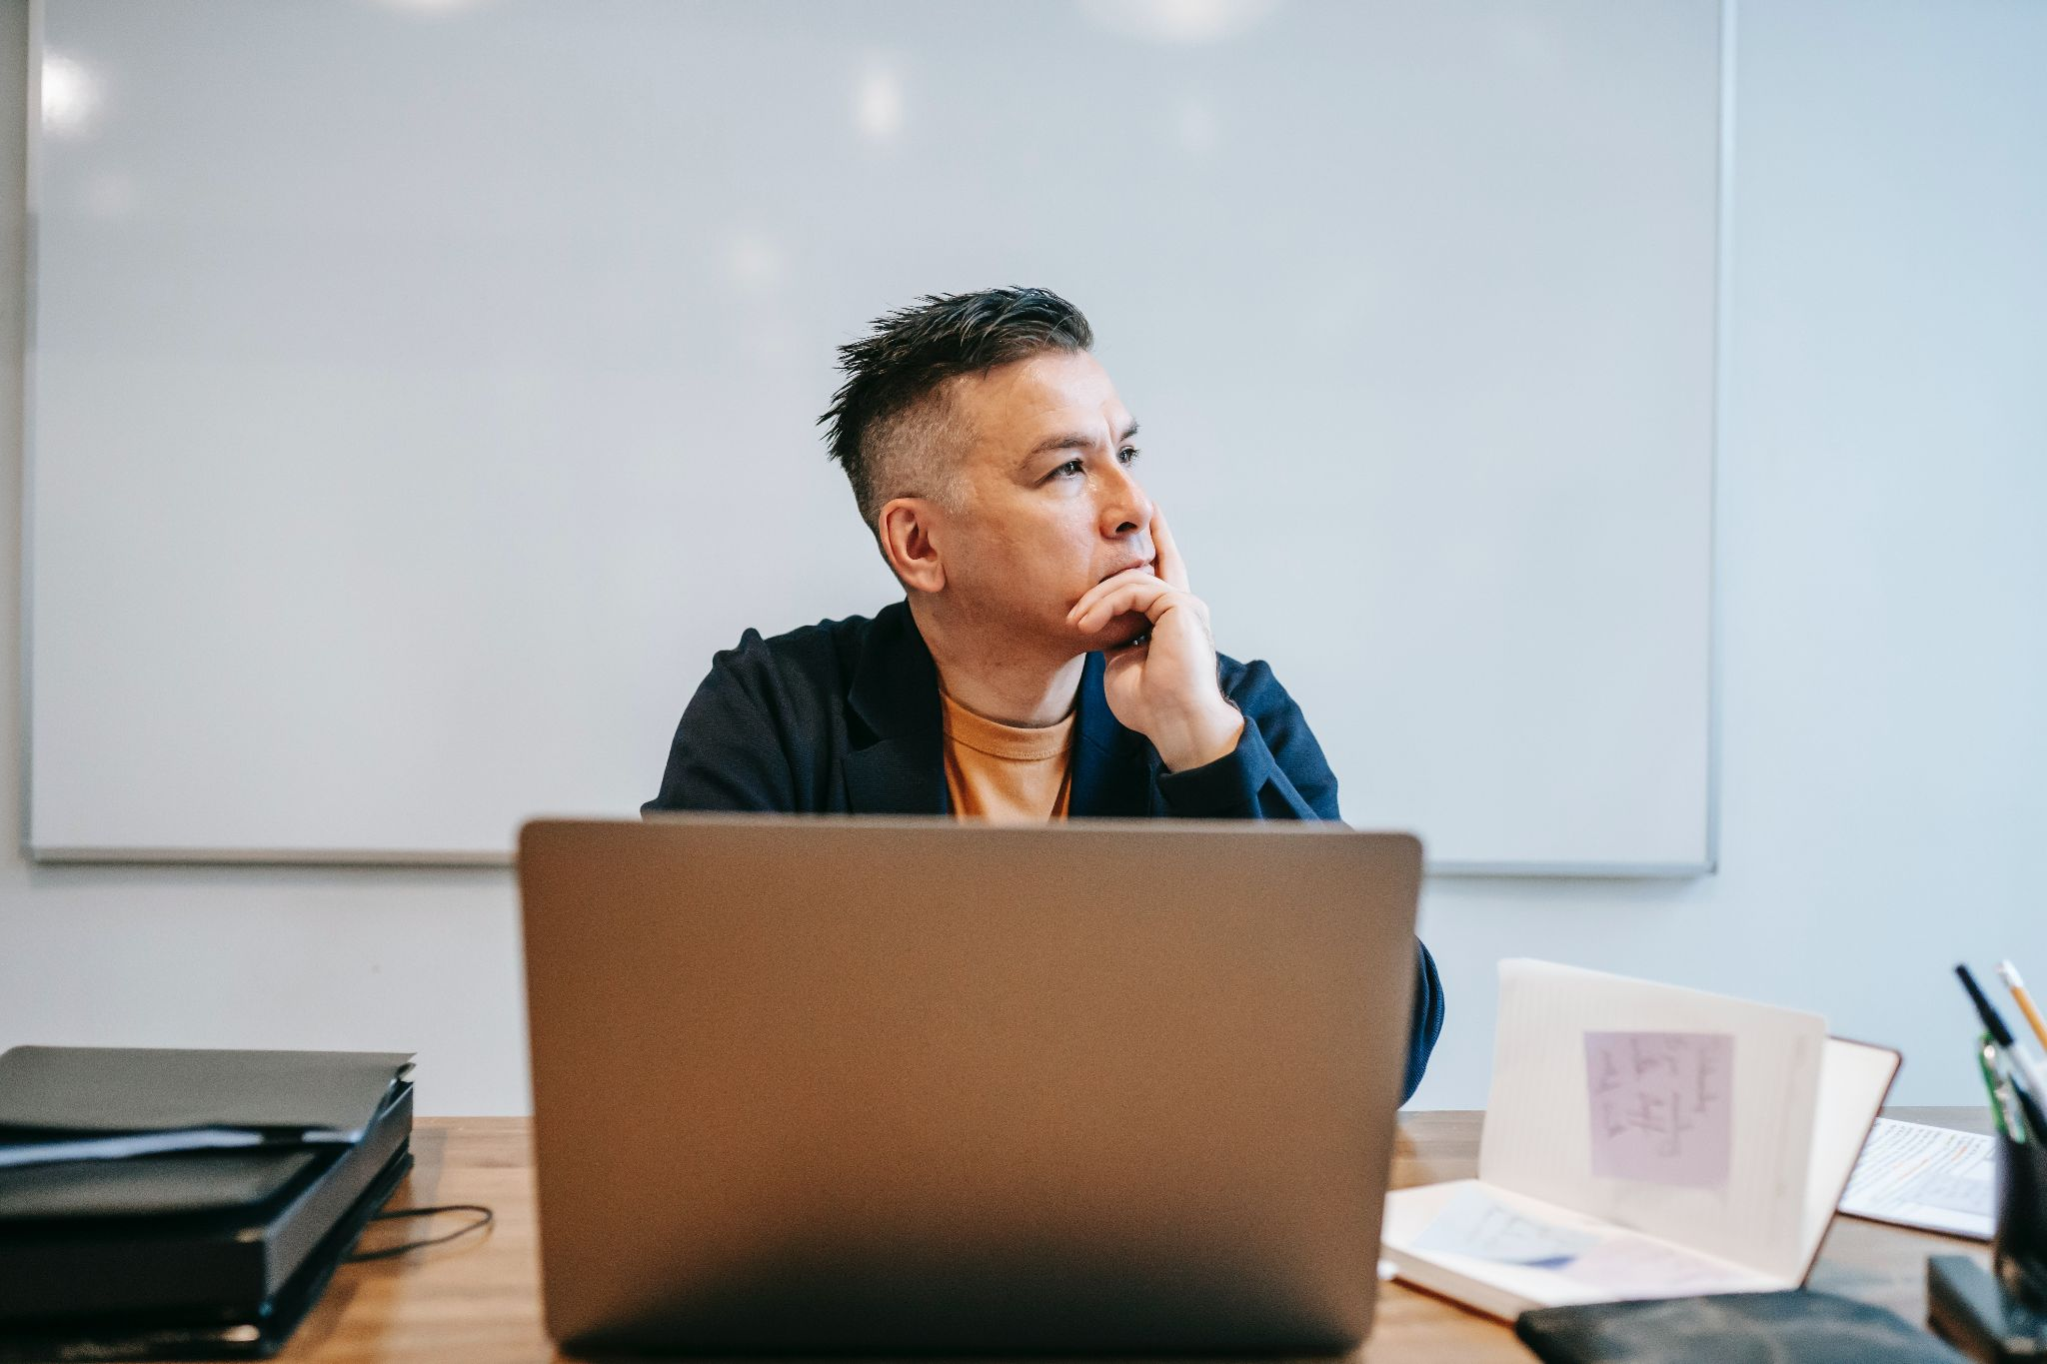
Positionality for researchers
Core
“...Requires researchers to identify their own degrees of privilege through factors of race, class, educational attainment, income, ability, gender, citizenship, among others, before seeking the epistemological basis of their intellectual craft” (Duarte, 2017)
“...Must see themselves and their conceptual universe in relation to the nature of the problem” (Duarte, 2017)
Image by Vanessa Garcia / Pexels
Notes:
Speaker notes: For researchers, positionality requires critical self-reflection and a reorientation of one’s own worldview so that it is relevant and appropriate to the subject that is being researched.
Pascua Yaqui/Chicana scholar Marisa Elena Duarte states:
“...The methodology of positionality requires researchers to identify their own degrees of privilege through factors of race, class, educational attainment, income, ability, gender, and citizenship, among others, before seeking the epistemological basis of their intellectual craft. Doing so helps them understand how their way of making meaning, of framing research, within their conceptual universe is tied to their positionality within an unjust world.
“...Before researchers can reframe a social problem and diagnose an intervention, they must see themselves and their conceptual universe in relation to the nature of the problem and, from that point, make decisions about what to foreground in the assessment and depiction of the problem” (Duarte, p. 135, 2017).
One major privilege that researchers professionals often have over their research subjects is information privilege.
Reference:
Duarte, M.E. (2017). Network Sovereignty: Building the Internet Across Indian Country. Seattle: University of Washington Press.

Slide 17
Information privilege
Core
What does “information privilege” mean?
(Or what do you think it means?)
Notes:
(For in-person or synchronous delivery, you can pose this question to the class for a brief discussion/to break up the lecture)
Speaker notes: What does “information privilege” mean, or what do you think it means?

Slide 18
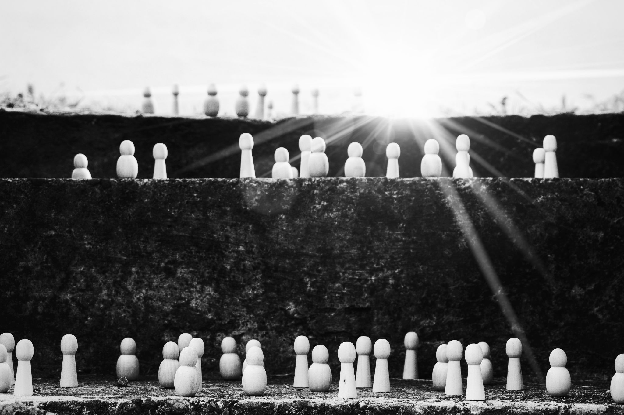
Information privilege
Core
Ability to access knowledge and resources that are not available to everyone
The power conferred by proximity to and familiarity with certain kinds of information
Accumulation of special rights and advantages regarding the consumption and production of information
Image by Susanne Jutzeler / Pexels
Notes:
Speaker notes: The librarian Char Booth coined the term “information privilege” to describe a condition in which some people have “the status, economic access, skills, structures, and networks to find and use diverse information in many contexts” (2014).
Information privilege is the ability to access knowledge and resources that are not available for everyone, the power conferred by proximity to and familiarity with certain kinds of information, and the accumulation of special rights and advantages regarding the consumption and production of information.
Like other forms of privilege, it’s often hard for those who have information privilege – such as researchers, librarians, and university students – to recognize this privilege or its significance.
As information professionals, it is up to us to holistically consider how the power associated with information can become embedded into other contexts.
Reference:
Booth, C. (2014). On information privilege. Info-mational. https://infomational.com/2014/12/01/on-information-privilege/

Slide 19
Core
Activity 1: Unpacking information privilege
Notes:
(This slide is for in-person and synchronous instruction)
Speaker notes: For the next 10-15 minutes, we will explore how information privilege applies to our own experiences.

Slide 20
Activity 1: Unpacking information privilege
Core
What are some ways that you experience information privilege?
Notes:
(This slide is for in-person instruction)
Speaker notes: In groups of 2-3, please discuss the following question: what are some of the ways that you experience information privilege?
(After 2-3 minutes of discussion, ask 3-5 students to share their thoughts with the class.)

Slide 21
Activity 1: Unpacking information privilege
Core
What did you notice about these answers?
Notes:
(This slide is for in-person instruction)
Speaker notes: What did you notice about these answers?
(Ask 3-5 students to share their thoughts with the class.)

Slide 22
Activity 1: Unpacking information privilege
Core
How might these answers manifest in libraries?
Notes:
(This slide is for in-person instruction)
Speaker notes: How might these answers manifest in libraries?
Suggested prompts for students to consider, if they’re stuck: The presentation of collections, physical arrangement of a library, library services, values or attitudes of libraries, values or attitudes of librarians
(Ask 3-5 students to share their thoughts with the class.)

Slide 23
Activity 1: Unpacking information privilege
Core
How did it feel to be asked about your information privilege? Did you feel defensive? Uncomfortable? Why or why not?
Notes:
(This slide is for in-person instruction)
Speaker notes: To wrap up this activity, I’d like to have you all silently reflect on this question: How did it feel to be asked about your information privilege? Did you feel defensive? Uncomfortable? Why or why not?

Slide 24
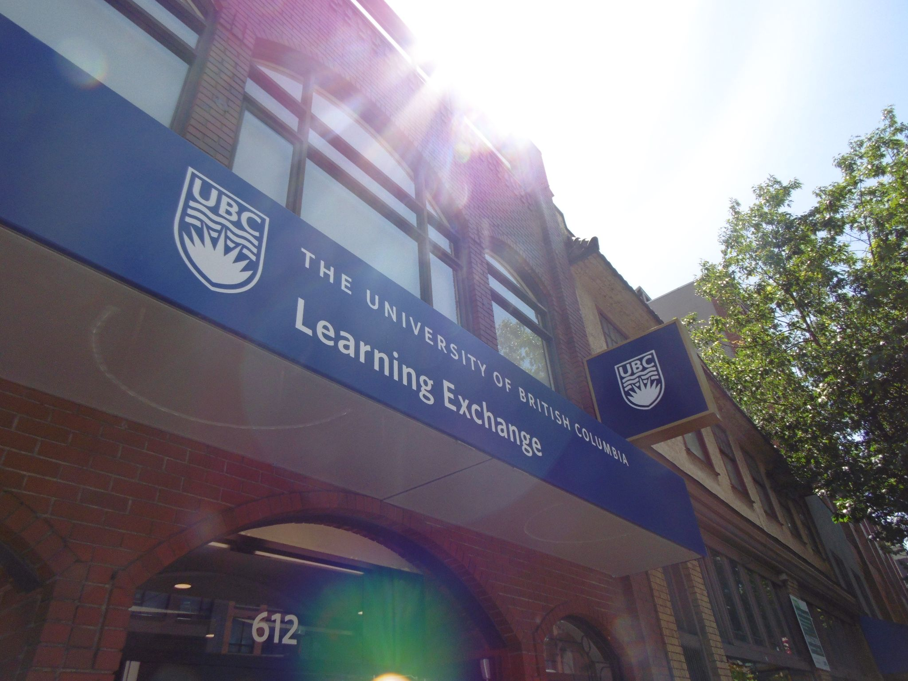
Part 2: The Downtown Eastside (DTES) and meaningful access to research
Core
Image by Geoff D’Auria / UBC Learning Exchange
Notes:
Speaker notes: We’ll now explore the Downtown Eastside Research Access Portal as a case study for enabling community-driven, meaningful access to research.

Slide 25
Contextualizing the DTES
Core
Established on the unceded, traditional, and continually occupied territory of the xʷməθkwəy̓əm (Musqueam), Skwxwú7mesh (Squamish), and Səl̓ílwətaɬ (Tsleil-Waututh) peoples
DTES community members tend to experience a lower level of information privilege due to a variety of barriers
DTES is often the subject of academic research
Notes:
Speaker notes: The Downtown Eastside is located in present-day Vancouver, a city that was established on the unceded, traditional, and continually occupied territory of the xʷməθkwəy̓əm (Musqueam), Skwxwú7mesh (Squamish), and Səl̓ílwətaɬ (Tsleil-Waututh) peoples.
Members of the Downtown Eastside community tend to experience a lower level of information privilege due to barriers to digital access, education, housing, employment, and other challenges.
Especially because the UBC’s Vancouver campus is very close to the Downtown Eastside, the Downtown Eastside community has become over-researched. Residents typically do not benefit from their participation in academic studies and often feel exploited by many of these academic studies.

Slide 26
Activity 2: Reflecting on the DTES
Core
In groups of 2-3, share your top 3 takeaways* from the “Getting to know the DTES” resources.
*Takeaways =
    2 comments on new things you learned or were surprised by
    1 question that came to mind
Notes:
(This slide is for in-person and synchronous instruction)
Speaker notes: For the next 10-15 minutes, let’s reflect on some of the resources on the Downtown Eastside that we engaged with for today’s class.
Activity instructions:
In groups of 2-3, students will share their top 2-3 takeaways from the “Getting to know the DTES” resources that they engaged with before class.
These takeaways can be framed as “2 comments and a question”, where students comment on 2 new things they learned or were surprised by and a question that came to mind while they were reviewing the material.
Have students break out into groups with students sitting near them.
Give students 5-10 minutes to discuss.
Afterward, bring the class back together and ask students to share the takeaways/comments and questions they discussed, reflect on surfacing different narratives and perspectives about the DTES, and what these narratives and perspectives say about the complexity of the neighbourhood.

Slide 27
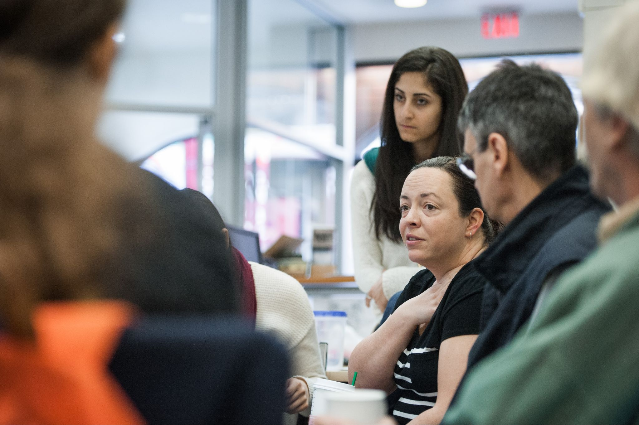
MRAi: Addressing over-research and supporting information accessibility in the DTES
Core
MRAi founded in 2015
  Responding to DTES community’s need to access high-quality research and information
DTES community is concerned with research projects that extracted information from residents and produced unavailable findings
DTES orgs want to preserve community-generated materials
These factors led to the creation of the RAP
MRAi’s goals, principles, more info:
  dtesresearchaccess.ubc.ca/about
Image by Martin Dee / UBC Brand & Marketing
Notes:
Speaker notes: Because institutions like UBC are located near the DTES, DTES residents have frequently been the subject of academic research. However, many residents feel that the neighbourhood has become over-researched, that researchers are extractive, and that the benefits of their participation in these research studies are not always perceptible.
The MRAi was founded in 2015 in response to consultations with people living and working in the DTES who voiced a need to access high-quality research and information. These groups expressed concern with research projects that extracted information from people in the neighbourhood and produced findings unavailable to residents. Members of community organizations also identified a need to preserve community-generated materials. Ultimately, these concerns and information needs are what led to the creation of the RAP.
The MRAi has specific goals and principles that guide their mission. These include increasing the accessibility and impact of research by providing easier online access to information about the DTES, identifying community-generated materials and increasing their availability in and beyond the DTES, creating opportunities for community organizations, community members, researchers, students, and others to share information and learn from one another; supporting making research accessible to everyone, and recognizing that not all knowledge should be available to everyone and that some knowledge is sacred or private (DTES Research Access Portal, n.d.). The list of these goals and principles and other information about the MRAi and the RAP, you can visit their “About” page linked in the slide.
Reference:
DTES Research Access Portal. (n.d.). About. https://dtesresearchaccess.ubc.ca/about

Slide 28
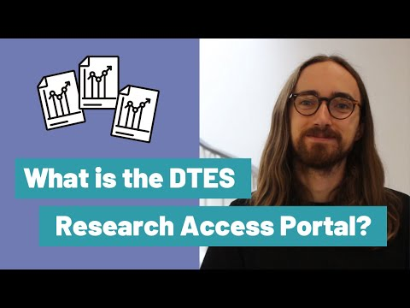
Core
Notes:
(This slide is for synchronous instruction)
Speaker notes: I’d now like to shift our focus to the RAP. We’ll watch this 2-minute video for a quick overview of the RAP looks like and how it works.
Video link: https://www.youtube.com/watch?v=yLoS2eZcv4E&feature=youtu.be

Slide 29
Activity 3: Searching the RAP
Core
Scenario: You are a librarian helping a graduate student find free-to-access articles on Indigenous health for a workshop they are hosting.
Task: Find 1-2 relevant sources for this student on the RAP (dtesresearchaccess.ubc.ca).
Notes:
(This slide is for in-person and synchronous instruction)
Speaker notes: For the next few minutes, I’d like us to use the RAP and think about our search process.
Activity instructions:
Students will imagine that they are librarians who are helping a graduate student find free-to-access articles on Indigenous health for a workshop they are hosting.
Have students use the RAP (dtesresearchaccess.ubc.ca) to find 1-2 resources for this student.
Give students 5-10 minutes to complete this activity.
Ask 1-2 students to share what resource(s) they would recommend and how they completed their search.

Slide 30
Reflecting on the RAP
Core
What aspects of the RAP work well to reduce barriers to accessing research?
What design features contribute to the easing of these barriers?
What's missing?
Notes:
(This slide is for in-person and synchronous instruction; it is a prompt for an optional 5-minute discussion)
Speaker notes: Now that we’re more familiar with the RAP, I’d like you to reflect on the ways the RAP works to reduce barriers to accessing research by considering the following questions:
What aspects of the RAP work well to reduce these barriers?
What design features contribute to the easing of these barriers?
What's missing?

Slide 31
Wrap-up
Core
Consider the DTES as a case study for how social barriers and challenges can exacerbate information privilege, lead to over-research and extractive research practice, and undermine the strength and resiliency of the community
Knowledge exchange can be a more collaborative and equitable process among community members who are historically excluded from these academic discussions
Reflect on our own positionality and information privilege
Notes:
Speaker notes: In today’s lecture, we examined the DTES as a case study for how barriers to education, housing, employment, and other challenges can exacerbate information privilege, lead to perceptions of over-research and extractive research practices, and undermine the strengths and resiliency of the community. We considered the ways that knowledge exchange can be more collaborative and equitable among community members who are historically excluded from these academic discussions, and we have reflected on our own positionality and information privilege. Our goal is to highlight the ways that a community-driven resource like the DTES RAP can help disrupt deficit-based narratives and build a more just, dynamic partnership with the communities we seek to serve.

Slide 32
Pathways
Pathway 1: Information access and alternative formats (Slide 33)
Pathway 2: Supporting community-led research (Slide 42)
Pathway 3: Community engagement and services (Slide 46)
Notes:
The rest of the slide deck includes slides for each of the pathways, linked above.
We recommend taking a 10-15 minute break before beginning a pathway.

Slide 33

Information access and alternative formats
Pathway 1
Image by Martin Dee / UBC Brand & Marketing
Notes:
Speaker notes: For the second part of today’s lesson, we will discuss how we can improve access to information.

Slide 34
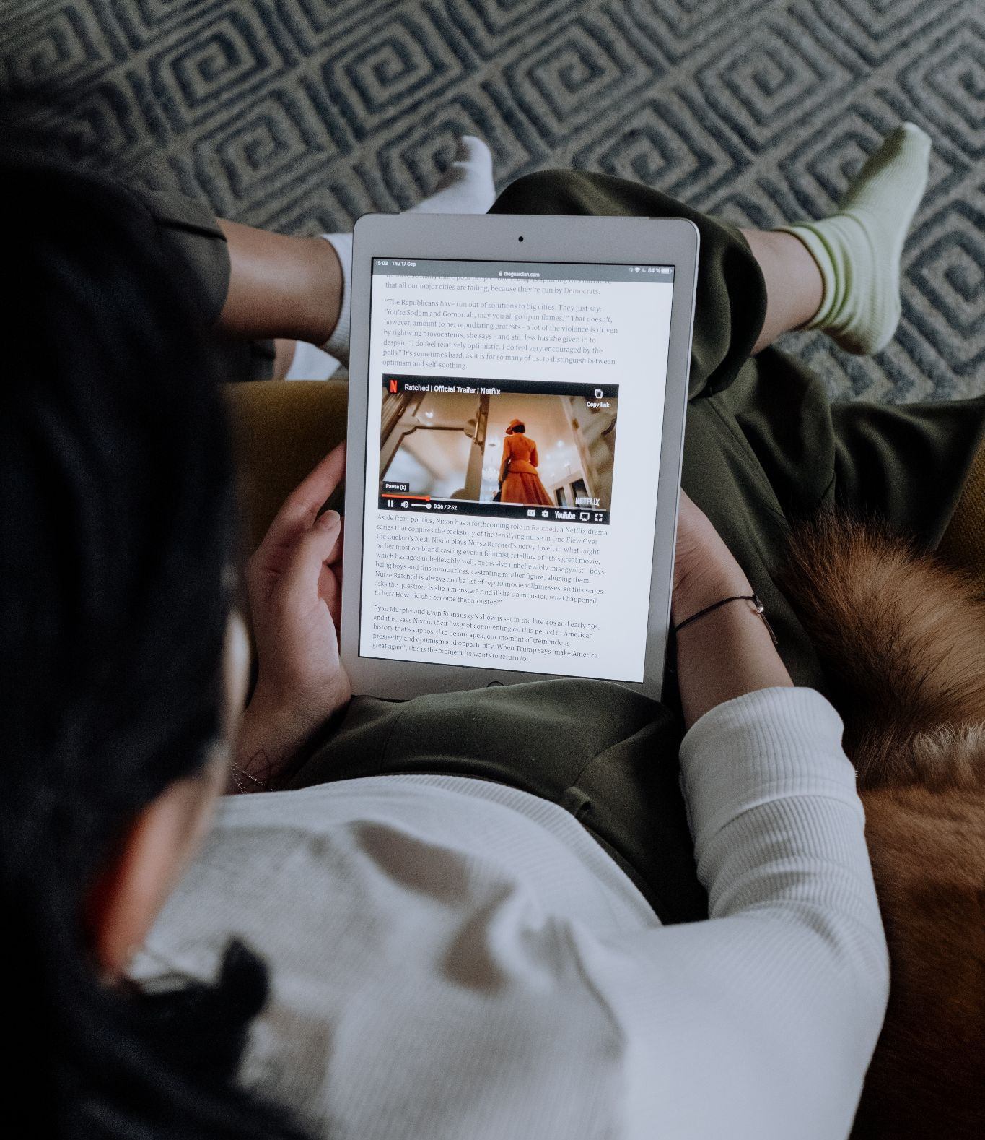
Improving information access
Pathway 1: Information access and alternative formats
Asset-based metadata
Non-traditional models of knowledge dissemination
Guiding question: How are librarians supporting the co-creation of knowledge for different constituents, especially non-experts?
Image by cottonbro / Pexels
Notes:
Speaker notes: Specifically, we will discuss how information access can be improved with asset-based metadata and non-traditional models of knowledge dissemination.
As a guiding question throughout this lesson, I would like you to consider how librarians are – and could more actively – support the co-creation of knowledge for different constituents, especially non-experts.

Slide 35

Part 1: Improving accessibility with asset-based metadata
Pathway 1: Information access and alternative formats
How can we describe content in a way that is accessible to non-experts?
Specialized terminology
  Library of Congress subject headings
  RAP asset-based subject headings
Image by Olena Sergienko / Unsplash
Notes:
Speaker notes: When creating a community-facing knowledge portal, one major challenge is describing content in a way that is accessible to non-experts. Scholarly publications tend to use specialized terminology and legacy classification systems (such as the Library of Congress [LC]) to create subject terms that are used as metadata in library discovery systems.
The RAP has grappled with this issue. For example, the RAP uses asset-based subject terms that are very specific to its goals and collection, but they may not be as familiar to a wider audience who is not familiar with these terms or a more asset-based way of framing social issues. Conversely, while many academic libraries use the LC system to organize their collections, LC subject terms can be incompatible with the inclusive, asset-based terminology needed to make the RAP more accessible.

Slide 36
Activity 1: Comparing terminology
Pathway 1: Information access and alternative formats
In groups of 3-4, choose 1 article from the RAP’s Research Topics (https://dtesresearchaccess.ubc.ca/topics)
Identify potential Library of Congress (LC) subject headings for this article (https://id.loc.gov/authorities/subjects.html)
Within your groups, address the following questions:
  How do the RAP’s topic terms differ from the LC subject headings you have chosen?
  How might different audiences react to the LC and RAP topics?
  Are there other terms not in the RAP’s Research Topics that could be included to enhance knowledge sharing?
  What ethical issues, if any, can you articulate about the way the knowledge in this article is represented by either classification system?
Notes:
(This slide is for in-person and synchronous instruction)
Speaker notes: For our next activity, we will consider asset- and deficit-based terminology by comparing the RAP’s Research Topics with Library of Congress (LC) subject headings.
Activity instructions:
In small groups, have students choose one freely available article from the RAP’s Research Topics (https://dtesresearchaccess.ubc.ca/topics).
Students will identify potential LC subject headings (https://id.loc.gov/authorities/subjects.html) for that article and consider the following questions:
How do the RAP’s topic terms differ from the LC subject headings you have chosen?
How would different audiences react to the LC and RAP topics?
Are there other terms not in the RAP’s Research Topics that could be included to enhance knowledge sharing?
What ethical issues, if any, can you articulate about the way the knowledge in this article is represented by either classification system?
Give students 15-20 minutes to complete this activity and have students share their findings afterward.

Slide 37
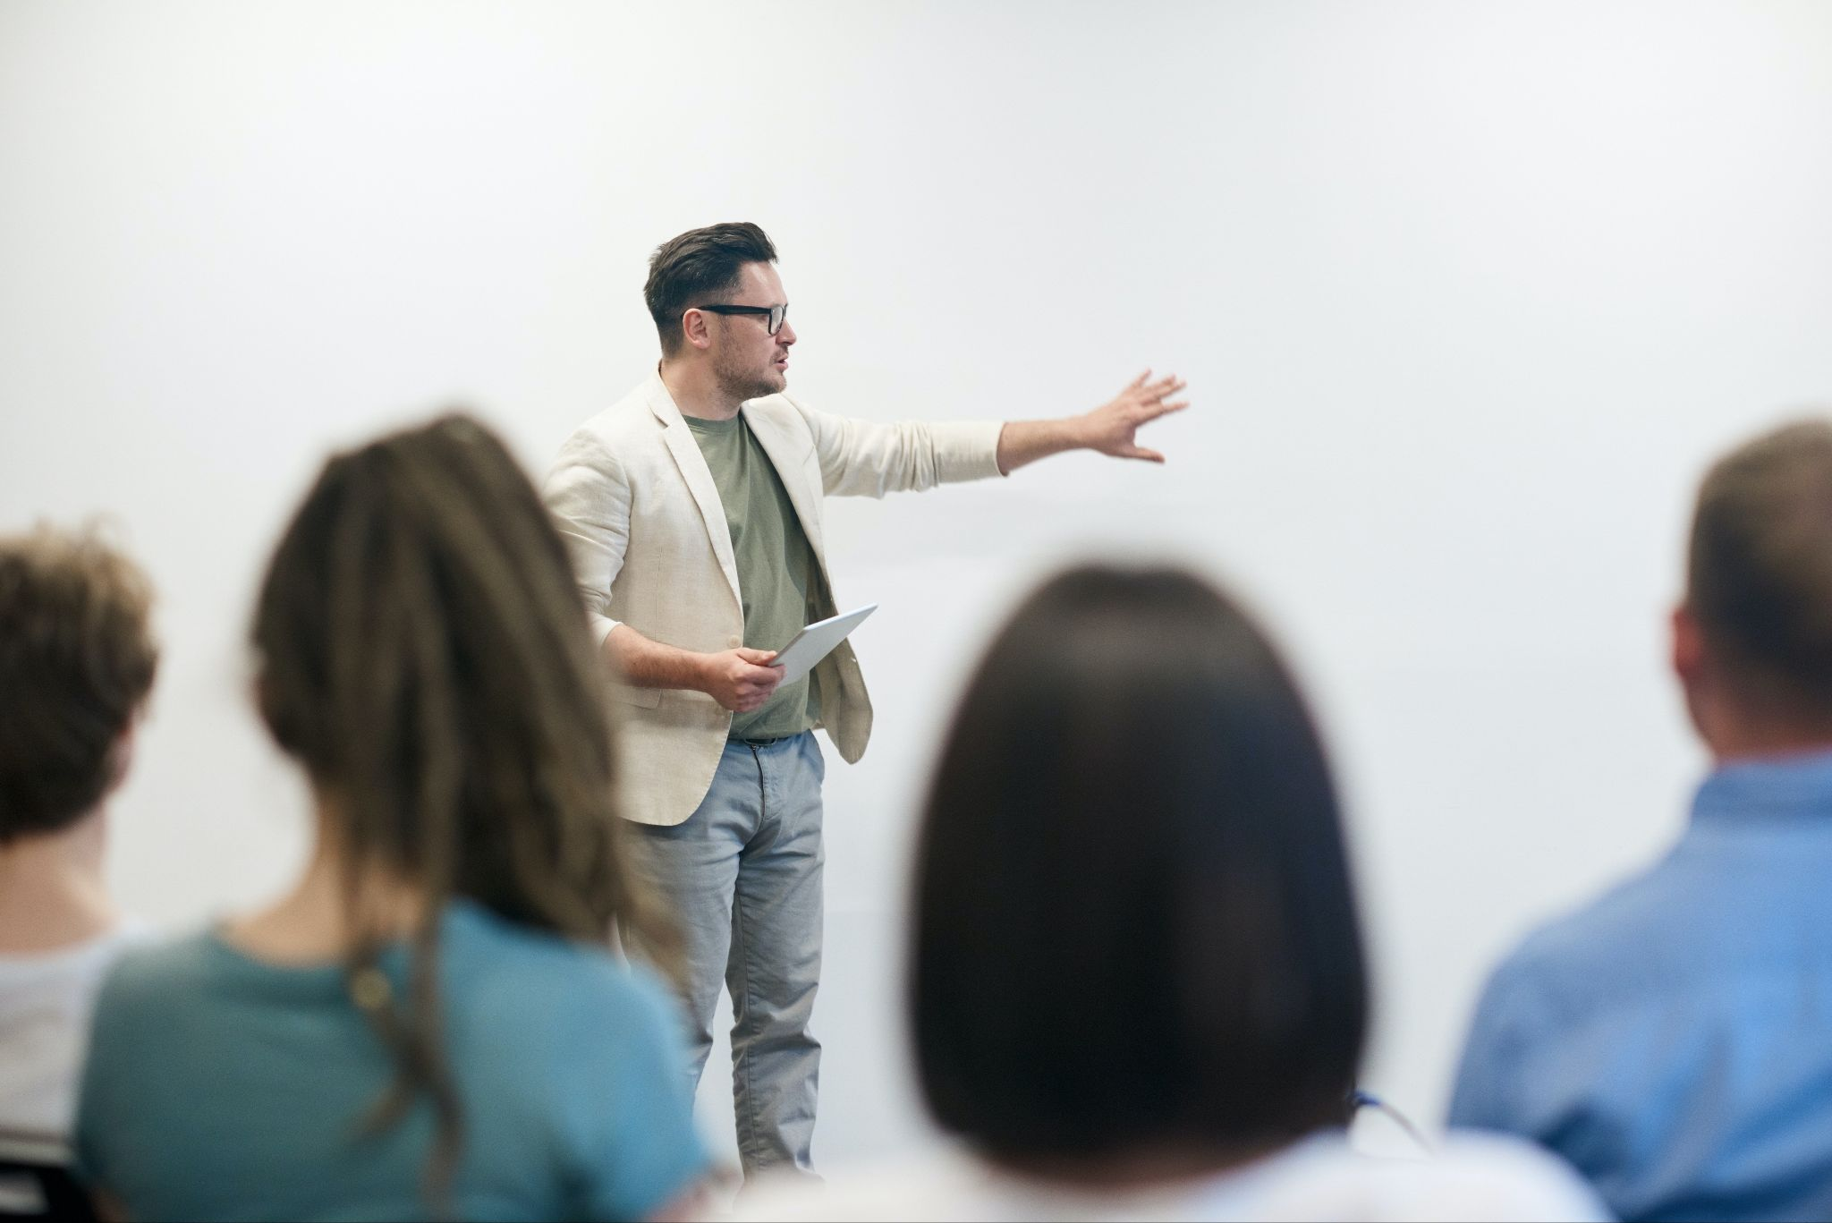
Part 2: Alternative formats
Pathway 1: Information access and alternative formats
Traditional model of knowledge dissemination =
  producers (publishers, scholars)
  consumers (“society”)
K* = represents all words/acronyms that describe knowledge exchange (Shaxson et al., 2012)
  knowledge mobilization
  knowledge transfer
  knowledge transfer and exchange
  knowledge brokering…
Image by fauxels / Pexels
Notes:
Speaker notes: As we’ve seen in the previous activity, the more traditional model of knowledge dissemination features a distinct group of producers – such as major publishers and university scholars – and consumers, who are patients, community residents, and the rest of “society”.
At the start of today’s class, we acknowledged that “knowledge exchange” is one of many terms used to describe the dissemination of research. K* [“K-star”] is a convenient term that was developed to represent the plethora of words/acronyms (including but not limited to knowledge mobilization [KMb], knowledge transfer [KT], knowledge transfer and exchange [KTE], and knowledge brokering [KB]) that describe this concept. Shaxson et al. (2012) addresses how these terms are systemically linked to each other and present a framework for thinking about K*, which will make sharing approaches and lessons learned easier.
Optional short discussion for in-person or virtual (synchronous) instruction (2-3 min): Can you think of ways that the traditional model of knowledge dissemination is being disrupted today?
For example, makerspaces and widely available web-based technologies are enabling individuals from all backgrounds and skill levels to create and share objects, podcasts, images, art, books, and so on.
Reference:
Shaxson, L., Bielak, A., Ahmed, I., Brien, D., Conant, B., Fisher, C., & Phipps, D. (2012, April). Expanding our understanding of K*(KT, KE, KTT, KMb, KB, KM, etc.): A concept paper emerging from the K* conference held in UNU-INWEH Hamilton, ON. Retrieved from https://www.researchgate.net/publication/235434226_Shaxon_et_al_2012_K_concept_paper_Expanding_our_understanding_of_K_KT_KE_KTT_KMb_KB_KM_etc

Slide 38
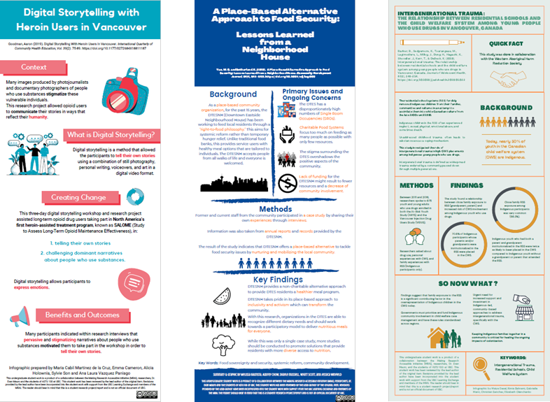
Case study: Student-instructor-researcher collaboration (MRAi + ASTU 100)
Pathway 1: Information access and alternative formats
The MRAi partnered with a first-year arts studies class at UBC (ASTU 100) to create qualitative research-based infographics on DTES research
ASTU 100 instructors and MRAi team engaged students and researchers in this process
Several example infographics created by ASTU 100 students.
Notes:
Speaker notes: In our reading, we learned about a collaboration between the MRAi and a first year arts studies class at UBC (ASTU 100), which resulted in the creation of qualitative research-based infographics about DTES research.
In order to ensure high quality representations of this research, the ASTU 100 instructors and MRAi team engaged both students and researchers in the process of creating these infographics.

Slide 39
MRAi + ASTU 100 Case study: Process
Pathway 1: Information access and alternative formats
MRAi + instructors select papers from RAP for students to work with
MRAi contacts corresponding authors to invite them to participate in the project by providing feedback on student work
MRAi gives a workshop to students about the DTES RAP & creating infographics
Students draft clear language summaries of the papers
Instructors select top summaries for authors to provide feedback
Students translate approved summaries into infographics
Instructors share draft infographics with researchers for feedback
Students revise and finalize infographics for researcher approval
If approved: Students + researcher sign licence for infographics; infographics are added to UBC’s institutional repository (cIRcle) and RAP
Notes:
Speaker notes: Here is an overview of what this process entailed.
For students, this exercise provides an opportunity to engage in knowledge exchange directly with researchers. For researchers, it’s an opportunity to extend the reach of their work with student support. It also helps reach MRAi goals by increasing the number of accessible research items included in the RAP and available for community members.
Note: These ASTU 100 student infographics can be found in the RAP (https://dtesresearchaccess.ubc.ca/search?q=%2a&size=20&from=0&sort=_score&term=&nested_term=affiliation.value.raw,Coordinated%2520Arts%2520Program%252C%2520UBC%3Bgenre.value.raw,Infographic%3B&terms=&range=&index=rap-prod).

Slide 40
Activity 2: Advancing accessible research items
Pathway 1: Information access and alternative formats
Creating these infographics requires a significant investment of time and still leaves many research papers without an accessible version. What strategies or techniques could be used to accelerate the creation of more accessible research derivatives?
Could this project be used as an example to encourage researchers to proactively plan for creating K* products?
How can librarians advocate for changes to scholarly publishing practices to encourage the creation of more K* products as part of research projects?
Notes:
(This slide is for in-person and synchronous instruction)
Speaker notes: For our next activity, I’d like you to think about the connection between this specific, tangible project and the broader context of librarian roles in advocating for more diverse, accessible forms of scholarly communication.
Activity instructions:
Divide students into groups of 3 and ask them to discuss the following questions:
1. Creating these infographics requires a significant investment of time and still leaves many research papers without an accessible version. What strategies or techniques could be used to accelerate the creation of more accessible research derivatives?
2. Could this project be used as an example to encourage researchers to proactively plan for creating K* products?
3. How can librarians advocate for changes to scholarly publishing practices to encourage the creation of more K* products as part of research projects?

Slide 41
Wrap-up
Pathway 1: Information access and alternative formats
Think critically about the way we describe items
Advocate for terminology that reflects how diverse communities describe themselves and the topics that are important to them
Support projects that translate research knowledge into more accessible formats
Advocate more broadly to raise expectations that research projects include accessible derivatives in their planning process, rather than as an afterthought
What role can you imagine librarians taking in supporting researchers who want to creates these kinds of products?
Notes:
Speaker notes: In this pathway, we have explored two ways in which librarians can contribute to making research information more accessible. First, we can think critically about the way we describe items and advocate for terminology that reflects how diverse communities describe themselves and the topics that are important to them. Second, we can support projects to translate research knowledge into more accessible formats while advocating more broadly to raise expectations that research projects include accessible derivatives in their planning process, rather than as an afterthought.
I’d like to close with this final reflection: What role can you imagine librarians taking in supporting researchers who want to create these kinds of products?

Slide 42
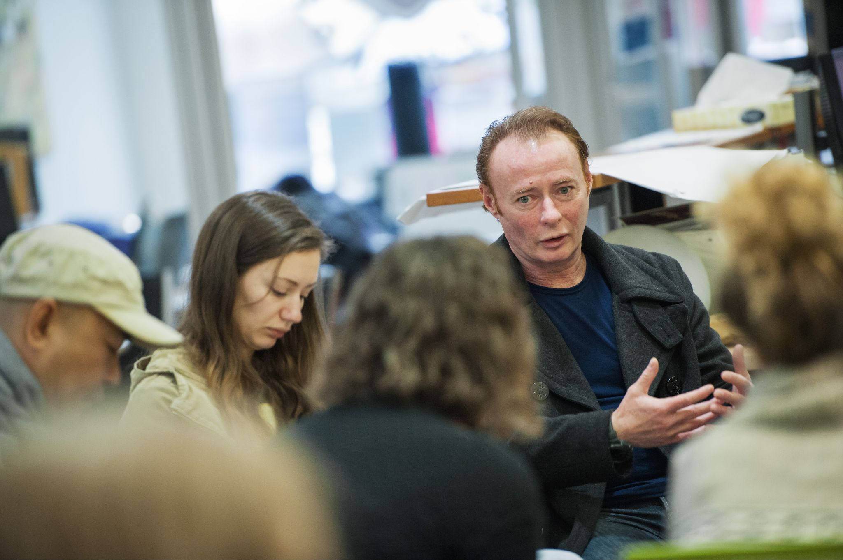
Supporting community-led research
Pathway 2
Image by Martin Dee / UBC Brand & Marketing
Notes:
Speaker notes: For the second part of today’s lesson, we will discuss what community-led research can look like.

Slide 43
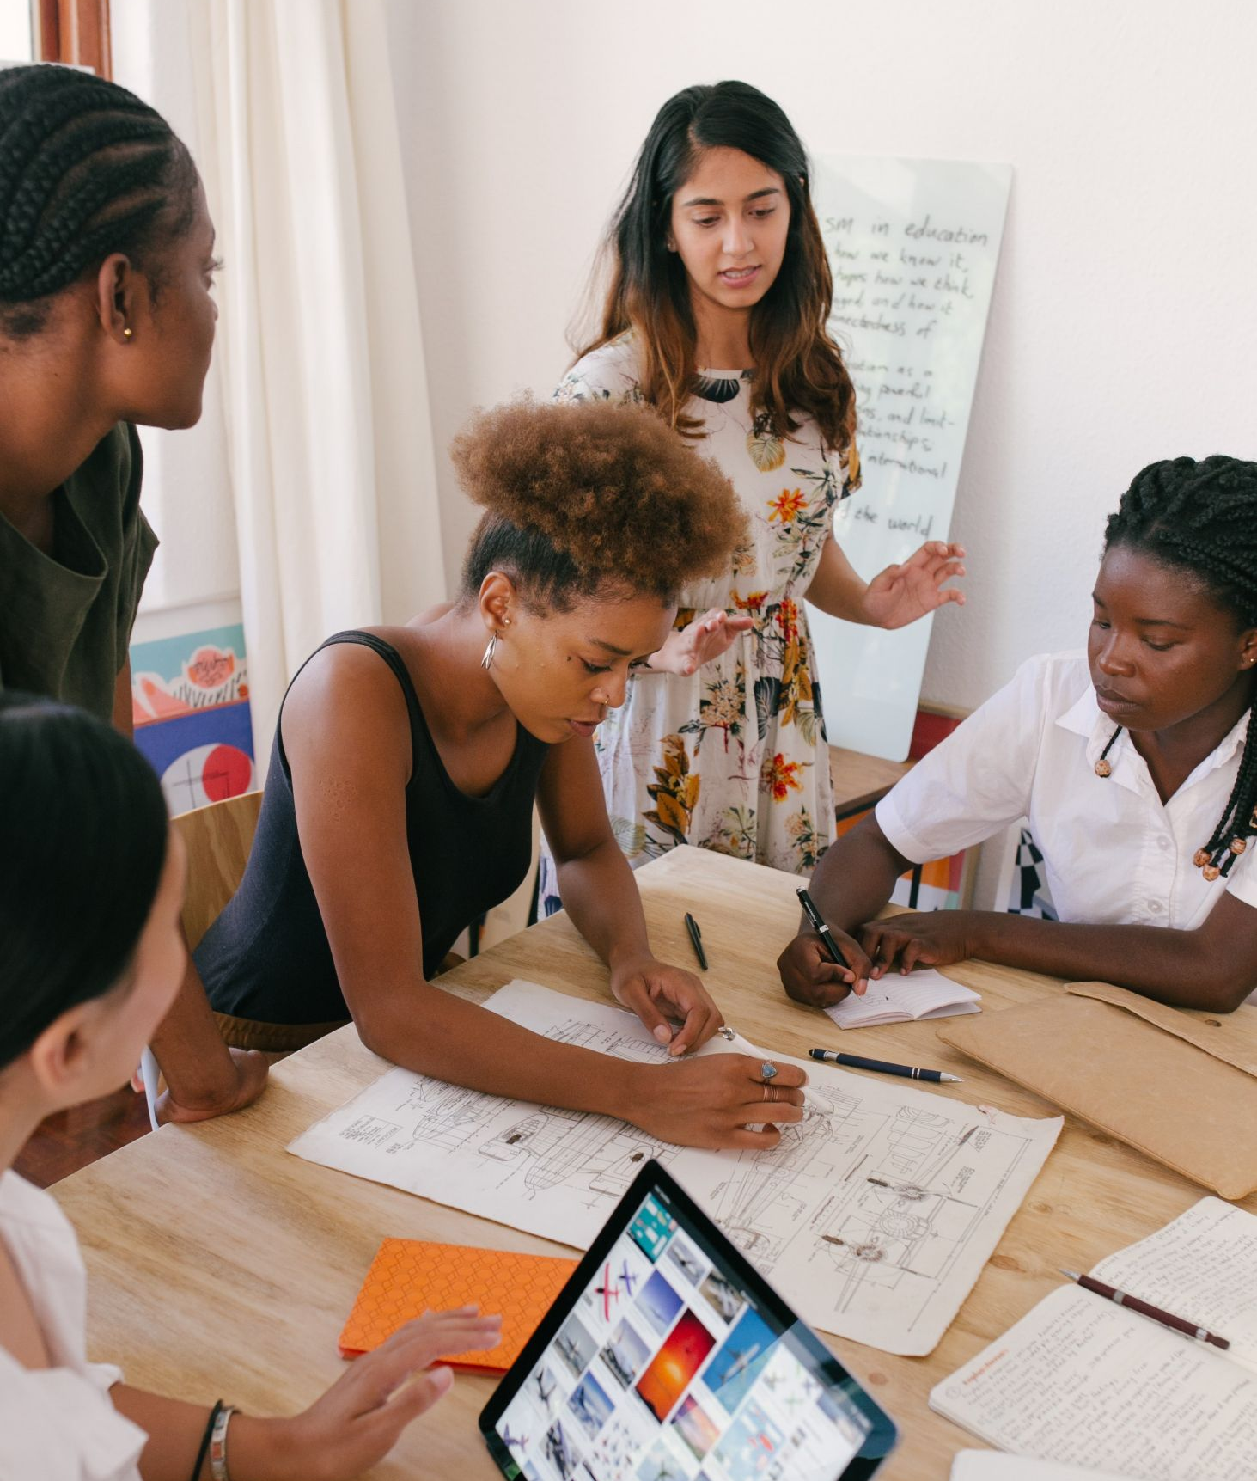
Discussion
Pathway 2: Supporting community-led research
What relationships and partnerships are reflected in the assigned readings? Who is involved? What are their roles?
Do the examples change the way you think about "expertise"? What kinds of expertise are reflected in information organizations and communities?
How do academic librarians serve a broader community than university students, staff and faculty?
Image by RF._.studio / Pexels
Notes:
(This slide is for in-person and synchronous instruction)
Speaker notes: We will start with some small-group discussion based on the materials we reviewed for today’s class.
Discussion instructions:
In small groups, have students discuss the following questions (10-15 minutes):
1. What relationships and partnerships are reflected in the assigned readings? Who is involved? What are their roles?
2. Do the examples change the way you think about "expertise"? What kinds of expertise are reflected in information organizations and communities?
3. How do academic librarians serve a broader community than university students, staff and faculty?
Afterward, bring students back together and have students share their reflections with the class.

Slide 44
Activity 1: Exploring and using community-generated material
Pathway 2: Supporting community-led research
Select and read 1 piece of community-generated research in the RAP (dtesresearchaccess.ubc.ca/search, search: community materials), then consider:
  What would you want students, researchers, and/or policy makers to know about the research? What issues does it address, and what is the value of its perspective?
  What drawbacks are there to students, researchers, and/or policy makers NOT learning about this research?
Come up with a strategy to promote this research to students, researchers, OR policy makers that includes:
  A main message
  How your group would deliver it
  Why your group think it’s a good approach
Notes:
(This slide is for in-person and synchronous instruction)
Speaker notes: For the second part of today’s lesson, we will start with some small-group discussion before sharing our thoughts as a class.
Activity instructions:
In small groups, students will locate community-generated research in the RAP (dtesresearchaccess.ubc.ca/search, search for "community materials") and select 1 piece to read and discuss. (If the piece is lengthy, students can skim it or assign a section to each group member to review.)
After reviewing, students should answer the following questions:
1. What would you want students, researchers, and/or policy makers to know about the research? What issues does it address, and what is the value of its perspective?
2. What drawbacks are there to students, researchers, and/or policy makers NOT learning about this research?
Each group will then come up with a strategy to promote their material to students, researchers, OR policy makers. The strategy should include a main message, how the group would deliver it, and why the group thinks it's a good approach.
Give students 20 minutes to complete this activity. Circle around to the groups to check in on their progress. Give a 5-minute warning before time is up.
Afterward, have each group present their findings to the class.

Slide 45
Wrap-up
Pathway 2: Supporting community-led research
Consider how academic research can be made more accessible to community members and organizations
Consider the role of community-generated materials in the research landscape
Information professionals have an important role in facilitating the movement of knowledge among different communities
Non-academic constituents contribute to knowledge that advances our understanding of societal issues
Notes:
Speaker notes: In this pathway, we have explored the concept of research from a non-academic perspective. We have explored different examples for how academic research can be made more accessible to community members and organizations, and we have considered the role of community-generated materials in the research landscape. The goal of this pathway is to underscore the role that librarians, archivists, information professionals and community educators have in facilitating the movement of knowledge between different communities and recognizing the role that non-academic constituents have in contributing to knowledge that advances our understanding about important societal issues.

Slide 46
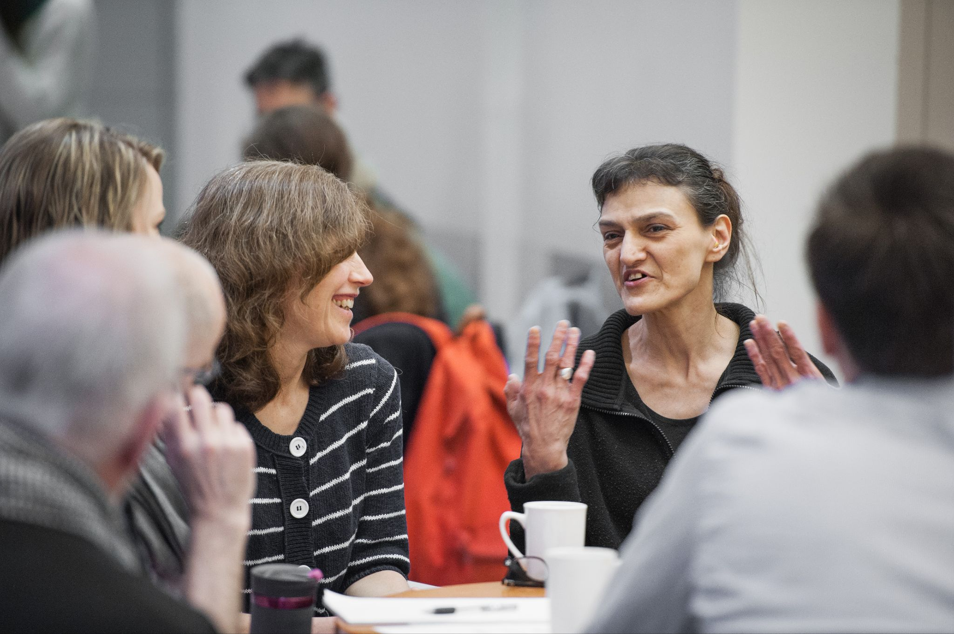
Community engagement and services
Pathway 3
Image by Martin Dee / UBC Brand & Marketing
Notes:
Speaker notes: For the second part of today’s lesson, we will be focusing on community engagement and services.

Slide 47
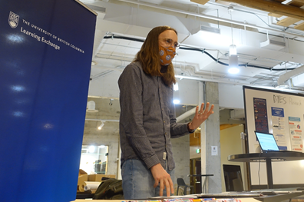
Engaging the community
Pathway 3: Community engagement and services
Librarians have a critical role to play as information intermediaries
The MRAi developed a free service to enable more meaningful access to the RAP and beyond for community members
  Community engagement approach
  Build relationships
  Dispel misconceptions
  Communicate clearly
Community engagement librarian Nick Ubels speaks with a community member at a pop up library event in the Downtown Eastside.
Image by Geoff D’Auria / UBC Learning Exchange
Notes:
Speaker notes: Aside from creating accessible resources informed by community priorities, librarians also have a critical role to play as information intermediaries. The MRAi has developed a free help service to enable more meaningful access to the items contained within the RAP and beyond for community members. While the core functions of this work (reference, information literacy workshops, etc) are well within the conventional instructional librarian skill set, they are developed and delivered using a community engagement approach that seeks to break down barriers to using this service.
Some of the affective barriers experienced by community members can be bridged through careful relationship-building. Tact, sensitivity, and a good sense of humour can go a long way towards earning trust. It’s important to recognize that many people may bring negative past experiences with, or stereotypical perceptions of, academic institutions and libraries. Working against a mixed reputation means you may not be starting from a blank slate, but repairing a relationship by showing up, and consistently following through on promises made. Take things slow and expect that this trust will take time to build. Over time, you can begin to understand the complex, inter-related organizations, individuals, and groups who co-exist within a given community. It can be helpful to identify gatekeepers, or those who have already established trust, as key allies in cultivating new relationships with community members. They can help you build credibility and navigate the nuanced politics that may be present.
One of the top five barriers identified in the Edmonton Public Library report is service awareness. Community members may have outdated misconceptions about what a librarian does or hold onto some library anxiety. These knowledge or affective barriers can limit the benefits they might experience from well-intentioned initiatives. Even when introducing resources and services that are community-led to the broader community, it’s critical to consider how to describe them in a way that clearly communicates their value. This work requires us to think carefully about how we communicate, and avoid academic or library jargon.
Optional short discussion question for in-person or virtual (synchronous) instruction (2-3 min): What are some academic or library jargon words that might not be clear to people outside of the profession?

Slide 48
Activity 1: Elevator pitch
Pathway 3: Community engagement and services
You will have 5 minutes to create a 30-second elevator pitch based on a particular scenario that describes a library resource or service to a community member from outside the university without using academic or library jargon.
  Scenarios:
    #1: Describe the DTES RAP and its value
    #2: Describe a free community reference service for DTES community members
After, we will form groups of 4 (two #1’s + two #2’s) and share/critique these pitches based on this criteria:
  Was the pitch clear?
  Was it compelling?
  What did you like?
  What could be improved?
Notes:
(This slide is for in-person and synchronous instruction)
Activity length = 25 min
Speaker notes: We’ll now do a fun activity to help develop the skills we need to reduce service awareness barriers by clearly and effectively describing library resources and services to non-academic audiences. Let’s get some practice avoiding these terms!
Activity instructions:
Count off students so half the class is “1” and the other half is “2”.
Assign the “1” students with Scenario 1: Describe the DTES RAP and its value.
Assign the “2” students with Scenario #2: Describe a free community reference service for DTES community members.
Ask students to individually spend 5 minutes creating a 30-second elevator pitch based on their assigned scenario that describes a library resource or service to a community member from outside the university without using the academic or library jargon.
After, ask students to form groups of 4, where 2 students have Scenario #1 and 2 students have Scenario #2 (ideally). For approximately 10 minutes, students take turns delivering their pitch and providing structured feedback:
Was the pitch clear?
Was it compelling?
What did you like?
What could be improved?
Reconvene the whole class to reflect on the activity for 5 minutes. Instructor prompts could include:
What did you find challenging?
What worked well?
Did you have any “eureka” moments or phrases to share?

Slide 49
MRAi and community engagement
Pathway 3: Community engagement and services
Discussion:
What did you notice about the Q & A in the D’Auria (2021) article?
How effective do you think it would be in explaining this work to a community member? What about a researcher or student?
This Q & A was created 1 year after the RAP intro video. Did you notice any differences in the way the RAP and help services were described?
Notes:
(This slide is for in-person and synchronous instruction)
Speaker notes: The MRAi team has built on their existing knowledge of the DTES community and continues to try out different ways to share the DTES RAP. One of the reading for today was a conversational Q & A intended to clearly explain the RAP and the work of a community engagement librarian. As a class, I’d like to have a brief discussion about this reading:
1. What did you notice about this Q & A?
2. How effective do you think it would be in explaining this work to a community member? What about a researcher or student?
3. This Q & A was created one year after the introductory video we watched during the first half of today’s lesson. Did you notice any differences in the way the RAP and help services were described?

Slide 50
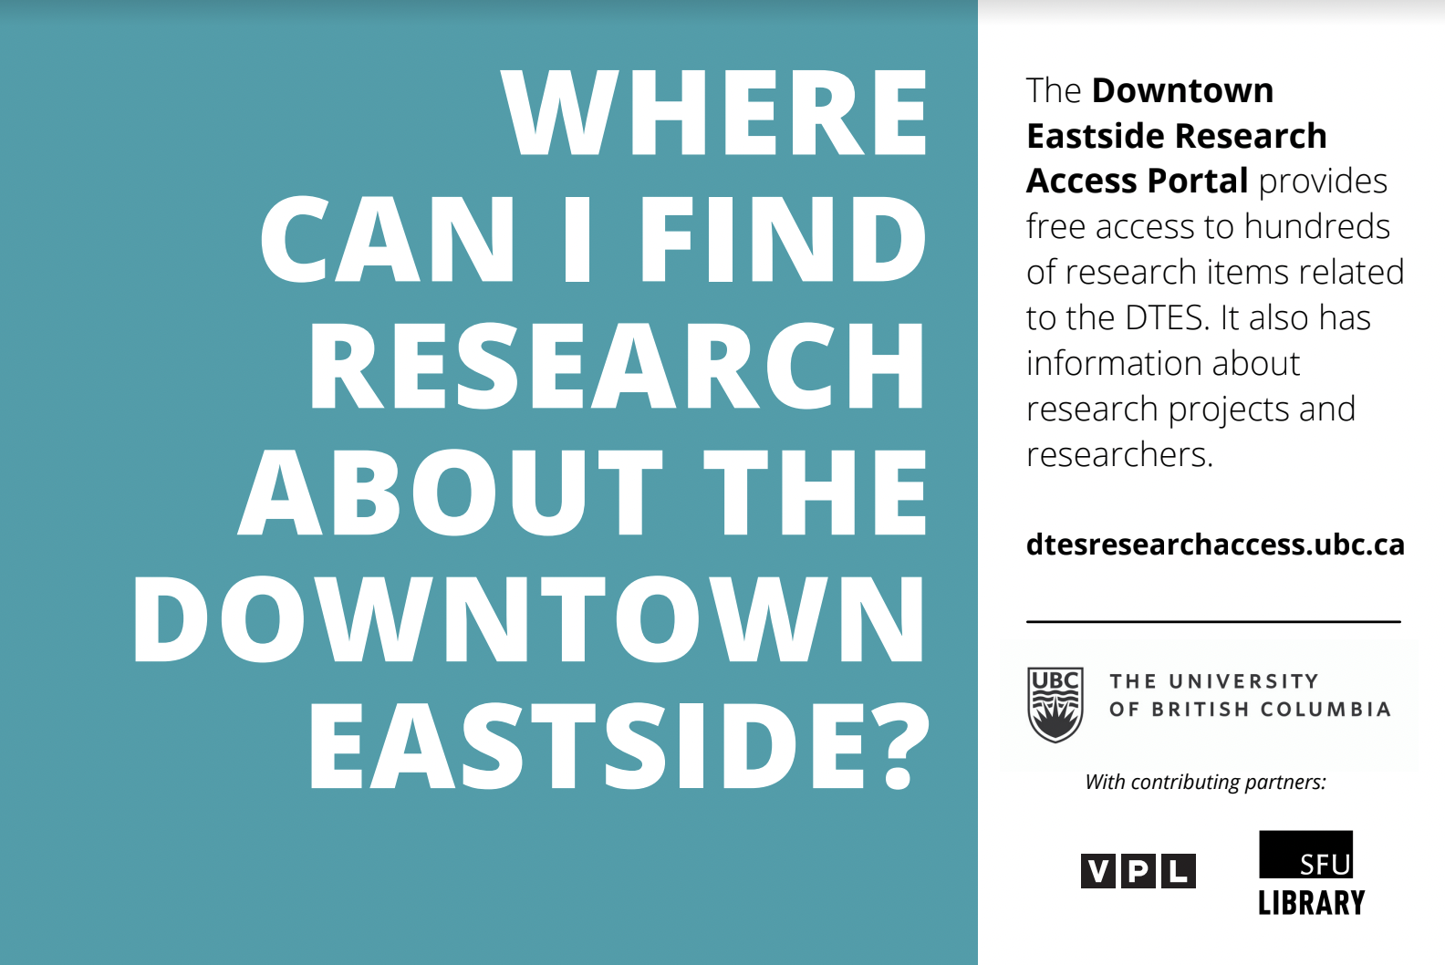
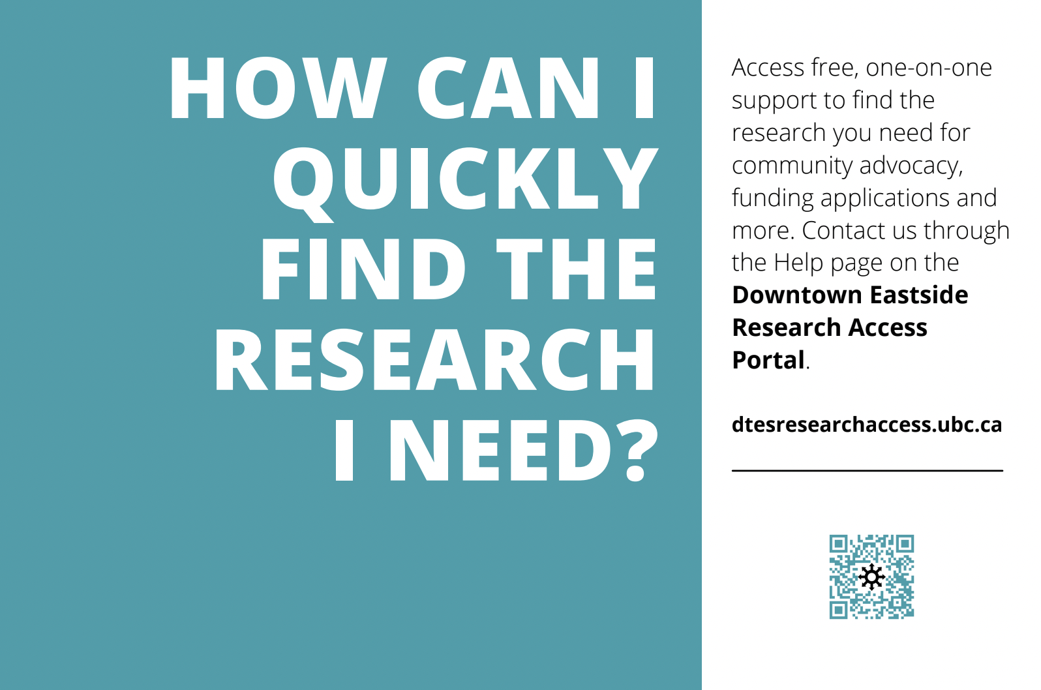
MRAi and community engagement
Pathway 3: Community engagement and services
Example 1
Example 2
Notes:
(This slide is for in-person and synchronous instruction)
Speaker notes: Before we wrap up, I’d like to share these 2 example postcards the MRAi has created to help promote the RAP. What works well with how these postcards are designed? What could potentially be improved to make these postcards more accessible or effective?

Slide 51
Wrap-up
Pathway 3: Community engagement and services
Effectively communicating library services to diverse community members requires intention, practice, and iteration
Continue to refine your approach and reflect on what resonates with different community members
Consider what kind of skills are needed to support this work – how might you cultivate these skills as you prepare to enter the profession?
Notes:
Speaker notes: Effectively communicating library services to diverse community members requires intention, practice, and iteration. And it doesn’t necessarily come easily after immersing ourselves in an library and information studies program among colleagues, practitioners, and instructors who often share similar vocabulary, background, and information privilege. Our desire as information professionals to be precise can sometimes inhibit our ability to opt for simpler language that might more meaningfully describe our work to patrons. Yet this is an important way for us to translate our professional knowledge to a public audience.
Of course, your decisions about how to meaningfully talk about these resources will shift depending on the community you’re engaging with. The important thing is to continue refining your approach and reflecting on how well your attempts seem to resonate with different community members.
In this pathway, we have explored some strategies and techniques to support community members to access research evidence. As we wrap up, I’d like you to reflect on what kind of skills are needed to support this work. How might you cultivate these skills as you prepare to enter the profession?

