Slide 1

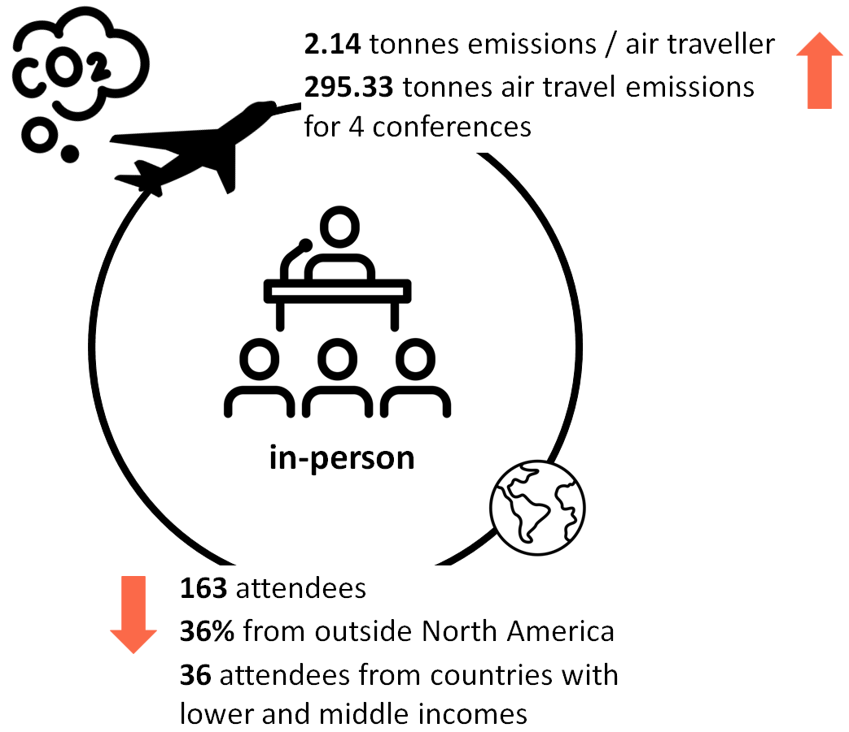
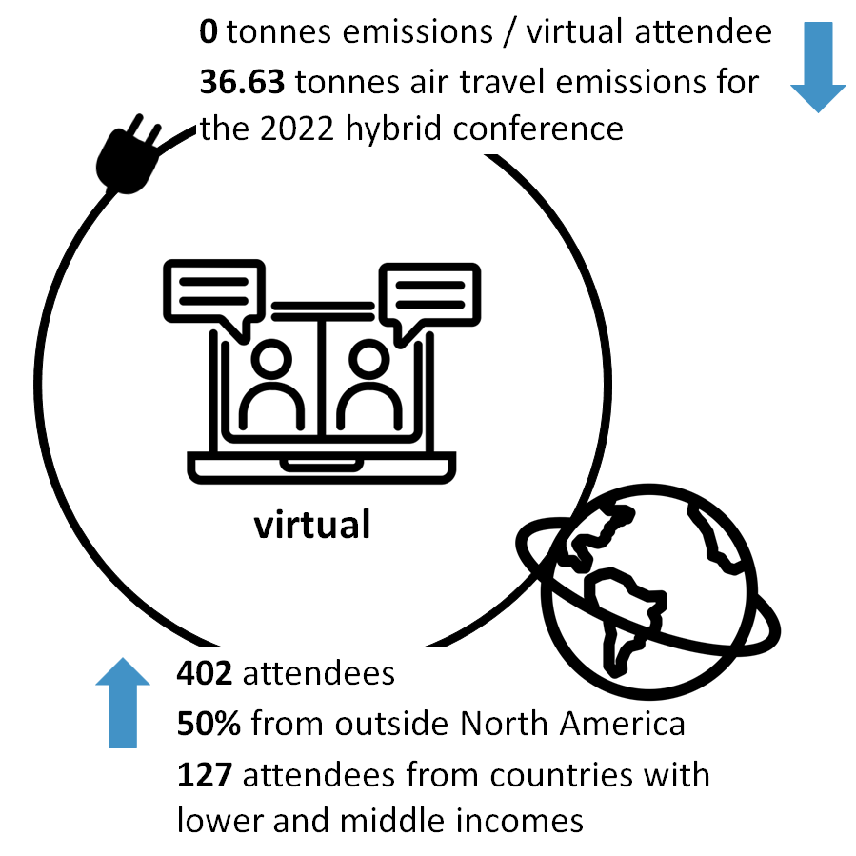
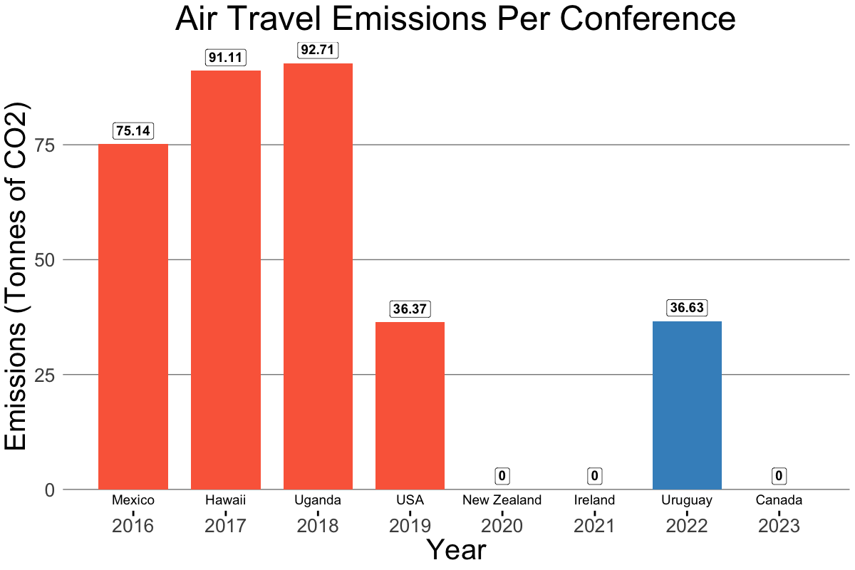
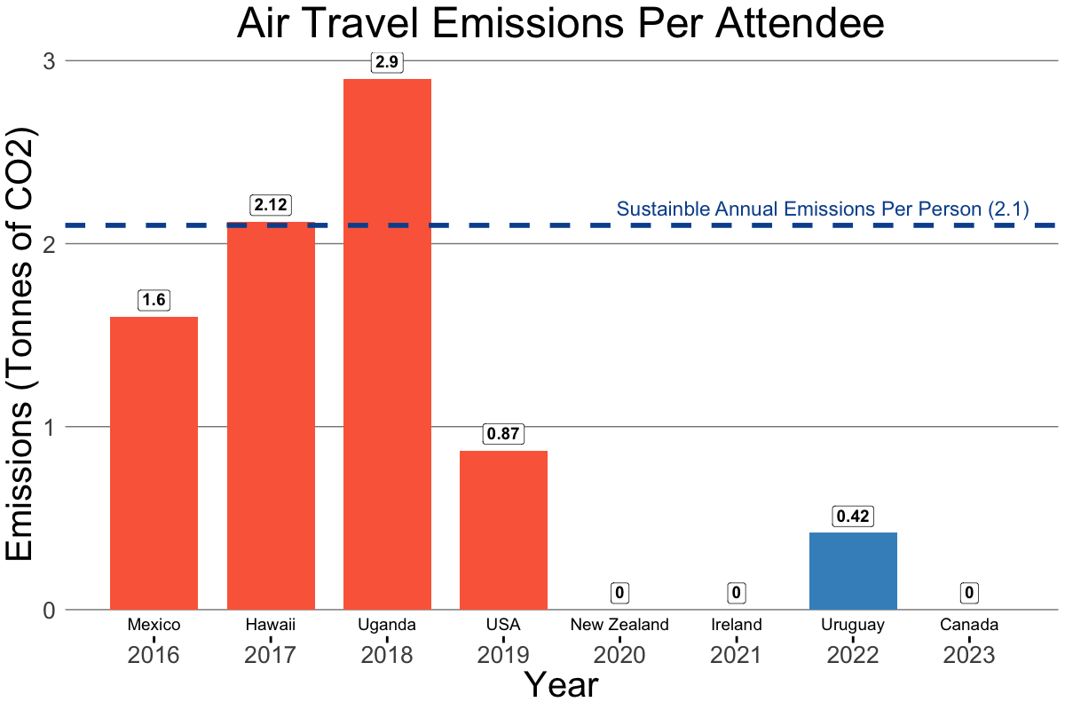
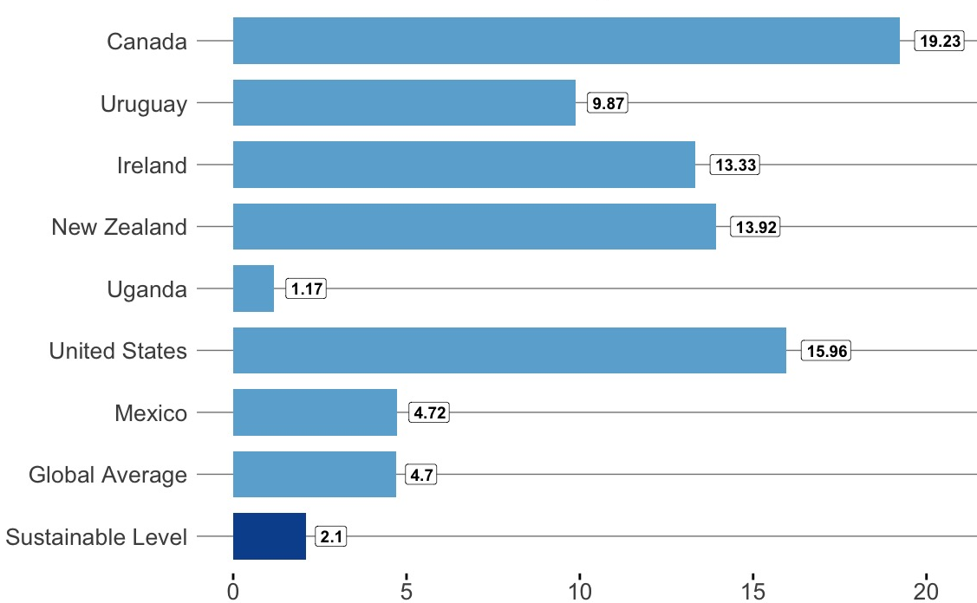

IAMSLIC Conferences in Changing Times
Helen L. Brown, Mathew Vis-Dunbar, Sally Taylor (University of British Columbia)
FACTORS DRIVING RESEARCH STUDY
COMPARING IN-PERSON TO VIRTUAL IAMSLIC CONFERENCES
ANALYSIS
Purpose
To apply climate science evidence to library professional activities by analyzing attendance and emissions from the eight most recent IAMSLIC annual conferences: four in-person, three virtual, and one hybrid. This assessment reflects on our recent experiences with new ways of hosting conferences, changing technology, and the necessity to significantly and rapidly decrease our emissions to address climate change.
Climate Crisis
The change in global annual temperatures from 1850 to 2022 is shown in the background of this poster using the Show Your Stripes data visualization by Professor Ed Hawkins. 2023 is expected to be the hottest year on record.
Emissions reductions are not on track to limit global warming to 1.5 degrees and a “whole-of-society” approach is needed.¹ As UN Secretary General António Guterres states, “our world needs climate action on all fronts – everything, everywhere, all at once.”² Now every job is a climate job.
Emissions from Professional Air Travel
Air travel accounts for 3.5% of global heating and air travel emissions are increasing.³ In fact, air travel is expected to double by 2036.⁴ It is also highly inequitable, with 80% of people estimated to have never flown.
hhhh
Most emissions from professional association activities result from travel to conferences and meetings. While there are many sources of emissions during conferences, air travel is the most significant. For example, one recent study noted that transportation accounted for almost 98% of conference emissions and switching to a virtual conference format would have decreased emissions by over 99%.⁵
hhh
In all of the research, air travel is identified as incompatible with limiting global heating. Furthermore, there are no technical solutions for decarbonizing air travel. Ultimately, we need to reduce air travel.
Methods
Calculated air travel emissions for trips > 500 km using Ostrom Climate
Assumed air travellers took economy class, plane flew at full capacity, and all flights used the smallest possible number of connections.
Excluded other emissions sources: travel for non-registered attendees (e.g. invited speakers), companion travel, associated vacation travel, other vehicle travel (e.g. taxis, cars, trains), food, accommodations, waste, and production and full life cycle emissions of equipment.
Observations
Air travel emissions: Emissions from conference air travellers averaged 2.14 tonnes of CO₂e, the same as the total annual sustainable level of emissions per person.
Streaming emissions: Streaming/data use in IAMSLIC virtual conferences averaged 0.01 tonnes CO₂e per attendee or 1-2 tonnes per conference.^{6,7}
Emissions saved: By holding the 2023 conference virtually, we saved 170 tonnes CO₂e from air travel that would have been created by registered attendees. For all four virtual conferences, we saved 1263 tonnes CO₂e.
Attendance:
  Regional hosting of the annual conference leads to a significant increase in attendees from that region for both in-person and virtual conferences.
  In comparing the four in-person conferences to the four virtual (including one hybrid) conferences, the average number of attendees increased from 41 to 100, with increases from all IAMSLIC regional group areas. Total attendance from outside North America increased from 59 to 199, and the number of attendees from lower and middle income countries ⁹ increased from 36 to 127 with the switch to virtual conferences.
Finding Options
Options to help build community, increase accessibility, and meet our responsibilities to prevent climate impacts and harm could include:
Virtual conferences
Trying a variety of virtual options for entertainment and social gathering
Sponsorships that cover registration or virtual conference expenses
Supports for accessibility such as recordings, captions, translation, etc.
Changing culture to encourage low emission participation
Local or regional hubs and gatherings
Less frequent in-person conferences
References
Poster adapted from: Brown, H. (2020/2021). “Climate Crisis, Libraries, and Evidence-Based Decision Making.” Journal of the Canadian Health Libraries Association, 41(3), 159.
¹ UN IPCC. AR6 Synthesis Report: Climate Change 2023.
² “Secretary-General's Video Message for Press Conference to Launch the Synthesis Report of the Intergovernmental Panel on Climate Change.” (20 March 2023).
³ Lee, D.S., et al. (2009). “Aviation and Global Climate Change in the 21st Century.” Atmos Environ, 43:22-3.
⁴ IATA. (2017). “2036 Forecast Reveals Air Passengers Will Nearly Double to 7.8 Billion”
⁵ McClintic, S. M., & Stashevsky, A. G. (2023). “Assessing Strategies to Reduce the Carbon Footprint of the Annual Meeting of the American Academy of Ophthalmology.” JAMA Ophthalmology, 141(9), 862.
⁶ University of Michigan: Office of Campus Sustainability. “Your Virtual Event’s Environmental Footprint.”
⁷ Faber, G. (2021). A Framework to Estimate Emissions from Virtual Conferences.
⁸ Climate Watch (2020). Historical GHG Emissions: Climate Watch Dataset.
⁹ World Bank (2023). World Bank Country and Lending Groups.
Air Travel Emissions Per Conference
Air Travel Emissions Per Attendee
In-person conferences
Virtual / hybrid conferences
tonnes CO2e
Attendance by Conference and Region
For Context: Annual Per Capita Emissions by Host Country⁸
Regions

