Slide 1
Introduction to Geodisy:
An open-source spatial discovery platform
Mark Goodwin, Eugene Barsky, and Paul Dante
May 2020

Slide 2
Geodisy is an open source discovery tool that allows users to find open data from Canadian researchers visually, spatially, and quickly
Search results are driven by an interactive map
Scholars Portal Dataverse is the current source for data content, expansion will occur this year
Contains data that is geospatial or simply associated with a location
All components are open source and code is freely available for others to adapt
Notes:
Mark -mention the intended user base here

Slide 3
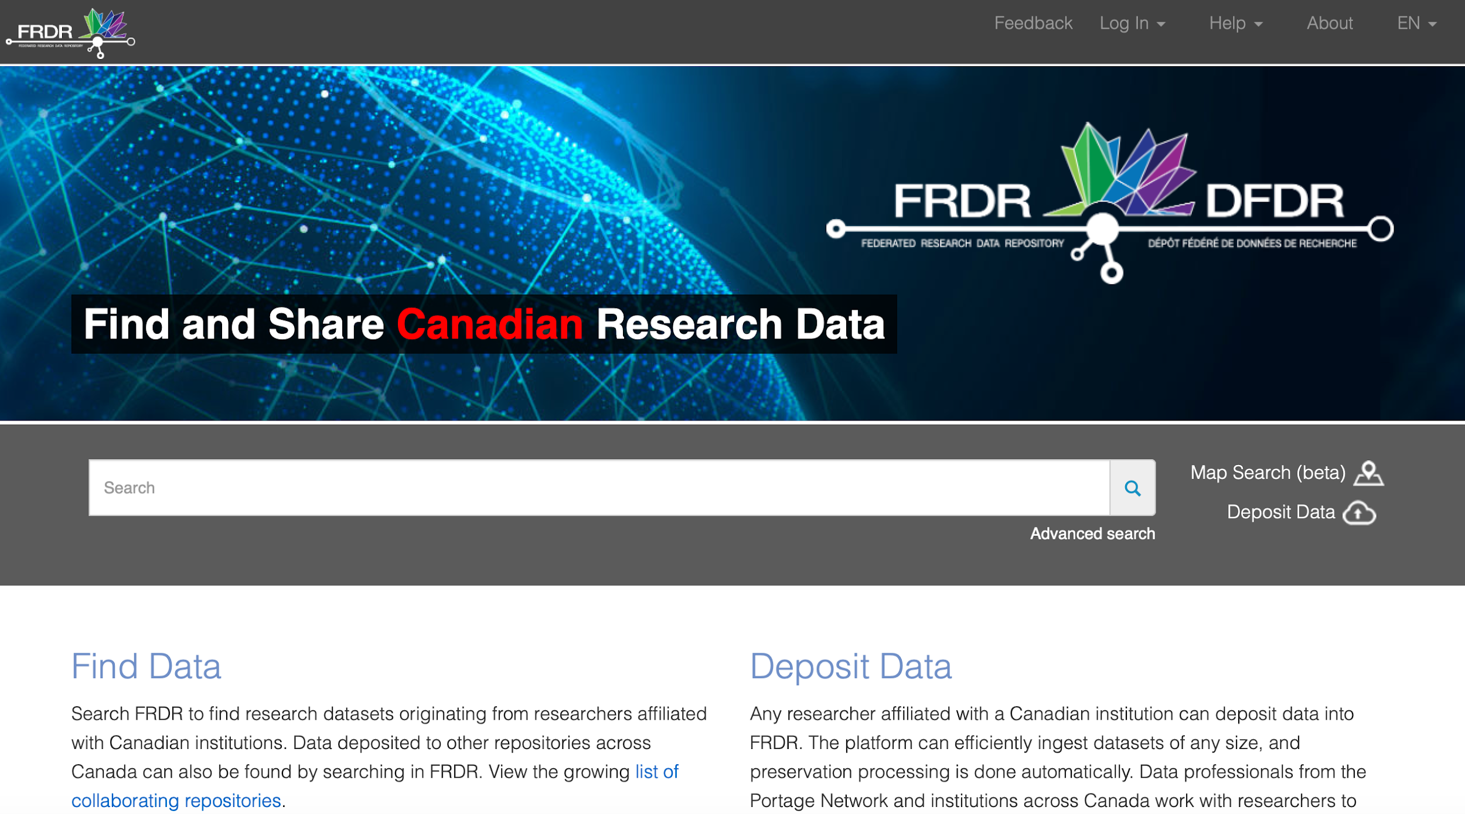
Notes:
Mark

Slide 4

Why is it useful?
Data can be difficult to find! When searching for data about a particular place, keywords can be hit or miss. A text search might look something like this:
((British Columbia OR BC OR B.C.)
N2 (north*))
OR (Alaska N2 south*) OR (Yukon N2 south*)
OR (Tatshenshini-Alsek ADJ2 park)
OR (Glacier Bay ADJ2 (park or preserve))
OR (Kluane ADJ2 (park OR reserve)) OR (Atlin ADJ2 (park OR recreation area) OR …
Emoji image from https://emojipedia.org/apple/
Notes:
Mark

Slide 5
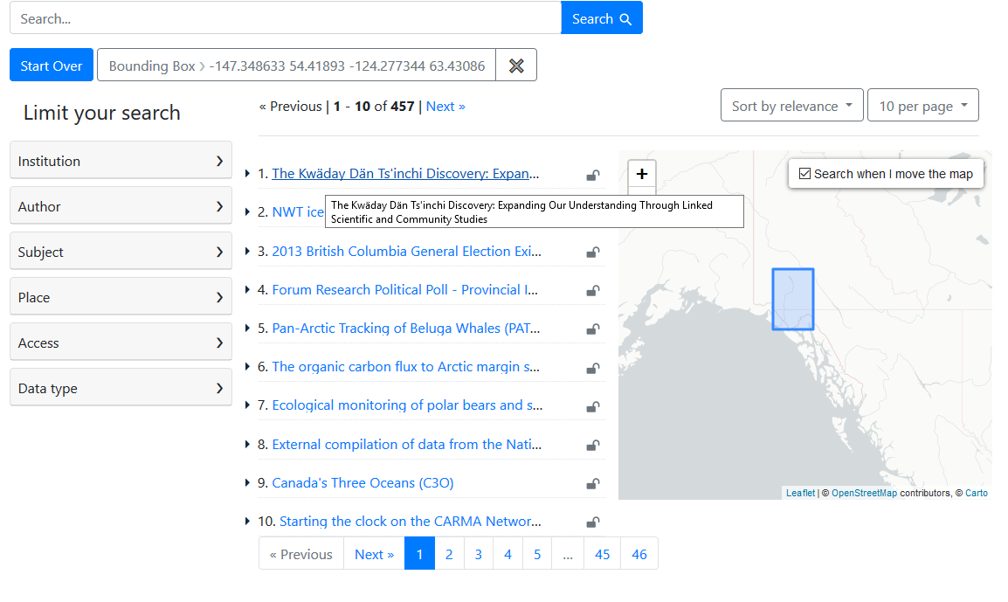

Geodisy interface
Emoji image from https://emojipedia.org/apple/
Notes:
Mark

Slide 6
Why is it important?
Geodisy allows for more open and effective research to better society
“FAIR Guiding Principles for scientific data management and stewardship” - published in Scientific Data, 2016. www.go-fair.org/fair-principles
FAIR: Findable, Accessible, Interoperable, Reusable
Geodisy supports FAIR Principles:
Cleaning, enhancing, and standardizing of metadata
Increasing discovery points for research data and metadata
Adaptability of Geodisy for other groups
Championing open data and open-source software
Notes:
Paul

Slide 7
Geodisy (re)uses 3 main open-source software components
Dataverse: Research data repository (Scholars Portal for phase 1)
+
GeoServer: Server for publishing and distributing geospatial data
+
GeoBlacklight: Geospatial discovery layer
Notes:
Paul

Slide 8
Project pipeline summary
Metadata is harvested from all Scholars Portal Dataverse with a geospatial component, and geospatial data files are harvested when possible (2,500 datasets from 500 Dataverses)
Bounding boxes are generated for each eligible dataset
Metadata is crosswalked to an international standard (ISO 19115) and GeoBlacklight JSON
Geospatial data files are deposited into GeoServer
All metadata is made publicly available on OpenGeoMetadata (Github)
Metadata and geospatial data files are harvested by GeoBlacklight for discovery
Notes:
Paul

Slide 9
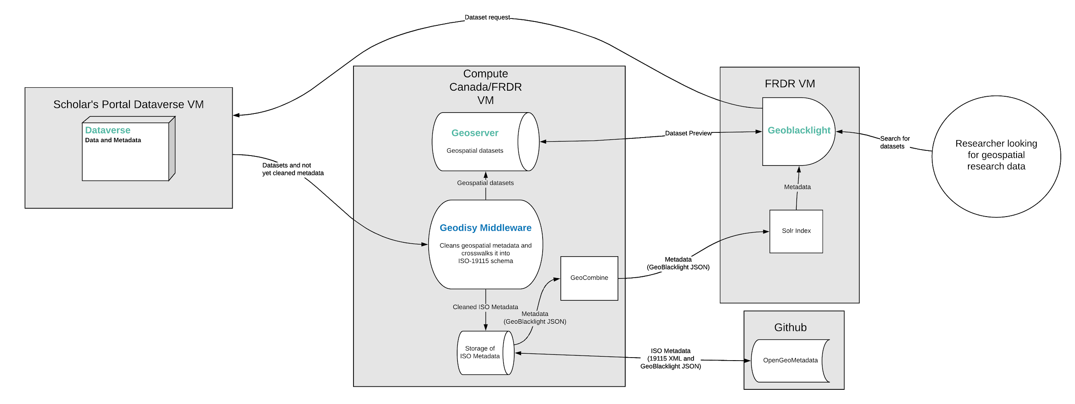
Geodisy Architecture
Notes:
Paul
Troubles dealing with multiple partners on the project - what security requirements.

Slide 10
Bounding boxes in Geodisy
Without bounding boxes, Geodisy cannot function - GeoBlacklight requires bounding boxes for discovery
All datasets that go through the Geodisy pipeline either have bounding box coordinates entered into the metadata by the depositor or a bounding box that is programmatically generated by Geodisy using dataset files or other metadata
Each geospatial file or set of coordinates (even if there are multiple in a single dataset) will get its own GeoBlacklight record
Datasets that do not include coordinates, geospatial filetypes, or geographic coverage metadata are not eligible for inclusion
Notes:
Paul

Slide 11
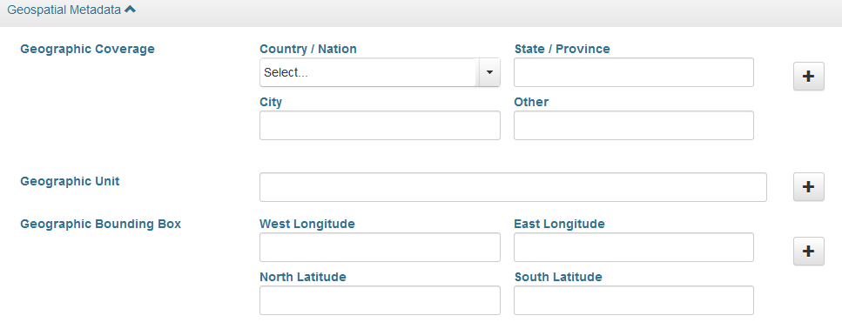
Dataverse metadata
Dataverse uses different blocks of metadata: citation (basic description), geospatial, social science, astronomy, and life sciences
The citation block includes several required fields for basic description
Geodisy first attempts to analyze geospatial files using GDAL. If unsuccessful, it utilizes the contents of the geospatial block
Notes:
Paul

Slide 12

Automated system for generating bounding boxes (1)
If the dataset contains geospatial type files, GDAL is used to generate coordinates

Slide 13
Automated system for generating bounding boxes (2)
If Dataverse dataset includes geographic bounding coordinates and no usable geospatial files, it is used for Geodisy’s bounding box

Slide 14
Automated system for generating bounding boxes (3)
If coordinates are not included/invalid and there are no geospatial filetypes, geographic coverage metadata is sent to Geonames for coordinates. However, it must contain one of the following combinations:
  Country/Nation
  Country/Nation AND State/Province
  Country/Nation AND State/Province AND City

Slide 15
Automated system for generating bounding boxes (4)
Regardless of geographic coverage metadata, if bounding boxes cannot be generated by GDAL datasets, they will be logged for manual review:
  If the “other” geographic coverage field contains text
  If the geographic coverage fields do not provide enough information
  If the geographic coverage information does not find a valid match in Geonames
  If Geonames finds a match but that match has no bounding box coordinates

Slide 16
Geodisy metadata treatment
ISO 19139 XML
(ISO 19115)
Each dataset’s ISO metadata will be available for download on GeoBlacklight
Dataverse JSON
Geodisy-generated metadata
GeoBlacklight JSON
This is the metadata GeoBlacklight uses for functionality
Notes:
Mark
multi step process, with two outputs

Slide 17
FRDR Geodisy demonstration
www.frdr-dfdr.ca

Slide 18
Next steps
Funded by NDRIO for 2020-2021
Integration with FRDR team
Adding multiple new repositories: working with and improving the FRDR metadata feed
Adding geospatial data preview
French translation of interface

Slide 19
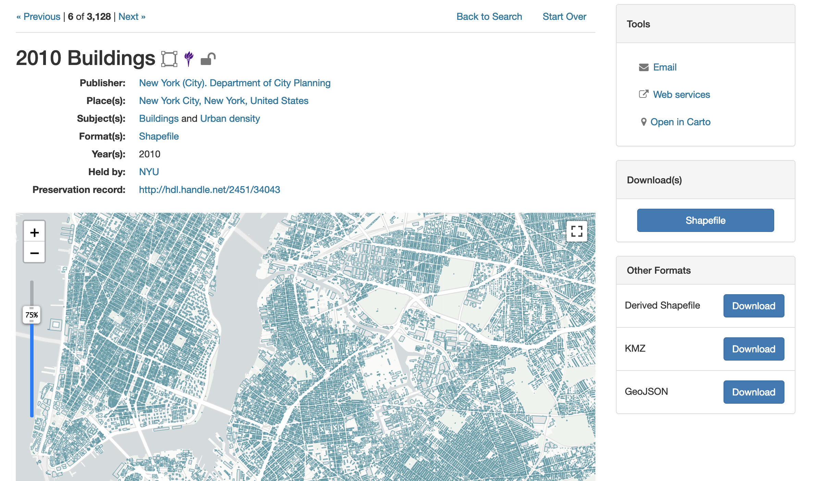
Next steps
Geospatial preview (NYU Spatial Data Repository GeoBlacklight)

Slide 20
Project Team
Eugene Barsky – Principal Investigator
Mark Goodwin – Metadata Coordinator
Paul Dante – Software Engineer
Github: https://github.com/ubc-library/geodisy
#geodisy on social media
Project Partners
Paul Lesack – University of British Columbia
Evan Thornberry – University of British Columbia
Edith Domingue – University of British Columbia
Tang Lee – University of British Columbia
Venkat Mahadevan – University of British Columbia
Jason Brodeur – McMaster University
Amber Leahey – Scholars Portal
Lee Wilson – Portage Network
Kelly Stathis – Portage Network
Neha Milan – Portage Network
Alex Garnett – Simon Fraser University
Todd Trann – University of Saskatchewan
Joel Farthing – University of Saskatchewan
Marcel Fortin – University of Toronto
Notes:
Mark

