Slide 1
Topics in Research Data Management: Geodisy
Eugene Barsky, Mark Goodwin, and Paul Dante
December 2019
Project funded by CANARIE (RDM-059)
Notes:
Mark

Slide 2

CANARIE is the backbone of the National Research and Education Network in Canada.
CANARIE funds and promotes:
reusable research software tools;
national research data management initiatives;
provides identity management services to the academic community;
offers advanced networking and cloud resources to boost commercialization in Canada’s technology sector.
Notes:
Mark -mention the intended user base here

Slide 3
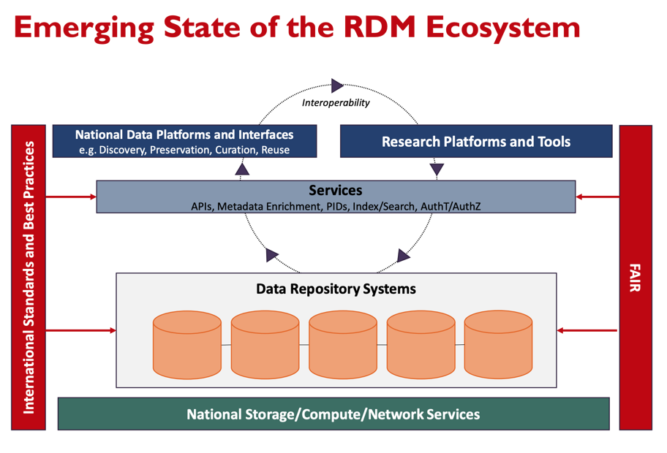
Notes:
Mark -mention the intended user base here

Slide 4
RDM Call #1 funding - Funding for the development of software components and tools to enable Canadian researchers to adopt best practices in RDM
UBC Library-led team received funding to prototype a federated map-based user interface for Canadian research data that provides an extensible software method to find and display location-aware data in a search interface which is both map and text based, combining research data with the functionality of a product such as Google Maps.
Notes:
Mark -mention the intended user base here

Slide 5
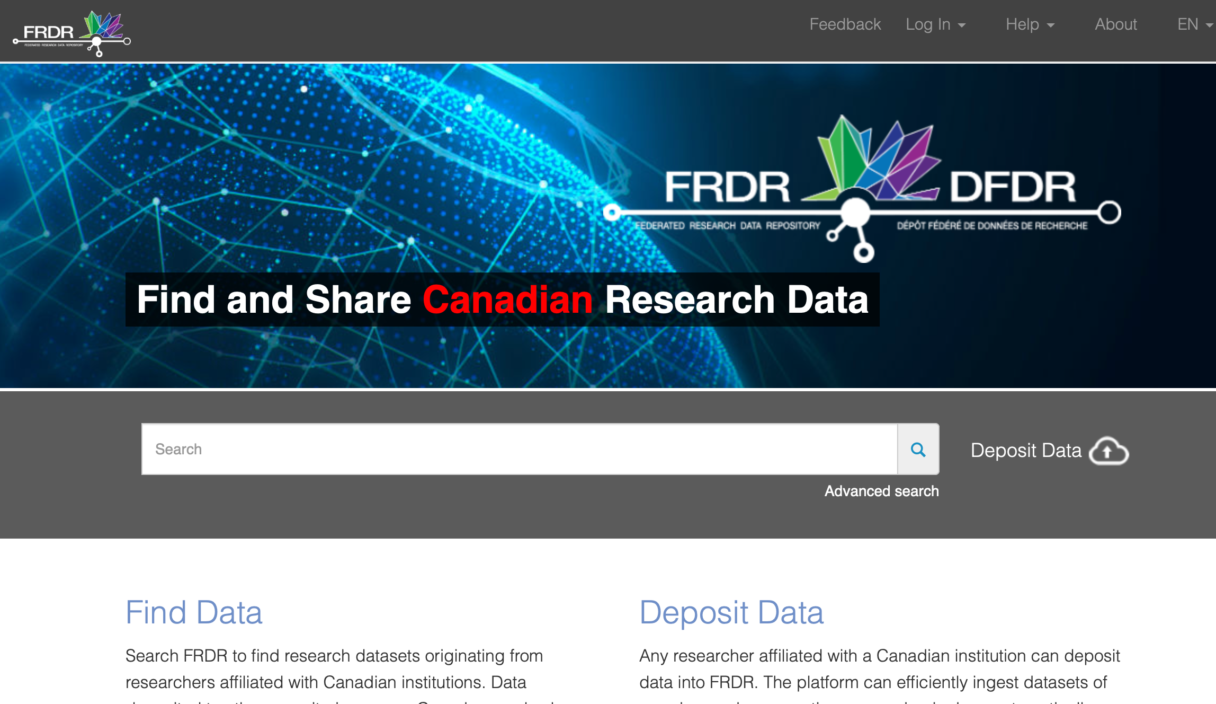
Notes:
Mark

Slide 6
Geodisy’s aim is to provide a tool that allows Canadian research data to be searched, filtered, and browsed using geographic locations as well as with text
Search results are driven by an interactive map
Location is the primary search facet, linking resources from a similar area
Relies less on textual searching, which is not ideal for spatial data
Useful across many subject areas, professions
Notes:
Mark -mention the intended user base here

Slide 7

Why use it?
Data can be difficult to find! When searching for data about a particular place, keywords can be hit or miss. A text search might look something like this:
((British Columbia OR BC OR B.C.)
N2 (north*))
OR (Alaska N2 south*) OR (Yukon N2 south*)
OR (Tatshenshini-Alsek ADJ2 park)
OR (Glacier Bay ADJ2 (park or preserve))
OR (Kluane ADJ2 (park OR reserve)) OR (Atlin ADJ2 (park OR recreation area) OR …
Emoji image from https://emojipedia.org/apple/
Notes:
Mark

Slide 8
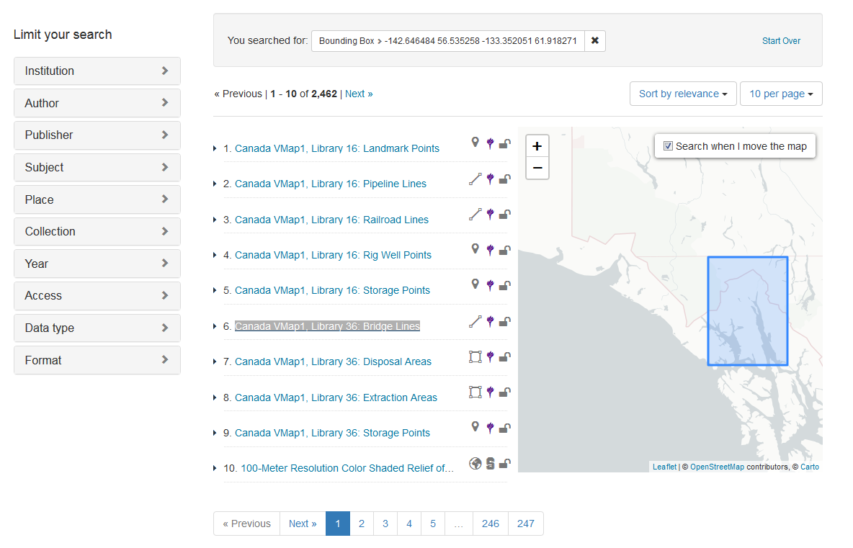

Geodisy will show you where, in addition to what (expected GeoBlacklight user interface - NYU Spatial Data Repository)
Emoji image from https://emojipedia.org/apple/
Notes:
Mark

Slide 9
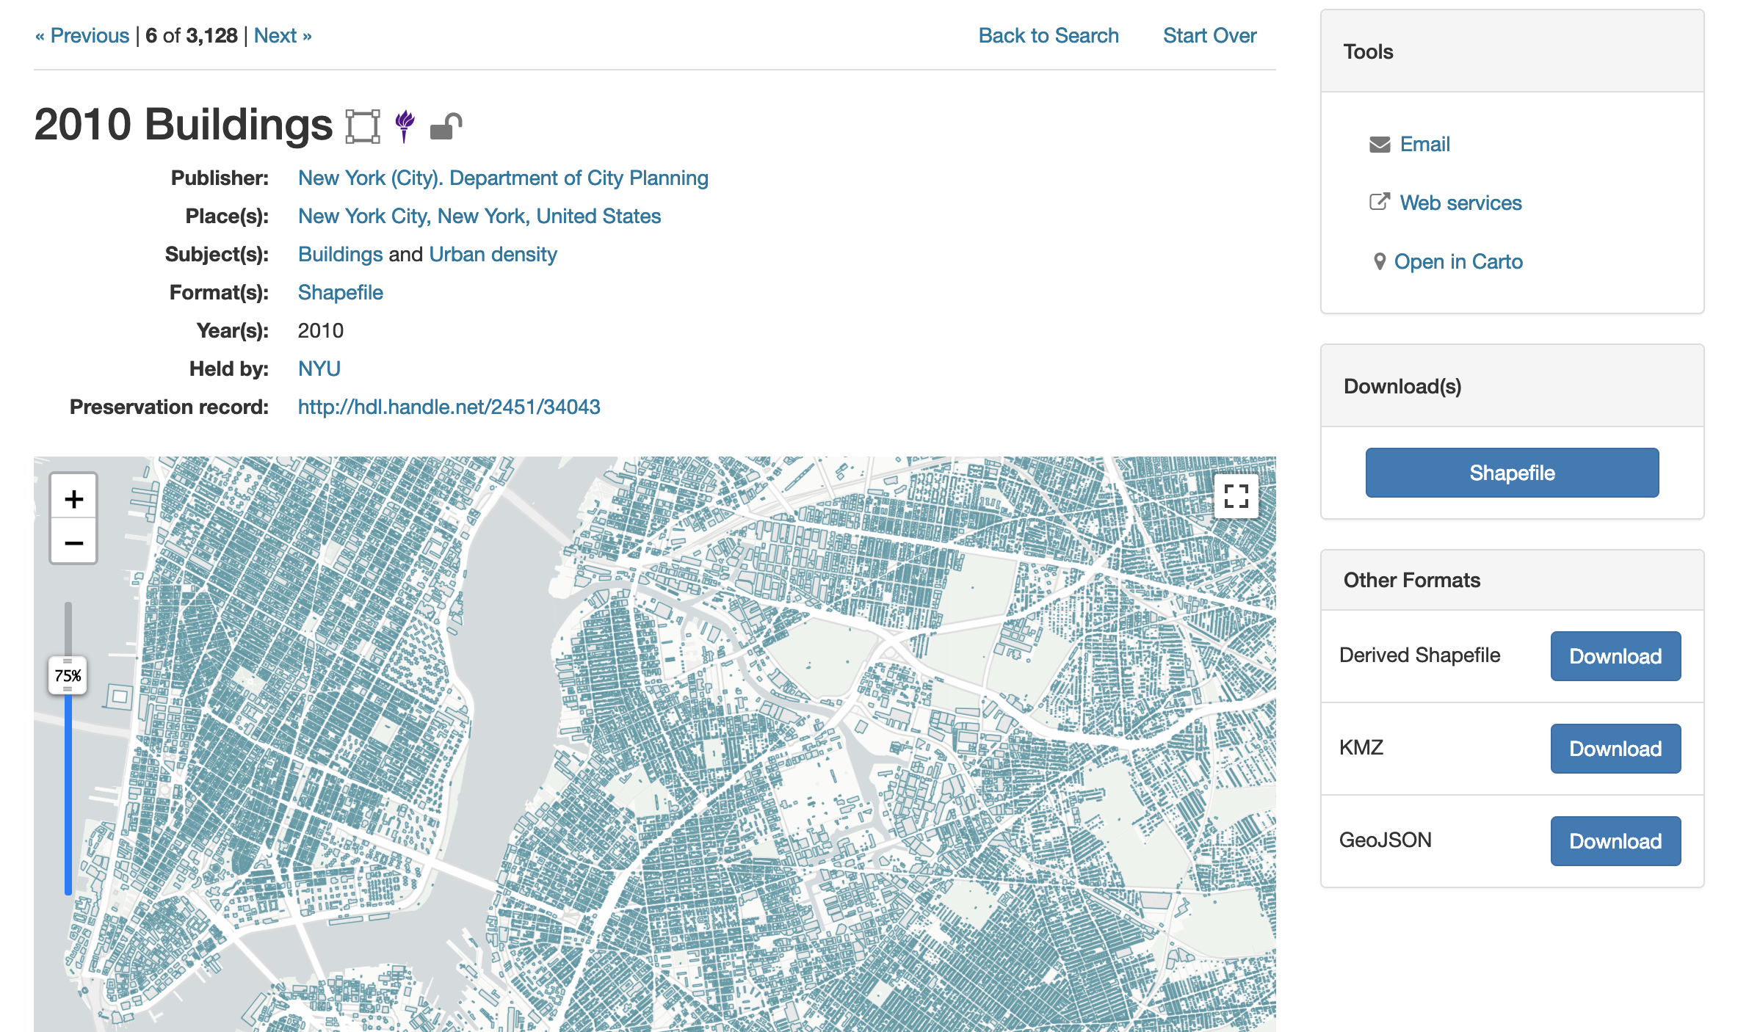
Example record page (expected GeoBlacklight user interface - NYU Spatial Data Repository)
Notes:
Mark

Slide 10
Geospatial discovery is possible using metadata
Metadata = information that describes a resource
Geospatial data = machine readable using a GIS
Quasi-geospatial data = data with a location component that isn’t true geospatial data*
Bounding boxes = rectangles representing the spatial extent of a data set
*to generate bounding boxes from quasi-geospatial data we are using geonames.org
Notes:
Paul
Metadata - music example
Geospatial - Geographic survey
Quasi-geospatial - Study of the Burnaby murder of crows

Slide 11
Geodisy¹ (re-)uses 3 main open-source software components
Dataverse²: Research data repository
+
GeoServer: Server for publishing and distributing geospatial data
+
GeoBlacklight: Geospatial discovery layer
¹ Geodisy source code and documentation is available in github - https://github.com/ubc-library/geodisy.
² For the initial step, for March 2020, Geodisy is funded to work with Canadian Dataverses only
Notes:
Paul

Slide 12
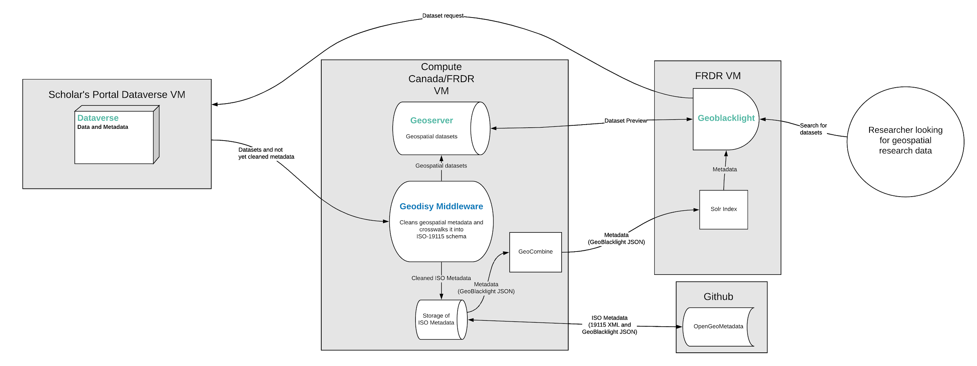
Geodisy Architecture
Notes:
Paul
Troubles with dealing with multiple partners on the project - what security requirements.

Slide 13
Project pipeline (in 8 steps):
1. Software will query datasets from the Scholars Portal Dataverses (and later from
UAlberta, Dal, UNB, UManitoba, etc.) to determine which have geospatial information
2. Software will harvest metadata from relevant quasi-geospatial datasets
3. Software will harvest both metadata and data files from geospatial datasets
4. Software will enrich the metadata with bounding boxes using GDAL (or from metadata or Geonames, if needed) and other information
5. Software will transform metadata to more universal standards (ISO 19115 and GeoBlacklightJSON)
6. Software will deposit geospatial data into Geoserver
7. Software will deposit geospatial and quasi-geospatial metadata into OpenGeoMetadata
8. Metadata will be harvested by GeoBlacklight for discovery
Notes:
Paul

Slide 14
Metadata schemas, standards, and crosswalks
Metadata schema: a structured series of metadata fields that describe a resource within a specified environment
Metadata standard: a structured series of metadata fields that describe a certain type of resource; overseen by a national or international group
  e.g. Dublin Core for general resources, DDI for social science resources, Darwin Core for biology resources, etc.
Crosswalk: when the elements/fields from one metadata standard are mapped onto the elements/fields of another standard
Notes:
Mark

Slide 15
Geodisy metadata treatment
ISO 19115
Each dataset’s ISO metadata will be available for download on GeoBlacklight
Dataverse schema
Geodisy-generated metadata
GeoBlacklight schema
This is the metadata GeoBlacklight uses for functionality
Notes:
Mark
multi step process, with two outputs

Slide 16
ISO 19115
Source: U.S. Geological Survey https://www.sciencebase.gov/catalog/file/get/59f8af92e4b063d5d309f043?name=USGS_BBLEH_2012.xml&transform=1&allowOpen=true
Notes:
Paul

Slide 17
Bounding boxes in Geodisy
Without bounding boxes, Geodisy cannot function
  GeoBlacklight uses bounding boxes for discovery
All datasets that will go through the Geodisy pipeline will either have bounding box coordinates entered into the metadata by the depositor or a bounding box that is programmatically generated by Geodisy using dataset files or other metadata
Each geospatial file or set of coordinates (even if there are multiple in a single dataset) will get its own GeoBlacklight record
Datasets that do not include coordinates, geospatial filetypes, or geographic coverage metadata are ignored
Notes:
Paul

Slide 18
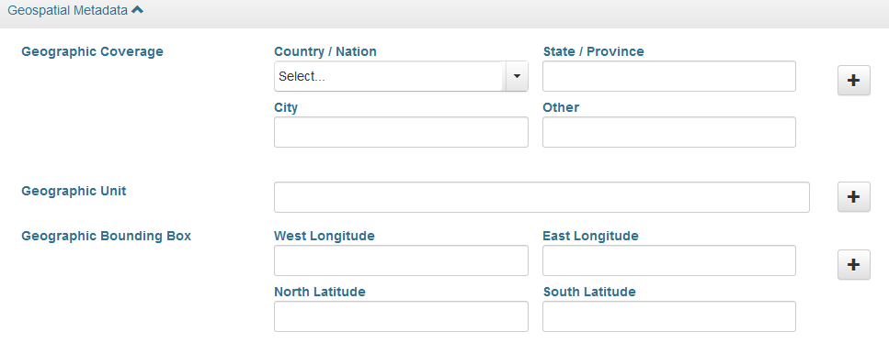
Dataverse metadata
Uses different blocks of metadata: citation (basic description), geospatial, social science, astronomy, and life sciences
The citation block includes several required fields for basic description
For bounding boxes, Geodisy first attempts to analyze geospatial files using GDAL. If unsuccessful, it utilizes the contents of the geospatial block
Notes:
Paul

Slide 19
Automated system for generating bounding boxes (1)
If the dataset contains geospatial type files, GDAL is used to generate coordinates
Notes:
Paul

Slide 20
Automated system for generating bounding boxes (2)
If Dataverse dataset includes geographic bounding coordinates and no usable geospatial files, it is used for Geodisy’s bounding box
Notes:
Paul

Slide 21
Automated system for generating bounding boxes (3)
If coordinates are not included/invalid and there are no geospatial filetypes, geographic coverage metadata is sent to Geonames for coordinates. However, it must contain one of the following combinations:
  Country/Nation
  Country/Nation AND State/Province
  Country/Nation AND State/Province AND City
Notes:
Paul

Slide 22
Automated system for generating bounding boxes (4)
Regardless of geographic coverage metadata, if bounding boxes cannot be generated by GDAL datasets will be logged for manual review in some cases:
  If the “other” geographic coverage field contains text
  If the geographic coverage fields do not provide enough information
  If the geographic coverage information does not find a valid match in Geonames
  If Geonames finds a match but that match has no bounding box coordinates
Notes:
Paul
Also talk about what a geographic unit is.

Slide 23
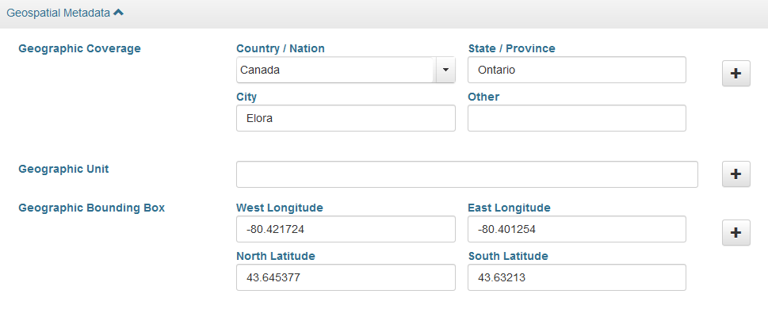
Examples
Automatic bounding box or logged for manual review?
(dataset contains no geospatial filetypes)
Notes:
Mark

Slide 24

Examples
Automatic bounding box!
(dataset contains no geospatial filetypes)
Emoji image from https://emojipedia.org/apple/
Notes:
Mark

Slide 25
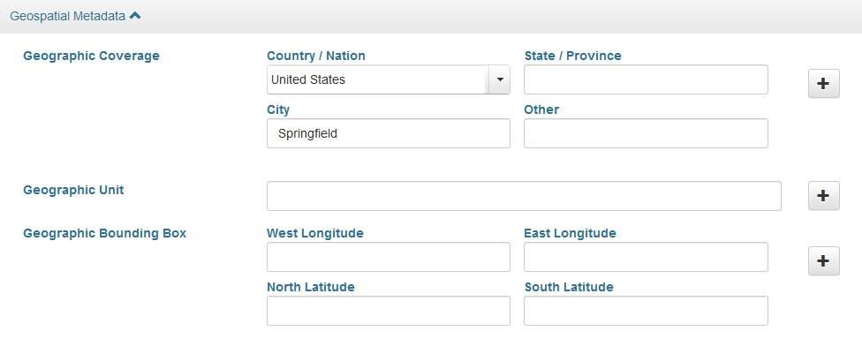
Examples
Automatic bounding box or logged for manual review?
(dataset contains no geospatial filetypes)
Notes:
Mark

Slide 26

Examples
Logged
(dataset contains no geospatial filetypes)
Emoji image from https://emojipedia.org/apple/
Notes:
Mark

Slide 27
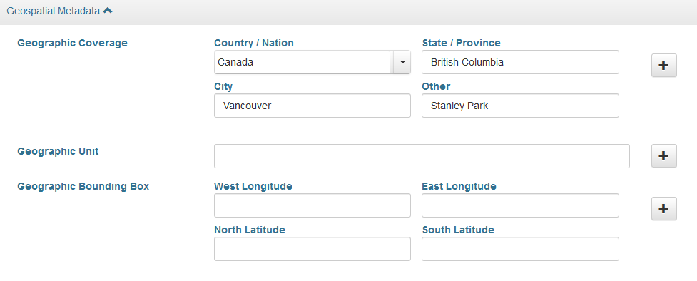
Examples
Automatic bounding box or logged for manual review?
(dataset contains no geospatial filetypes)
Notes:
Mark

Slide 28

Examples
Logged
(dataset contains no geospatial filetypes)
Emoji image from https://emojipedia.org/apple/
Notes:
Mark

Slide 29
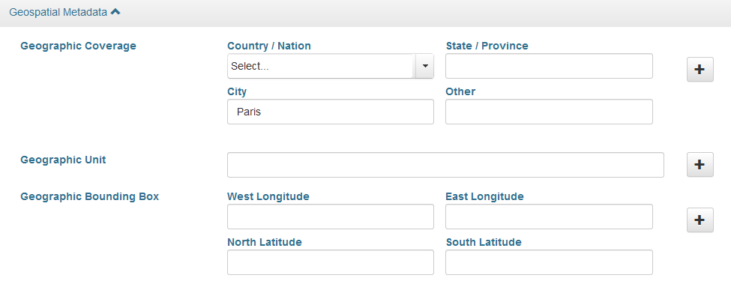
Examples
Automatic bounding box or logged for manual review?
(dataset includes a shapefile)
Notes:
Mark

Slide 30

Examples
Automatic bounding box!
(dataset includes a shapefile)
Emoji image from https://emojipedia.org/apple/
Notes:
Mark

Slide 31
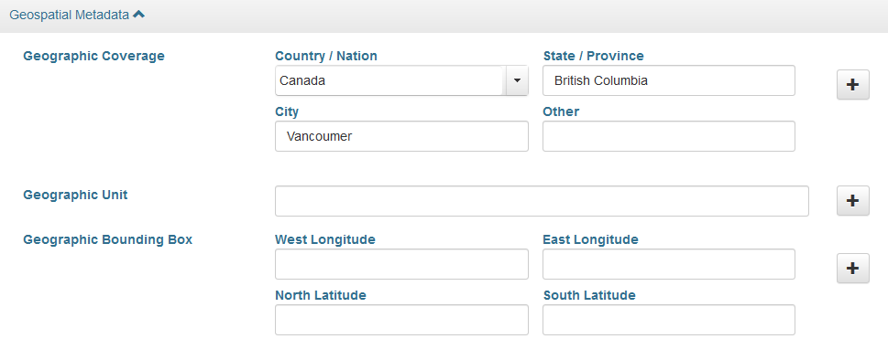
Examples
Automatic bounding box or logged for manual review?
(dataset contains no geospatial filetypes)
Notes:
Mark

Slide 32
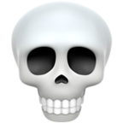
Examples
Logged
(dataset contains no geospatial filetypes)
Emoji image from https://emojipedia.org/apple/
Notes:
Mark

Slide 33
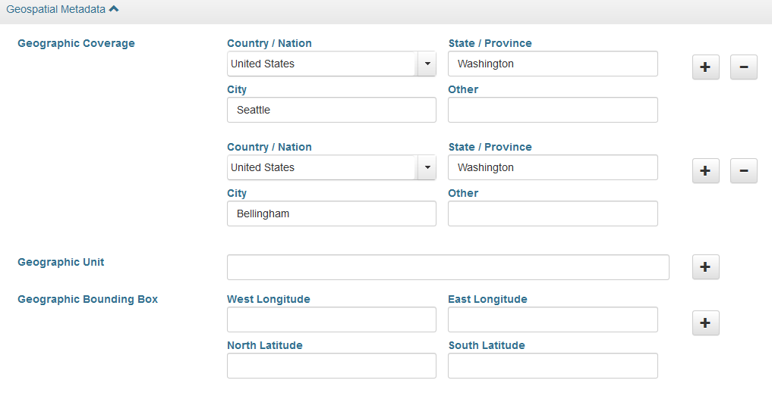
Examples
Automatic bounding box or logged for manual review?
(dataset contains no geospatial filetypes)
Notes:
Mark

Slide 34

Examples
Automatic bounding box(es)!
(dataset contains no geospatial filetypes)
Emoji image from https://emojipedia.org/apple/
Notes:
Mark

Slide 35
Alpha version of Geodisy
http://206-12-92-97.cloud.computecanada.ca:3000/

Slide 36
Core Project Team (UBC)
Eugene Barsky – Principal Investigator
Paul Dante – Software Developer
Edith Domingue – ARC Client Services Manager
Mark Goodwin – Geospatial Metadata Coordinator
Tang Lee – Project Manager
Paul Lesack – Co-Principal Investigator
Evan Thornberry – Co-Principal Investigator
Project Partners
Jason Brodeur – McMaster University
Marcel Fortin – University of Toronto
Alex Garnett – SFU
Amber Leahey – Scholars Portal
Jason Hlady – University of Saskatchewan
Venkat Mahadevan – UBC ARC
Todd Trann – University of Saskatchewan
Lee Wilson – Portage Network
Launching in spring 2020
Notes:
Mark

Slide 37
Keep up to date:
#Geodisy on social media
researchdata.library.ubc.ca/find/geodisy
github.com/ubc-library/geodisy
Email: geodisy.info@ubc.ca
Twitter: @MarkJWGoodwin, @thornberry_evan
Notes:
Mark

