Slide 1

Notes:
Mark

Slide 2
Search data by location: Geodisy project
Paul Dante, Eugene Barsky, and Mark Goodwin
August 2019; Funded by CANARIE (RDM-059)
Notes:
Mark

Slide 3
We aim for Canadian research data to be searched, filtered, and browsed using geographic locations as well as with text
Search results are driven by an interactive map
Location is the primary search facet, linking resources from a similar area
Relies less on textual searching, which is not ideal for spatial data
Notes:
Mark

Slide 4
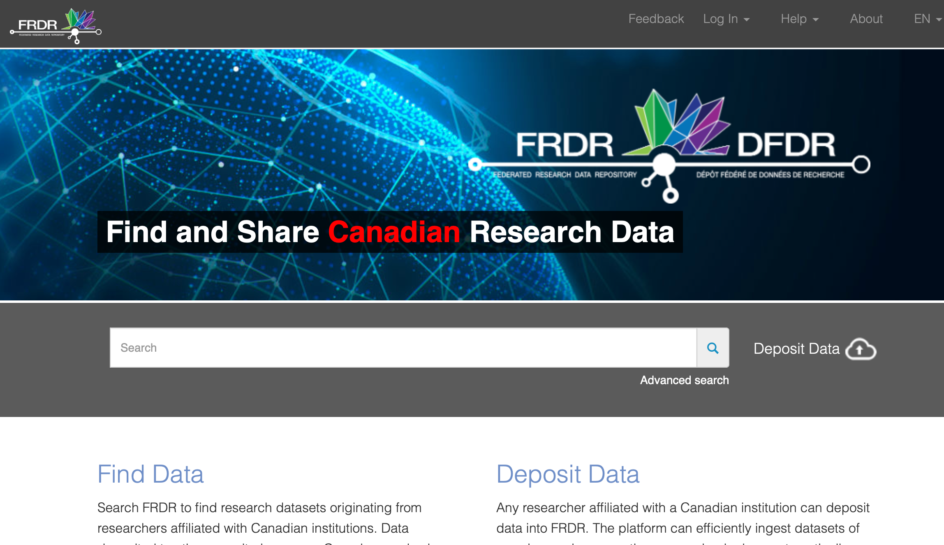
Notes:
Mark

Slide 5
Why use it?
Data can be difficult to find! When searching for data about a particular place, keywords can be hit or miss. Geodisy will show you where, in addition to what.
Geodisy will benefit any research area that has use for location-based discovery, including climate change, community development, public health, conservation, and many more.
Notes:
Mark

Slide 6


Who will use it?
People
Institutions
Researchers, students, journalists, etc
Canada’s Federated Research Data Repository (FRDR)
Any entity with the available infrastructure
Notes:
Mark

Slide 7
Geospatial discovery is possible using metadata
Metadata = information that describes a resource
Geospatial data = machine readable using a GIS
Quasi-geospatial data = data with a location component that isn’t true
geospatial data*
Bounding boxes = rectangles representing the spatial extent of a
data set
*to generate bounding boxes from quasi-geospatial data we are using geonames.org
Notes:
Paul
Metadata - music example
Geospatial - Geographic survey
Quasi-geospatial - Study of the Burnaby murder of crows

Slide 8
Geodisy¹ (re-)uses 3 main open-source software components
Dataverse²: Research data repository
+
GeoServer: Server for publishing and distributing geospatial data
+
GeoBlacklight: Geospatial discovery layer
¹ Geodisy source code and documentation is available in github - https://github.com/ubc-library/geodisy.
² For the initial step, for March 2020, Geodisy is funded to work with Canadian Dataverses only
Notes:
Paul

Slide 9
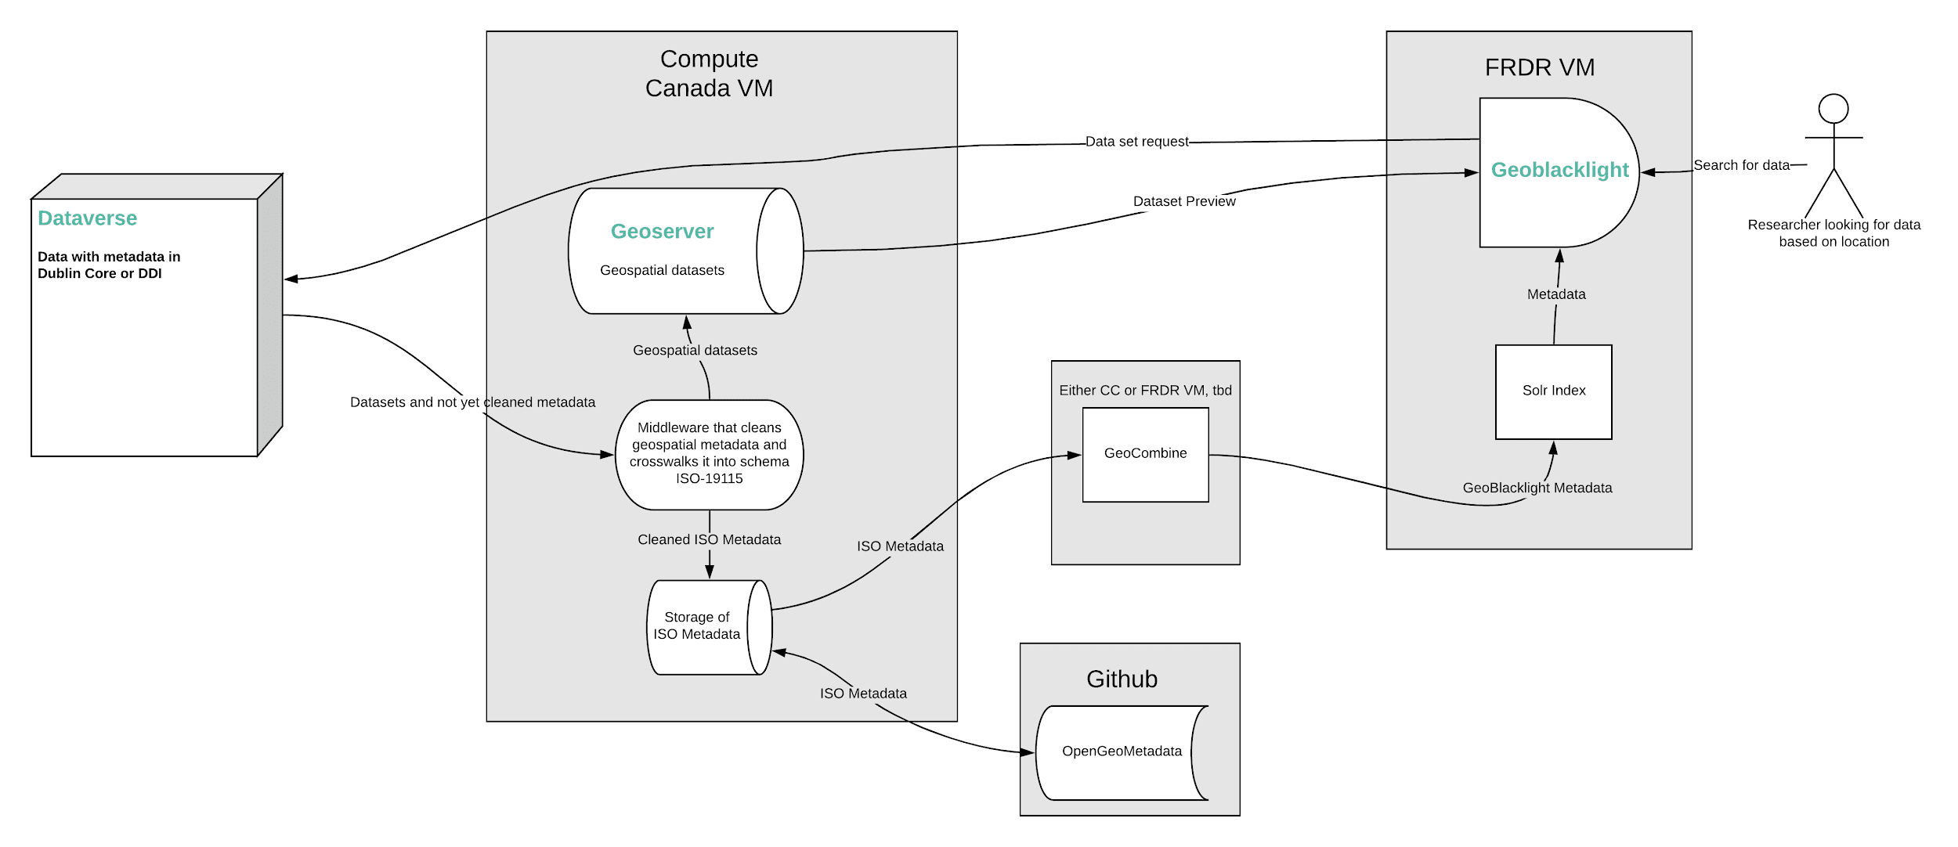
Geodisy Architecture
Notes:
Paul
Troubles with dealing with multiple partners on the project - what security requirements.

Slide 10
Project pipeline (in steps):
Software will query datasets from the Scholars Portal Dataverses (and later from
UAlberta, Dal, UNB, UManitoba, etc.) to determine which have geospatial information
Software will harvest metadata from relevant quasi-geospatial datasets
Software will harvest both metadata and data files from geospatial datasets
Software will transform metadata to more universal standard (ISO 19115) and add bounding boxes if needed (GDAL or Geonames)
Software will deposit geospatial data into Geoserver
Software will deposit geospatial and quasi-geospatial metadata into OpenGeoMetadata
Metadata will be harvested by GeoBlacklight for discovery
Notes:
Paul

Slide 11
Bounding boxes in Geodisy
Without bounding boxes, Geodisy cannot function
  GeoBlacklight uses bounding boxes for discovery
All datasets that will go through the Geodisy pipeline will either have bounding box coordinates entered into the metadata by the depositor or a bounding box that is programmatically generated by Geodisy using dataset files or other metadata
Notes:
Paul

Slide 12
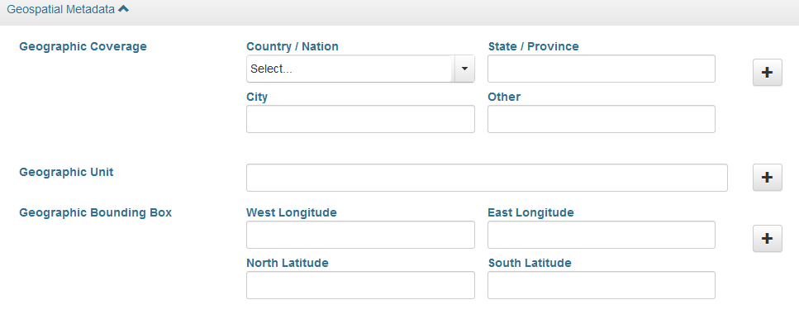
Dataverse metadata
Uses different blocks of metadata: citation (basic description), geospatial, social science, astronomy, and life sciences
The citation block includes several required fields for basic description
Geodisy is reliant on the content of the geospatial block
Notes:
Paul

Slide 13
Automated system for generating bounding boxes (1)
If Dataverse dataset includes geographic bounding coordinates, it is used for Geodisy’s bounding box
Notes:
Paul

Slide 14
Automated system for generating bounding boxes (2)
If coordinates are not included/invalid but the dataset contains a geospatial filetype, GDAL is used to generate coordinates
Notes:
Paul

Slide 15
Automated system for generating bounding boxes (3)
If coordinates are not included/invalid and there are no geospatial filetypes, geographic coverage metadata is sent to Geonames for coordinates. However, it must contain one of the following combinations:
  Country/Nation
  Country/Nation AND State/Province
  Country/Nation AND State/Province AND City
Notes:
Paul

Slide 16
Automated system for generating bounding boxes (4)
Datasets that do not include coordinates, geospatial filetypes, or geographic coverage metadata are ignored
Notes:
Paul

Slide 17
Automated system for generating bounding boxes (5)
Regardless of geographic coverage metadata, datasets will be logged for manual review in some cases:
  If the “other” geographic coverage field contains text
  If the geographic coverage fields do not provide enough information
  If the geographic coverage information does not find a valid match in Geonames
  If Geonames finds a match but that match has no bounding box coordinates
Notes:
Paul
Also talk about what a geographic unit is.

Slide 18
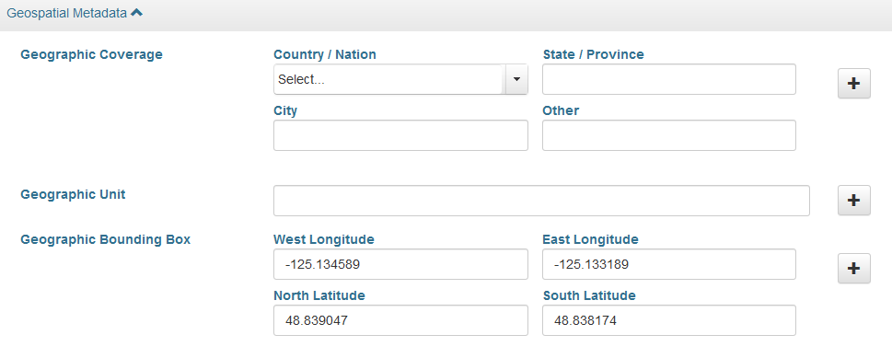
Examples
Automatic bounding box or logged for manual review?
(dataset contains no geospatial filetypes)
Notes:
Mark

Slide 19

Examples
Automatic bounding box!
(dataset contains no geospatial filetypes)
Notes:
Mark

Slide 20
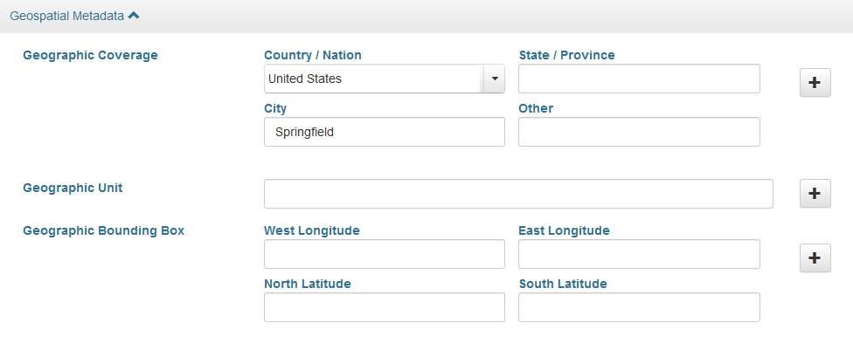
Examples
Automatic bounding box or logged for manual review?
(dataset contains no geospatial filetypes)
Notes:
Mark

Slide 21

Examples
Logged
(dataset contains no geospatial filetypes)
Notes:
Mark

Slide 22
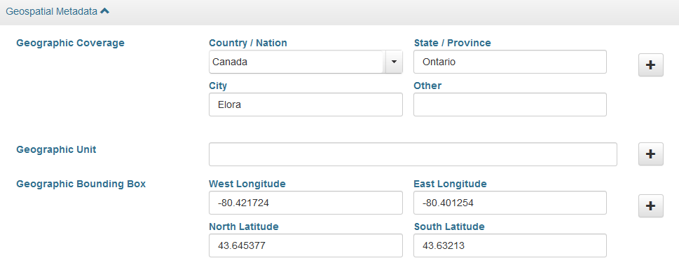
Examples
Automatic bounding box or logged for manual review?
(dataset contains no geospatial filetypes)
Notes:
Mark

Slide 23

Examples
Automatic bounding box!
(dataset contains no geospatial filetypes)
Notes:
Mark

Slide 24
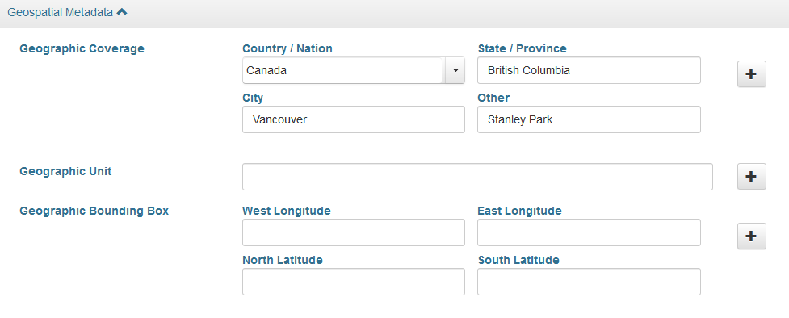
Examples
Automatic bounding box or logged for manual review?
(dataset contains no geospatial filetypes)
Notes:
Mark

Slide 25

Examples
Logged
(dataset contains no geospatial filetypes)
Notes:
Mark

Slide 26
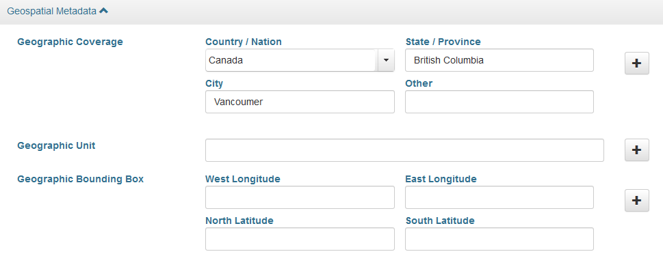
Examples
Automatic bounding box or logged for manual review?
(dataset contains no geospatial filetypes)
Notes:
Mark

Slide 27

Examples
Logged
(dataset contains no geospatial filetypes)
Notes:
Mark

Slide 28
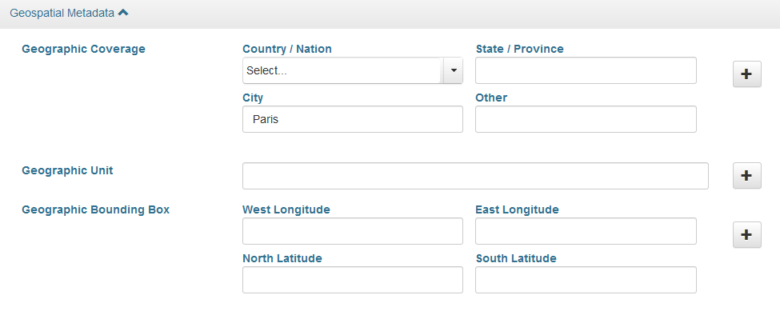
Examples
Automatic bounding box or logged for manual review?
(dataset includes a shapefile)
Notes:
Mark

Slide 29

Examples
Automatic bounding box!
(dataset includes a shapefile)
Notes:
Mark

Slide 30
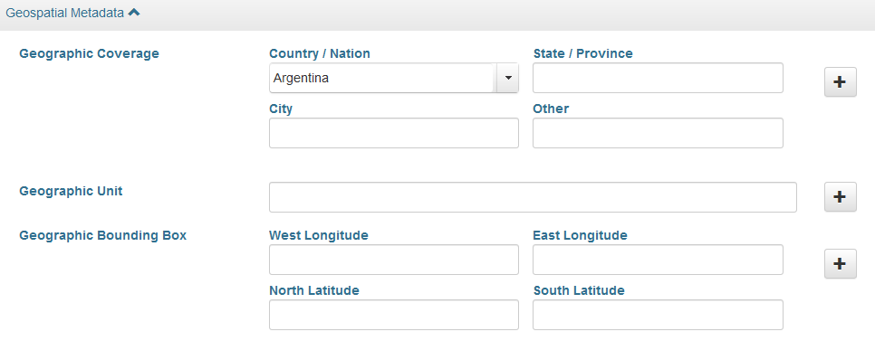
Examples
Automatic bounding box or logged for manual review?
(dataset contains no geospatial filetypes)
Notes:
Mark

Slide 31

Examples
Automatic bounding box!
(dataset contains no geospatial filetypes)
Notes:
Mark

Slide 32
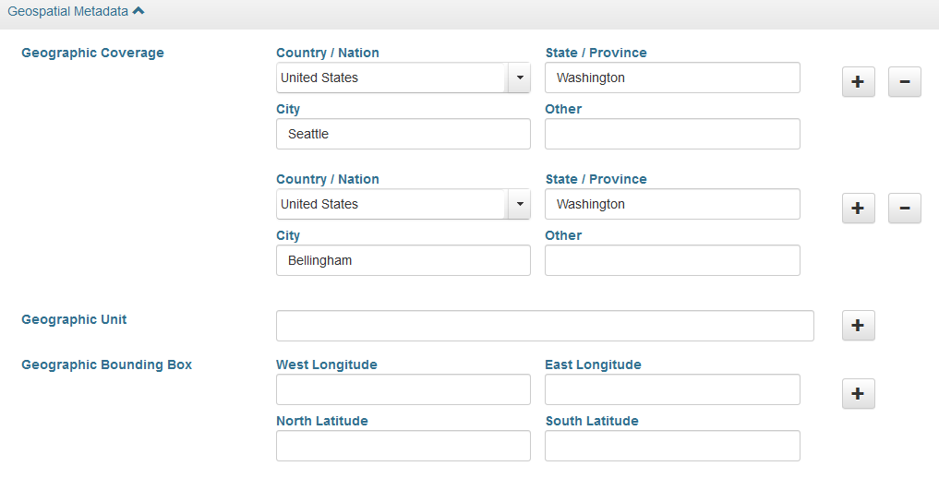
Examples
Automatic bounding box or logged for manual review?
(dataset contains no geospatial filetypes)
Notes:
Mark

Slide 33

Examples
Automatic bounding box!
(dataset contains no geospatial filetypes)
Notes:
Mark

Slide 34
Metadata standards and crosswalks
Metadata standard: a standardized series of metadata fields that describe a certain type of resource
  e.g. Dublin Core for general resources, DDI for social science resources, Darwin Core for biology resources, etc
Crosswalk: when the elements/fields from one metadata standard are mapped onto the elements/fields of another standard
Notes:
Mark

Slide 35
Geodisy metadata treatment
Geodisy-specific metadata
Dataverse schema
ISO 19115
GeoBlacklight schema
crosswalk
crosswalk*
Each dataset’s ISO metadata will be available for download on GeoBlacklight
This is the metadata GeoBlacklight uses for functionality
*This crosswalk uses a pre-existing tool developed by Stanford called GeoCombine
Notes:
Mark
multi step process, with two outputs

Slide 36
Dataverse to ISO 19115 crosswalk
Notes:
Mark

Slide 37
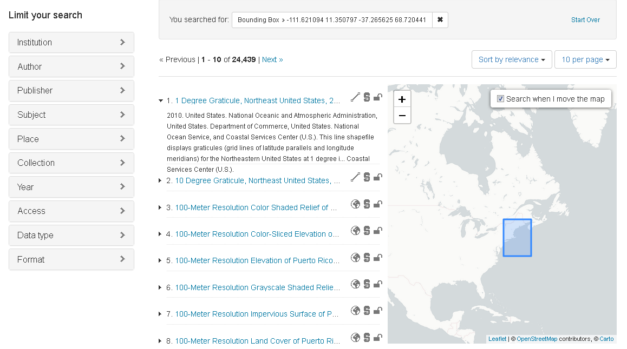
Expected UI (NYU Spatial Data Repository)
Notes:
Paul

Slide 38
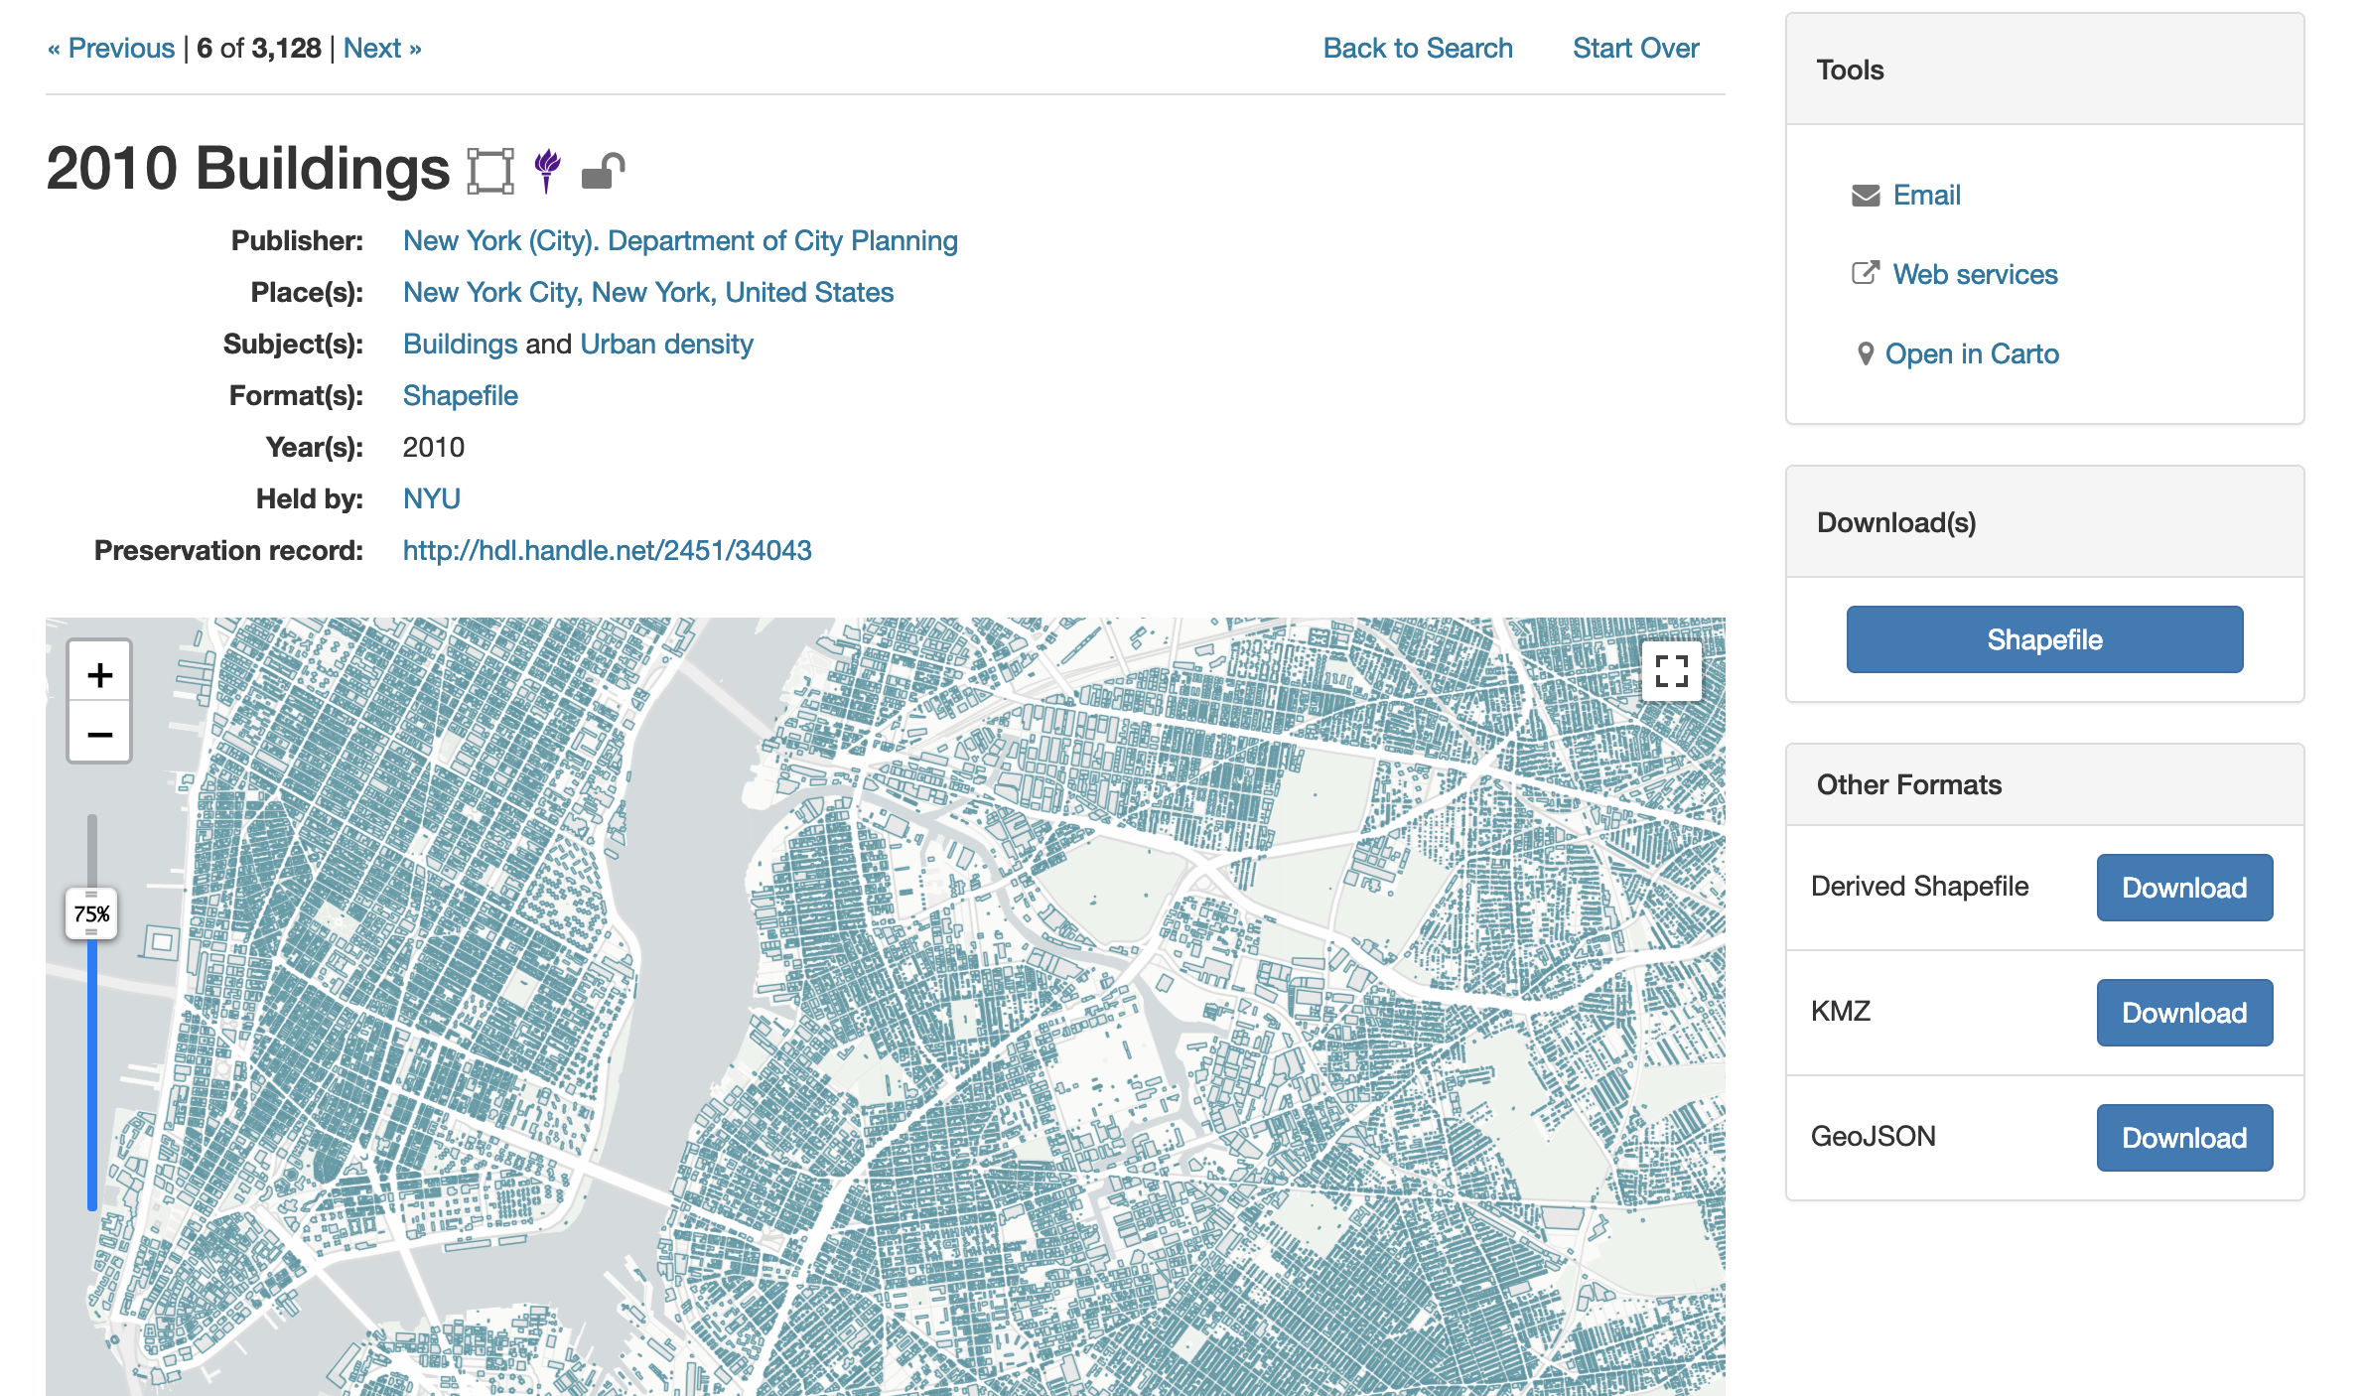
Expected UI (NYU Spatial Data Repository)
Notes:
Paul

Slide 39
Core Project Team (UBC)
Eugene Barsky – Principal Investigator
Paul Dante – Software Developer
Edith Domingue – ARC Client Services Manager
Mark Goodwin – Geospatial Metadata Coordinator
Tang Lee – Project Manager
Paul Lesack – Co-Principal Investigator
Evan Thornberry – Co-Principal Investigator
Project Partners
Jason Brodeur – McMaster University
Marcel Fortin – University of Toronto
Alex Garnett – SFU
Amber Leahey – Scholars Portal
Jason Hlady – University of Saskatchewan
Venkat Mahadevan – UBC ARC
Todd Trann – University of Saskatchewan
Lee Wilson – Portage Network
Launching in spring 2020
Notes:
Paul

Slide 40
Keep up to date:
#Geodisy on social media
researchdata.library.ubc.ca/find/geodisy
github.com/ubc-library/geodisy
Email: geodisy.info@ubc.ca
Twitter: @MarkJWGoodwin, @thornberry_evan
Notes:
Paul

