Slide 1
Open For Learning
Exploring the Possibilities for your Classroom
Erin Fields, Liaison Librarian and Flexible Learning Coordinator
Christina Hendricks, Sr. Instructor, Philosophy, and Chair of Arts One
Lucas Wright, Open Education Strategist

Slide 2
Introduction
What does open education mean to you?
Have you had an experience learning or teaching in the open?
Share with your table and then with the group

Slide 3

This presentations is licensed under Creative Commons Share Alike

Slide 4


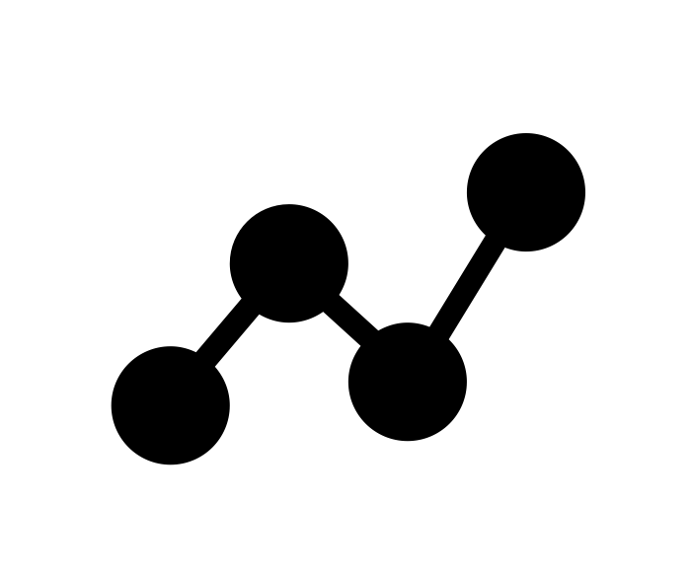
Workshop

Slide 5

Open Pedagogy - Overview
Student as Producer…(is) redesigning the process of academic production by connecting intellectual and manual labour in a form whereby the student recognises themselves within the total institutional process of the production of knowledge and meaning.
Mike Neary from Student as Producer: A Pedagogy for the Avant-Garde
These are assignments that students complain about doing and faculty complain about grading. They’re assignments that add no value to the world – after a student spends three hours creating it, a teacher spends 30 minutes grading it, and then the student throws it away. Not only do these assignments add no value to the world, they actually suck value out of the world.
David Wiley from What is Open Pedagogy?

Slide 6
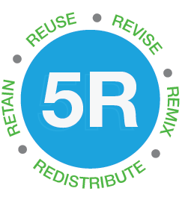
Open Resources
What are Open Resources?
Openly available educational resources (e.g. textbooks, lesson plans, videos, animations,etc.)
Many of these resources were traditionally only offered through formal education systems
Benefits of Open Resources
Visibility of work
Modify and adapt instead of re-create
Student cost
Greater range of resource options

Slide 7
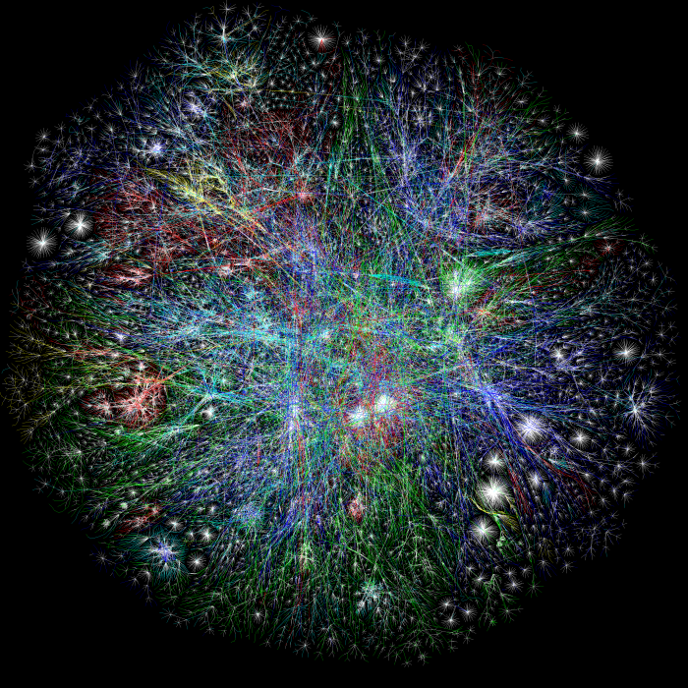
Finding & Using Open Resources
What is a real barrier to using Open Resources?
Too much content makes it too hard to find
Licensing is complicated
Lack of strategy
Making it Simple
Understanding licenses (http://copyright.ubc.ca/)
Narrowing the search
Assessment of content

Slide 8
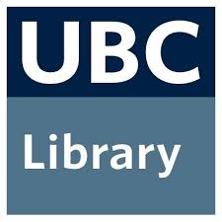
Finding and Using Open Resources
What does the Library do well?
Provides curated and vetted resources for academic engagement, including research and teaching.
Making it Simple (http://guides.library.ubc.ca/open_education)
Open Education Repositories
Open Textbooks
Open Data
Open Access Journals

Slide 9
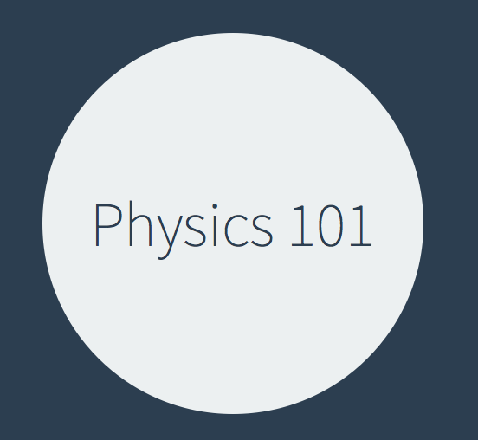
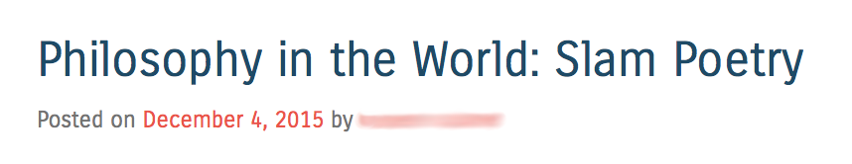
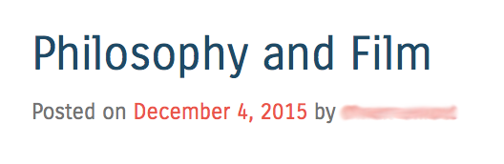
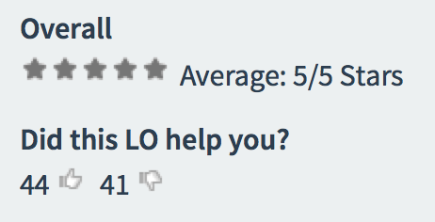
Teaching in the Open
Philosophy in the World posts, PHIL 102
(Christina Hendricks)
Learning objects in Physics 101 (Simon Bates)

Slide 10
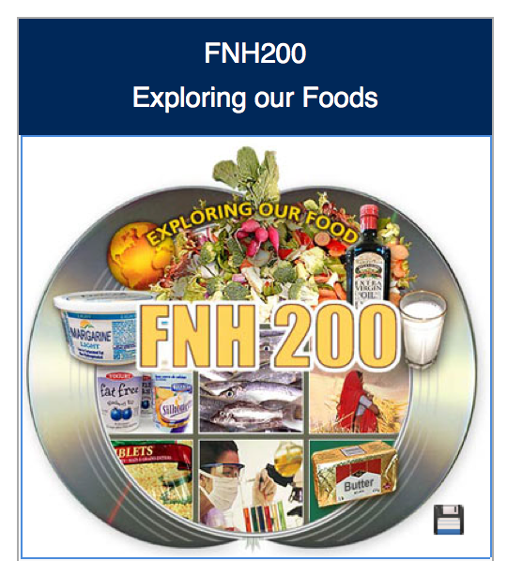
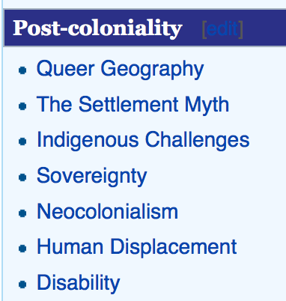
UBC Wiki projects
GRSJ 224 Gender, Race, Sexuality & Social Justice in Literature (Janice Stewart)
Food, Nutrition and Health 200 (Judy Chan)

Slide 11
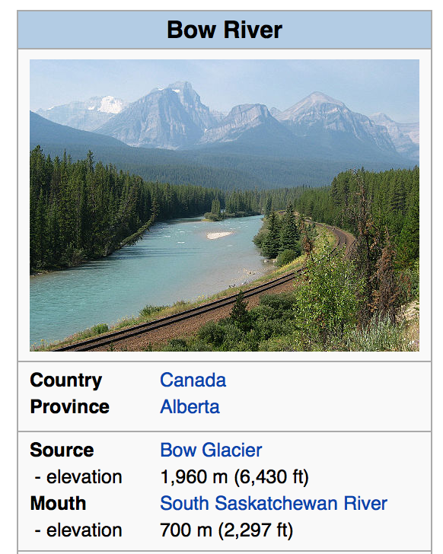

Wikipedia Projects
ASTU 260: Knowledge Dissemination (Kathryn Grafton, Summer 2015)
Image: Wikipedia Education Program Logo by David Peters of EXBROOK, licensed CC BY-SA 3.0
Bow River, part of HIST 396 Wikipedia project (Tina Loo, 2012)

Slide 12

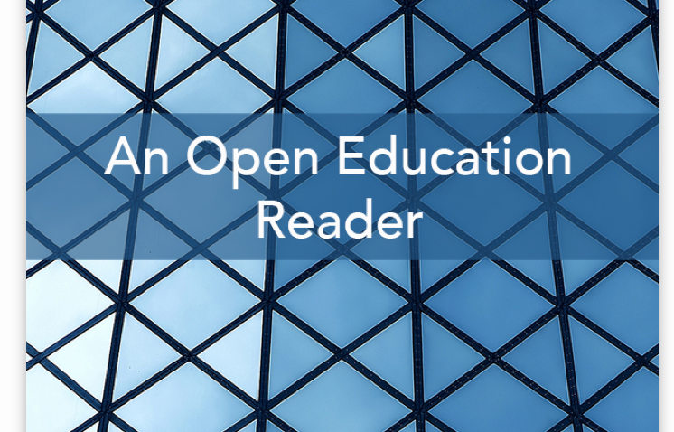
Open books created by students
Ed. George Veletsianos; see here for info
Ed. David Wiley; see here for info
Book cover photo by Shahadat Hossein, licensed CC BY 2.0

Slide 13
Open Challenges
http://bit.ly/1MXbzQN
Select one of the challenges
Complete a challenge by filling in the form. Include:
  A detailed description
  A hyperlink to your artifact
If you complete one challenge, try another one or contribute to the challenge bank or resources you used in the challenge.

Slide 14
Join us for Open for Learning
Using and remixing Open Resources in your Courses,
February
Teaching in the Open
March
Sharing your Practice and Academic Profile
May

Slide 15
Image Attribution
Book Search by Creative Stall, The Noun Project, CC 3.0
Adapted from Group by Gregor Črešnar and Creative Commons by Austin Condiff, The Noun Project, CC 3.0
Classroom by Boudewijn Mijnlieff, The Noun Project, CC 3.0
Molecule by Luca Reghellin, The Noun Project, CC 3.0

Slide 16
Thank You
Questions

