Slide 1
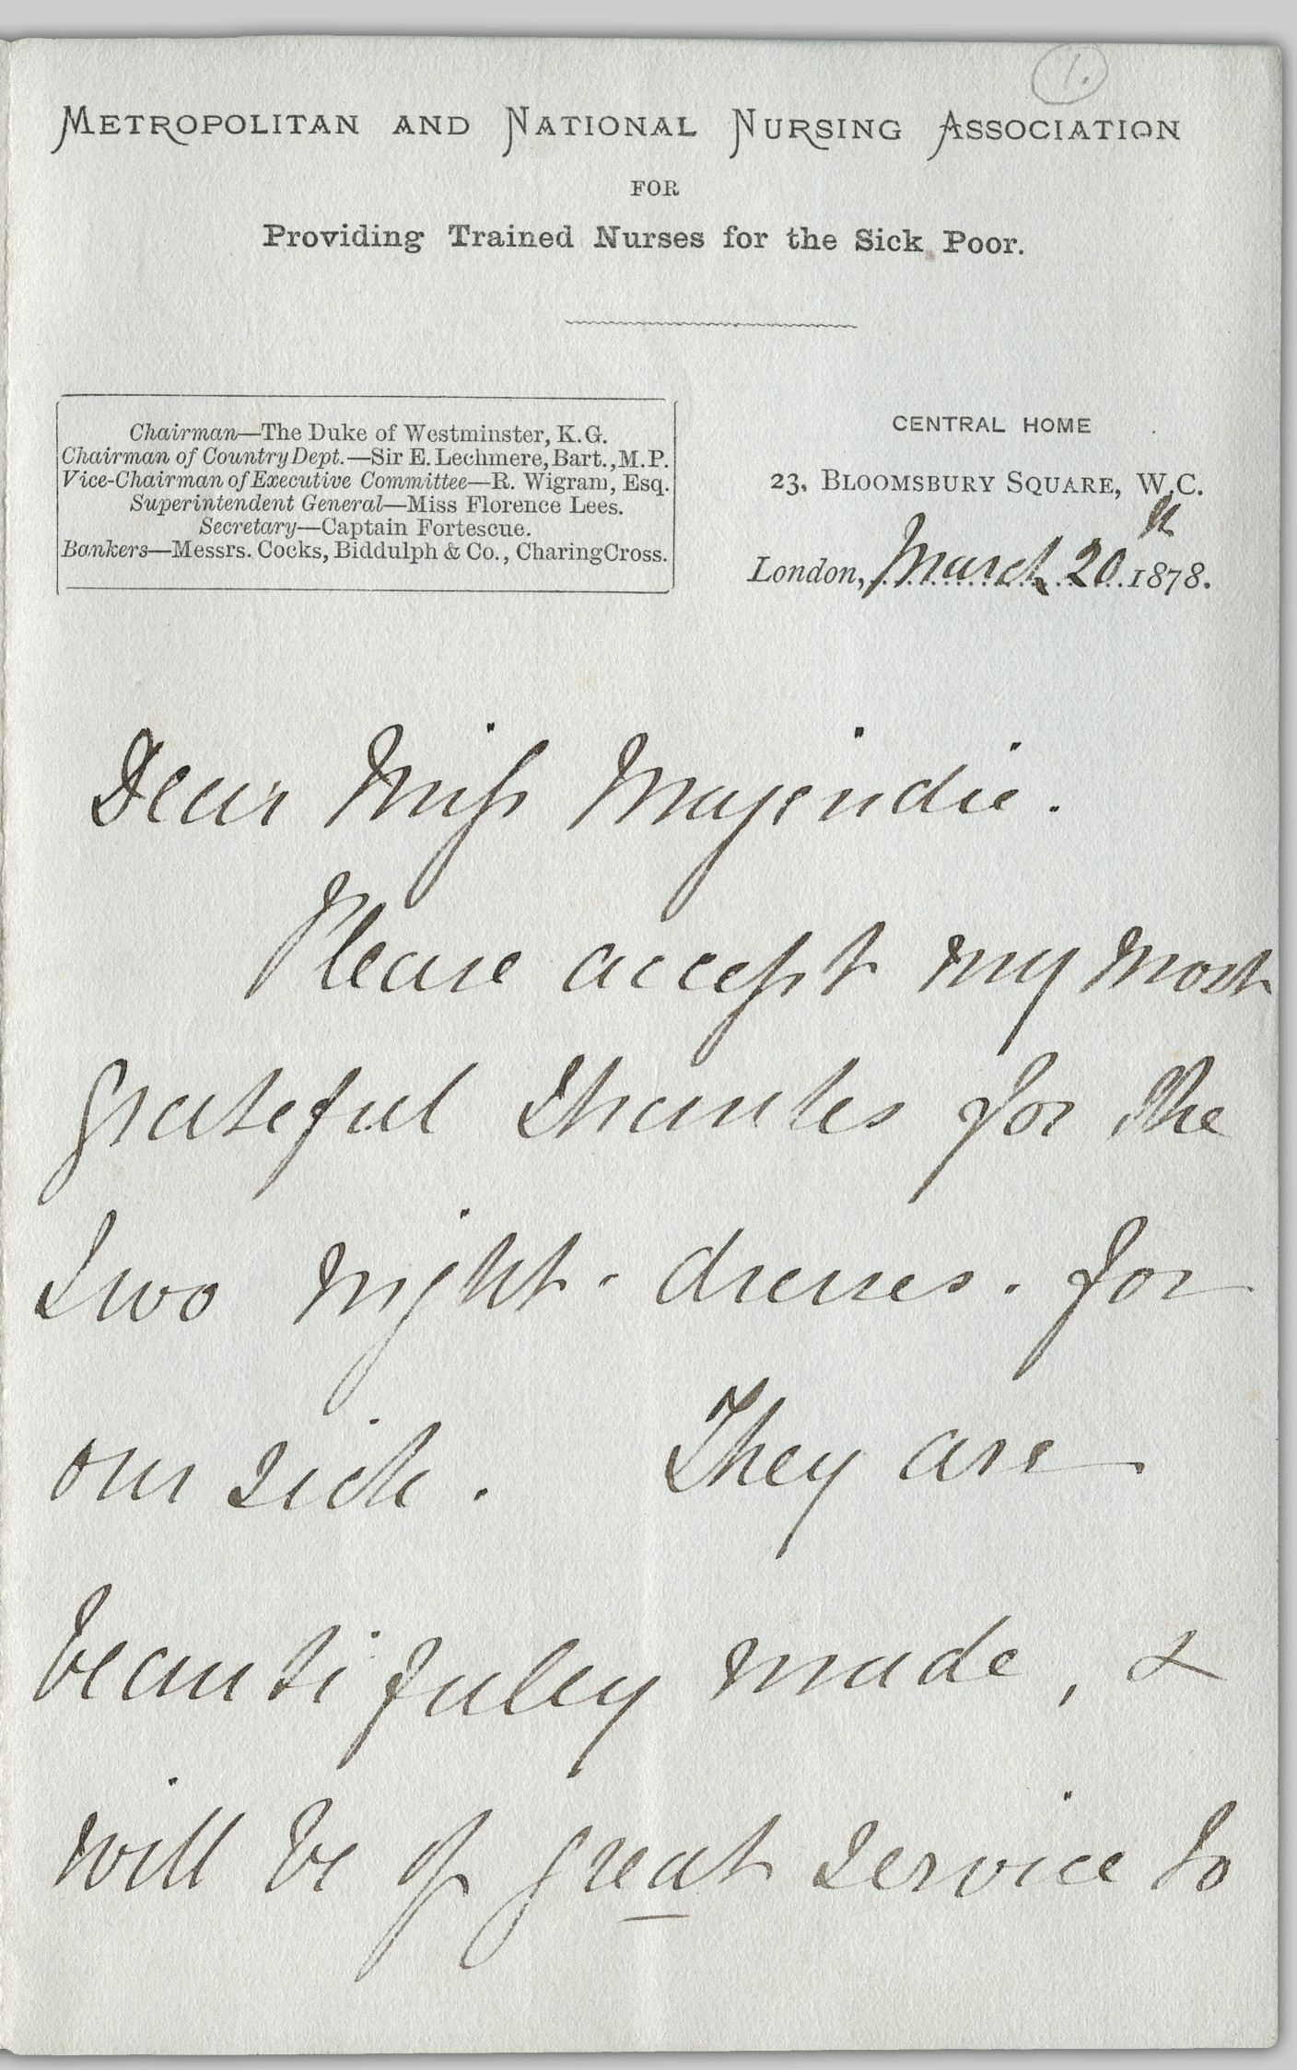
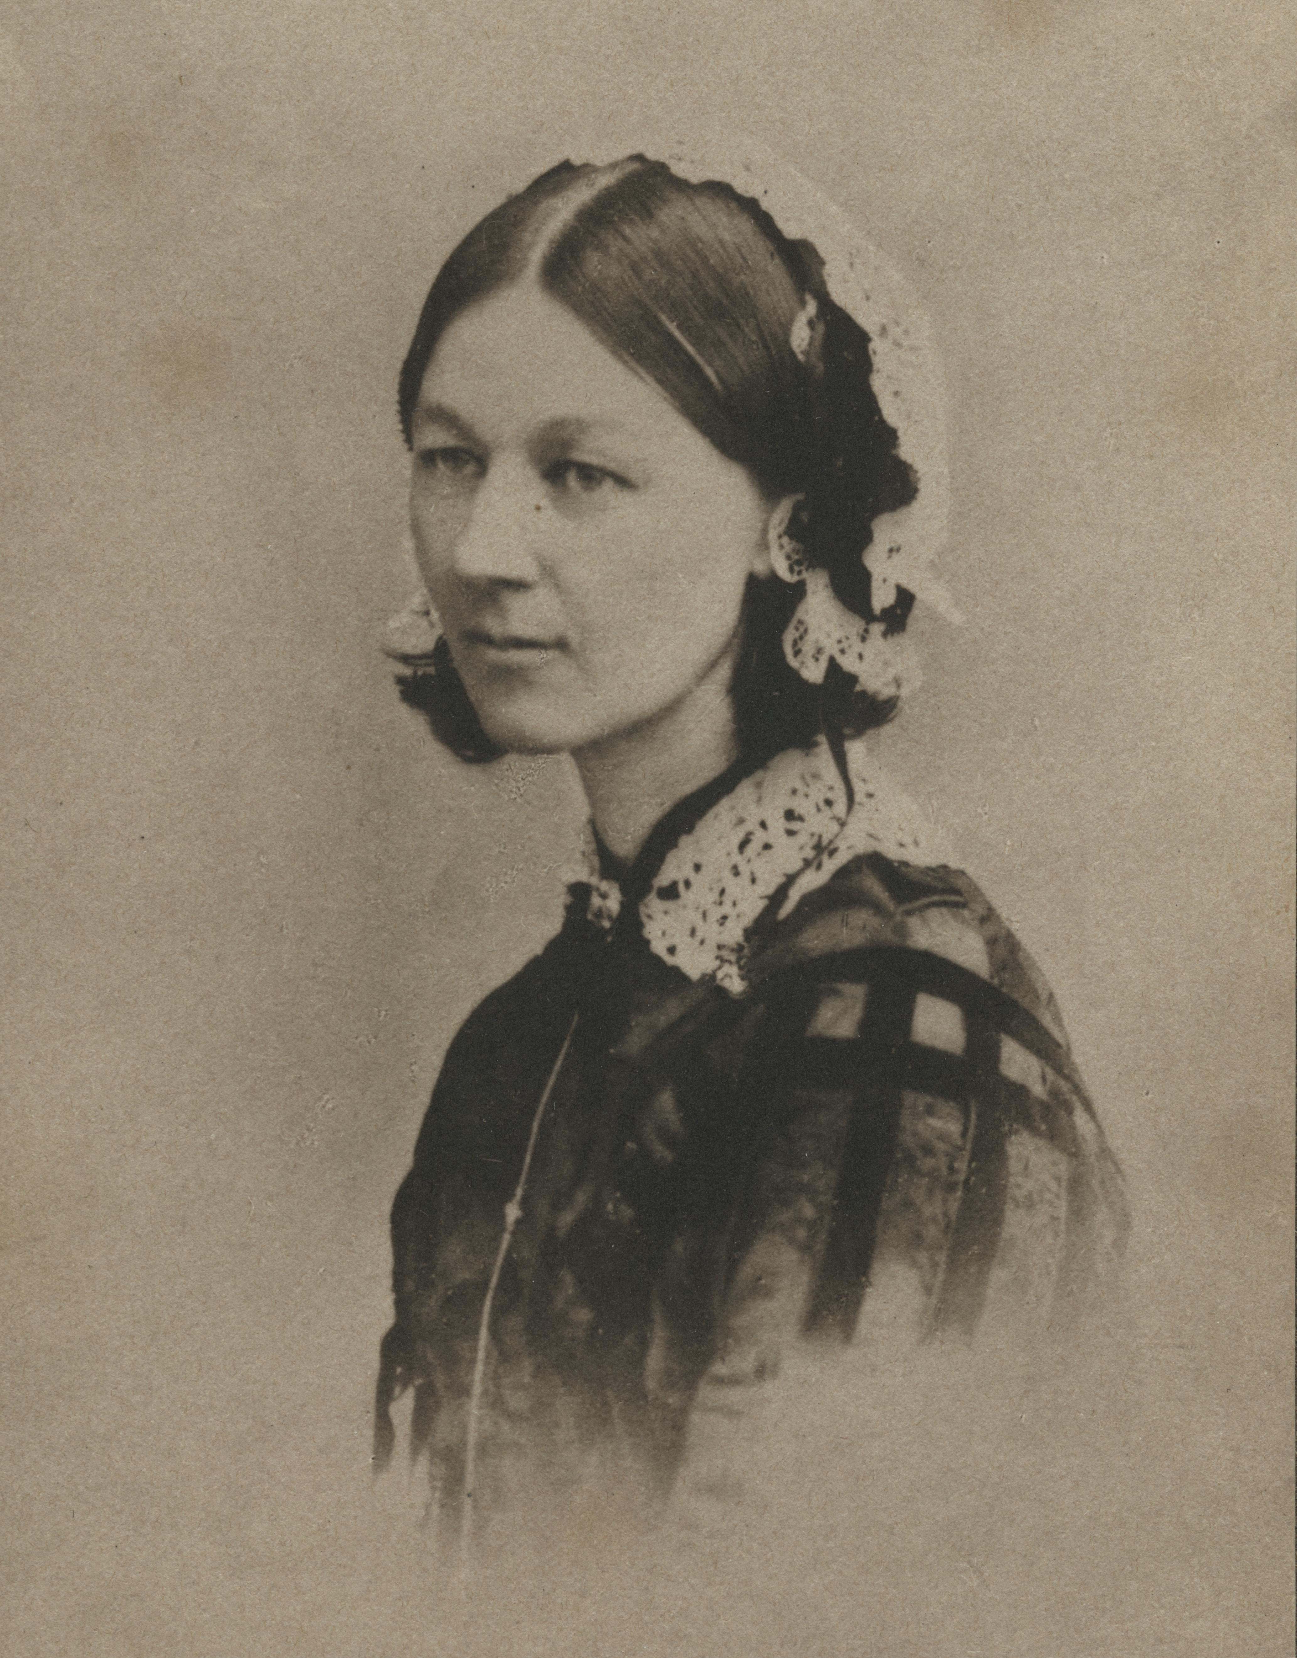
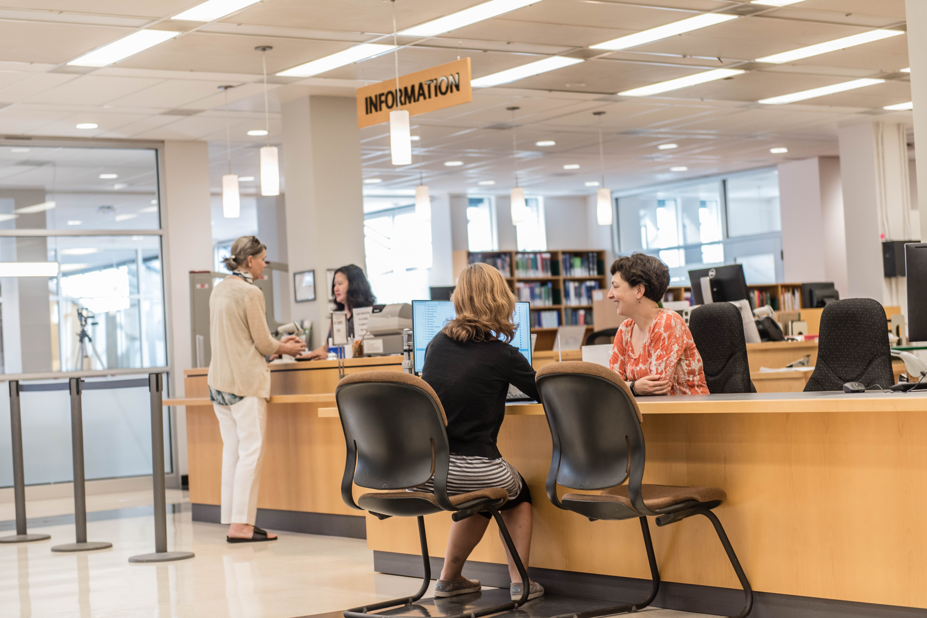
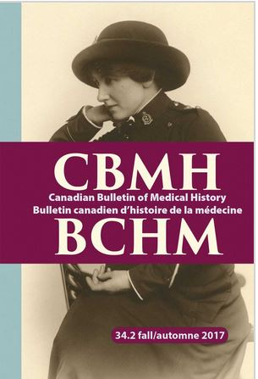
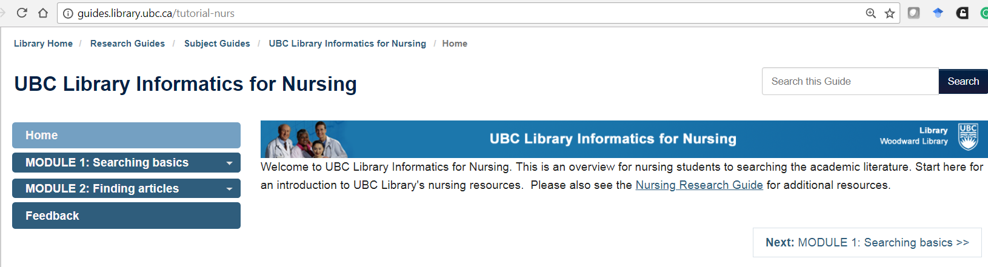
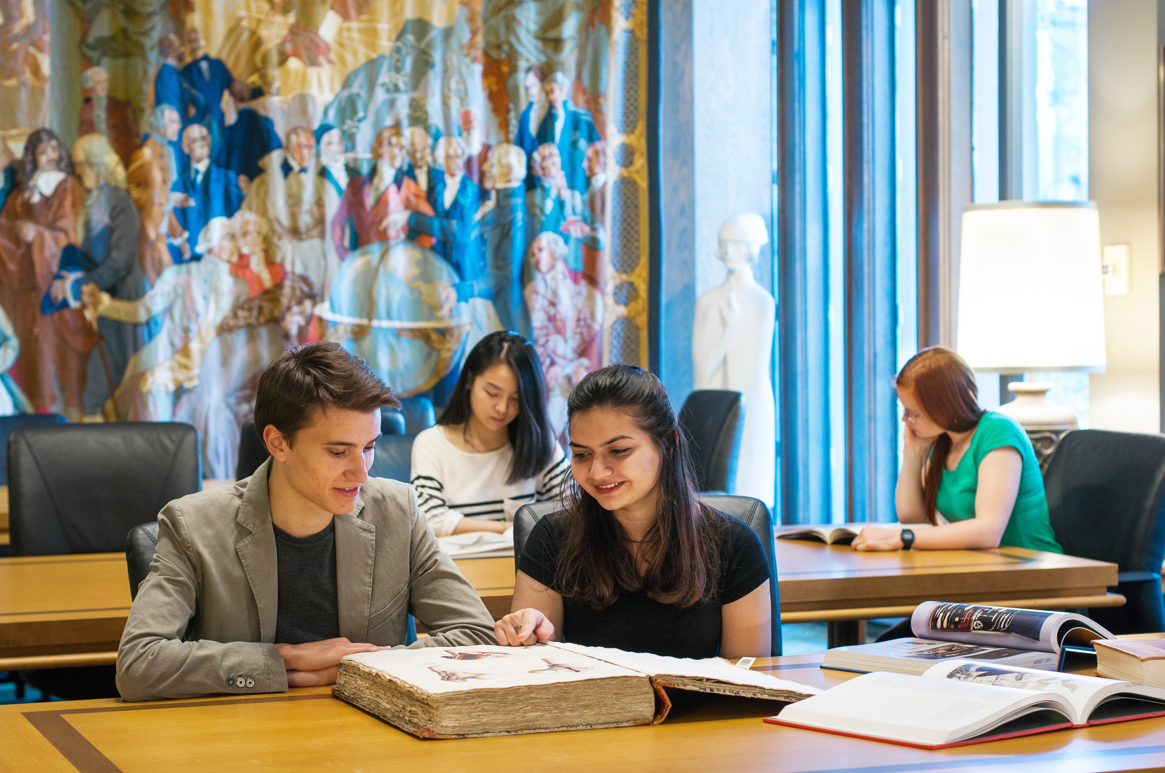
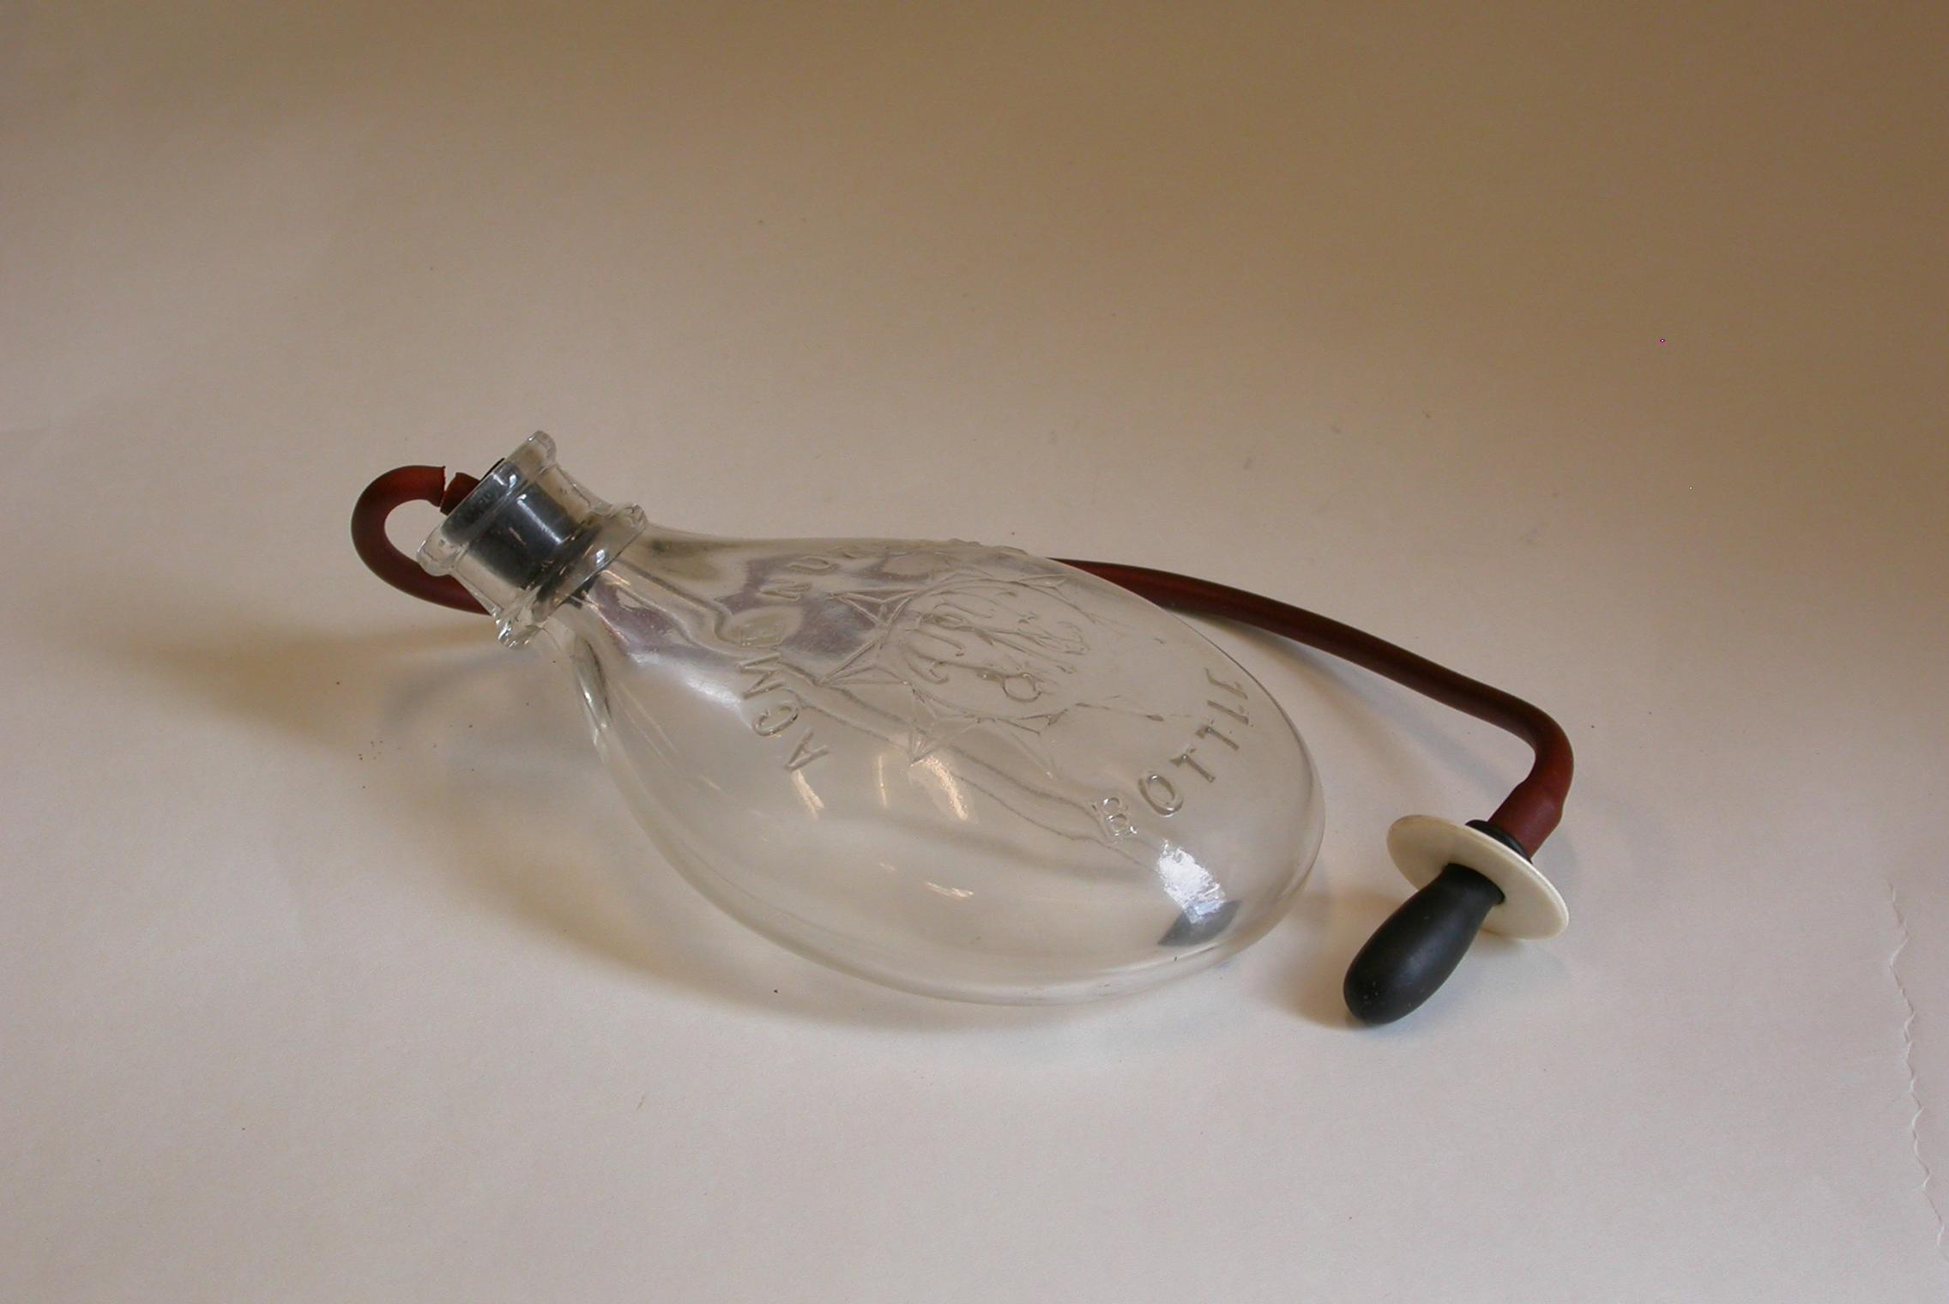
In Search of Nursing’s History:
Collections and Research Services
1
Katherine Miller, MLIS
Nursing Librarian and Faculty of Land and Food Systems Librarian
Woodward Library
Introduction
Librarians and archivists partner with faculty, students and other scholars on nursing history scholarship and research. Some of the activities include digitization of unique materials; acquiring and preserving information in print and online; and providing one-on-one consultations and classroom instruction to nursing researchers.
2
1
Collections
Research Consultations
Instruction
print and online books
access to journals and journal articles
open collections (grey literature such as Nursing theses & dissertations, graduate student projects/posters, recordings of lectures)
print ephemera: pamphlets
artifacts such as the infant feeders https://open.library.ubc.ca/collections/feeders
indexes: CINAHL - Cumulative Index to Nursing and Allied Health Literature (2700+ journals)
And more: http://guides.library.ubc.ca/nursing
In today’s complex information ecosystem, information professionals help you navigate the complex process of finding and managing the literature for advanced literature reviews, scoping and systematic reviews.
Information literacy workshops and classroom instruction are offered to the UBC Community and general public in-person and online. Topics include:
Using various indexes and software to find the literature. Adapting search strategies to various search engines
Evidence based practice
Managing your search results with bibliographic citation management tools
Online instruction is one of the ways librarians and archivists provide instruction. Some examples:
CINAHL: http://guides.library.ubc.ca/CINAHL
UBC Library Informatics of For Nurses http://guides.library.ubc.ca/Tutorial-Nurs
We warmly invite your questions!
katherine.miller@ubc.ca
3
Spaces
Inspiring research and study spaces close to collections and library reference expertise.
4
7
4
Indexes to the Literature
References
1. [Unknown]. (1859). Florence Nightingale [P]. doi:http://dx.doi.org/10.14288/1.0018260
2. Craven, Dacre, Mrs. (1878, March 20). [Letter, Florence Lees to Miss Majendie, March 20, 1878] [C]. doi: http://dx.doi.org/10.14288/1.00182692. Joseph P. UBC_20170327_8593.jpg. [photo], 2017.
3. Joseph, P. (2017). Information Desk. [photo]. Woodward Library, UBC.
4. [Unknown]. (2017). [Journal Cover]. Canadian Bulletin of Medical History, 34(2). https://www.utpjournals.press/journals/loi/cbmh
5. [Unknown]. (1899). [Nursing bottle] [Photo]. doi:http://dx.doi.org/10.14288/1.0132852
6. Dee, M. (2017). Memorial Room. [photo] Woodward Library, UBC.
7. UBC Library Informatics for Nursing. Retrieved from: http://guides.library.ubc.ca/Tutorial-Nurs
6
5
Notes:
TEMPLATE IS FULLY CUSTOMIZABLE. BOXES AND PLACEHOLDERS CAN BE REMOVED. COLOURS CAN BE CHANGED.
UBC LOGO MUST REMAIN TOP LEFT. UBC BRANDING BAR AT THE BOTTOM CAN BE DELETED IF DESIRED.

