Slide 1


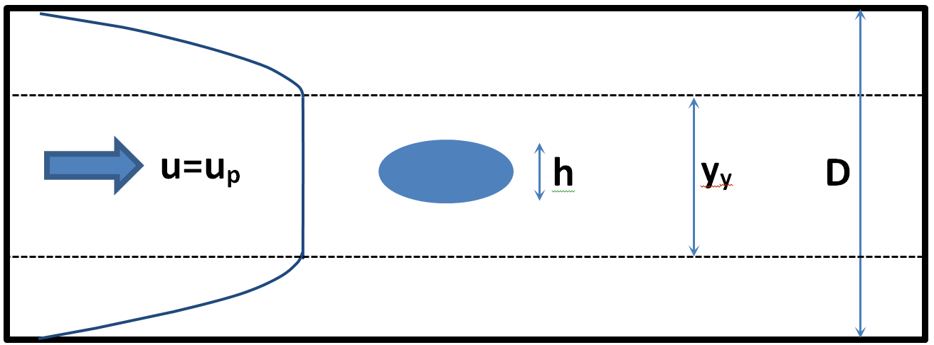
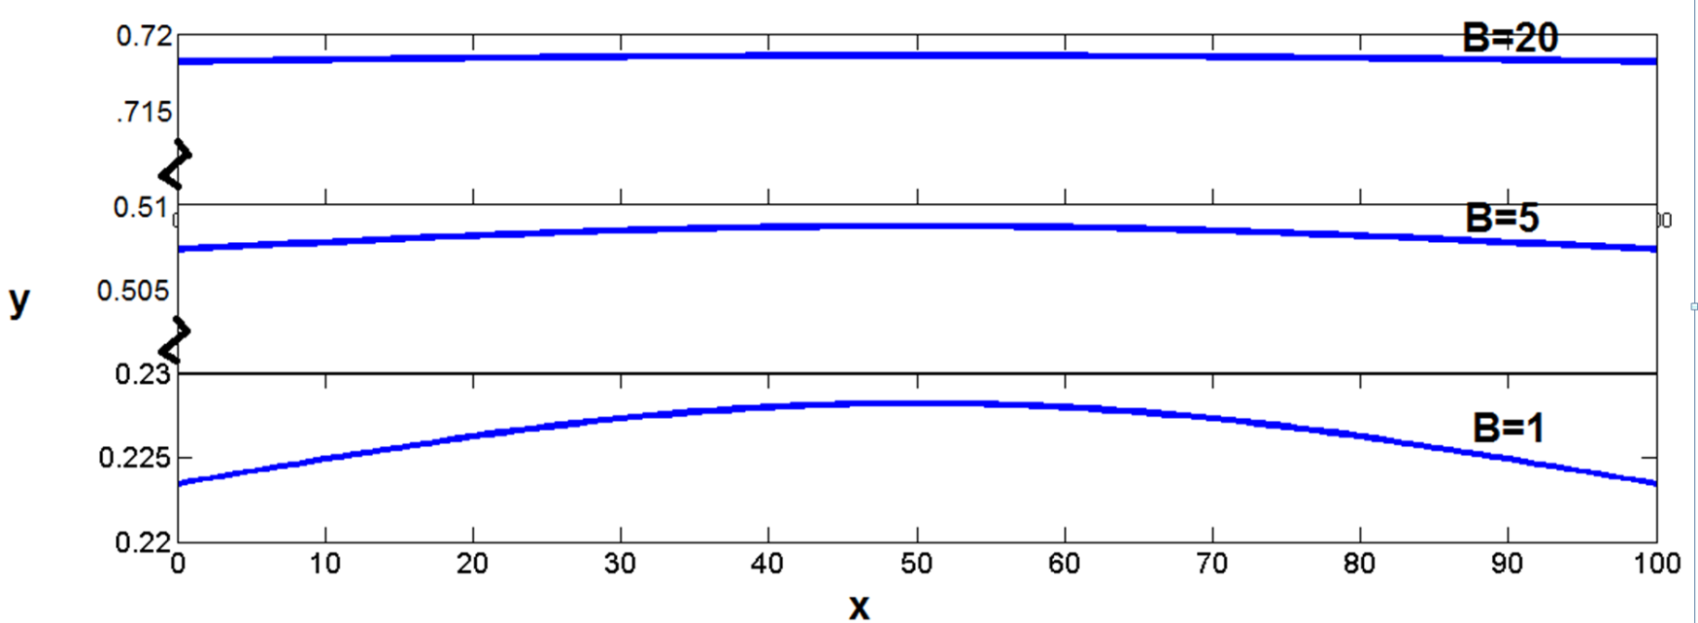
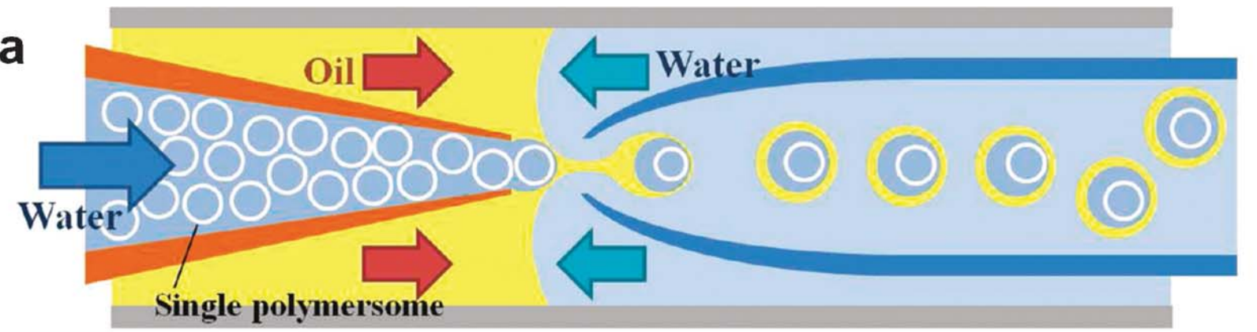
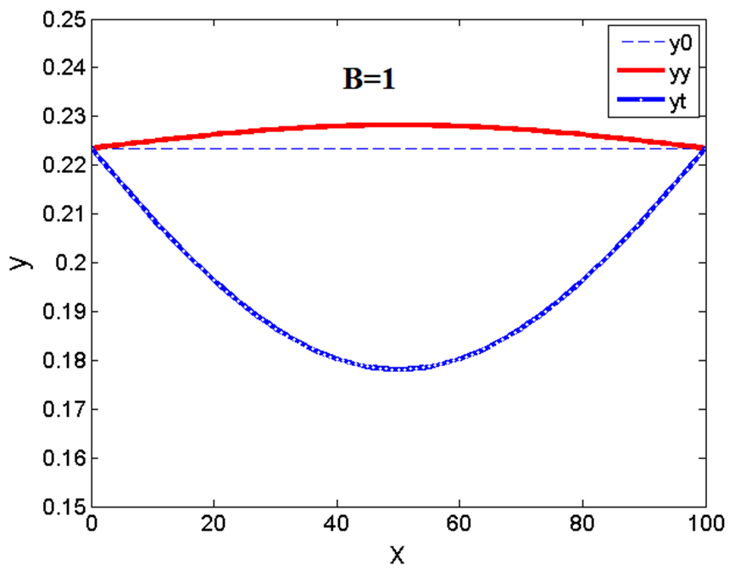
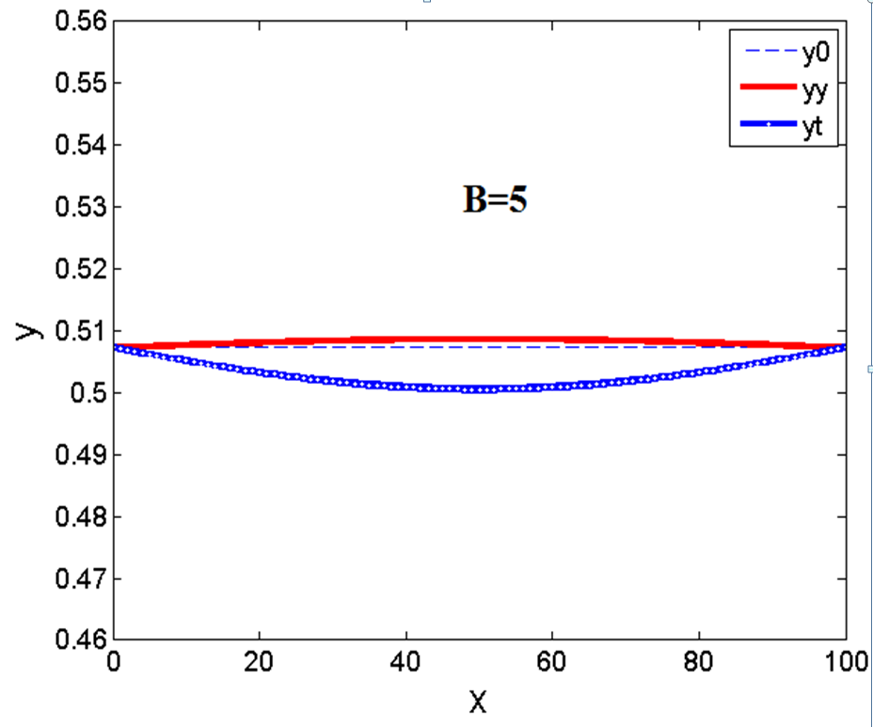
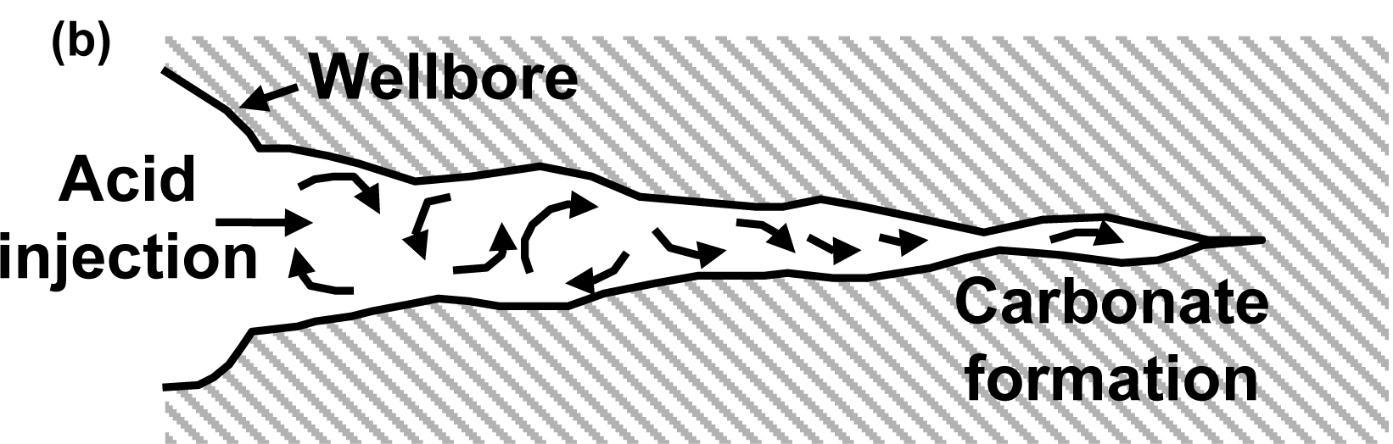
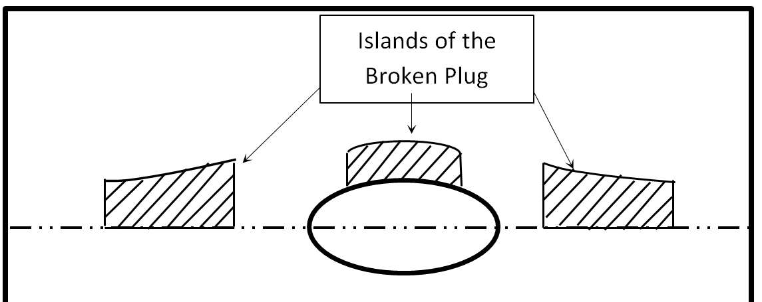
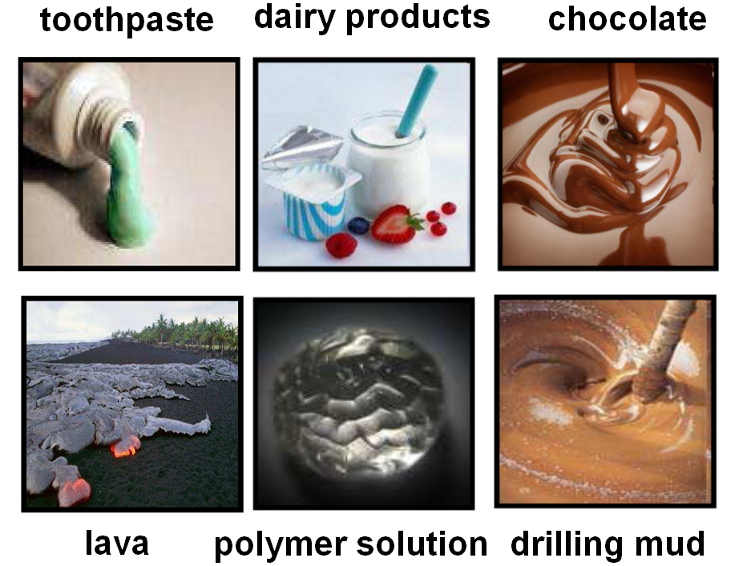
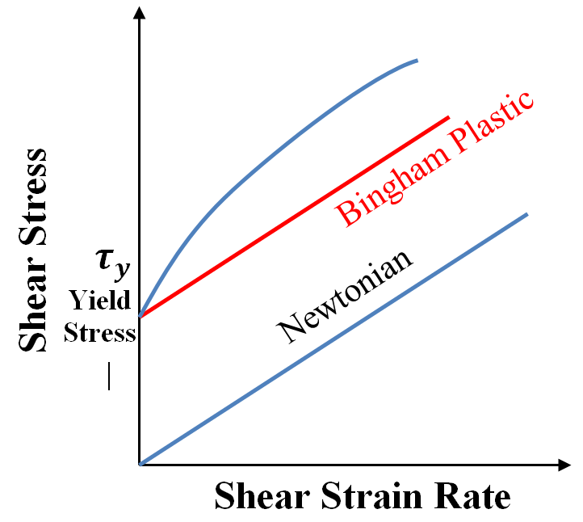

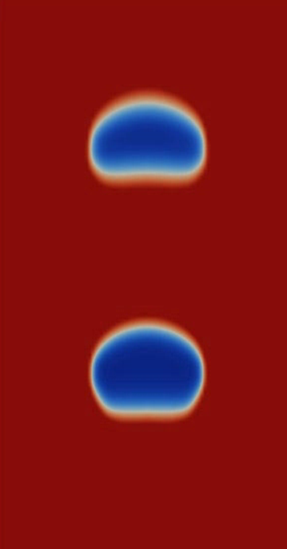
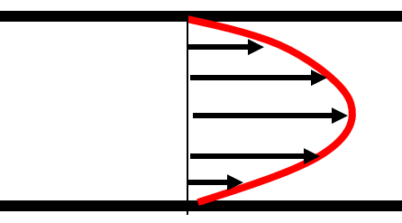
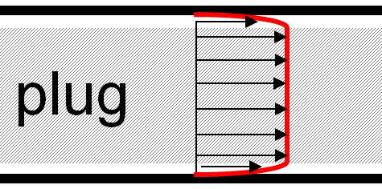
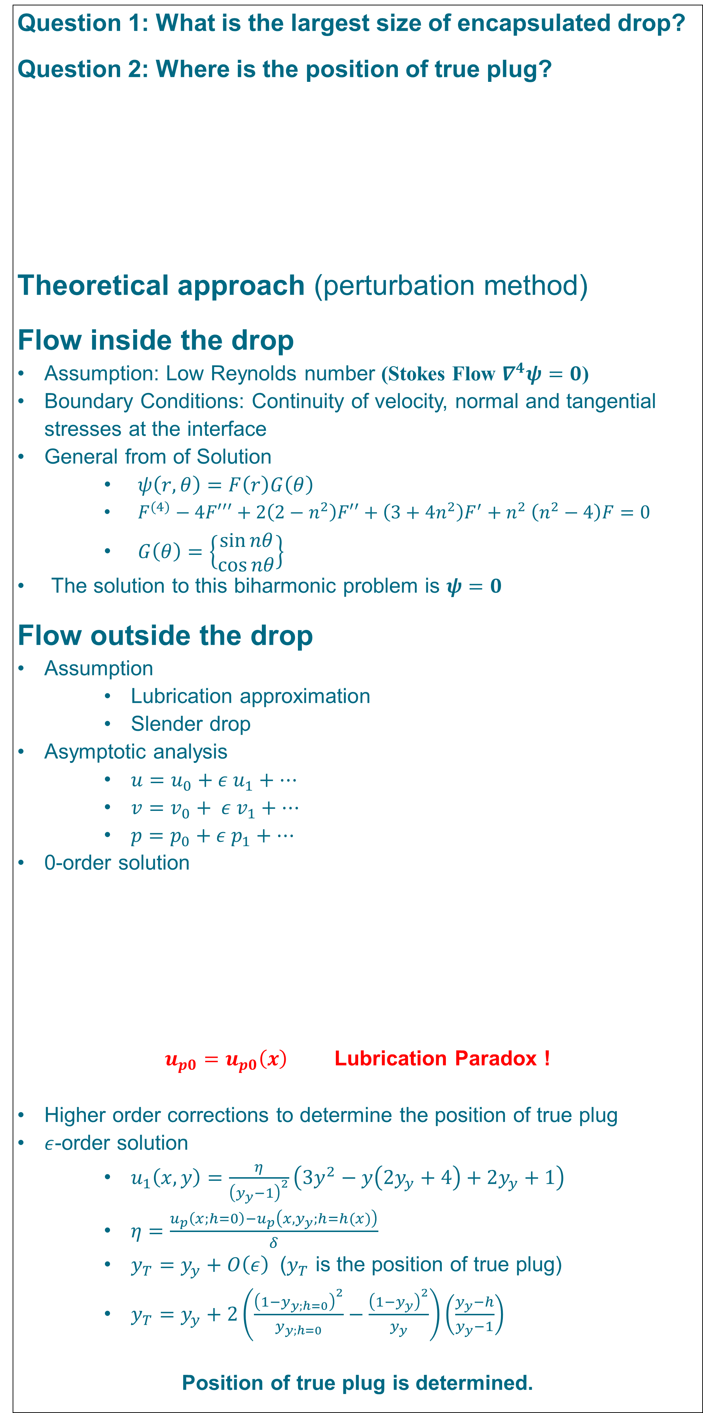
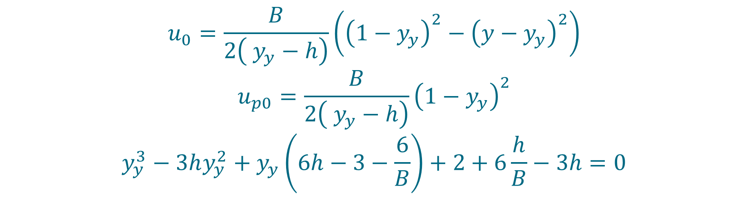

Drop Encapsulation
Amir Maleki
Prof. Ian Frigaard
Question 1: What is the largest size of encapsulated drop?
Question 2: Where is the position of true plug?
Theoretical approach (perturbation method)
Flow inside the drop
Assumption: Low Reynolds number (Stokes Flow $∇^{4}ψ=0$)
        Boundary Conditions: Continuity of velocity, normal and tangential stresses at the interface
        General from of Solution
        $ψ\left(r,θ\right)=F\left(r\right)G\left(θ\right)$
        $F^{(4)}−4F′′′+2\left(2−n^{2}\right)F′′+\left(3+4n^{2}\right)F^{′}{+ n}^{2}\left(n^{2}−4\right)F=0$
        $G\left(θ\right)=\left\{\begin{matrix}\sin{nθ} \\ \cos{nθ}\end{matrix}\right\}$
The solution to this biharmonic problem is $ψ=0$
Flow outside the drop
Assumption
        Lubrication approximation
        Slender drop
Asymptotic analysis
        $u=u_{0}+ε u_{1}+…$
        $v=v_{0}+ ε v_{1}+…$
        $p=p_{0}+ε p_{1}+…$
0-order solution
$u_{p0}=u_{p0}\left(x\right)$Lubrication Paradox !
Higher order corrections to determine the position of true plug
$ε$-order solution
        $u_{1}\left(x,y\right)=\frac{η}{{\left(y_{y}−1\right)}^{2}}\left({3y}^{2}−y\left({2y}_{y}+4\right)+2y_{y}+1\right)$
        $η=\frac{u_{p}\left(x;h=0\right)−u_{p}\left(x,y_{y};h=h(x)\right)}{δ}$
        $y_{T}=y_{y}+O\left(ε\right)$($y_{T}$ is the position of true plug)
        $y_{T}=y_{y}+2\left(\frac{{\left(1−y_{y;h=0}\right)}^{2}}{y_{y;h=0}}−\frac{{\left(1−y_{y}\right)}^{2}}{y_{y}}\right)\left(\frac{y_{y}−h}{y_{y}−1}\right)$
Position of true plug is determined.
Results
Position of yielded and true plug interface
Background and Motivation
In Microscale, surface tension is a dominate force, allowing to encapsulate drops in another fluid which has numerous application in microfluidics devices.
Micro drop Encapsulation [1]
This opens up possibilities for application in large scale industries (e.g. petroleum, food, personal care and drug industries)
It is observed that Stable multi-layer flow can be achieved using a yield stress fluid [2].
Hypothesis: To encapsulate a Macroscale drop in a yield stress fluid (visco-plastic fluid).
Schematic sketch of the problem
Yielded plug interface (0-order approximation)
Is it feasible to encapsulate
a macro size drop?
Acid Fracturing, a potential application of macro drop encapsulation
Composite asymptotic solution compared
to 0-order approximation
Future Work
Theory
      Islands of a broken plug
      Solve for a Macroscale drop
Computation:
      Rheolef Finite Element Package
      Adaptive Mesh
      Augmented Lagrangian method handle the exact viso-plastic model
Visco-plastic fluids (fluids with yield stress)
Flow of a single fluid in a duct
$$u_{0}=\frac{B}{2\left( y_{y}−h\right)}\left({\left(1−y_{y}\right)}^{2}−{\left(y−y_{y}\right)}^{2}\right)$$
$$u_{p0}=\frac{B}{2\left( y_{y}−h\right)}{\left(1−y_{y}\right)}^{2}$$
$$y_{y}^{3}−3hy_{y}^{2}+y_{y}\left(6h−3−\frac{6}{B}\right)+2+6\frac{h}{B}−3h=0$$
A broken plug
Preliminary computation results for drop encapsulation [3]
$$τ_{ij}=\left(μ+\frac{B}{\dot{γ}}\right){\dot{γ}}_{ij} ⟺τ>B$$
$$\dot{γ}=0 ⟺τ<B$$
$$B=\frac{{\hat{τ}}_{y}\hat{D}}{\hat{μ}\hat{U}}$$
References
[1] Duncanson et al. “Microfluidic synthesis of advanced microparticles for encapsulation and controlled release” Lab Chip, 2012, 12(12):2135-45.
[2] Hormozi et al. “Extending the visco-plastic lubrication concept to near net shape products and encapsulation”, Annual transaction of the Nordic rheology society, Vol 20, 2012
[3] S. Hormozi & I. A. Frigaard (2012) Nonlinear stability of a visco-plastically lubricated viscoelastic fluid flow. Journal of Non-Newtonian Fluid Mechanics. 160-170, 61-73.
Examples of visco-plastic
fluids
Yielded part
Newtonian Fluid
Bingham Fluid

